Slide 1
The finite element method- a review
By
S Ziaei-Rad
Mechanical Engineering Department, IUT

Slide 2
FEM Basic FEATURES
The finite element method has the following three basic features:
1. Divide the whole (i.e. domain) into parts, called finite elements.
2. Over each representative element, develop the relations among the secondary and primary variables (e.g. forces and displacements, heats and temperatures, and so on).
3. Assemble the elements (i.e. combine the relations of all elements) to obtain the relations between the secondary and primary variables of the whole system.

Slide 3
One dimension problems
Consider
Where a=a(x), c=c(x) and f=f(x) are known functions. u=u(x) is the unknown.
A typical interval called finite element has a length of he and located between xa and xb.

Slide 4
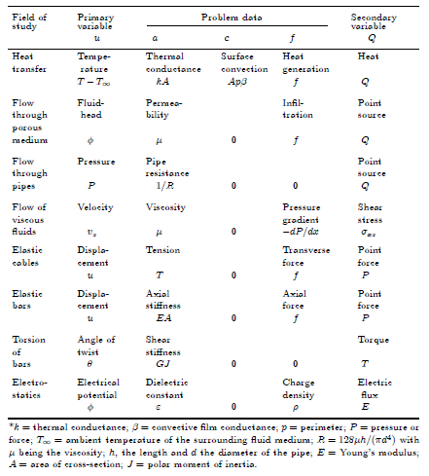
1D problems

Slide 5
Finite element approximation
A solution in the form of
The solution should satisfy the differential equation and also the end condition over element.

Slide 6
Finite element approximation
The difference between 2 sides of equation is called “residual”
One way is
If = → Galerkin method
The set of weight functions must be linearly independent
to have linearly independent algebraic equations.
Weight function

Slide 7
Derivation of the weak form
A three steps procedure
1- write the weighted-residual statement
2-using differential by part trade the derivative between the weight and approximation functions
This is called weak form because it allows approximation function with weaker continuities.

Slide 8
Derivation of the weak form
3-examine the boundary term appearing in the weak form
The BCs on primary variables are called Essential or Dirichlet BCs.
The BCs on secondary variable are called Natural or Neumann BCs.

Slide 9
Derivation of the weak form
In writing the final weak form
The final expression is
From mechanical point of view Q is the axial force.

Slide 10
remarks
The weak form contains two types of expression
(Product of u and w)
(only w)
They have the following properties
Bilinear form
Linear form

Slide 11
Remarks
The weak form can now be expressed
Which is called the variational problem associated to the differential equation.
B creates the element coefficient
L creates the load vector

Slide 12
remarks
The weak form is the statement of the principle of minimum potential energy.
The work done by distributed applied force f and
Point force Qs
Elastic Strain Energy
Stored in the bar

Slide 13
Interpolation function
The approximation solution should be selected such that the differentiability of the weak form satisfied and also the end condition on primary variables.
Since the weak form contain first-order derivatives, thus any polynomial of first degree and higher can be used.

Slide 14
Linear interpolation
The first degree polynomial
The polynomial is admissible if
Linear Lagrange interpolation function

Slide 15
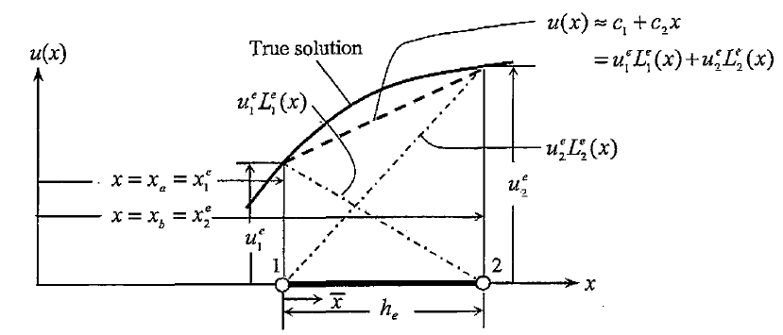
Linear interpolation
Also
Note that

Slide 16
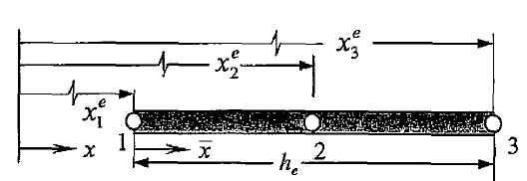
Quadratic interpolation
For a second degree polynomial

Slide 17
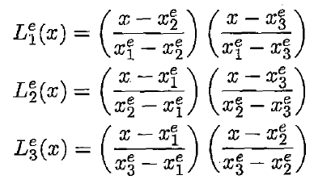
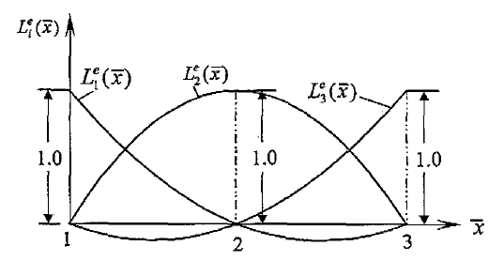
Quadratic interpolation
where

Slide 18
convergence

Slide 19
convergence

Slide 20
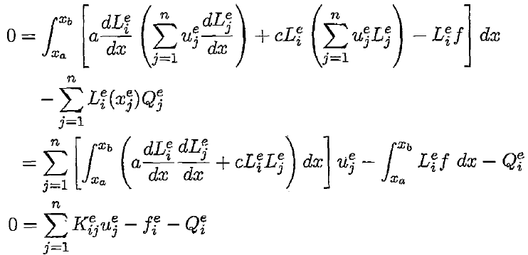
Finite element model
The weak form
Substituting

Slide 21
Finite element model
Where
The equation has 2n unknowns
Coefficient matrix or stiffness matrix
Force vector or source vector

Slide 22
Finite element model
Some of these unknowns are from BCs
The remaining by balance of secondary variable Q at common nodes
Doing the integration

Slide 23
Finite element model

Slide 24
Two dimensional problems
The governing equation is
The functions axx=axx(x,y), byy=byy(x,y) and f=f(x,y) are known functions.
The following BCs are assumed

Slide 25
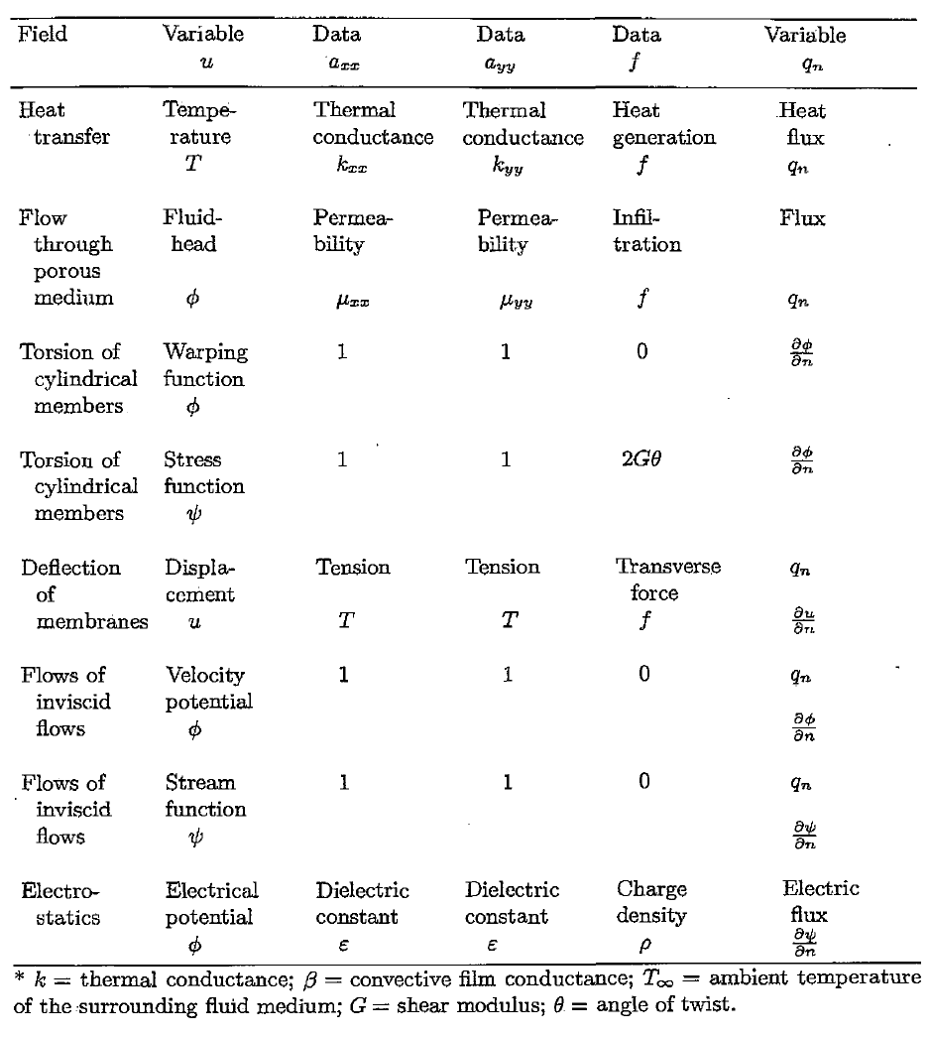
2D problems

Slide 26
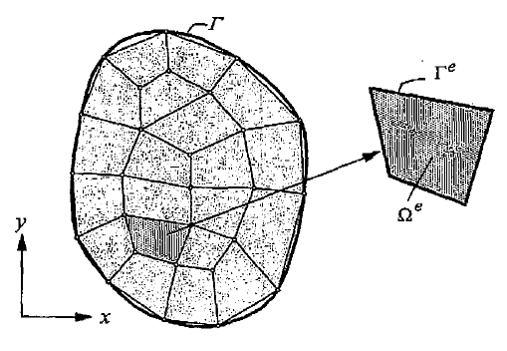
Finite element approximation
The domain is first divided into several subdomain
The unknown u is approximated in an element

Slide 27
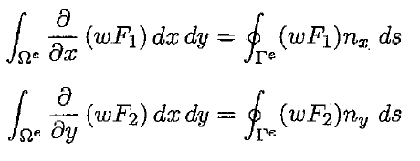
Weak formulation
Step 1
Step 2- distribute the differential between u and w

Slide 28
Weak formulation
Thus
By definition qn is positive outward around the surface as we move counterclockwise around the boundary.
Secondary variable

Slide 29
Weak formulation
Step 3
Bilinear form
Linear form

Slide 30
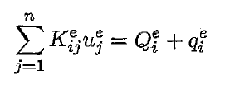
Finite element model
The weak form need u to be at least linear in x and y
For Galerkin formulation

Slide 31
Interpolation function
For convergence
As linear approximation
For quadratic
Triangular element
Rectangular element

Slide 32
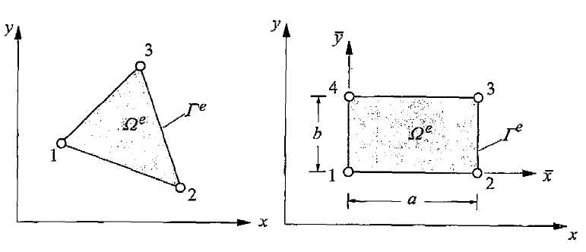
Linear triangular element
The linear interpolation function for 3 nodes triangular
Lagrange interpolation function

Slide 33
Linear triangular element
If along the element the functions a, b , f are constant
Then
For a right triangular element with base a and height b

Slide 34
Linear triangular element
The evaluation of boundary integral
Has two parts:
1- for interior edges they cancel out each other on neighboring elements (balance of internal flux)
2-the portion of boundary that within the , the integral should be computed.

Slide 35
Linear rectangular element
For a 4 nodes rectangular elements
The Lagrangian interpolation functions are
The integral should be evaluated on a rectangular of sides a and b

Slide 36
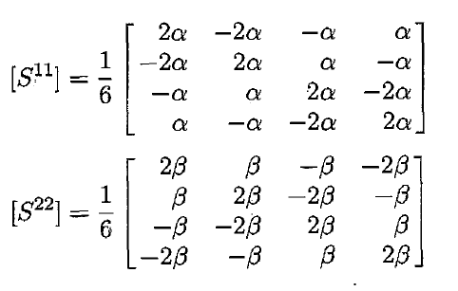
Linear rectangular element
For constant values of a,b,f over element

Slide 37
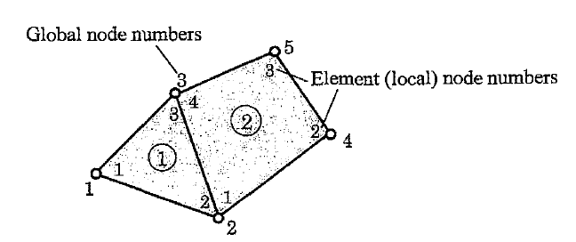
Assembly of elements
Assembly has two rules
Stiffness matrix of
Triangular element
Stiffness matrix of
rectangular element
Imposing the continuity of the primary variables for elements 1 and 2

Slide 38
Assembly of elements
Balance of secondary variables
The internal flux on side 2-3 of element 1 should be equal to the internal flux of side 4-1 element 2
In FE it means

Slide 39
Assembly of elements
For element 1 (triangular element)
For rectangular element

Slide 40
Assembly of elements
Imposing balance, means
2nd equation (1)+1st equation (2)
3rd equation(1)+4th equation (2)
Using local-global node number

Slide 41
Heat conduction by heat convection at boundaries
When dealing with heat convection from boundary to the surrounding the FE model should be corrected.
For such case the balance of energy is
The previous equation is now

Slide 42
Heat conduction by heat convection at boundaries
Or
where

Slide 43
Heat conduction by heat convection at boundaries
For no convective heat transfer elements hc=0 and the case is the same as before
Indeed the contribution is only for elements whose sides fall on the boundary with specified convective heat conduction.

Slide 44
Library of 2D elements
Two develop the case for general elements we consider master elements first.
These masters can be used for elements with irregular shapes.
This requires a transformation from irregular shape element to the master element.

Slide 45
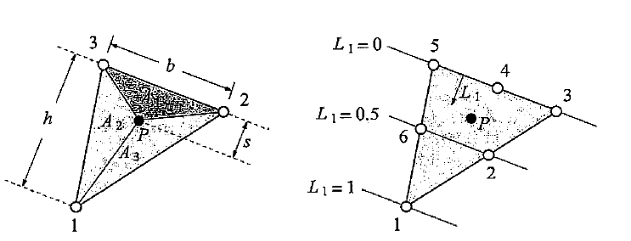
Triangular element
First, define the area or natural coordinates

Slide 46
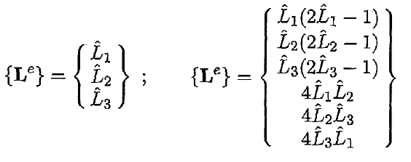
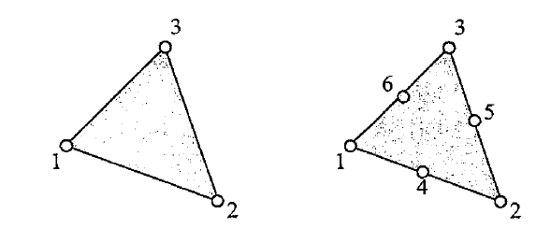
Triangular element
Linear and quadratic interpolation functions are
Vertices nodes
Middle nodes

Slide 47
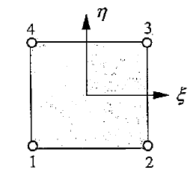
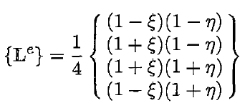
Rectangular element
For a rectangular element, consider a local coordinate

Slide 48
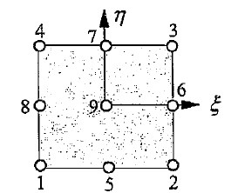
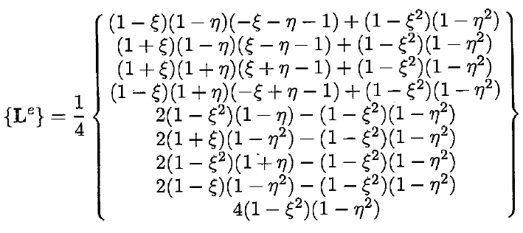
Rectangular element
For higher order

Slide 49
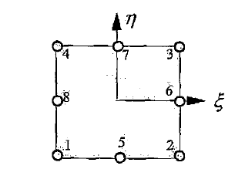
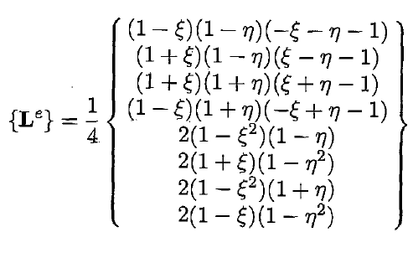
Rectangular element
For serendipity element

Slide 50
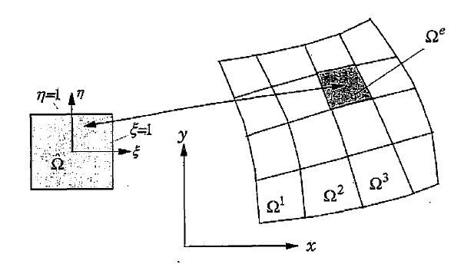
numerical integration
In a complicated mesh, each element transformed to a master element
The transformation between a typical element of the mesh and the master element is

Slide 51
numerical integration
Coordinate transformation (Degree m)
Variable approximation(Degree n)

Slide 52
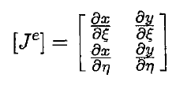
numerical integration
Consider for example
Jacobian matrix

Slide 53
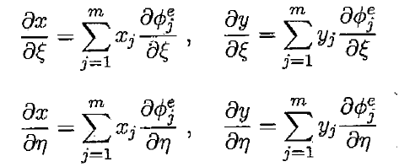
numerical integration
or

Slide 54
Integrating over a master rectangular element
The integrals are calculated numerically using Gauss-Legendre formula
M and N are number of Gauss quadrature points in different directions. Usually M=N

Slide 55
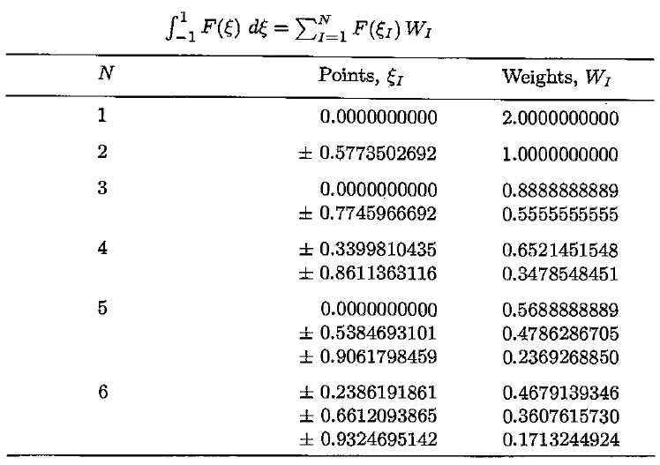
The weights for a rectangular element

Slide 56
Computer implementation

Slide 57
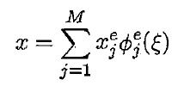
One dimensional problem
Here we discuss the detail of calculating the matrices of one dimensional problems
The mass matrix is for transient analysis.
The transformation is

Slide 58
One dimensional problem
For linear transformation
The derivatives wrt natural coordinates

Slide 59
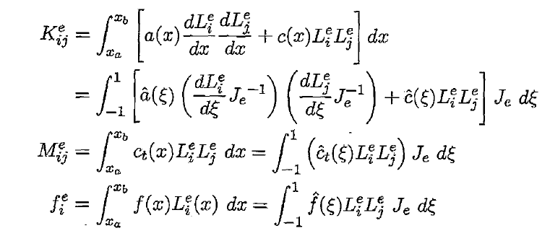
One dimensional problem
The integrands are

Slide 60
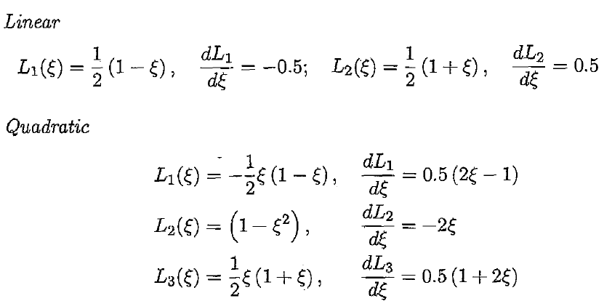
One dimensional problem
For different element types

Slide 61
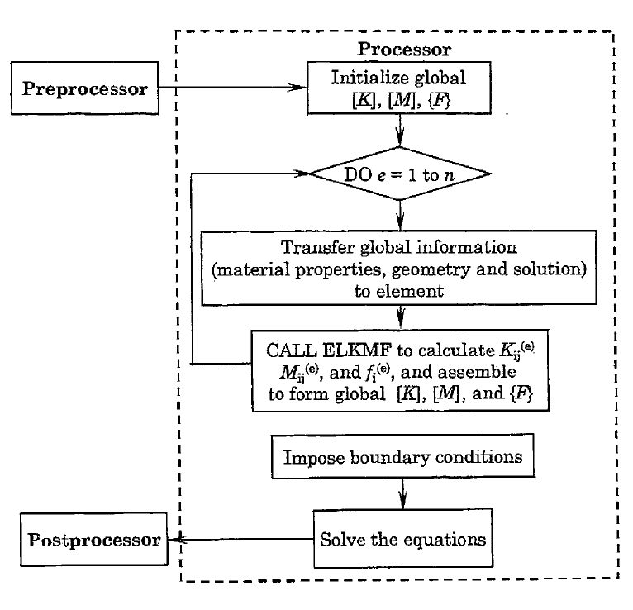
flowchart

Slide 62
Integrating over a master TRItangular element
For triangular element
Only two shape functions are independent here.
After transformation

Slide 63
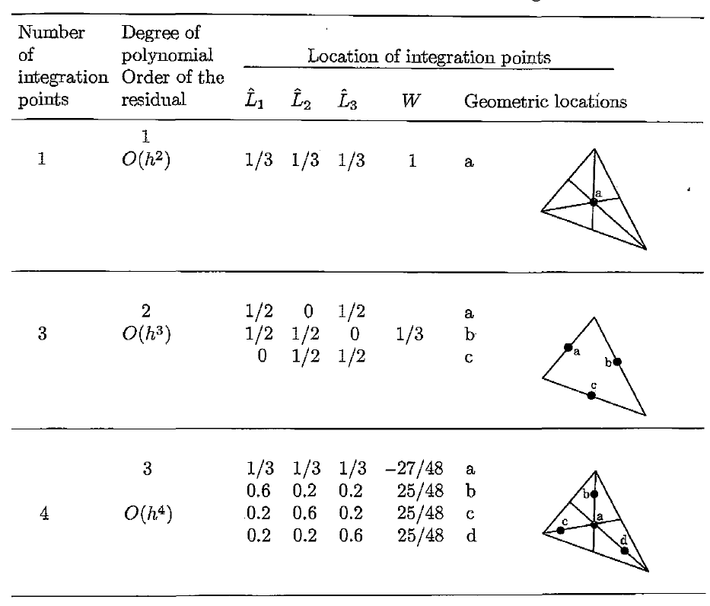
The weights for a TRItangular element

