Slide 1
Introduction
By
S Ziaei-Rad
Department of Mechanical Engineering
IUT

Slide 2
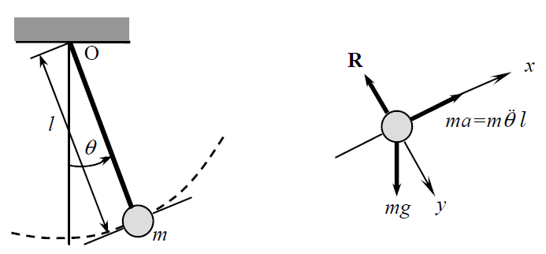
Example
The mathematical models are representative of some physical phenomenon.
As an example, one can consider the simple pendulum

Slide 3




Example
The equation of motion is
Subject to initial condition
This is a nonlinear equation.
For linear approximation

Slide 4



Example
And
Thus
For initial zero velocity

Slide 5

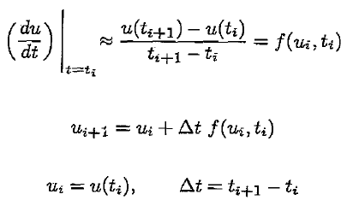
Numerical simulation
It means solving the governing equations by a numerical method and a computer.
Numerical methods typically transform the differential equations into a set of algebraic equations.
Suppose

Slide 6



Numerical simulation
The pendulum equations are
Discretize
At time t=0, =
The solution depends on time step, the smaller time step results in more accurate solution.

Slide 7
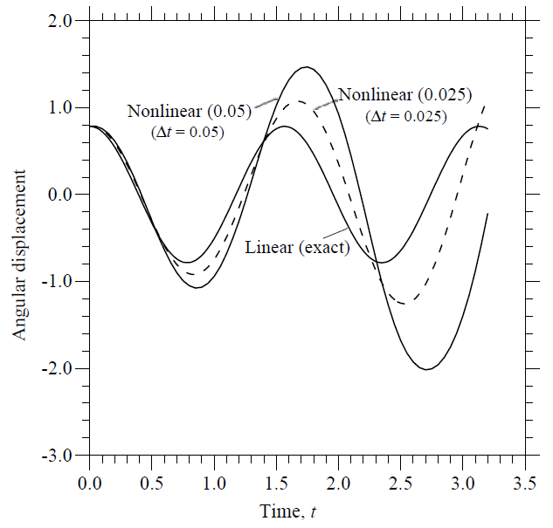
Numerical simulation

Slide 8
The finite element method
In finite difference method, the derivatives are approximated by Taylor series.
Finite difference suffer from 2 drawbacks
  It is usually more suitable for rectangular grids
  Applying BCs of gradient types usually require additional approximation

Slide 9
The finite element method
The FEM has 3 basic features
  A domain is represented by simple subdomain called finite element.
  Over each element, the unknown variables approximated by simple polynomial with unknowns at nodes
  The algebraic equations from all elements obtain from continuity and equilibrium conditions.

Slide 10
Nonlinear analysis
Nonlinear analysis is necessary
1- designing high performance components for some industries, e.g. aerospace, nuclear
2-assessing functionality of some system containing damage and failure
3-establishing cause of some failure
4-Simulating true material behavior of process
5- gaining realistic understanding of physical phenomena

Slide 11
Features of nonlinear analysis
The principle of superposition does not hold.
Analysis can be carried out for one load case at a time.
The history (or sequence) of loading influences the response.
The initial state of the system (e.g. prestress) may be important.

Slide 12
Classification of nonlinerity
Geometric nonlinearity
Material nonlinearity
Nonlinearity due to change in initial conditions or boundary conditions

Slide 13
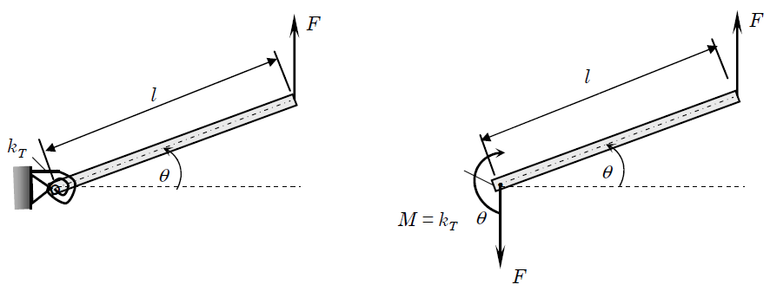

Example of geometric nonlinearity
Consider
For linear

Slide 14
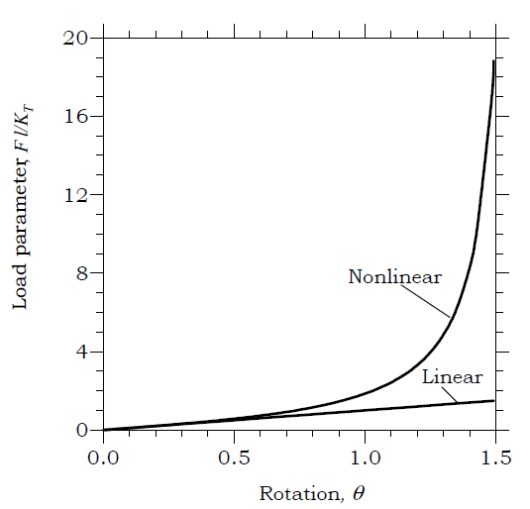
Example of geometric nonlinearity

Slide 15

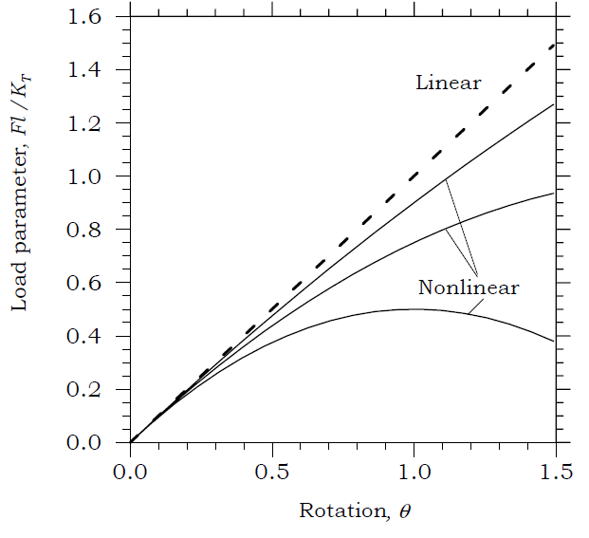
Material nonlinearity
Material nonlinearity can be introduced if the moment – rotation relation is not linear
Softening type behavior

Slide 16
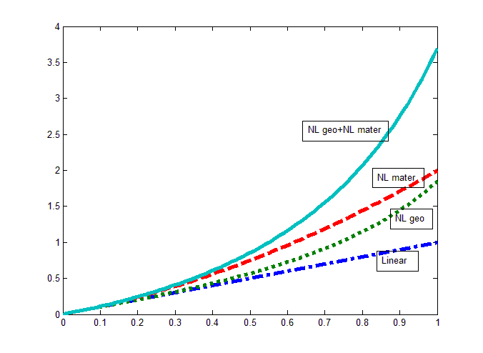
Material nonlinearity

Slide 17
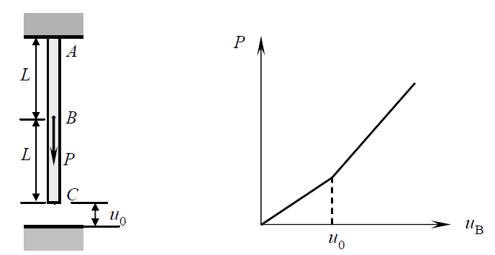
BCs nonlinearity
Consider the example

Slide 18

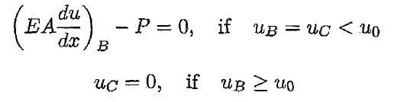

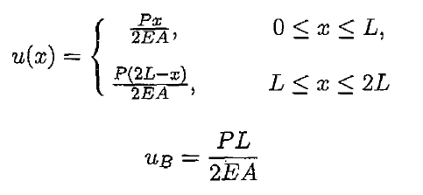
BCs nonlinearity
The governing equation is
The BCs are
Contact or nonlinear BCs

Slide 19
Big Picture
Analysis is an aid to design and it involves
  mathematical model development
  The mathematical model is developed using laws of physics and assumptions concerning the process behavior.
  data acquisition by measurements
  The data includes the actual system parameters (geometry, loading, and boundary conditions) and constitutive properties. The constitutive properties such as the modulus, conductivity, and so on are determined in laboratory experiments.

Slide 20
Big Picture
  numerical simulation
  The mathematical model, in most practical cases, does not admit analytical (or exact) solution due to the geometric complexity and/or nonlinearities. It is necessary to employ numerical methods to compute an approximate solution to the mathematical model.
  evaluation of the results in light of known information and corrections to the mathematical model

Slide 21
Idealization Steps
two-dimensional or three-dimensional?
linear or nonlinear (what types of nonlinearities? )
what type constitutive model?
how to idealize the loads and boundary conditions?
what coupling effects, if any?

Slide 22
FEM Steps
(1) choice of unknowns, which in turn dictates the type of finite element model,
(2) type of elements,
(3) type of mesh
(4) magnitude of “load” increments,
(5) type of iterative method of solution,
(6) error criterion,
(7) error tolerance,
(8) maximum allowable number of iterations for termination of the program.

