Slide 1
Operating Systems
chapter 3: Processes
Isfahan University of Technology
Electrical and Computer Engineering Department
97-2 semester
Zeinab Zali
References of the slides:
The textbooks slides
Personal slides

Slide 2
Chapter 1 main concepts
Operating System Definition
  Kernel, system program, application program
  OS operations: IO, Process, Memory, Storage, Protection/security
  Device controller, Device driver, Interrupt, trap, Interrupt service routine
  IO handling: Interrupt, DMA
  Computer Architecture: single processor, multi, cores, clusters
  Multi programming, time sharing
  Computer Environments : main frame, PC, Distributed, client-server, P2P, Virtualization, Cloud

Slide 3
Chapter 2 main concepts
OS services and tasks : user and system view
User OS Interface: CLI and GUI
System Calls
  System Call Interface
    OS API , Programming Language API
  System Call Implementation
  System Call parameter passing
System programs
OS Design and Implementations
  Policy and mechanism
  Assembly and high-level languages coding
  OS structure: monolithic, layers, microkernel, modules, Hybrid
OS Debugging
  Dump: core and crash
  Performance tuning: trace-listing and profiling
OS config and generation
System boot

Slide 4
Chapter 3: Processes
Process Concept
Process Scheduling
Operations on Processes
Interprocess Communication
Examples of IPC Systems
Communication in Client-Server Systems

Slide 5
Process Concept
An operating system executes a variety of programs:
  Batch system – jobs
  Time-shared systems – user programs or tasks
Textbook uses the terms job and process almost interchangeably
Process – a program in execution; process execution must progress in sequential fashion
Multiple parts
  The program code, also called text section
  Current activity including program counter, processor registers
  Stack containing temporary data
    Function parameters, return addresses, local variables
  Data section containing global variables
  Heap containing memory dynamically allocated during run time

Slide 6
Process Concept (Cont.)
Program is passive entity stored on disk (executable file), process is active
  Program becomes process when executable file loaded into memory
Execution of program started via GUI mouse clicks, command line entry of its name, etc
One program can be several processes
  Consider multiple users executing the same program
A process itself can be an execution environment for others
  JVM

Slide 7
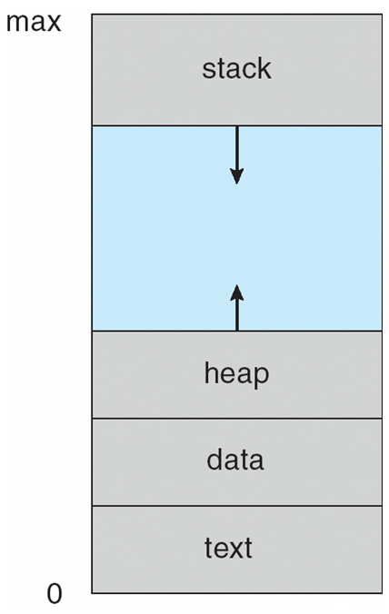
Process in Memory

Slide 8
Process State
As a process executes, it changes state
  new: The process is being created
  running: Instructions are being executed
  waiting: The process is waiting for some event to occur
  ready: The process is waiting to be assigned to a processor
  terminated: The process has finished execution

Slide 9
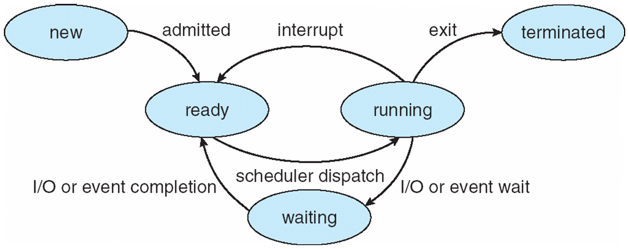
Diagram of Process State
Suspend-ready
Suspend-wait

Slide 10
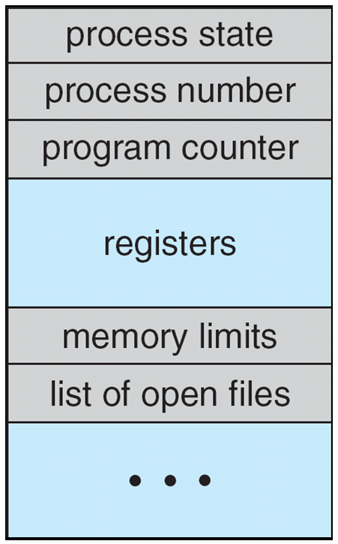
Process Control Block (PCB)
Information associated with each process
(also called task control block)
Process state – running, waiting, etc
Program counter – location of instruction to next execute
CPU registers – contents of all process-centric registers
CPU scheduling information- priorities, scheduling queue pointers
Memory-management information – memory allocated to the process
Accounting information – CPU used, clock time elapsed since start, time limits, process number
I/O status information – I/O devices allocated to process, list of open files
All processor designs include a register or set of registers,
often known as the program status word (PSW), that contains status information. The PSW typically contains condition codes plus other status information.

Slide 11
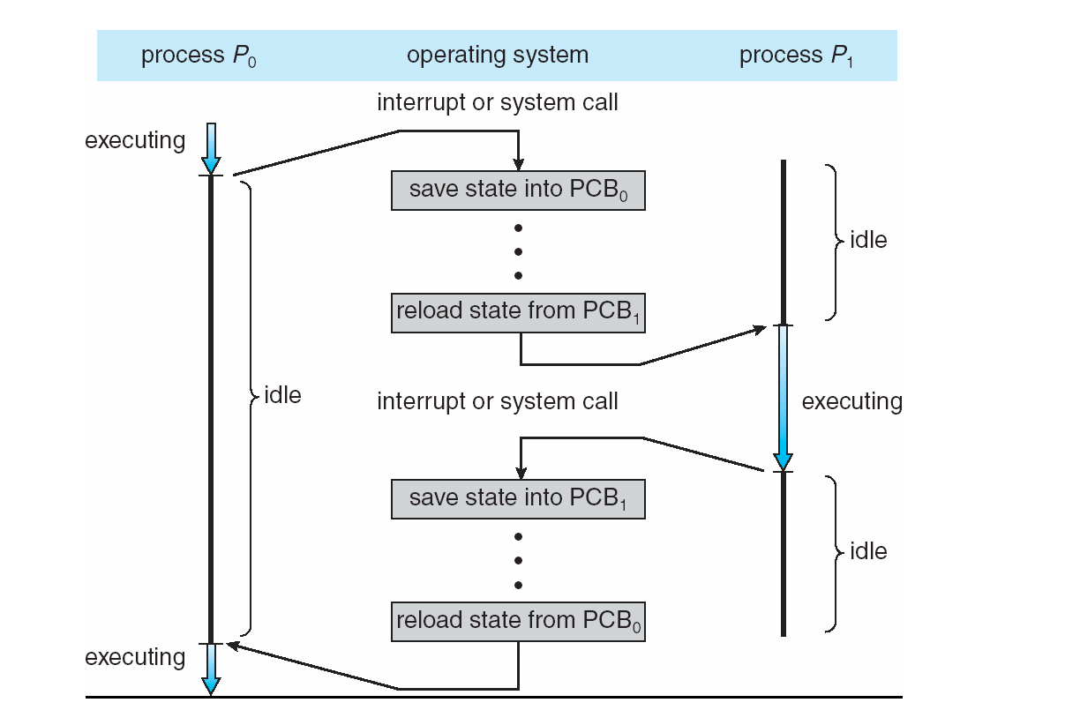
CPU Switch From Process to Process

Slide 12
Threads
So far, process has a single thread of execution
Consider having multiple program counters per process
  Multiple locations can execute at once
    Multiple threads of control -> threads
Must then have storage for thread details, multiple program counters in PCB
See next chapter

Slide 13
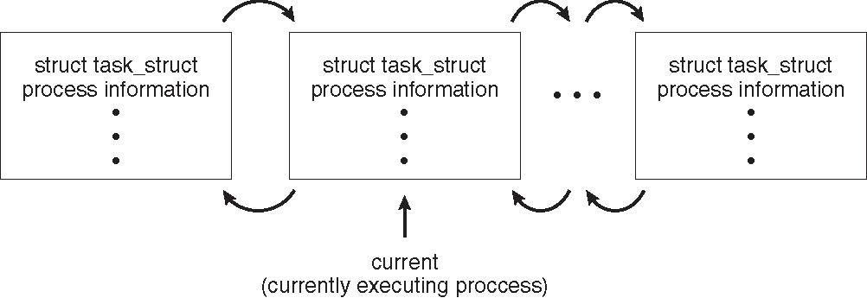
Process Representation in Linux
Represented by the C structure task_struct
pid t_pid; /* process identifier */
long state; /* state of the process */
unsigned int time_slice /* scheduling information */
struct task_struct *parent; /* this process’s parent */
struct list_head children; /* this process’s children */
struct files_struct *files; /* list of open files */
struct mm_struct *mm; /* address space of this process */
<linux/sched.h>

Slide 14
Look inside sched.h and find the corresponding data structures to this chapter
<linux/sched.h>
rb_node
Rq (running queue)
State (runnable, unrunnable, stopped)

Slide 15
Process Scheduling
Maximize CPU use, quickly switch processes onto CPU for time sharing
Process scheduler selects among available processes for next execution on CPU
Maintains scheduling queues of processes
  Job queue – set of all processes in the system
  Ready queue – set of all processes residing in main memory, ready and waiting to execute
  Device queues – set of processes waiting for an I/O device
  Processes migrate among the various queues

Slide 16
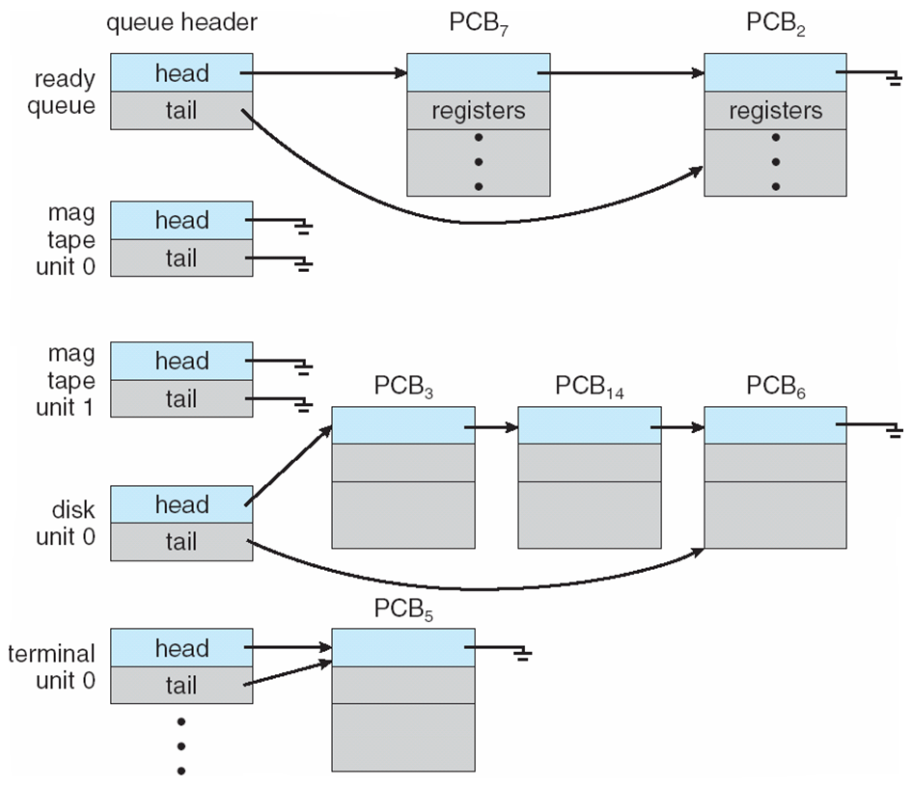
Ready Queue And Various I/O Device Queues
Notes:
از این صفها ایده بگیرید

Slide 17
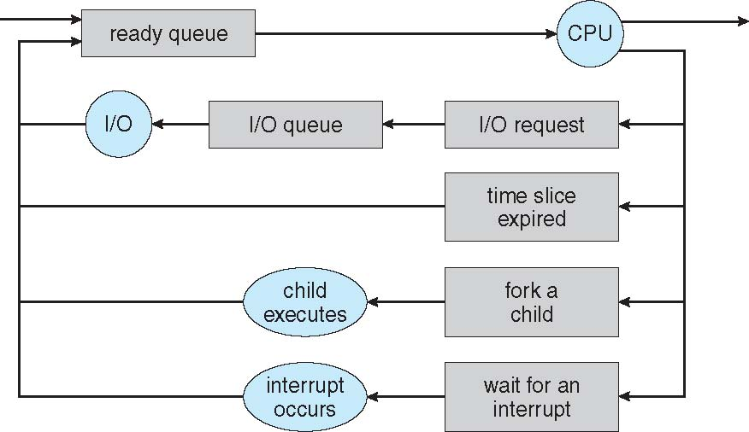
Representation of Process Scheduling
Queueing diagram represents queues, resources, flows

Slide 18
Schedulers
Short-term scheduler (or CPU scheduler) – selects which process should be executed next and allocates CPU
  Sometimes the only scheduler in a system
  Short-term scheduler is invoked frequently (milliseconds) ⇒ (must be fast)
Long-term scheduler (or job scheduler) – selects which processes should be brought into the ready queue
  Long-term scheduler is invoked infrequently (seconds, minutes) ⇒ (may be slow)
  The long-term scheduler controls the degree of multiprogramming
Processes can be described as either:
  I/O-bound process – spends more time doing I/O than computations, many short CPU bursts
  CPU-bound process – spends more time doing computations; few very long CPU bursts
Long-term scheduler strives for good process mix
Notes:
یونیکس بلندمدت ندارد. و میان مدت دارد

Slide 19
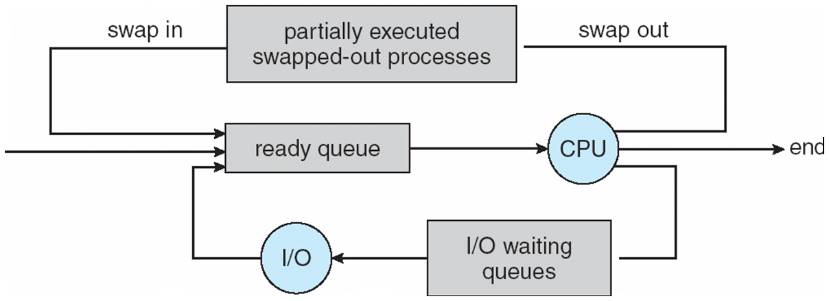
Addition of Medium Term Scheduling
Medium-term scheduler can be added if degree of multiple programming needs to decrease
  Remove process from memory, store on disk, bring back in from disk to continue execution: swapping

Slide 20
Context Switch
When CPU switches to another process, the system must save the state of the old process and load the saved state for the new process via a context switch
Context of a process represented in the PCB
Context-switch time is overhead; the system does no useful work while switching
  The more complex the OS and the PCB ➔ the longer the context switch
Time dependent on hardware support
  Some hardware provides multiple sets of registers per CPU ➔ multiple contexts loaded at once
Notes:
CPU dispatcher

Slide 21
Operations on Processes
System must provide mechanisms for:
  process creation,
  process termination,
  Inter-Process Communication
  …

Slide 22
Process Creation
Parent process create children processes, which, in turn create other processes, forming a tree of processes
Generally, process identified and managed via a process identifier (pid)
Resource sharing options
  Parent and children share all resources
  Children share subset of parent’s resources
  Parent and child share no resources
Execution options
  Parent and children execute concurrently
  Parent waits until children terminate
ps -el
ps -f 2
Prevent overloading the system by too many child processes
Notes:
Ps or top

Slide 23
A Tree of Processes in Linux
pstree

Slide 24
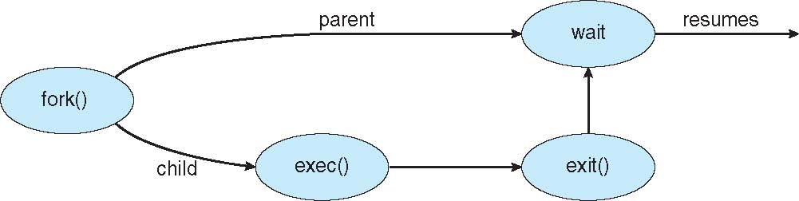
Process Creation (Cont.)
Address space
  Child duplicate of parent
  Child has a program loaded into it
UNIX examples
  fork() system call creates new process
  exec() system call used after a fork() to replace the process’ memory space with a new program

Slide 25
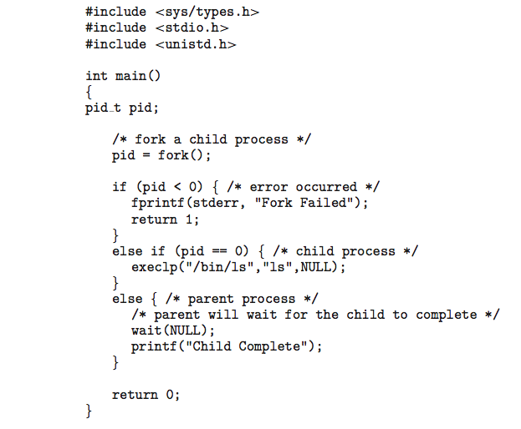
C Program Forking Separate Process

Slide 26
Quiz
What is the output of following code? How many processes are created?
Main(){
pid_t pid1, pid2, pid3;
pid1 = fork();
wait()
pid2 = fork();
if (pid1 == 0 or pid2==0){
printf(‘new child process’);
}
pid3 = fork();
printf(“End of the process”);
}

Slide 27
Process Termination
Process executes last statement and then asks the operating system to delete it using the exit() system call.
  Returns status data from child to parent (via wait())
  Process’ resources are deallocated by operating system
Parent may terminate the execution of children processes using the kill() system call. Some reasons for doing so:
  Child has exceeded allocated resources
  Task assigned to child is no longer required
  The parent is exiting and the operating systems does not allow a child to continue if its parent terminates

Slide 28
Process Termination
Some operating systems do not allow child to exists if its parent has terminated. If a process terminates, then all its children must also be terminated.
  cascading termination. All children, grandchildren, etc. are terminated.
  The termination is initiated by the operating system.
The parent process may wait for termination of a child process by using the wait()system call. The call returns status information and the pid of the terminated process
pid = wait(&status);
If no parent waiting (did not invoke wait()) process is a zombie
If parent terminated without invoking wait , process is an orphan
All processes transition to zombie state when they terminate,
but generally they exist as zombies only briefly.
Once the parent calls wait(), the process identifier of the zombie process
and its entry in the process table are released.

Slide 29
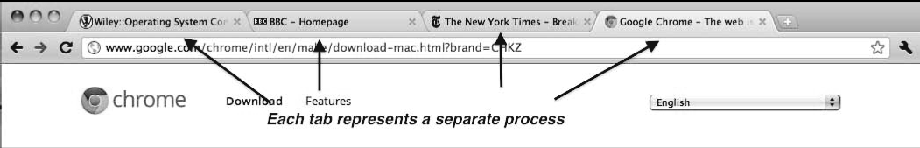
Multiprocess Architecture – Chrome Browser
Many web browsers ran as single process (some still do)
  If one web site causes trouble, entire browser can hang or crash
Google Chrome Browser is multiprocess with 3 different types of processes:
  Browser process manages user interface, disk and network I/O
  Renderer process renders web pages, deals with HTML, Javascript. A new renderer created for each website opened
    Runs in sandbox restricting disk and network I/O, minimizing effect of security exploits
  Plug-in process for each type of plug-in

Slide 30
Interprocess Communication
Processes within a system may be independent or cooperating
Cooperating process can affect or be affected by other processes, including sharing data
Reasons for cooperating processes:
  Information sharing
  Computation speedup
  Modularity
Cooperating processes need interprocess communication (IPC)
Two models of IPC
  Shared memory
  Message passing (for small amounts of data)
Notes:
X server and client
Pipe : ps -aux | grep “java”

Slide 31
Communications Models
(a) Message passing. (b) shared memory.

Slide 32
Interprocess Communication – Shared Memory
An area of memory shared among the processes that wish to communicate
The communication is under the control of the users processes not the operating system.
Benefits:
  Faster than message passing
Disadvantages:
  OS only provides the facility for accessing the shared memory, data types and their locations, and synchronization are the roles of user processes

Slide 33
Interprocess Communication – Message Passing
Message system – processes communicate with each other without sharing the same address space directly
IPC facility provides two operations:
  send(message)
  receive(message)
The message size is either fixed or variable

Slide 34
IPC types
Shared Memory
  Bounded-buffer or un-bounded buffer
  Face with Producer-Consumer problem
Message passing
  Physical link
    Shared memory, Hardware bus, Network
  Logical link
    Naming
      Direct (name the process), indirect (name the mailbox or link)
    Synchronization
      Block, Non-block
    Buffering
      Zero, bounded, un-bounded

Slide 35
Bounded-Buffer – Producer
item next_produced;
while (true) {
/* produce an item in next produced */
while (((in + 1) % BUFFER_SIZE) == out)
; /* do nothing */
buffer[in] = next_produced;
in = (in + 1) % BUFFER_SIZE;
}

Slide 36
Bounded Buffer – Consumer
item next_consumed;
while (true) {
while (in == out)
; /* do nothing */
next_consumed = buffer[out];
out = (out + 1) % BUFFER_SIZE;
/* consume the item in next consumed */
}

Slide 37
Examples of shared Memory
POSIX
POSIX Shared Memory
  Process first creates shared memory segment and open it
  shm_fd = shm_open(name, O CREAT | O RDWR, 0666);
  Set the size of the object
ftruncate(shm_fd, 4096);
  Now the process could write to the shared memory
  sprintf(shared memory, "Writing to shared memory");

Slide 38
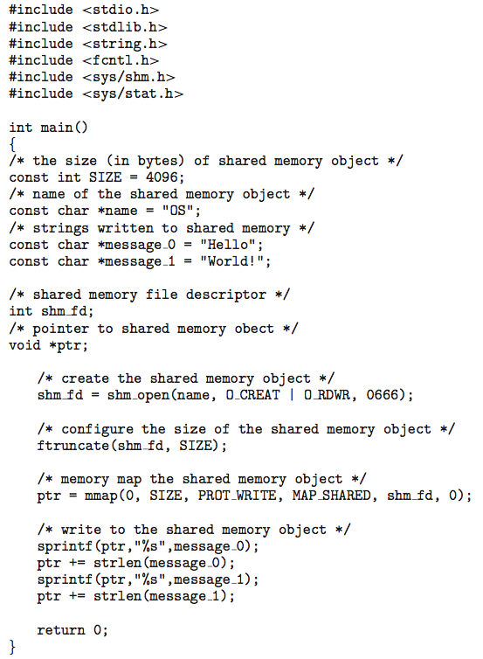
IPC POSIX Producer

Slide 39
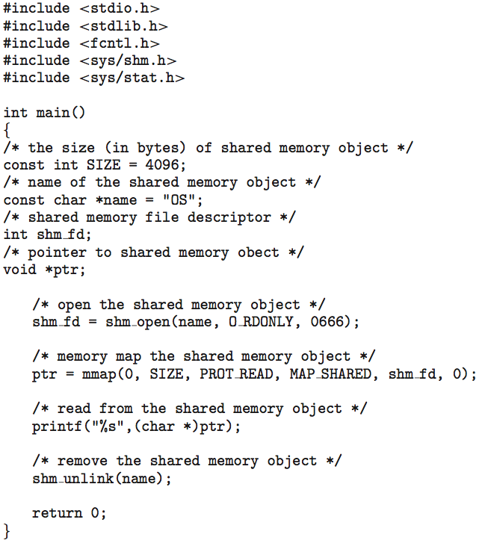
IPC POSIX Consumer

Slide 40
Communications in Client-Server Systems
Message-based
Sockets
Pipes
Remote Procedure Calls (RPC)
  A protocol using other IPC mechanisms such as pipes or sockets
Remote Method Invocation
  RPC for Java

Slide 41
Examples of IPC Applications
X Server and client
  Unix-domain sockets, named pipes, …
Piping commands in shell
  pipe
Database server
  Socket, RPC
Web services
  Kind of RPC
…

Slide 42
Sockets
A socket is defined as an endpoint for communication
Concatenation of IP address and port – a number included at start of message packet to differentiate network services on a host
The socket 161.25.19.8:1625 refers to port 1625 on host 161.25.19.8
Communication consists between a pair of sockets
All ports below 1024 are well known, used for standard services
Special IP address 127.0.0.1 (loopback) to refer to system on which process is running

Slide 43
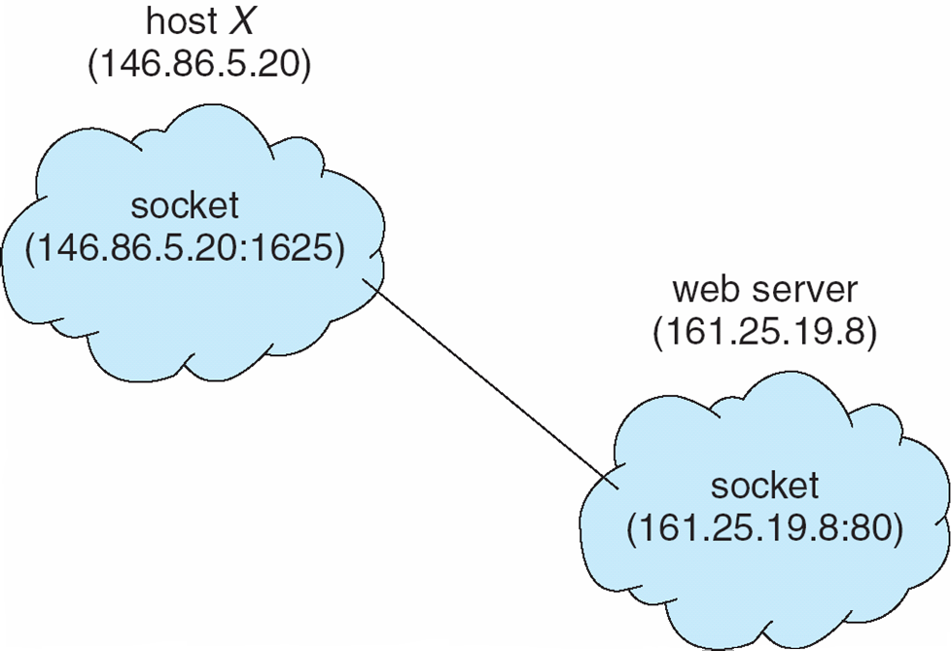
Socket Communication
types of sockets
  Connection-oriented (TCP)
  Connectionless (UDP)
  Unix sockets

Slide 44
Remote Procedure Calls
Remote procedure call (RPC) abstracts procedure calls between processes on networked systems
  Again uses ports for service differentiation
Stubs – client-side proxy for the actual procedure on the server
The client-side stub locates the server and marshalls the parameters
The server-side stub receives this message, unpacks the marshalled parameters, and performs the procedure on the server
On Windows, stub code compile from specification written in Microsoft Interface Definition Language (MIDL)
Data representation handled via External Data Representation (XDL) format to account for different architectures
  Big-endian and little-endian

Slide 45
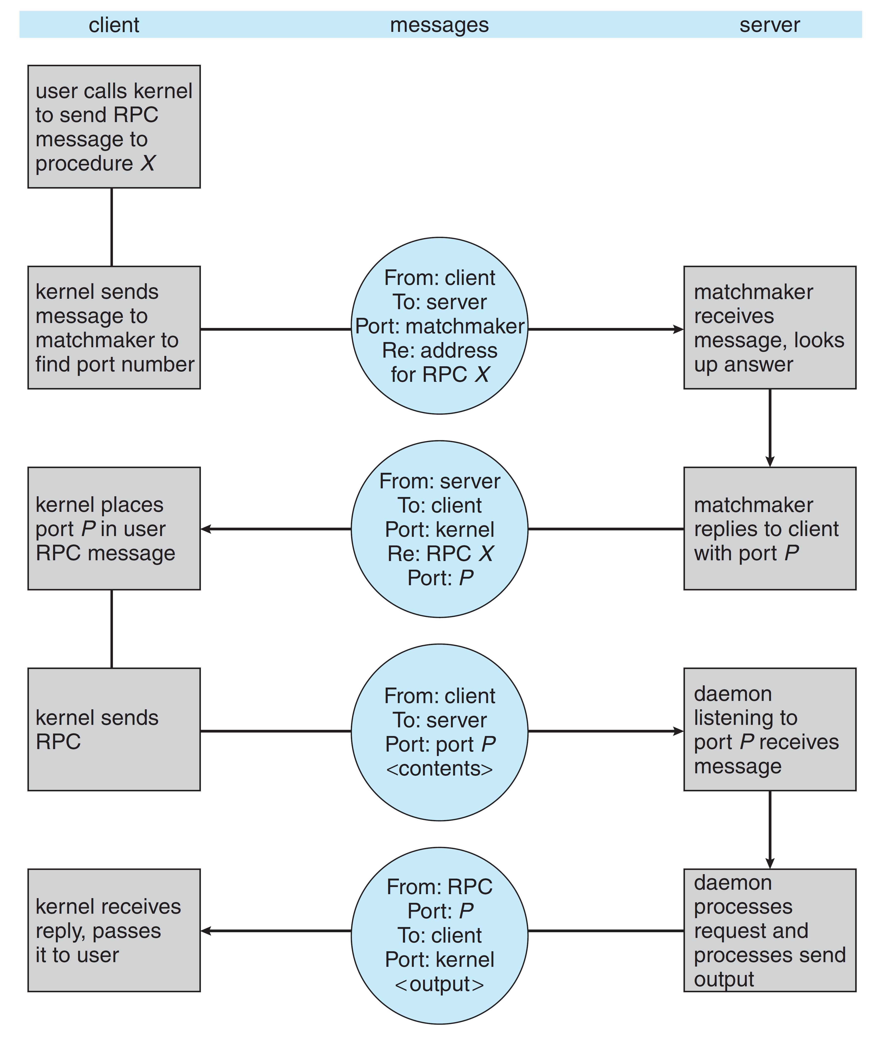
Execution of an RPC

Slide 46
Pipes
Acts as a conduit allowing two processes to communicate
Ordinary pipes – cannot be accessed from outside the process that created it. Typically, a parent process creates a pipe and uses it to communicate with a child process that it created.
Named pipes – can be accessed without a parent-child relationship.

Slide 47
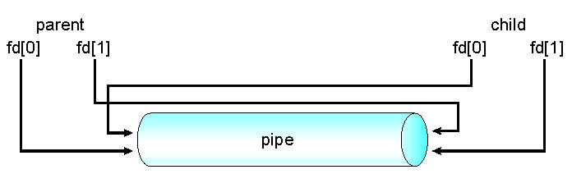
Ordinary Pipes
Ordinary Pipes allow communication in standard producer-consumer style
Producer writes to one end (the write-end of the pipe)
Consumer reads from the other end (the read-end of the pipe)
Ordinary pipes are therefore unidirectional
Require parent-child relationship between communicating processes
Windows calls these anonymous pipes
read-end
write-end

Slide 48
Named Pipes
Named Pipes are more powerful than ordinary pipes
Communication is bidirectional
No parent-child relationship is necessary between the communicating processes
Several processes can use the named pipe for communication
Provided on both UNIX and Windows systems

Slide 49
End of Chapter 3

