Slide 1
Operating Systems
chapter 1 & 2
Isfahan University of Technology
Electrical and Computer Engineering Department
98-99-2 semester
Zeinab Zali
References of the slides:
The textbooks slides
Ion Stocia
Personal slides
Notes:
<number>
<number>
<number>

Slide 2
Operating System Course
first semester of 98-99
Instructor info
Zeinab Zali
A time for you in my office:
Sunday 11-12:30
Tuesday 11-12:30
RESEARCH INTERESTS
Future Internet and network architectures
Operating Systems, Distributed Systems
Cloud Computing Infrastructures and Big Data processing
NLP, MT

Slide 3
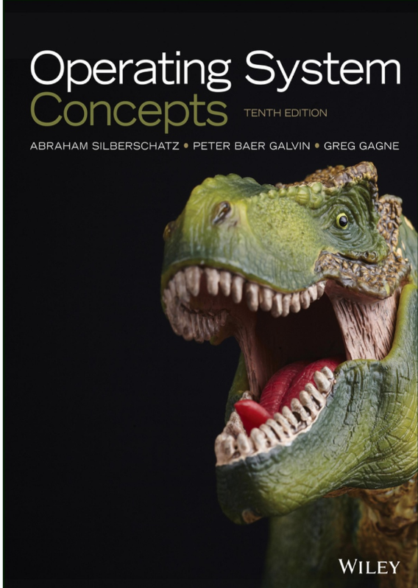
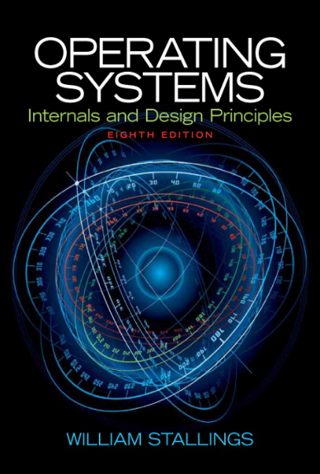
Text books
Operating Systems Concepts,
A. Silberschatz, P.B. Galvin, G. Gange,
10th edition
Operating Systems:
Internals and Design Principles,
William Stallings
Notes:
<number>
<number>
<number>

Slide 4




Grading
Quiz (2 Quizes) Class activities | 1 1 upto 2
Homework | 5
Midterm Final | 7 If mid+final<7 then fail 7
Notes:
<number>
<number>
<number>

Slide 5


Slide 6
How do we enjoy this course
Class time:
The start time is fixed (9:32!), but the end of the class depends on each session’s course (trying to finish at 10:45 but it may take up to 10:55)
Interactive class:
  You can talk about the course concepts in new applications and OSs (sometimes proposed by myself)
  some breaks during session time for your talk (about anything related to university)
Notes:
<number>
<number>
<number>

Slide 7
How do we enjoy this course
Deadlines
  10% penalty per day
  Can’t be more than 4 days late
  Two “late points” to use (still can’t be more than 4 days late)
  Please don’t ask for deadline extension:) think about all your problems when setting up the deadlines.
Please keep in touch with the course concepts and instructor!
  Listening , Studying, programming, Searching, Sending email to me, asking from the Tas, coming to my office
Notes:
<number>
<number>
<number>

Slide 8
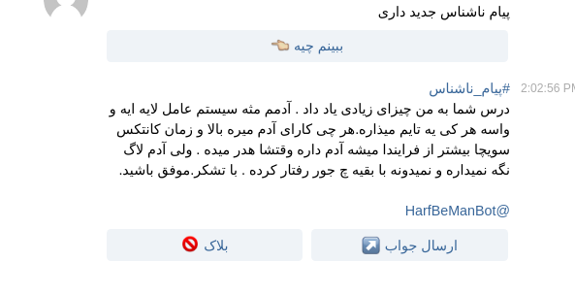
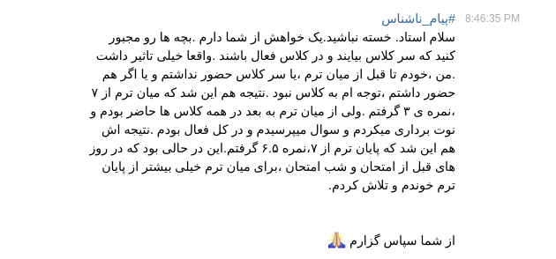

What your friends says about the course!:)

Slide 9
Some important points
Book
English Slides
chapter 1, 2
Make a note from assertions in the lectures at class
Programming Homeworks
Lab

Slide 10
What are we looking for?
Notes:
<number>
<number>
<number>

Slide 11
What do you expect from this course?

Slide 12
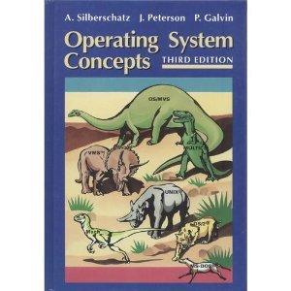
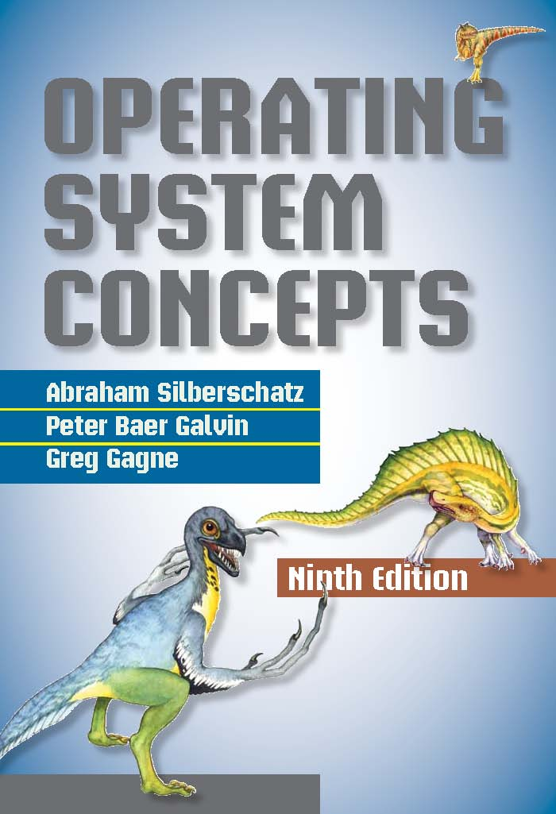
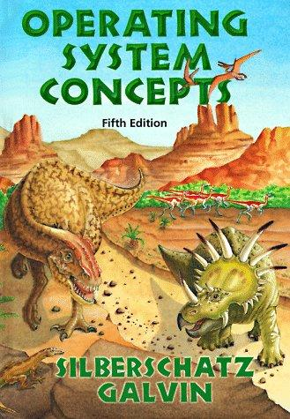
Why dinosaurs?
Notes:
<number>
<number>
<number>

Slide 13
Syllabus
Operating System Introduction : 2
Operating System Structures : 2
Processes : 4
Threads : 3
Process Synchronization : 5
CPU scheduling: 3
Deadlocks: 3
Main Memory: 2
Virtual Memory: 2
Midterm
Notes:
<number>
<number>
<number>

Slide 14
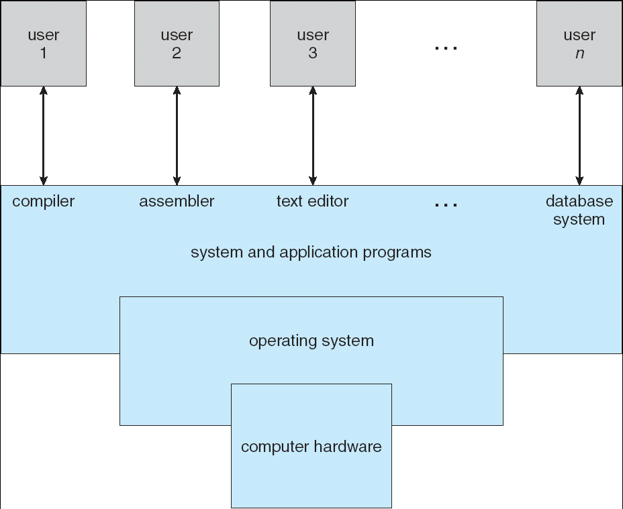
Four Components of a Computer System
Notes:
<number>
<number>
<number>

Slide 15
Computer System Structure
Computer system can be divided into four components
  Hardware – provides basic computing resources
    CPU, memory, I/O devices
  Operating system
    Controls and coordinates use of hardware among various applications and users
  Application programs – define the ways in which the system resources are used to solve the computing problems of the users
    Word processors, compilers, web browsers, database systems, video games
  Users
    People, machines, other computers
Notes:
<number>
<number>
<number>

Slide 16
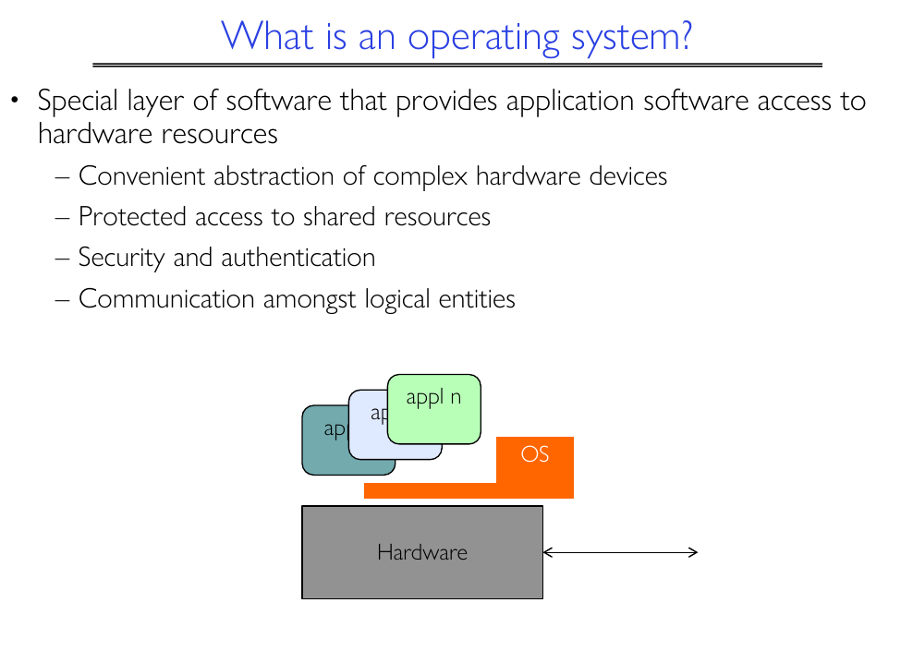

Slide 17
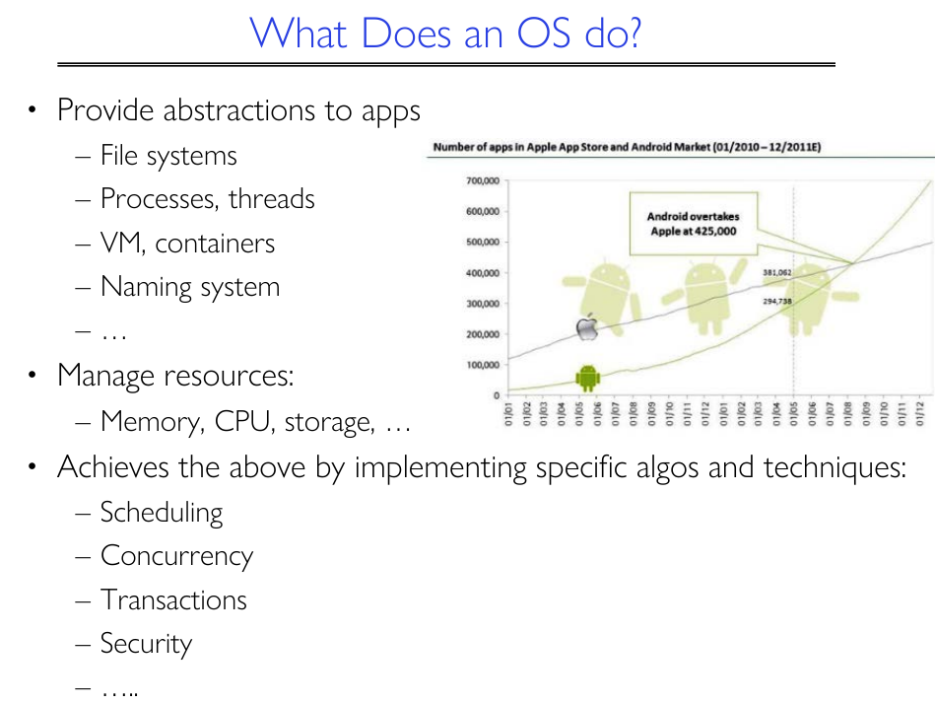
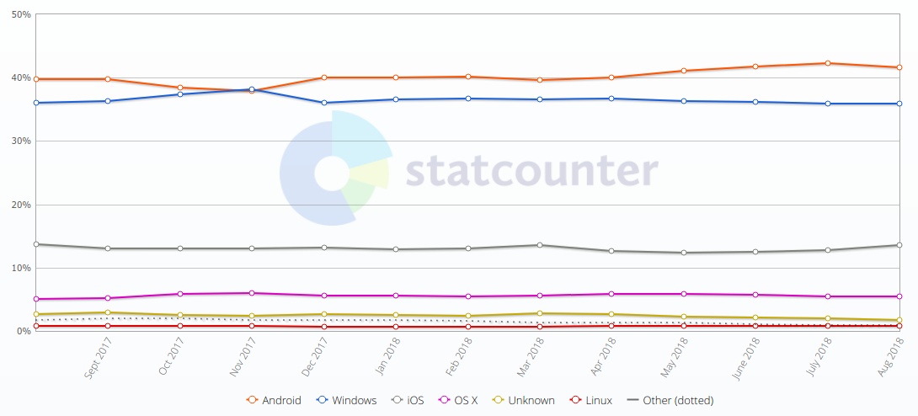

Slide 18
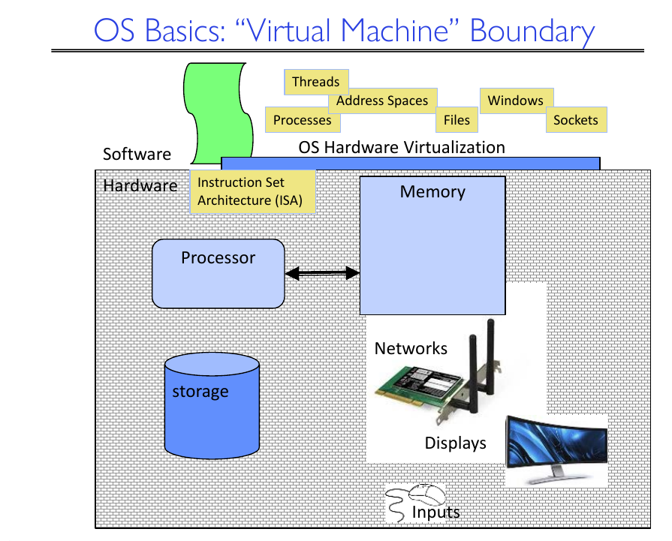

Slide 19
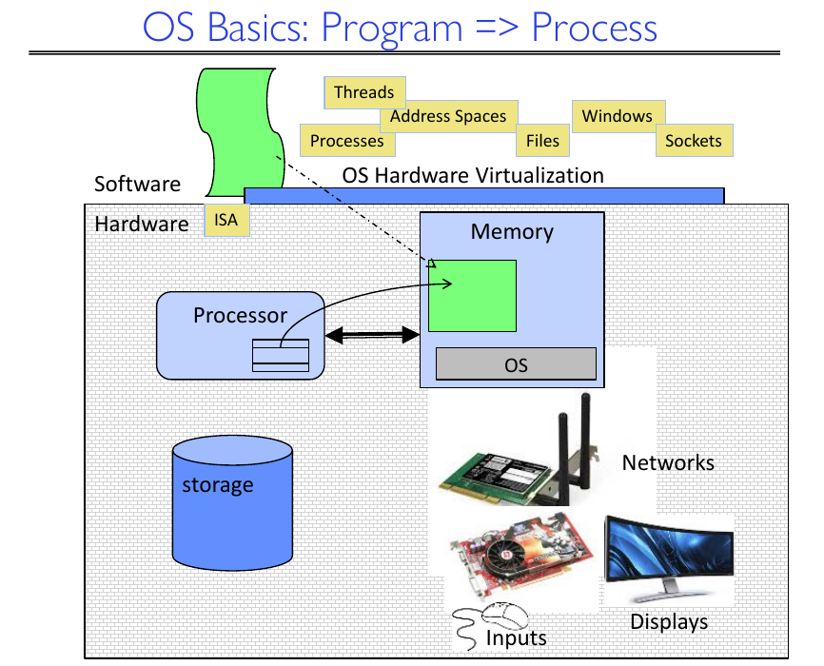

Slide 20
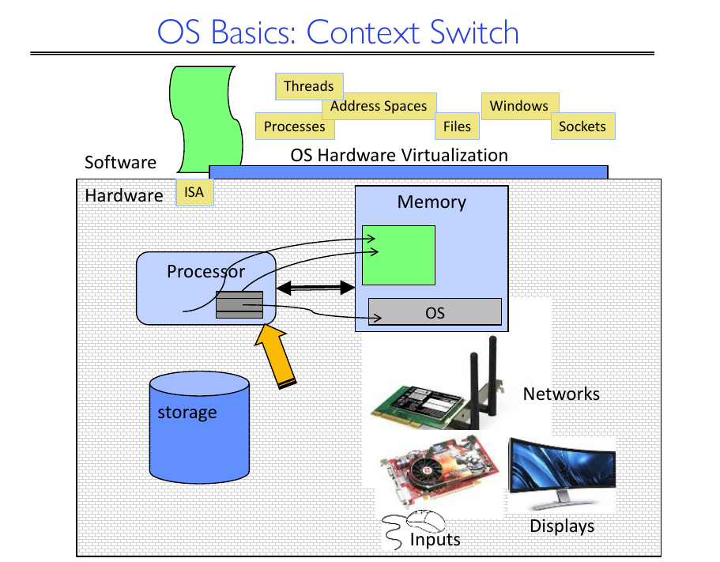

Slide 21
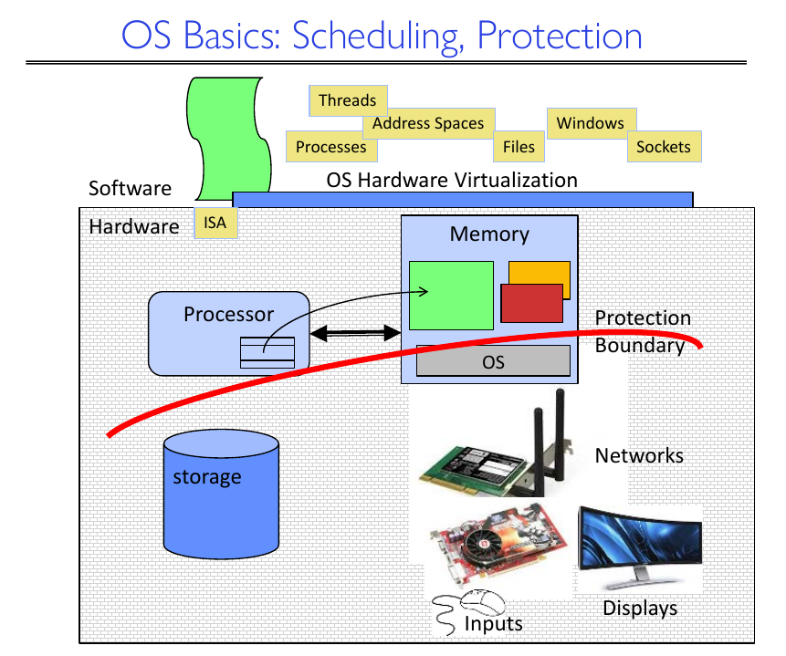

Slide 22
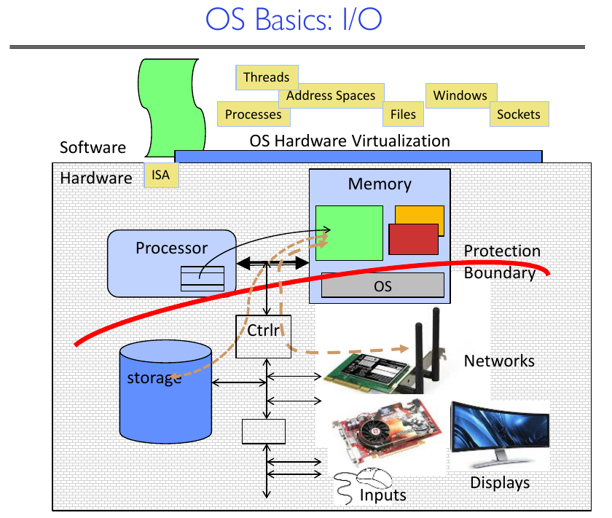

Slide 23
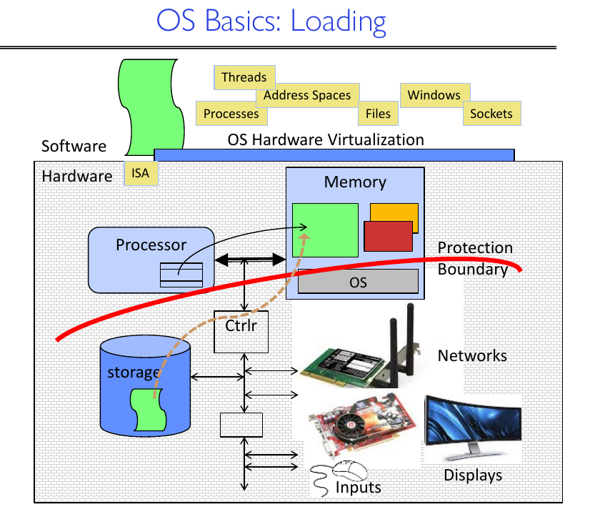

Slide 24
Sum up: What is an Operating System?
A program that acts as an intermediary between a user of a computer and the computer hardware.
Operating system goals:
  Execute user programs and make solving user problems easier.
  Make the computer system convenient to use.
  Use the computer hardware in an efficient manner.
Notes:
<number>
<number>
<number>

Slide 25
Sum up: Operating System Definition
OS is a resource allocator
  Manages all resources
  Decides between conflicting requests for efficient and fair resource use
OS is a control program
  Controls execution of programs to prevent errors and improper use of the computer
Notes:
<number>
<number>
<number>

Slide 26
Sum up: OS operations
I/O handling
Process Management
Memory Management
Storage Management
Protection and Security
  user-ID, Group-ID, permission
  Viruses, attacks, intrusion
Notes:
<number>
<number>
<number>

Slide 27
What makes OS exciting and challenging

Slide 28
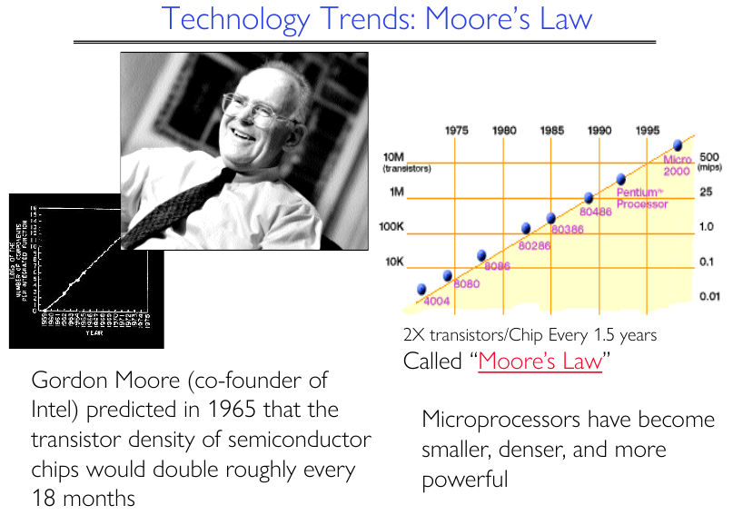

Slide 29
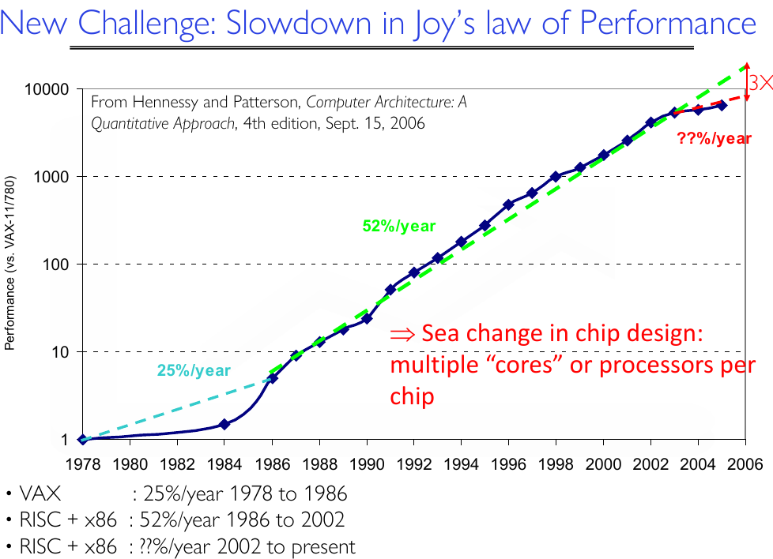

Slide 30
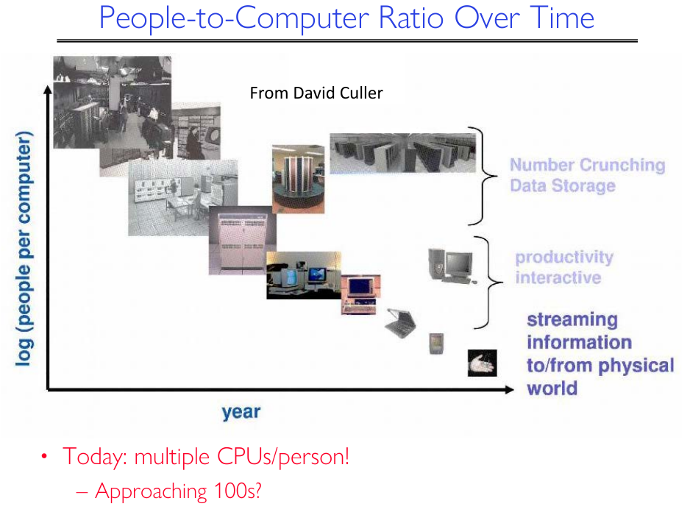

Slide 31
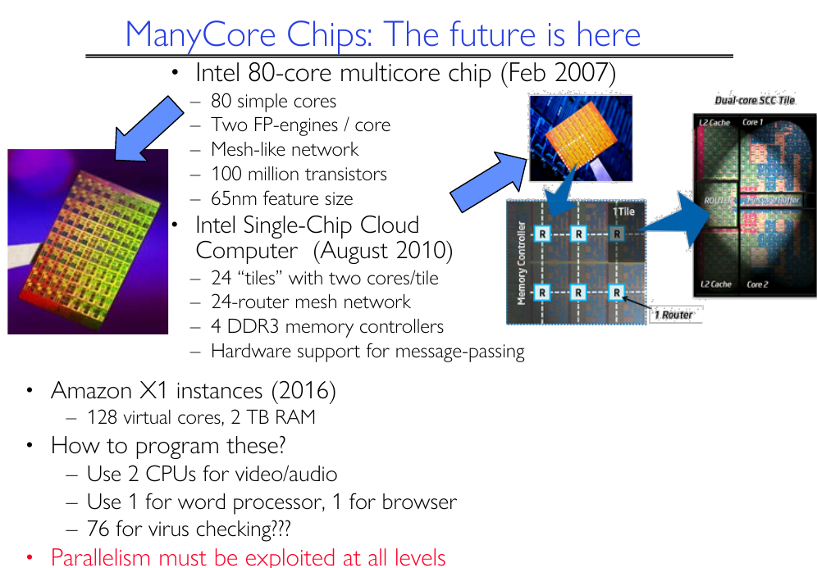

Slide 32
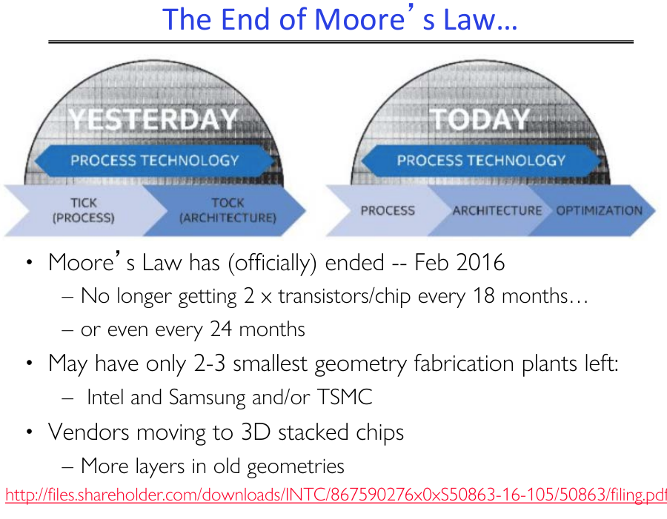

Slide 33
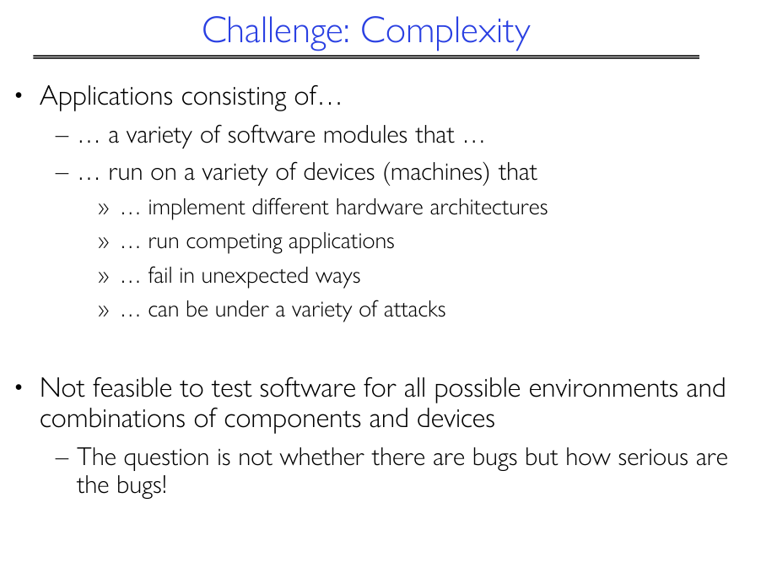

Slide 34
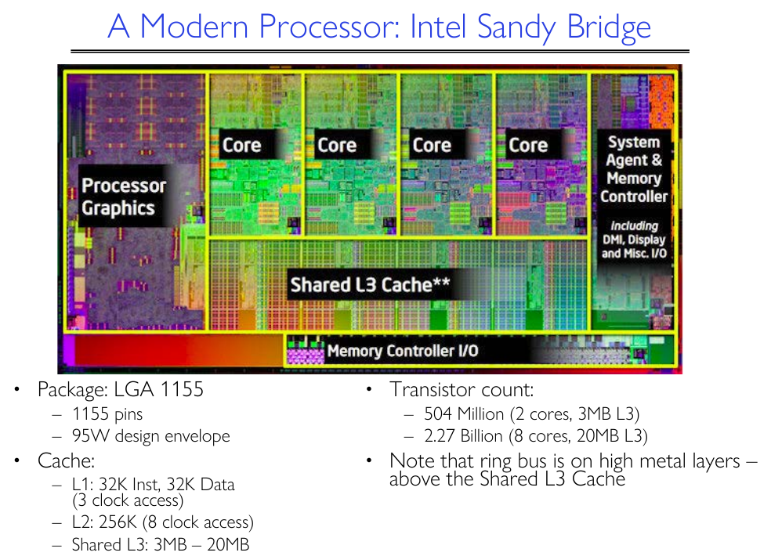

Slide 35
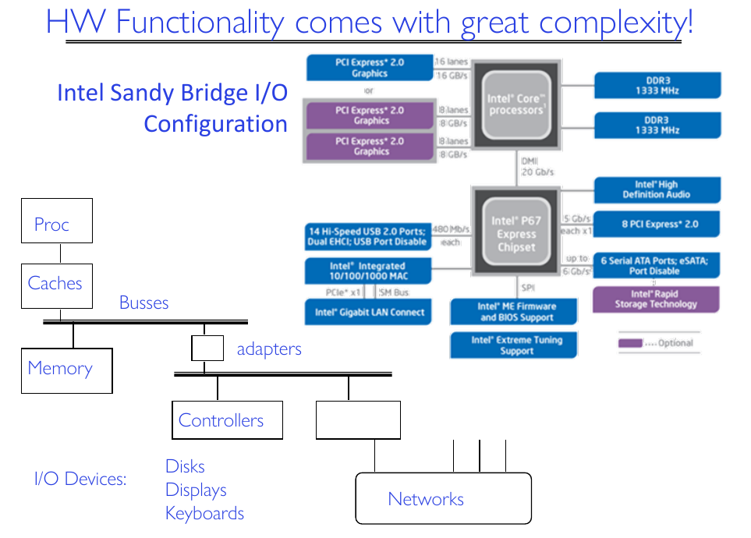

Slide 36
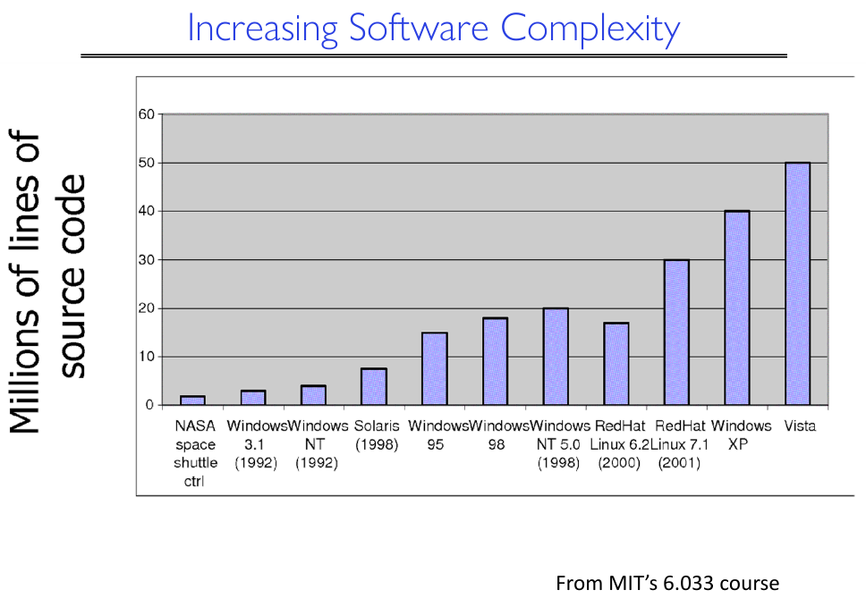

Slide 37
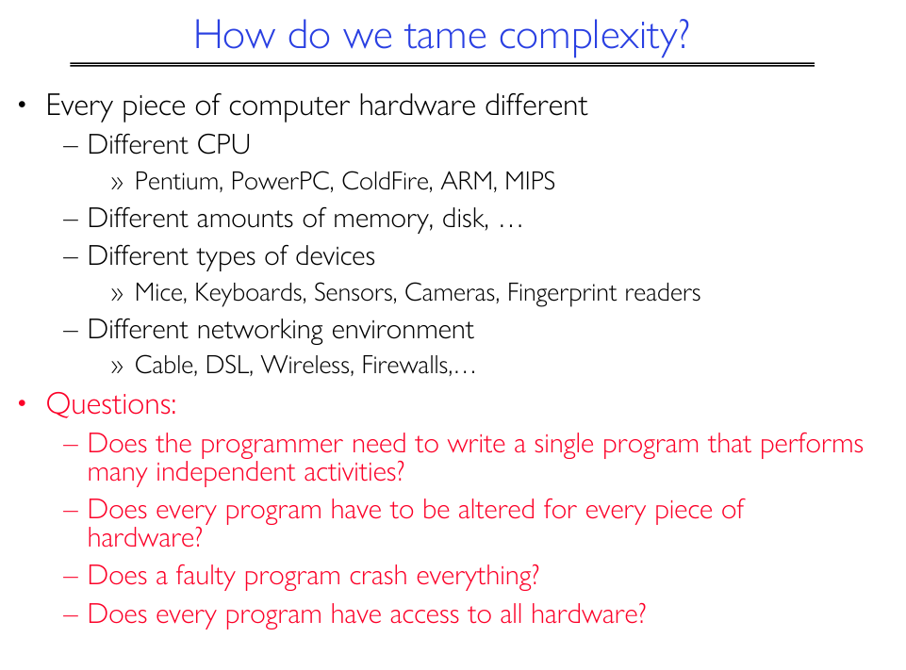

Slide 38
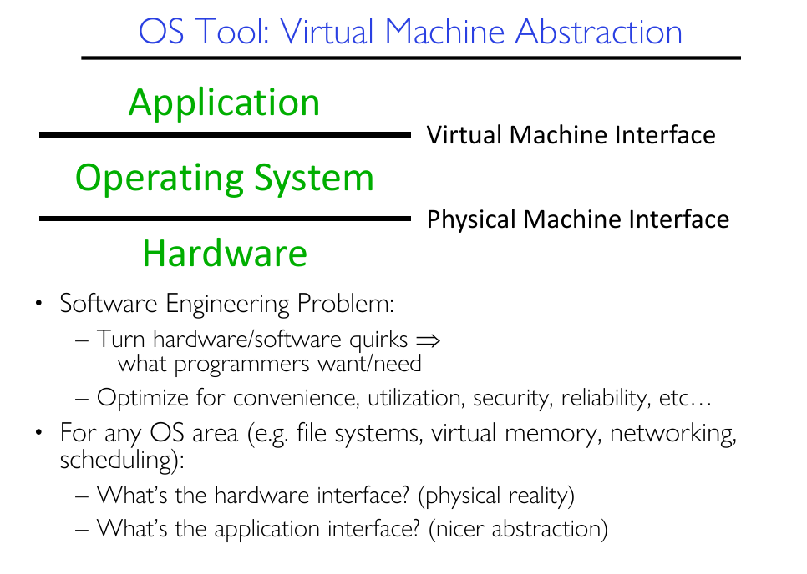

Slide 39
Operating System Services (user)
The operating-system services that are helpful to the user:
  User interface (UI).
    Batch , Command-Line (CLI), Graphics User Interface (GUI),
  Program execution - load a program into memory and to run that program, end execution ( either normally or abnormally)
  I/O operations – for a file or an I/O device
  File-system manipulation - read and write, create and delete, search files and directories, list file Information, permission management.
  Communications – Processes may exchange information, on the same computer or between computers over a network
  Error detection – OS needs to be constantly aware of possible errors
    May occur in the CPU and memory hardware, in I/O devices, in user program
    For each type of error, OS should take the appropriate action to ensure correct and consistent computing
Notes:
<number>

Slide 40
Operating System Services (System)
The OS functions for ensuring the efficient operation of the system itself via resource sharing
  Resource allocation - When multiple users or multiple jobs running concurrently, resources must be allocated to each of them
    Many types of resources - CPU cycles, main memory, file storage, I/O devices.
  Accounting - To keep track of which users or processes use how much and what kinds of computer resources
  Protection and security - The owners of information stored in a multiuser or networked computer system may want to control use of that information, concurrent processes should not interfere with each other
    Protection
    Security
Notes:
<number>

Slide 41
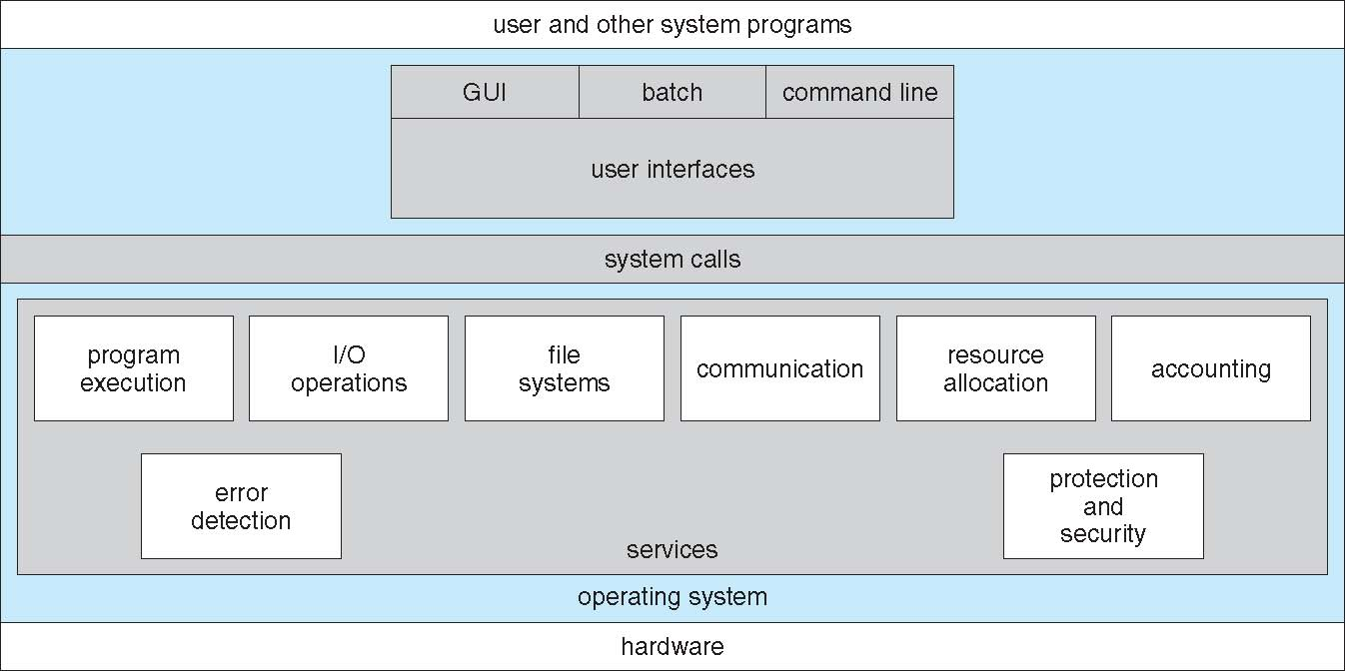
A View of Operating System Services

Slide 42
Operating System Definition (Cont.)
Stand alone devices
  “The one program running at all times on the computer” is the kernel. Everything else is either a system program (ships with the operating system) or an application program
Mobile devices
  Kernel
  middleware
Notes:
<number>
<number>
<number>

Slide 43
OS History
Unix: 1960
BSD Unix: 1978
MS DOS: 1981
Windows: 1983
Mac OS x: 1984
Linux: 1991
Solaris: 1991
iOS: 2007 (Apple)
Android OS: 2008(Google)
Open Source
Notes:
<number>
<number>
<number>

Slide 44
Operating System Structure
Multiprogramming needed for efficiency
  Single user cannot keep CPU and I/O devices busy at all times
  Multiprogramming organizes jobs (code and data) so CPU always has one to execute
  A subset of total jobs in system is kept in memory
  Some jobs are selected to move to memory via job scheduling
  When it has to wait (for I/O for example), OS switches to another job
Timesharing (multitasking) is logical extension in which CPU switches jobs so frequently that users can interact with each job while it is running, creating interactive computing
  Response time should be < 1 second
  Each user has at least one program executing in memory process
  If several jobs ready to run at the same time  CPU scheduling
  If processes don’t fit in memory, swapping moves them in and out to run
  Virtual memory allows execution of processes not completely in memory
Notes:
<number>
<number>
<number>

Slide 45
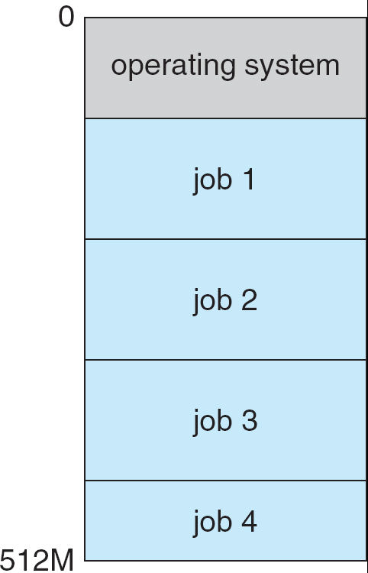
Memory Layout for Multiprogrammed System
Notes:
<number>
<number>
<number>

Slide 46
User Operating System Interface - CLI
CLI or command interpreter allows direct command entry
  Function: Primarily fetches a command from user and executes it
  Organization: Sometimes implemented in kernel, sometimes by systems program
  Multiple flavors implemented – shells
    Bourne shell, bash, third-party shells
  Implementation approaches:
    commands are built-in
    Commands are just names of programs
      Benefit: flexible for adding new features without shell modification
Echo $SHELL
Notes:
<number>

Slide 47
User Operating System Interface - GUI
User-friendly desktop interface
  Usually mouse, keyboard, and monitor
  Icons represent files, programs, actions, etc
  Invented at Xerox PARC: 1973
Many systems now include both CLI and GUI interfaces
  Microsoft Windows is GUI with CLI “command” shell
  Apple Mac OS X is “Aqua” GUI interface with UNIX kernel underneath and shells available
  Unix and Linux have CLI with optional GUI interfaces (CDE, KDE, GNOME)
Notes:
<number>

Slide 48
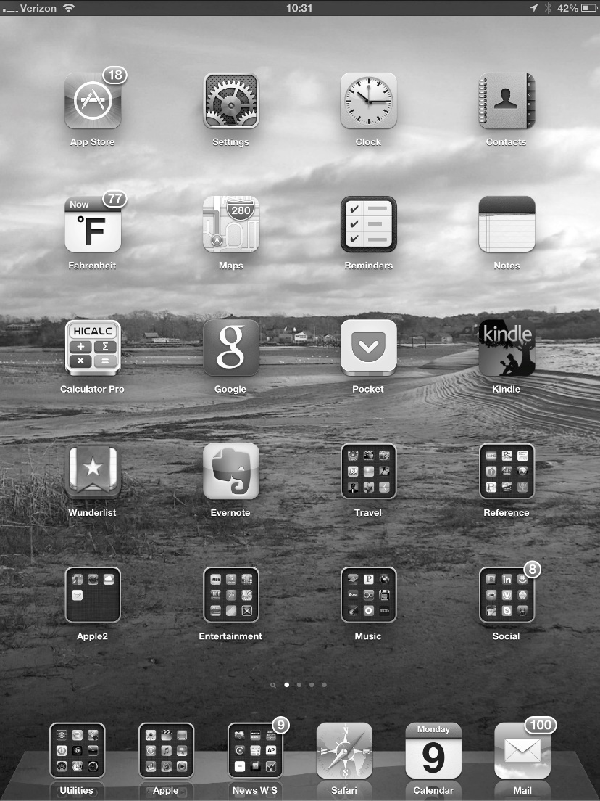
Touchscreen Interfaces
Touchscreen devices require new interfaces
  Mouse not possible or not desired
  Actions and selection based on gestures
  Virtual keyboard for text entry
  Voice commands.
Notes:
<number>

Slide 49
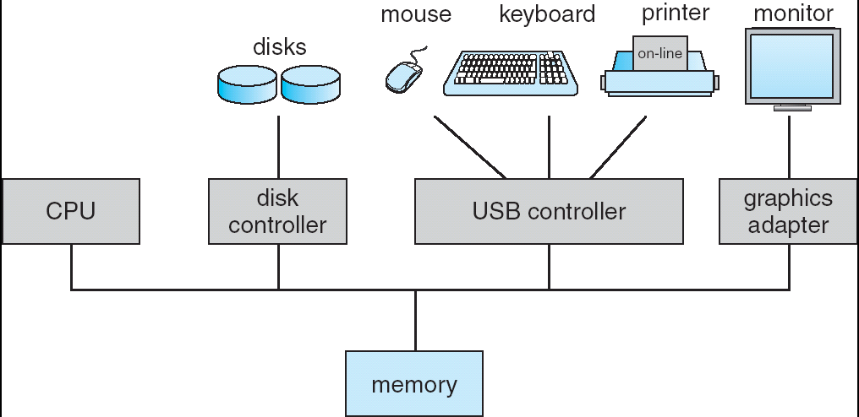
Computer System Organization
Computer-system operation
  One or more CPUs, device controllers connect through common bus providing access to shared memory
  Concurrent execution of CPUs and devices competing for memory cycles
Notes:
<number>
<number>
<number>

Slide 50
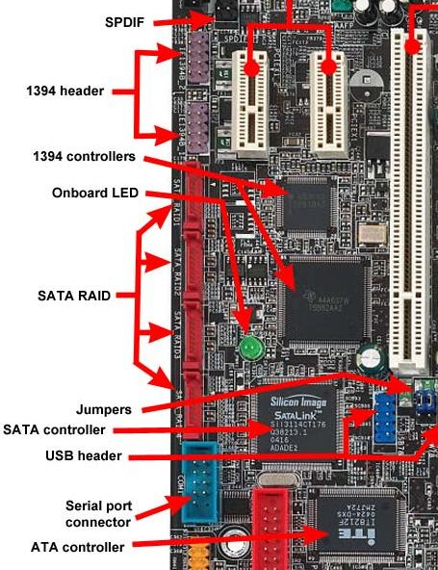
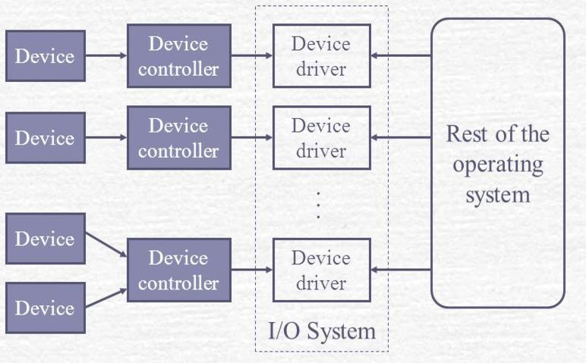
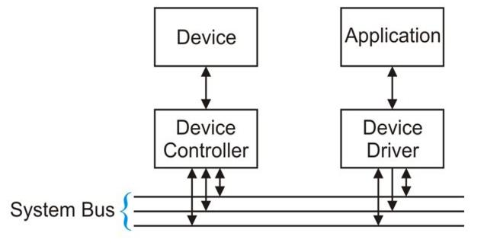
Computer-System Operation
I/O devices and the CPU can execute concurrently.
Each device controller is in charge of a particular device type.
Each device controller has a local buffer.
CPU moves data from/to main memory to/from local buffers
I/O is from the device to local buffer of controller.
Device controller informs CPU that it has finished its operation by causing an interrupt.
Device Driver for each device controller to manage I/O
  Provides uniform interface between controller and kernel
Notes:
<number>
<number>
<number>

Slide 51
Common Functions of Interrupts
Interrupt transfers control to the interrupt service routine generally, through the interrupt vector, which contains the addresses of all the service routines.
Interrupt architecture must save the address of the interrupted instruction.
Multiple Interrupts:
  Sequential Interrupt processing: Incoming interrupts are disabled while another interrupt is being processed to prevent a lost interrupt.
  Nested Interrupt processing
A trap is a software-generated interrupt caused either by an error or a user request.
An operating system is interrupt driven.
Notes:
<number>
<number>
<number>

Slide 52
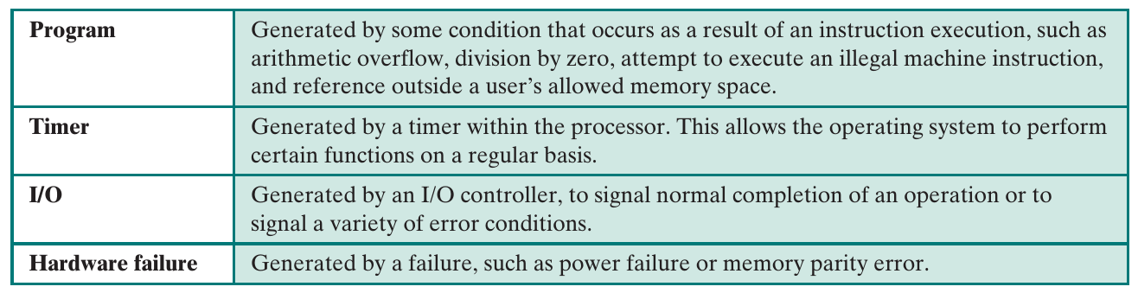
Interrupt types
Hardware
signal to CPU
Interrupt
Software
system call
Or trap
Notes:
<number>
<number>
<number>

Slide 53
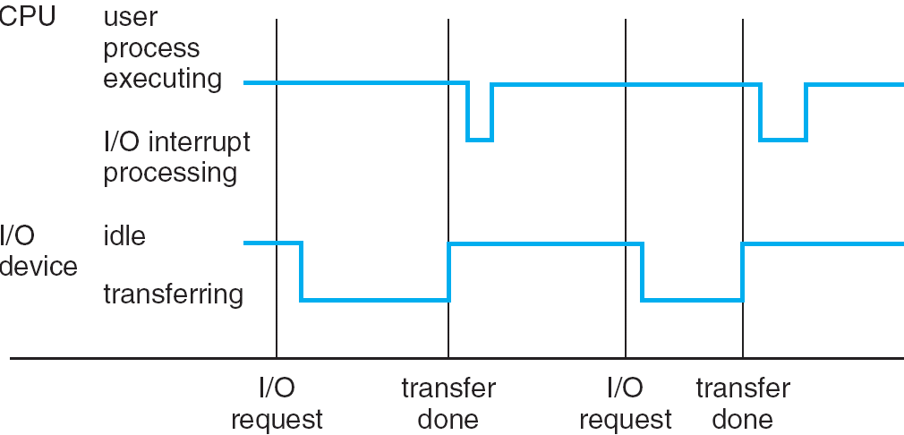
Interrupt Timeline
Notes:
<number>
<number>
<number>

Slide 54
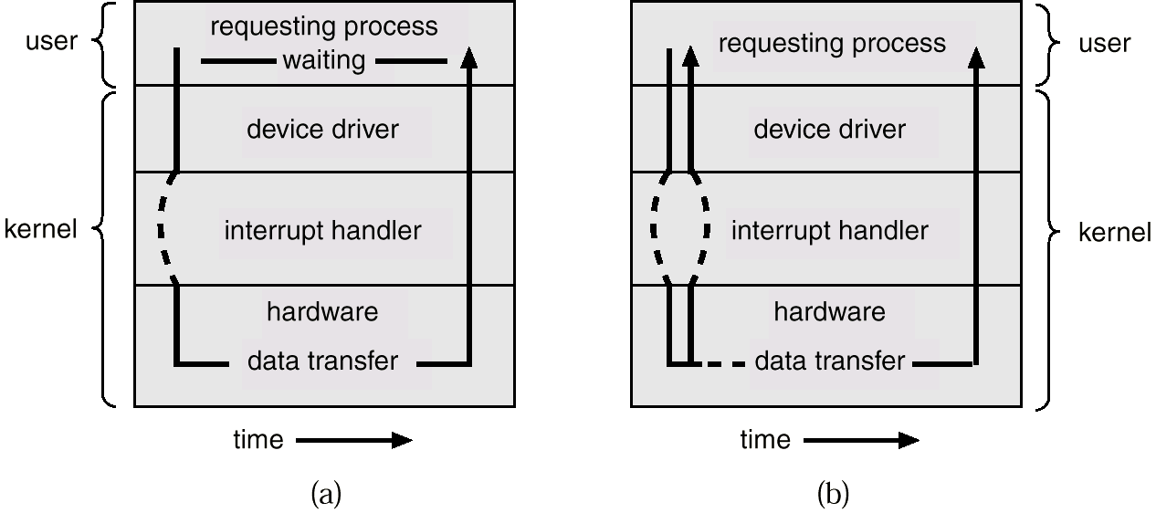
Two I/O Methods
Interrupt-driven
Direct Memory Access (DMA)
Synchronous
Asynchronous
Notes:
<number>
<number>
<number>

Slide 55
Direct Memory Access Structure
Used for high-speed I/O devices able to transmit information at close to memory speeds.
Device controller transfers blocks of data from buffer storage directly to main memory without CPU intervention.
Only one interrupt is generated per block, rather than the one interrupt per byte.
Switch or Bus
DMA is more effective in switch architecture
Notes:
<number>
<number>
<number>

Slide 56
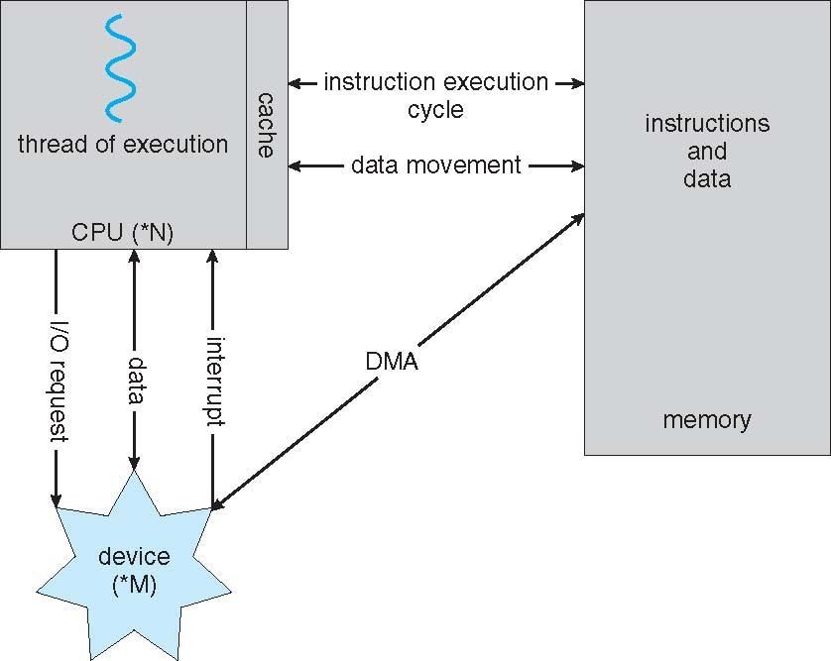
How a Modern Computer Works
Notes:
<number>

Slide 57
Operating-System Operations
Interrupt driven by hardware
Software error or request creates exception or trap
  Division by zero, request for operating system service
Dual-mode operation allows OS to protect itself and other system components
User mode and kernel mode
  Mode bit provided by hardware
    Provides ability to distinguish when system is running user code or kernel code
    Some instructions designated as privileged, only executable in kernel mode
    System call changes mode to kernel, return from call resets it to user
Multi-mode : Virtual machine manager
System call is the method used by a process to request action
by the OS. The system call service routine is a part of the OS
Notes:
<number>
<number>
<number>

Slide 58
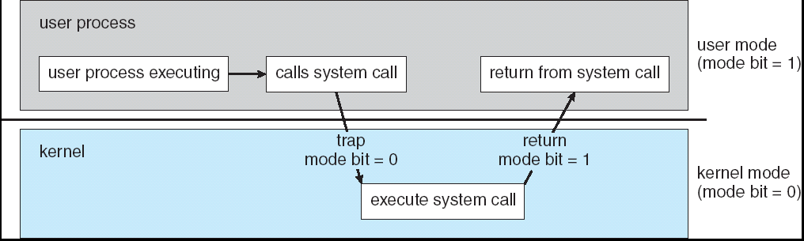
Transition from User to Kernel Mode
Timer to prevent infinite loop / process hogging resources
  Set interrupt after specific period
  Operating system decrements counter
  When counter zero generate an interrupt
  Set up before scheduling process to regain control or terminate program that exceeds allotted time
Notes:
<number>
<number>
<number>

Slide 59
تمرین
۱- هر یک از دسته مفاهیم زیر را با هم مقایسه کنید:
Device Driver- Device Controller
CPU scheduling- Job scheduling
۲- دو رویکرد متفاوت در برنامه نویسی CLI را بیان کرده و با هم مقایسه کنید
3- يکی از وظايف اصلی سيستم عامل، تخصيص منابع يا resource allocation است. در اين رابطه دو منبع اصلی هر سيستم را نام ببريد.

Slide 60
System Calls
Definition: Programming interface to the services provided by the OS
Implementations:
  Typically written in a high-level language (C or C++)
  Low-level tasks (access hardware) using assembly
How to use: Application Programming Interface (API)
  OS API (kernel libraries)
  Languages API (runtime libraries included in the compiler)
Three most common APIs :
  Win32 API for Windows,
  POSIX API for POSIX-based systems (including virtually all versions of UNIX, Linux, and Mac OS X) libc
  Java API for the Java virtual machine (JVM)
Notes:
<number>

Slide 61
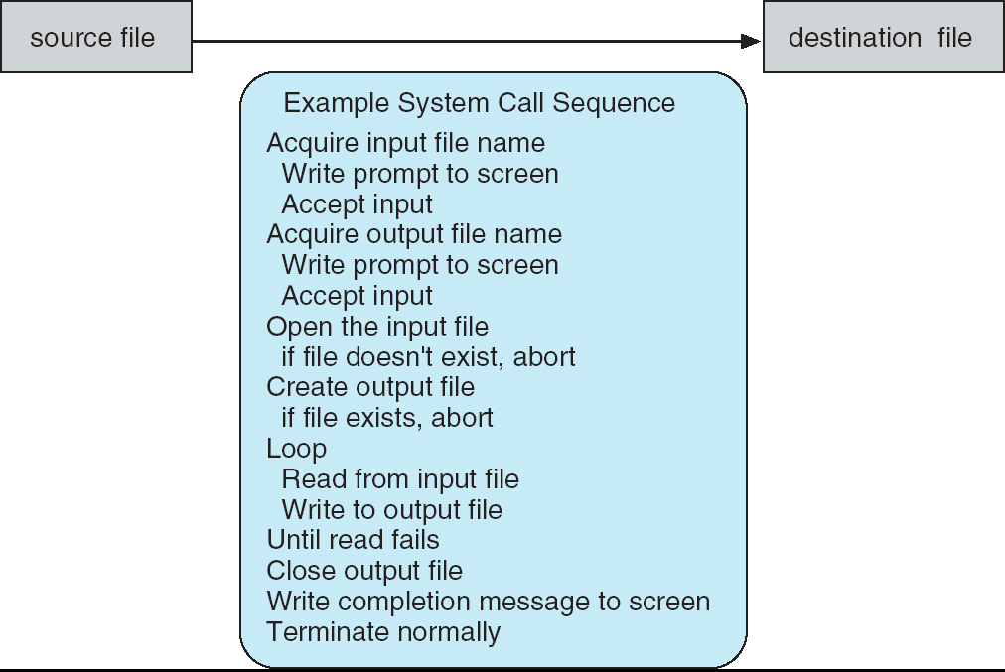
Example of System Calls
System call sequence to copy the contents of one file to another file
Notes:
<number>

Slide 62
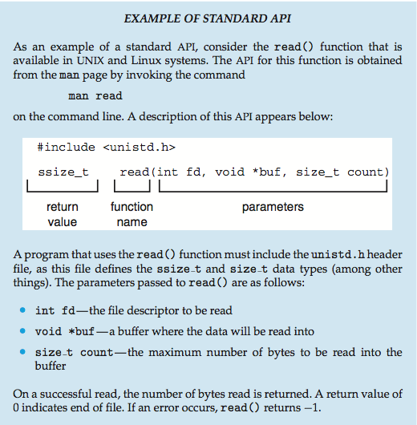
Example of Standard API
Notes:
<number>

Slide 63
System Call Implementation
Typically, a number associated with each system call
  System-call interface maintains a table indexed according to these numbers
  The system call interface invokes the intended system call in OS kernel and returns status of the system call and any return values
The caller need know nothing about how the system call is implemented
  Just needs to obey the APIs
Notes:
<number>

Slide 64
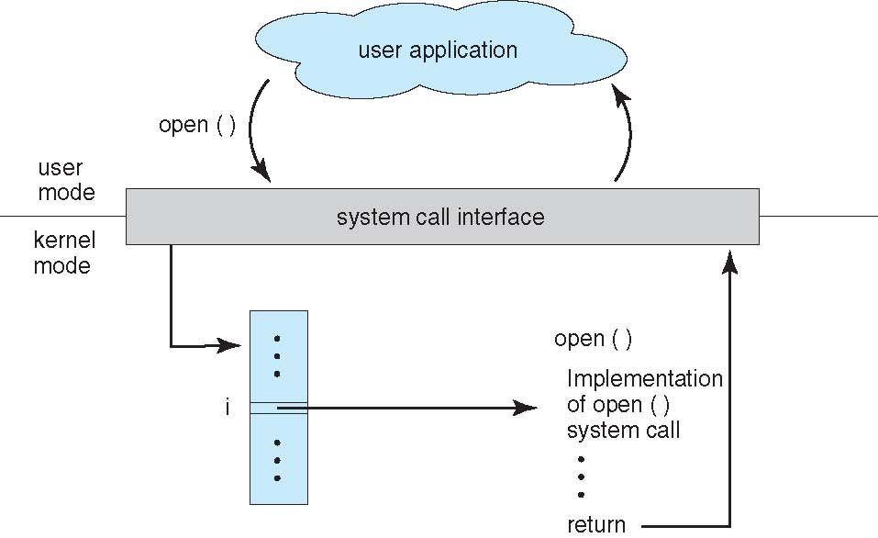
API – System Call – OS Relationship
Notes:
<number>

Slide 65
System Call Parameter Passing
Invoking a System Call through:
  identity of desired system call
  Exact type and amount of information
Three general methods used to pass parameters to the OS
  Simplest: pass the parameters in registers
    In some cases, may be more parameters than registers
  Parameters stored in a block, or table, in memory, and address of block passed as a parameter in a register
    This approach taken by Linux and Solaris
  Parameters placed, or pushed, onto the stack by the program and popped off the stack by the operating system
Block and stack methods do not limit the number or length of parameters being passed
Notes:
<number>

Slide 66
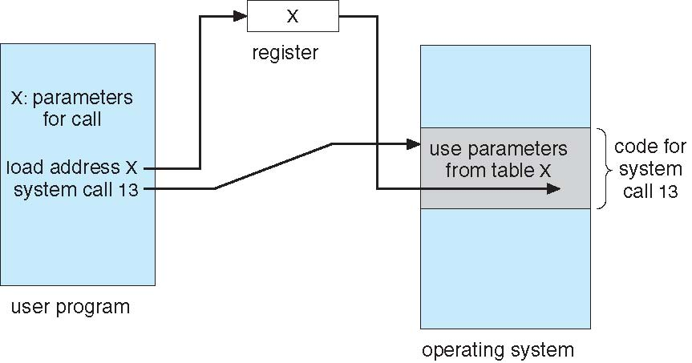
Parameter Passing via Table
OS API
Notes:
<number>

Slide 67
Types of System Calls
Process control
  create and terminate process, event, signal, allocate and free memory, Dump memory if error, Debugger and Locks, …
File management
  create, delete, open, close, read, write file, manipulate file attributes
Device management
  request, release, read, write, attach, detach device
Information maintenance
  get/set time or date, get/set system data, …
Communications
  create, delete communication, attach/detach remote devices,…
Protection
  Control access to resources, Get and set permissions, Allow and deny user access
Notes:
<number>

Slide 68
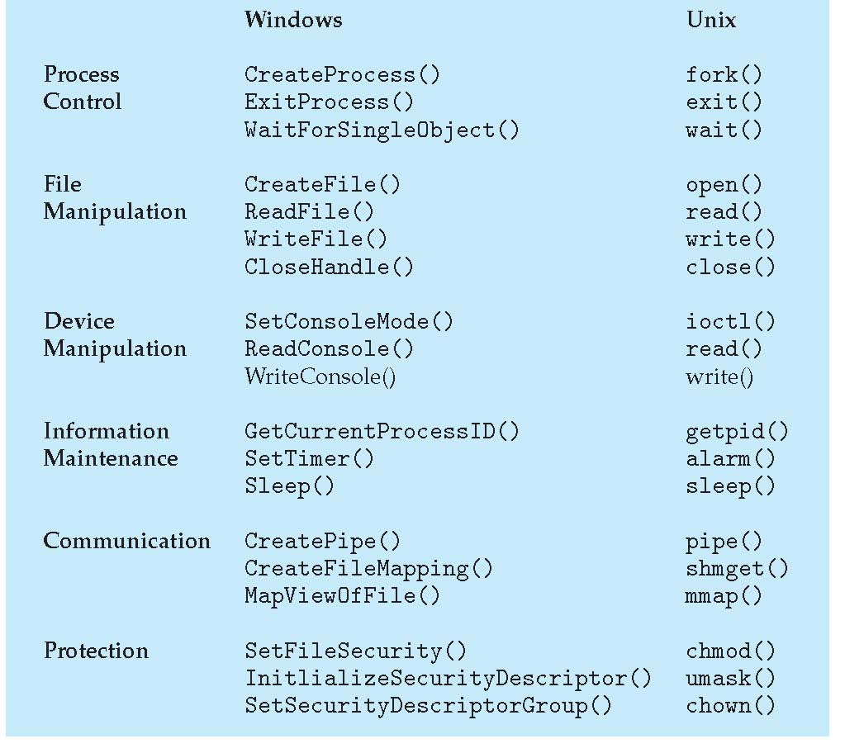
Examples of Windows and Unix System Calls

Slide 69
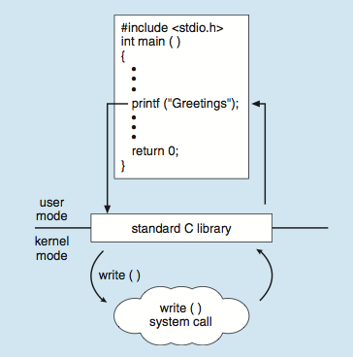
Standard C Library Example
C program invoking printf() library call, which calls write() system call
Notes:
<number>

Slide 70
Quick student research
Please find
system call table in the kernel of your linux
Two samples of system call interface code

Slide 71
System Programs
System programs provide a convenient environment for program development and execution. they run the entire time that the kernel is running.
  In Unix, init is the first system process that starts many other daemons
Different types:
  File manipulation
  Status information
  Programming language support
  Program loading and execution
  Communications: web browser, remote login, …
  Background services
Most users’ view of the operation system is defined by system programs and application programs, not the actual system calls
Registry or /etc/..
Service or daemon
Notes:
<number>

Slide 72
System Boot
When power initialized on system, execution starts at a fixed memory location
  Firmware ROM used to hold initial boot code
Operating system must be made available to hardware so hardware can start it
  Small piece of code – bootstrap loader, stored in ROM or EEPROM locates the kernel, loads it into memory, and starts it
  Sometimes two-step process where boot block at fixed location loaded by ROM code, which loads bootstrap loader from disk
Common bootstrap loader, GRUB, allows selection of kernel from multiple disks, versions, kernel options
Kernel loads and system is then running
Notes:
<number>

Slide 73
تمرین
4- وظايف سيستم عامل عبارتند از
resource management، I/O handling، Process management، Memory management، Storage management، Protection ، security .
در مورد هر یک از تدابیر سخت افزاری یا نرم افزاری الف و ب، به این سؤالات پاسخ دهید
(۱) این تدبیر سخت افزاری یا نرم افزاری یا هردو است؟(توضيح مختصر) (۲) اين تدبير به منظور اجرای کدام یک از وظايف نامبرده در سیستم عامل به کار می‌رود؟ (۳) توضیح مختصر دهید که چگونه وظيفه موردنظر با تدبير ذکرشده برآورده می‌شود.
الف) تعريف مدهای کرنل و کاربر
5- با ذکر حداقل دو مثال بنويسيد در چه مواردی اپليکيشنی که شما برنامه نويسی می کنيد از سيستم عامل استفاده میکند؟ اپليکيشن شما چگونه درخواست هايش را به سيستم عامل میفرستد؟ آیا در زبان‌های برنامه نويسی امکانی جهت ارسال دستور به سيستم عامل وجود دارد؟

Slide 74
Operating System Design and Implementation
Internal structure of different Operating Systems can vary widely
Start the design by defining goals and specifications
Affected by choice of hardware, type of system
User goals and System goals
  User goals – operating system should be convenient to use, easy to learn, reliable, safe, and fast
  System goals – operating system should be easy to design, implement, and maintain, as well as flexible, reliable, error-free, and efficient
Embedded, real-time
Notes:
<number>
Real-time operating systems, embedded

Slide 75
Operating System Design and Implementation (Cont.)
Important principle to separate
  Mechanism: How to do it?
  Policy: What will be done?
Mechanisms determine how to do something, policies decide what will be done
  Ex: CPU scheduler can be time-sharing, batch, realtime, …
The separation of policy from mechanism is a very important principle, it allows maximum flexibility if policy decisions are to be changed later
  Unix: Basic set of policy-free primitive building blocks, different policies with user-created kernel modules or programs
  Windows and OS X: All encoded in the system, so a global look
Specifying and designing an OS is highly creative task of software engineering
Notes:
<number>

Slide 76
Implementation
Much variation
  Early OSes in assembly language
  Then system programming languages like Algol, PL/1
  Now C, C++
Actually usually a mix of languages
  Lowest levels in assembly
  Main body in C
  Systems programs in C, C++, scripting languages like PERL, Python, shell scripts
More high-level language easier to port to other hardware
  But slower
Emulation can allow an OS to run on non-native hardware
Notes:
<number>

Slide 77
OS Implementation
Assembly, C, C++, Perl, Python, Shell
high level vs Low level
Bottleneck routines in assembly
Others high-level
Faster programming
Reduced speed
Improved generated code using compiler technologies
Portable to other hardwares
Increased Storage requirements
Better data structures and algorithms
Notes:
<number>

Slide 78
Operating System Structure
General-purpose OS is very large program
Various ways to structure ones
  Simple structure – MS-DOS
  More complex – UNIX
  Layered – an abstrcation
  Microkernel -Mach

Slide 79
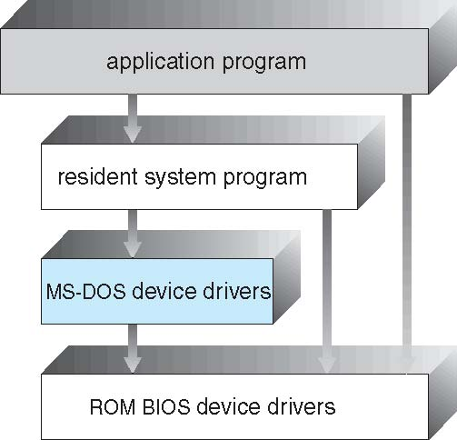
Simple Structure -- MS-DOS
MS-DOS – written to provide the most functionality in the least space
  Not divided into modules
  Although MS-DOS has some structure, its interfaces and levels of functionality are not well separated
Notes:
<number>

Slide 80
Non Simple Structure -- UNIX (Monolithic)
UNIX – limited by hardware functionality, the original UNIX operating system had limited structuring. The UNIX OS consists of two separable parts
  Systems programs
  The kernel
    Consists of everything below the system-call interface and above the physical hardware
    Provides the file system, CPU scheduling, memory management, and other operating-system functions; a large number of functions for one level
      Little overhead in the system call interface or in communications within the kernel
Notes:
<number>

Slide 81
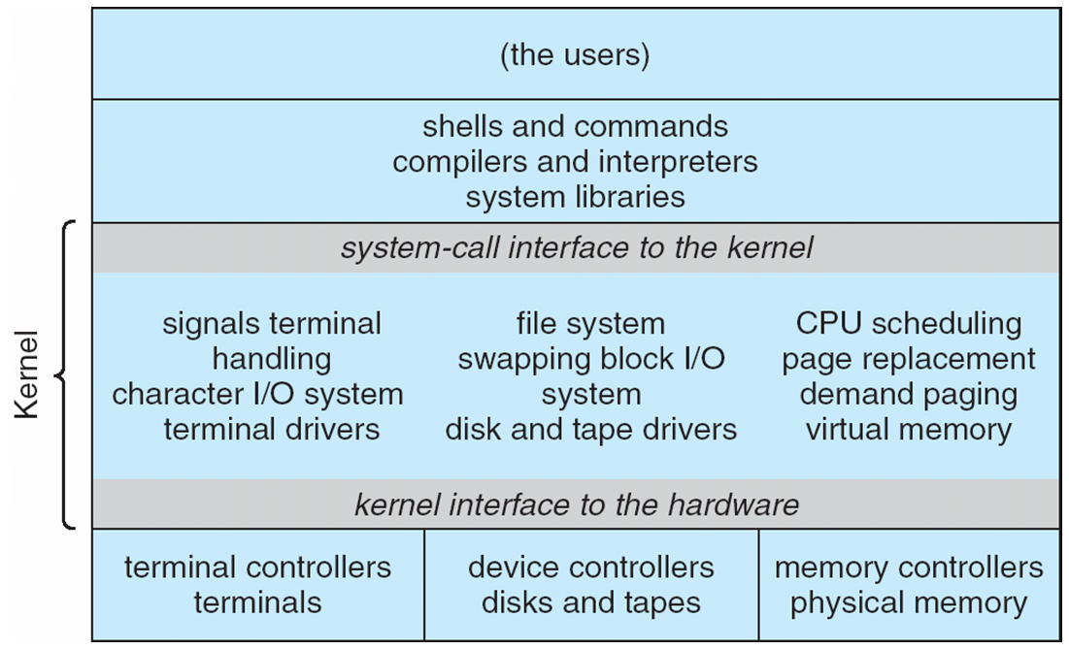
Traditional UNIX System Structure
Beyond simple but not fully layered
Notes:
<number>

Slide 82
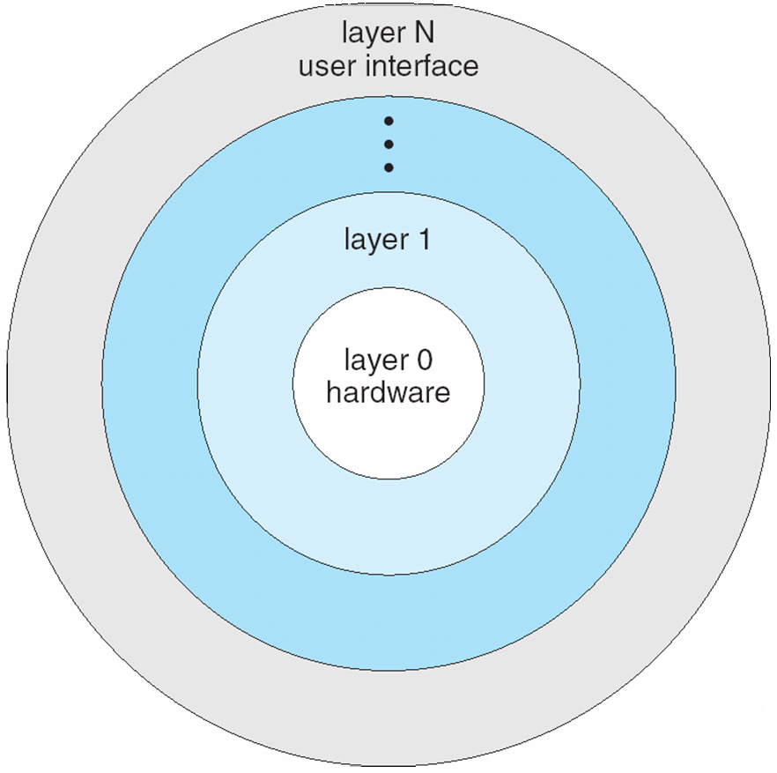
Layered Approach
The operating system is divided into a number of layers (levels), each built on top of lower layers. The bottom layer (layer 0), is the hardware; the highest (layer N) is the user interface.
With modularity, layers are selected such that each uses functions (operations) and services of only lower-level layers
Benefits:
  Simplicity of construction
  Simplicity of debugging
Problems:
  Defining various layers
  overhead
Notes:
<number>

Slide 83
Microkernel System Structure
Moves as much from the kernel into user space
Mach and QNx example of microkernel
  Mac OS X kernel (Darwin) partly based on Mach
  QNx: Real-time OS for embedded systems
Communication takes place between user modules using message passing
Benefits:
  Easier to extend a microkernel
  Easier to port the operating system to new architectures
  More reliable (less code is running in kernel mode)
  More secure
Detriments:
  Performance overhead of user space to kernel space communication
Notes:
<number>

Slide 84
Microkernel System Structure
Notes:
<number>

Slide 85
Modules
Many modern operating systems implement loadable kernel modules (Microkernel+layered)
  Core components in kernel + additional services via loadable modules
    Boot time modules
    During run time
  Each core component is separate
  Each talks to the others over known interfaces
  Each is loadable as needed within the kernel
Overall, similar to layers but with more flexible
  Linux, Solaris, etc
Notes:
<number>

Slide 86
Hybrid Systems
Most modern operating systems are actually not one pure model
  Hybrid combines multiple approaches to address performance, security, usability needs
  Linux and Solaris kernels in kernel address space, so monolithic, plus modular for dynamic loading of functionality
  Windows mostly monolithic, plus microkernel for different subsystem personalities
Apple Mac OS X hybrid, layered, Aqua UI plus Cocoa programming environment
  Below is kernel consisting of Mach microkernel and BSD Unix parts, plus I/O kit and dynamically loadable modules (called kernel extensions)
Notes:
<number>

Slide 87
Mac OS X Structure
Unix kernel
Microkernel
Loadable modules

Slide 88
iOS
Apple mobile OS for iPhone, iPad
  Structured on Mac OS X, added functionality
  Does not run OS X applications natively
    Also runs on different CPU architecture (ARM vs. Intel)
  Cocoa Touch Objective-C API for developing apps
  Media services layer for graphics, audio, video
  Core services provides cloud computing, databases
  Core operating system, based on Mac OS X kernel
Notes:
<number>

Slide 89
Android
Developed by Open Handset Alliance (mostly Google)
  Open Source
Similar stack to IOS
Based on Linux kernel but modified
  Provides process, memory, device-driver management
  Adds power management
Runtime environment includes core set of libraries and Dalvik virtual machine
  Apps developed in Java plus Android API
    Java class files compiled to Java bytecode then translated to executable than runs in Dalvik VM
Libraries include frameworks for web browser (webkit), database (SQLite), multimedia, smaller libc
Notes:
<number>

Slide 90
Android Architecture
Notes:
<number>

Slide 91
Operating-System Debugging
Debugging is finding and fixing errors, or bugs
OS generate log files containing error information
Failure of an application can generate core dump file capturing memory of the process
Operating system failure can generate crash dump file containing kernel memory
Beyond crashes, performance tuning can optimize system performance
  Sometimes using trace listings of activities, recorded for analysis
  Profiling is periodic sampling of instruction pointer to look for statistical trends
Kernighan’s Law: “Debugging is twice as hard as writing the code in the first place. Therefore, if you write the code as cleverly as possible, you are, by definition, not smart enough to debug it.”
Dump: The act of copying raw data from one place to another with little or no formatting for readability.
Usually dump refers to copying data from main memory to display screen or a printer

Slide 92
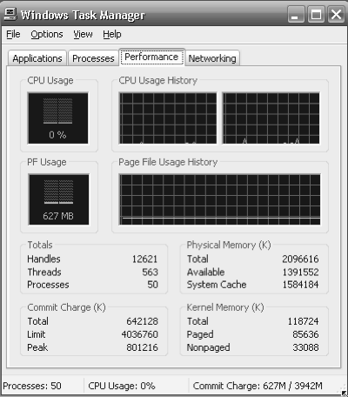
Performance Tuning
Improve performance by removing bottlenecks
OS must provide means of computing and displaying measures of system behavior
For example, “top” program or Windows Task Manager

Slide 93

DTrace
DTrace tool in Solaris, FreeBSD, Mac OS X allows live instrumentation on production systems
  Probes fire when code is executed within a provider, capturing state data and sending it to consumers of those probes
Example of following XEventsQueued system call move from libc library to kernel and back
Notes:
<number>

Slide 94


Dtrace (Cont.)
DTrace code to record amount of time each process with UserID 101 is in running mode (on CPU) in nanoseconds
Notes:
<number>

Slide 95
Operating System Generation
Operating systems are designed to run on any of a class of machines; the system must be configured for each specific computer site
SYSGEN program obtains information concerning the specific configuration of the hardware system
  Used to build system-specific compiled kernel or system-tuned
  CPU, disk format, memory, what devices, OS options
  Make menuconfig
OS Configuration
OS Generation
SYSGEN
Compile Time
Link Time
Execution Time
Notes:
<number>

Slide 96
Computer System Architecture
Single-processor
Multiprocessor
  Hyper-threading processors
Clustered Systems
Notes:
<number>
<number>
<number>

Slide 97

Symmetric Multiprocessing Architecture
Notes:
<number>

Slide 98

A Dual-Core Design
Multi-chip and multicore
Systems containing all chips
  Chassis containing multiple separate systems
Notes:
<number>

Slide 99
Clustered Systems
Notes:
<number>

Slide 100

Storage-Device Hierarchy
Hidden Magnetic disk + battery
Flash memory
Notes:
<number>
<number>
<number>

Slide 101

Performance of Various Levels of Storage
Caching – copying information into faster storage system; main memory can be viewed as a cache for secondary storage
Notes:
<number>
<number>
<number>

Slide 102
Computing Environments
Traditional computing
  Office: Main frames
  Home: Personal computers
    Network connection
Mobile computing : Apple iOS and Google Android
Distributed Systems (LAN, WAN)
Client-Server
Peer-to-peer
Virtualization (Emulation)
Cloud Computing
Embedded Systems: (Real-time embedded: hard and soft)
Notes:
<number>
<number>
<number>

Slide 103
Computing Environments – Distributed
Distributed computiing
  Collection of separate, possibly heterogeneous, systems networked together
    Network is a communications path, TCP/IP most common
      Local Area Network (LAN)
      Wide Area Network (WAN)
      Metropolitan Area Network (MAN)
      Personal Area Network (PAN)
  Network Operating System provides features between systems across network
    Communication scheme allows systems to exchange messages
    Illusion of a single system
Notes:
<number>

Slide 104

Computing Environments (Cont.)
Client-Server Computing
  Many systems now servers, responding to requests generated by clients
    Compute-server provides an interface to client to request services (i.e. database)
    File-server provides interface for clients to store and retrieve files
Notes:
<number>
<number>
<number>

Slide 105
Peer-to-Peer Computing
Another model of distributed system
P2P does not distinguish clients and servers
  Instead all nodes are considered peers
  May each act as client, server or both
  Node must join P2P network
    Registers its service with central lookup service on network, or
    Broadcast request for service and respond to requests for service via discovery protocol
  Examples include Napster and Gnutella, Voice over IP (VoIP) such as Skype
Notes:
<number>
<number>
<number>

Slide 106
Computing Environments - Virtualization
Allows operating systems to run applications within other OSes
  Vast and growing industry
Emulation used when source CPU type different from target type (i.e. PowerPC to Intel x86)
Virtualization – OS natively compiled for CPU, running guest OSes also natively compiled
  Consider VMware running WinXP guests, each running applications, all on native WinXP host OS
  VMM (virtual machine Manager) provides virtualization services
Notes:
<number>

Slide 107
Computing Environments - Virtualization
Notes:
<number>

Slide 108
Computing Environments – Cloud Computing
Delivers computing, storage, even apps as a service across a network
Logical extension of virtualization because it uses virtualization as the base for it functionality.
Many types
  Public cloud – available via Internet to anyone willing to pay
  Private cloud – run by a company for the company’s own use
  Hybrid cloud – includes both public and private cloud components
  Software as a Service (SaaS) – one or more applications available via the Internet (i.e., word processor)
  Platform as a Service (PaaS) – software stack ready for application use via the Internet (i.e., a database server)
  Infrastructure as a Service (IaaS) – servers or storage available over Internet (i.e., storage available for backup use)
Notes:
<number>

Slide 109

What do you think about future?
Like people 50 years before

Slide 110
Computing Environments – Cloud Computing
Cloud computing environments composed of traditional OSes, plus VMMs, plus cloud management tools
  Internet connectivity requires security like firewalls
  Load balancers spread traffic across multiple applications
Notes:
<number>

