Slide 1
Advanced Operating Systems
Zeinab Zali
Isfahan University of Technology

Slide 2
zali.iut.ac.ir
zali@cc.iut.ac.ir
A time for you in my office:
Sunday 11-12:30
Tuesday 11-12:30
RESEARCH INTERESTS
Future Internet and network architectures
Operating Systems, Distributed Systems
Cloud Computing Infrastructures and Big Data processing
Natural Language Processing, Machine Translation

Slide 3
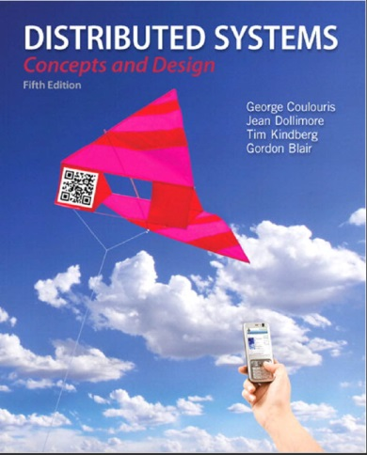
Course Resources
Distributed systems: concepts and design, George Coulouris, Jean Dollimore, Tim Kindberg and Gordon Blair, Fifth Edition, published by Addison Wesley, May 2011
Modern Operating Systems: Design and implementations, Andrew S. Tanenbaum (Author), Herbert Bos, 4th edition,2014
Distributed Systems, Maarten van Steen, Andrew S. Tanenbaum, 3th edition, 2017
papers
Notes:
Main book is old but it contains the main basic topics and algorithms in this area

Slide 4
Evaluation
Midterm 35%
Final 35%
Excercises, project and seminar 30%

Slide 5
Prerequisites
Network
Operating System
Programming

Slide 6
Topics
Introduction
System Model
Inter Process Communication
Remote Invocation
Group Communication
Clock
Distributed Mutual Exclusion
Transactions, Distributed Transactions
File Systems
Distributed File Systems

Slide 7
Why Take this course?

Slide 12
Why take this course?
Huge amounts of computing are now distributed ...
A few years ago, Intel threw its hands up in the air: couldn’t increase GHz much more without CPU temperatures reaching solar levels
But we can still stuff more transistors (Moore’s Law)
Result: Multi-core and GPUs.
Result 2: Your computer has become a parallel/distributed system. In a decade, it may have 128 cores.

Slide 13
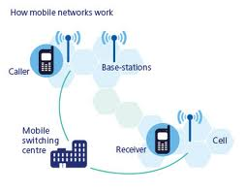
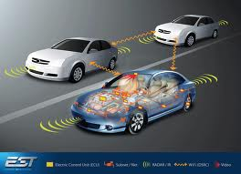
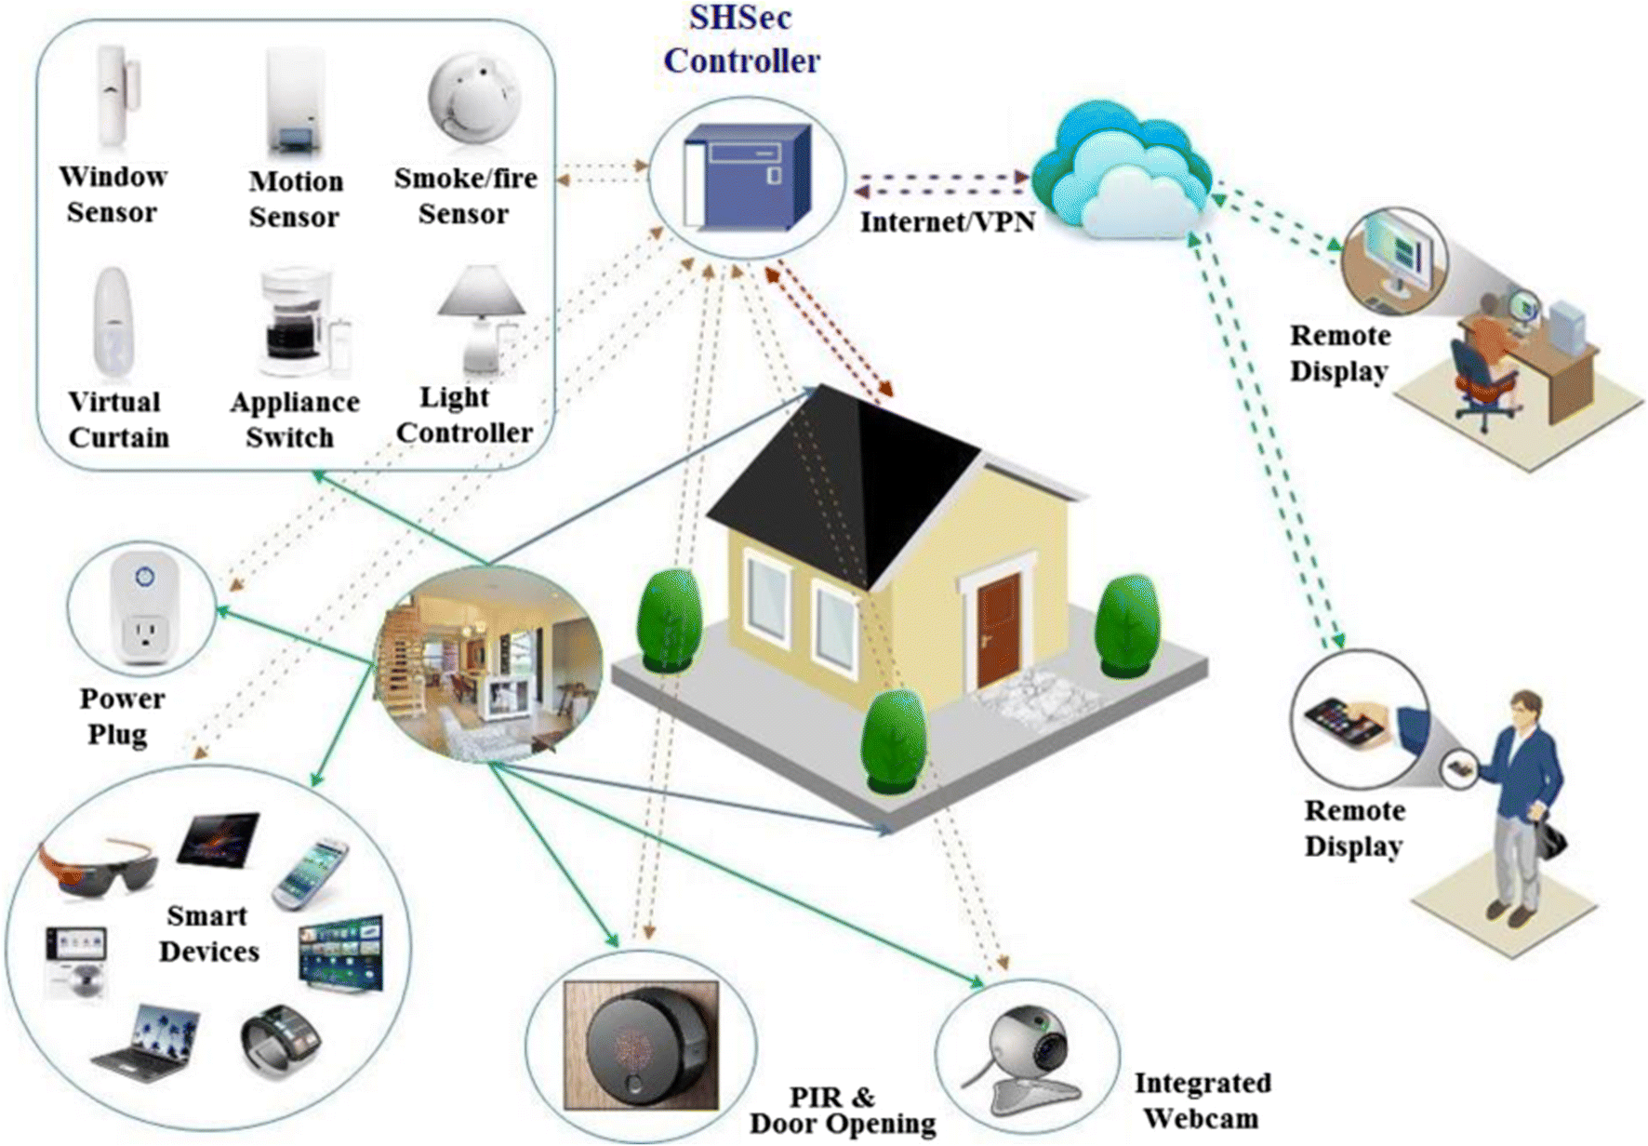
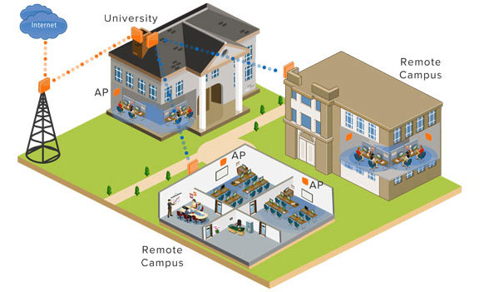
Today distributed systems are everywhere
Networks of computers are everywhere!
Mobile phone networks
Corporate networks
Factory networks
Campus networks
Home networks
In-car networks
On board networks in planes and trains

Slide 14
Our goals in this course
To address the issues to be resolved in the design of distributed systems and describing successful approaches in the form of abstract models, algorithms and detailed case studies of widely used systems.

Slide 15
Definition
A system in which hardware or software components located at networked computers communicate and coordinate their actions only by passing messages. [Coulouris]
“A distributed system is a collection of independent computers that appear to the users of the system as a single computer.” [Tanenbaum]
The prime motivation for constructing and using distributed systems stems from a desire to share resources:
Hardware or software

Slide 16
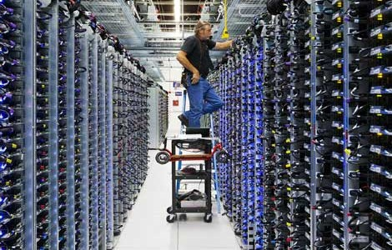
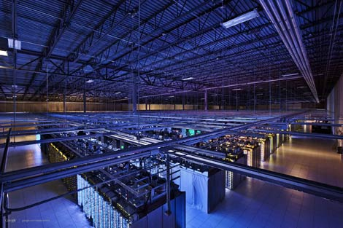
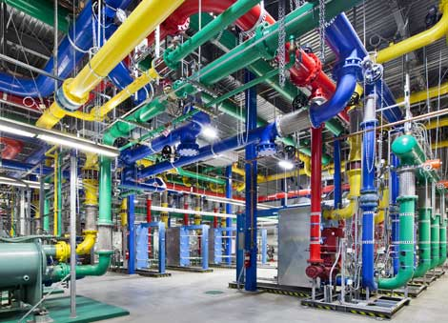
Lets look at a famous example

Slide 17
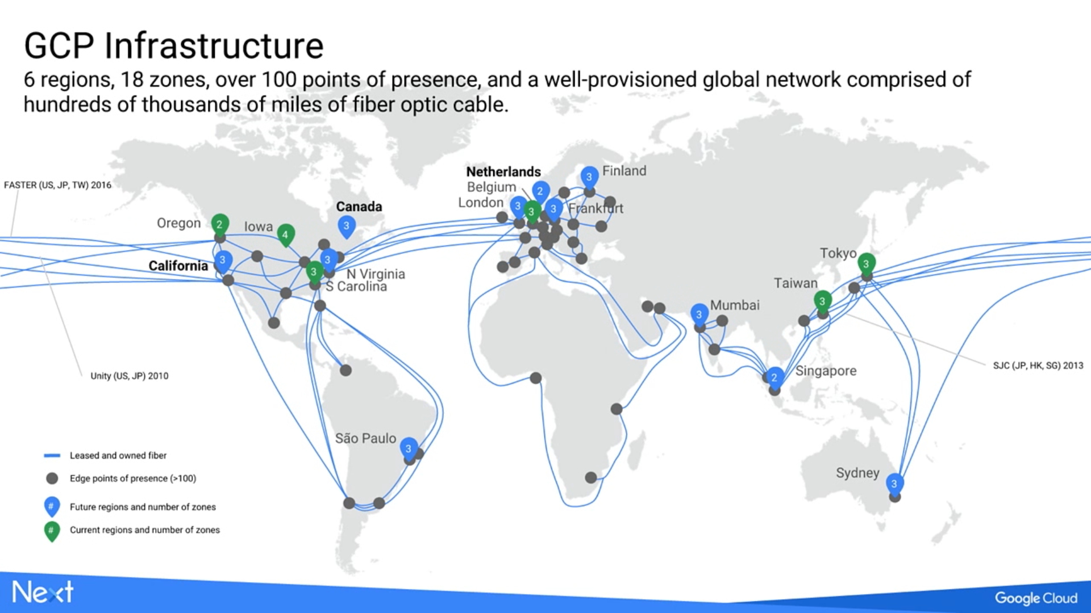
Google Cloud platform, 2017

Slide 18
Google Cloud platform, 2019
As of 2019, Google Cloud Platform is available in 20 regions and 61 zones
Each region is an independent geographic area that consists of zones.
A zone is a deployment area for Google Cloud Platform resources within a region.

Slide 19
Google Distributed System(DS) Services?
Web Search
High performance computation (Hadoop)
Google Docs
Storage (Google Drive)
Streaming and Video (Youtube)
Maps

Slide 20
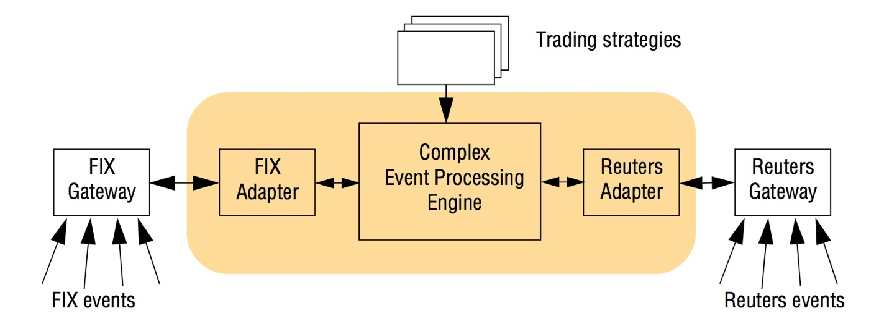
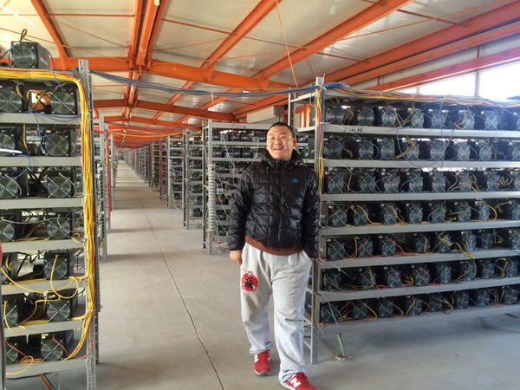
Some other DS Examples
Massively Multiplayer online Game
Financial trading
Bitcoin

Slide 21
DS Characteristics (I)
Concurrency: concurrent program execution on different nodes is the norm in DS
Accessing and modifying the shared resources are problematic
No global clock
Some algorithms are based on clock synchronization
To know the global time (not local time) of an event in a computer

Slide 22
DS Characteristics (II)
Independent failures: Each component of the system can fail independently, leaving the others still running. it is the responsibility of system designers to plan for the consequences of possible failures (Byzantine story)

Slide 23
DS vs Networks
A computer network is an interconnected collection of autonomous computers able to exchange information
Network entities are visible and they are explicitly addressed (IP address).
A distributed system consists of multiple autonomous computers in a computer network which is appeared to the user transparently
The operating system automatically allocates jobs to processors, moves files among various computers without explicit user intervention.

Slide 24
Today trends related to DSs
Pervasive networking
Internal networks and Internet
IoT, Smart homes, Smart Cities
Mobile and ubiquitous computing
the performance of computing tasks while the user is on the move
utilize resources that are conveniently nearby as they move around(location-aware or context-aware computing)
Distributed multimedia systems
Required: Suitable throughput or realtime streaming (Ex: Video conferencing)
Distributed computing as a utility
Storage and processing units outsides of our PCs
Software services

Slide 25
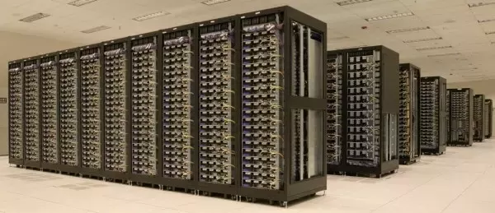
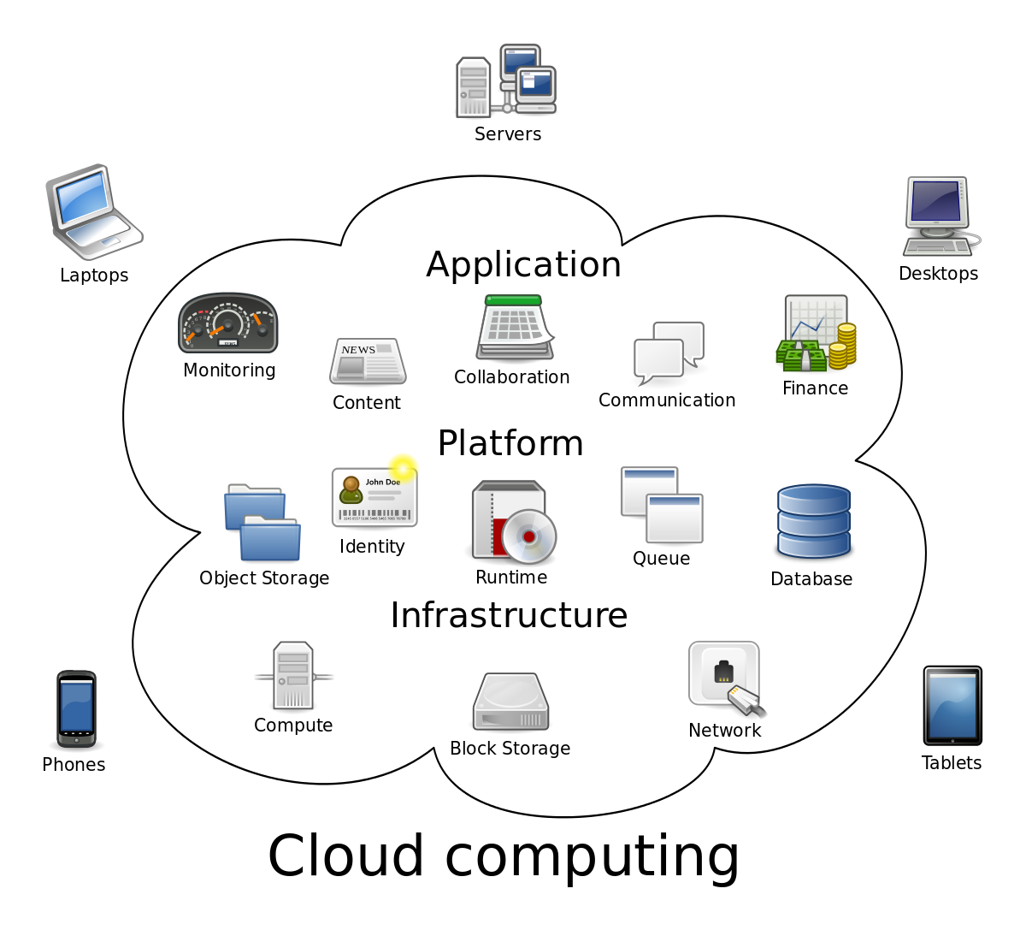
Two typical classes of DS
Cluster:
“A type of parallel or distributed processing system, which consists of a collection of interconnected stand-alone computers cooperatively working together as a single, integrated computing resource” [Dr. Rajkumar Buyya ].
Cloud:
“a type of parallel and distributed system consisting of a collection of interconnected and virtualized computers that are dynamically provisioned and presented as one or more unified computing resources based on service-level agreements established through negotiation between the service provider and consumers” [Dr. Rajkumar Buyya ].

Slide 26
Challenge (I): Heterogeneity
Differences in:
Networks (protocols)
computer hardware (byte ordering of integer)
operating systems (different APIs)
programming languages
implementations by different developers
Solutions:
Middlewares: a software layer that provides a programming abstraction as well as masking the heterogeneity of the underlying networks, hardware, operating systems and programming language (Ex. CORBA)
mobile codes (java applet, virtual machine approach, javascript)

Slide 27
Challeng (II): openness
The degree to which new resource-sharing services can be added and be made available for use by a variety of client programs.
To publish their key interfaces
To publish their documents trough RFC

Slide 28
Challeng (III): security
Confidentiality: protection against disclosure to unauthorized individuals
Integrity: protection against alteration or corruption
Availability: protection against interference with the means to access the resources
Two typical security challenge:
Denial of service attacks
Security of mobile code

Slide 29
Challeng (IV): scalability
A system is described as scalable if it will remain effective when there is a significant increase in the number of resources and the number of users.
Controlling the cost of physical resources
Controlling the performance loss
Preventing software resources running out(lack of IPv4 addresses)
Avoiding performance bottlenecks

Slide 30
Challeng (V): Failure handling
Detecting failures: calculating Checksum
Masking failures: retransmiting the undelivered message
Tolerating failures: using redundancy
Recovery from failure: rolbacking to a safe state
Redundancy: different routes between any two routers, replicating a content in two servers or each domain name is repeated twice in DNS servers

Slide 31
Challeng (VI): concurrency
Concurrent resource accessing through many users
Solution: synchronization
Fair scheduling
Preserve dependencies (e.g. distributed transactions)
Avoid deadlocks

Slide 32
Challeng (VII): Transparency
Access transparency: enables local and remote resources to be accessed using identical operations.
Location transparency: enables resources to be accessed without knowledge of their physical or network location (for example, which building or IP address).
Concurrency transparency: enables several processes to operate concurrently using shared resources without interference between them.
Replication transparency: enables multiple instances of resources to be used to increase reliability and performance without knowledge of the replicas by users or application programmers.
Failure transparency: enables the concealment of faults, allowing users and application programs to complete their tasks despite the failure of hardware or software components.
Mobility transparency: allows the movement of resources and clients within a system without affecting the operation of users or programs.
Performance transparency: allows the system to be reconfigured to improve performance as loads vary.
Scaling transparency: allows the system and applications to expand in scale without change to the system structure or the application algorithms.

Slide 33
Case study:web
HTML, URLs, Http
Codes to run on clients: javascript, AJAX
Codes to run on server: CGI(dead)
Web services : json, restful

