Slide 1
By: Morteza Karimzadeh

Slide 2
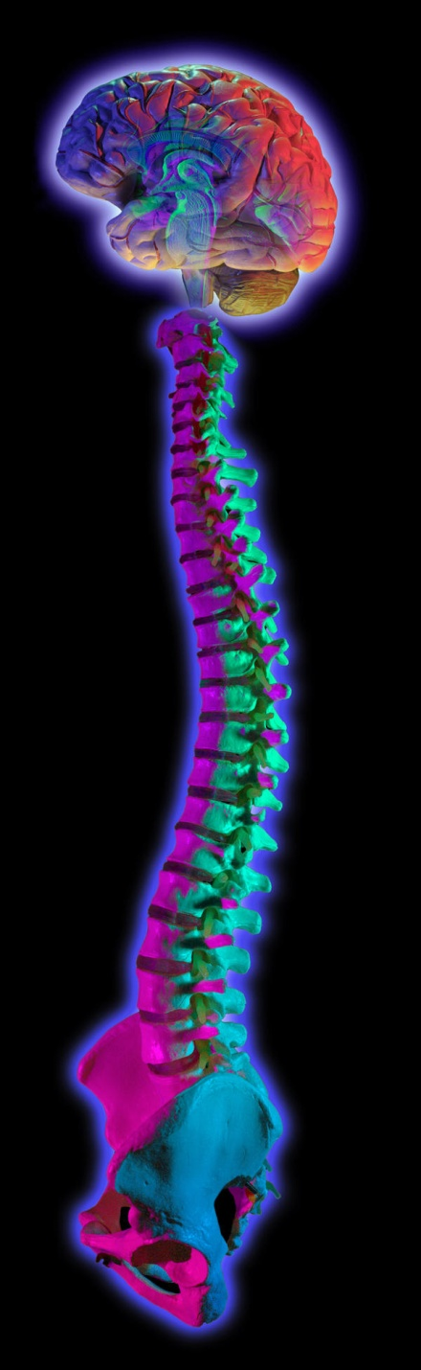
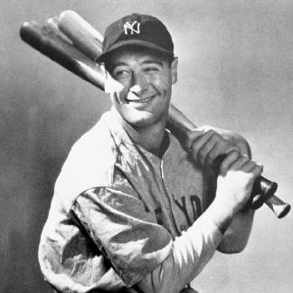
Definition of ALS
  It is a progressive neurodegenerative disease that affects nerve cells in the brain and spinal cord
  Is often referred to as “Lou Gehrig’s Disease”
A = absence of
Amyotrophic
myo = muscle
trophic = nourishment
ALS
lateral = side (of spine)
sclerosis = hardening or scarring
Lou Gehrig
Mulder, D. W. Adv. Neurol. 36, 15–22 (1982).

Slide 3
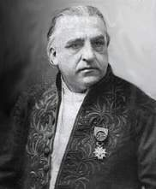
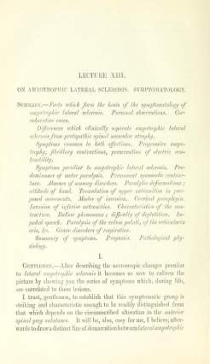
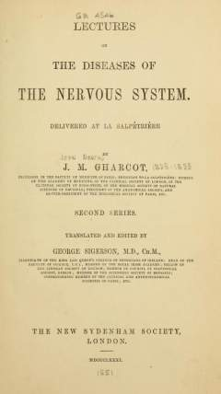
History of ALS
He was a noted French neurologist who has jcbeen called “the Father of Neurology”
first reports of the characteristics of ALS were jgin 1874
Fatal syndrome
First described in publication by Dr. Jean- jhMartin Charcot in 1869 in Paris
Lectures translated into English in 1881
Jean- Marie Charcot (1825-1893)
dev.nsta.org/evwebs/2150/history.htm

Slide 4
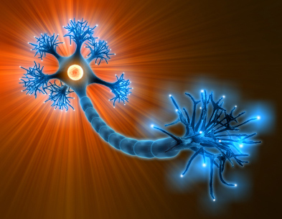
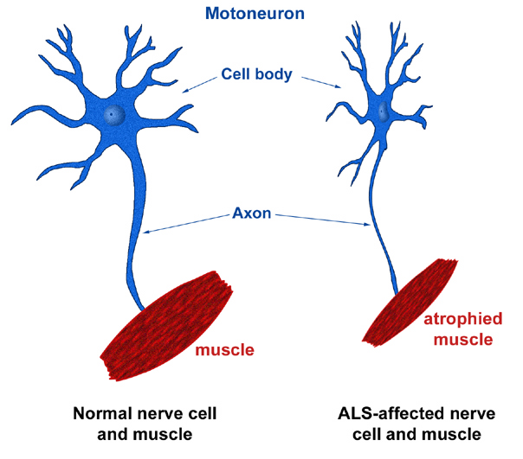
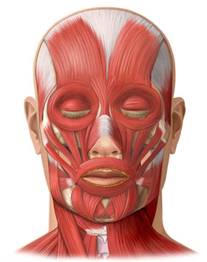
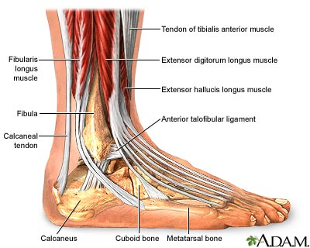
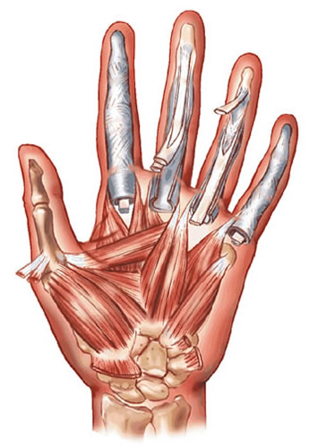
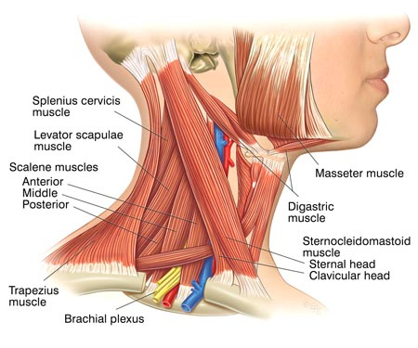
ALS description
ALS is a progressive fatal type of motor
neuron disease resulting in spasticity, diffuse ncmuscular atrophy and weakness
Normal nerve cell and ALS-affected nerve cell
Steele, A. J. et al. Neurology 64, 454–458 (2005).

Slide 5
Facts to Know about ALS
ALS can strike anyone with different rates
Average life expectancy of patients is between 3 to 5 years
6-8 cases pre 100,000 people
In 10% of cases, disease is inherited
Men are affected more often than women
Most commonly strikes people between 40 and 60 years of age
McGuire, V. Neurology 47, 571–573 (1996).

Slide 6
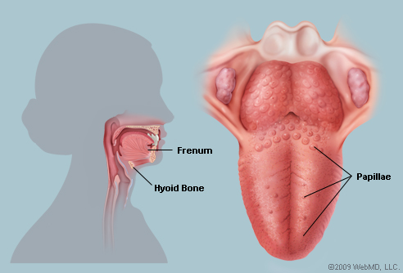
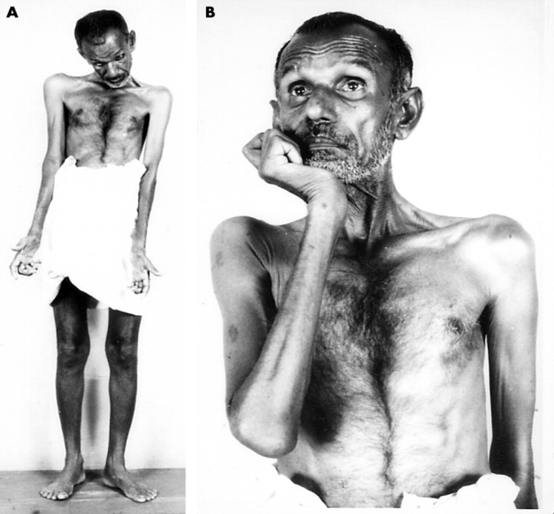
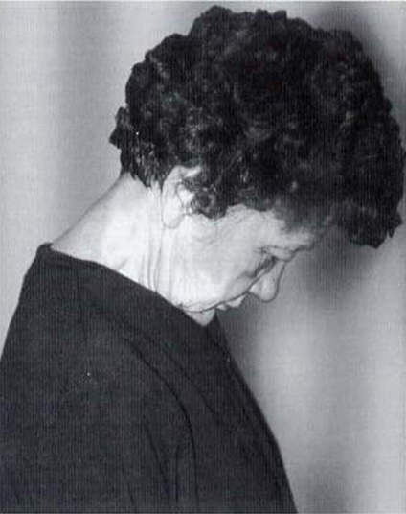
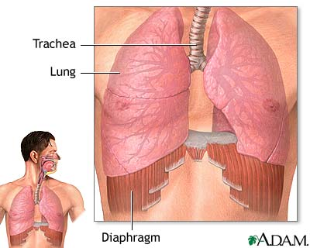
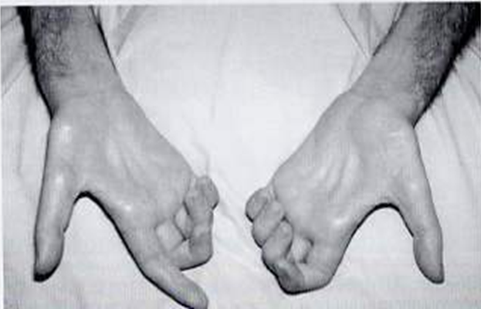
Clinical Manifestations
Typical initial symptoms
  Upper extremity weakness
  Dysarthria: difficulty is speech
  Dysphagia
Death is usually the result of respiratory infection secondary to compromised respiratory status
Phukan J, Pender NP, Hardiman O. Lancet Neuro 6, 994–1003 (2007)

Slide 7
Etiology of ALS
The exact cause of motor neuron degeneration has not be proven
Approximately 10% of people with ALS have an inherited form of the disease called (FALS)
Remaining 90% of people with ALS have no family history of ALS, this is called (SALS)
Familial ALS
Sporadic ALS
ALS CASES
100%
90%
“sporadic”
?
10%
inherited
Rowland, L. P. in Amyotrophic Lateral Sclerosis and Other Motor Neuron Diseases (ed. Rowland, L. P.) 3–23 (Raven, 1992).

Slide 8
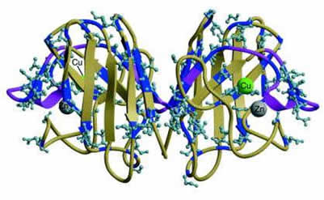
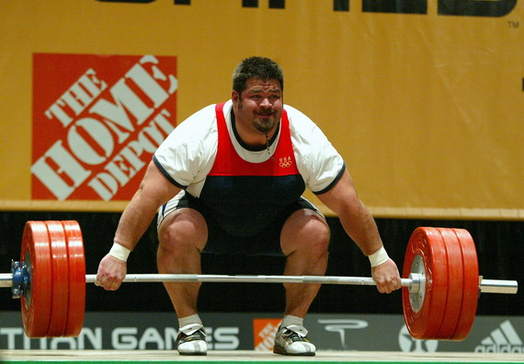
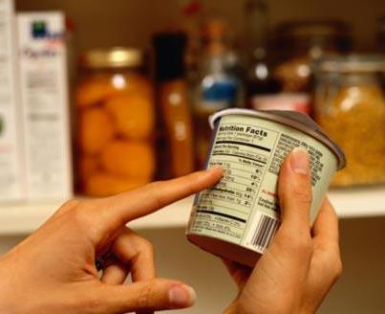
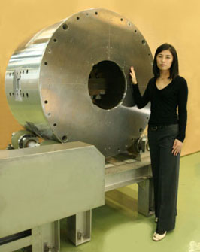
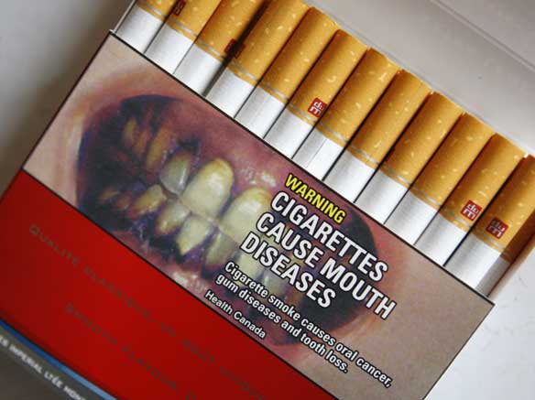
Etiology of ALS
Agents have been reported to cause ALS:
SOD1 gene defects
Strong magnetic field
Heavy exercises
Glutumate foods
Toxins
Smoking
Excess of Mn, Pb, Al and Se in food
Cleveland, D. W. Nature Rev. Neurosci. 2, 806–819 (2001)

Slide 9
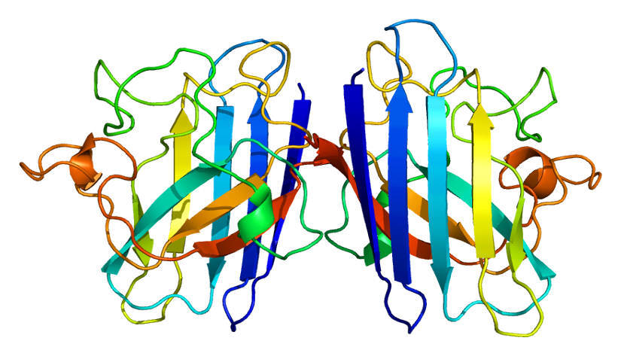
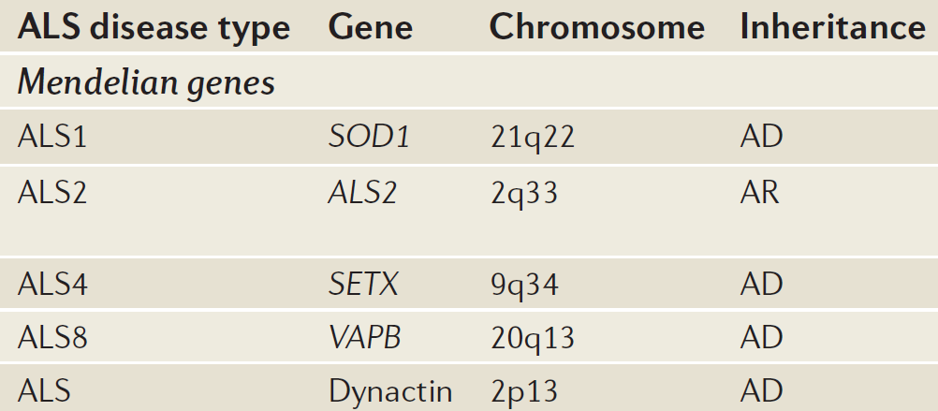
SOD1
Mendelian genetics of ALS
Superoxide dismutase is metalloenzyme which appear to be ubiquitous among all oxygen consuming species
This gene provides protection against superoxide radical which can cause severe oxidative damage
Genes that predispose to ALS
Rosen, D. R. et al. Mutations in Cu/Zn superoxide dismutase gene are associated with familial amyotrophic lateral sclerosis. Nature 362, 59–62 (1993)

Slide 10
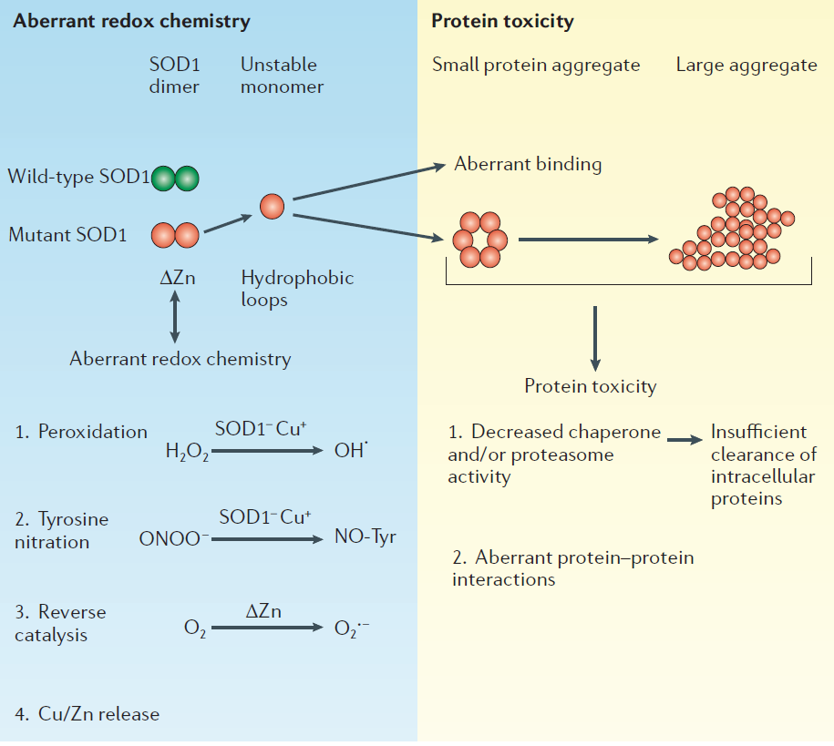
Models of mutant SOD1-mediated toxicity
Jaarsma, D. et al. Neurobiol. Dis. 7, 623–643 (2000)

Slide 11
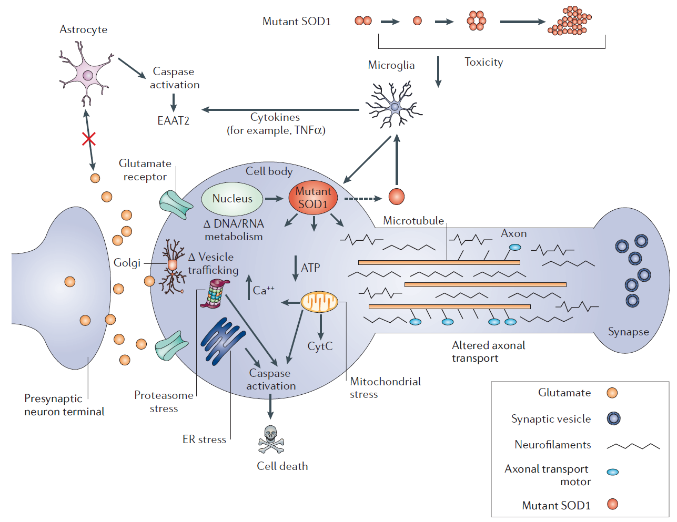
Mutant SOD1 impairs multiple cellular functions

Slide 12
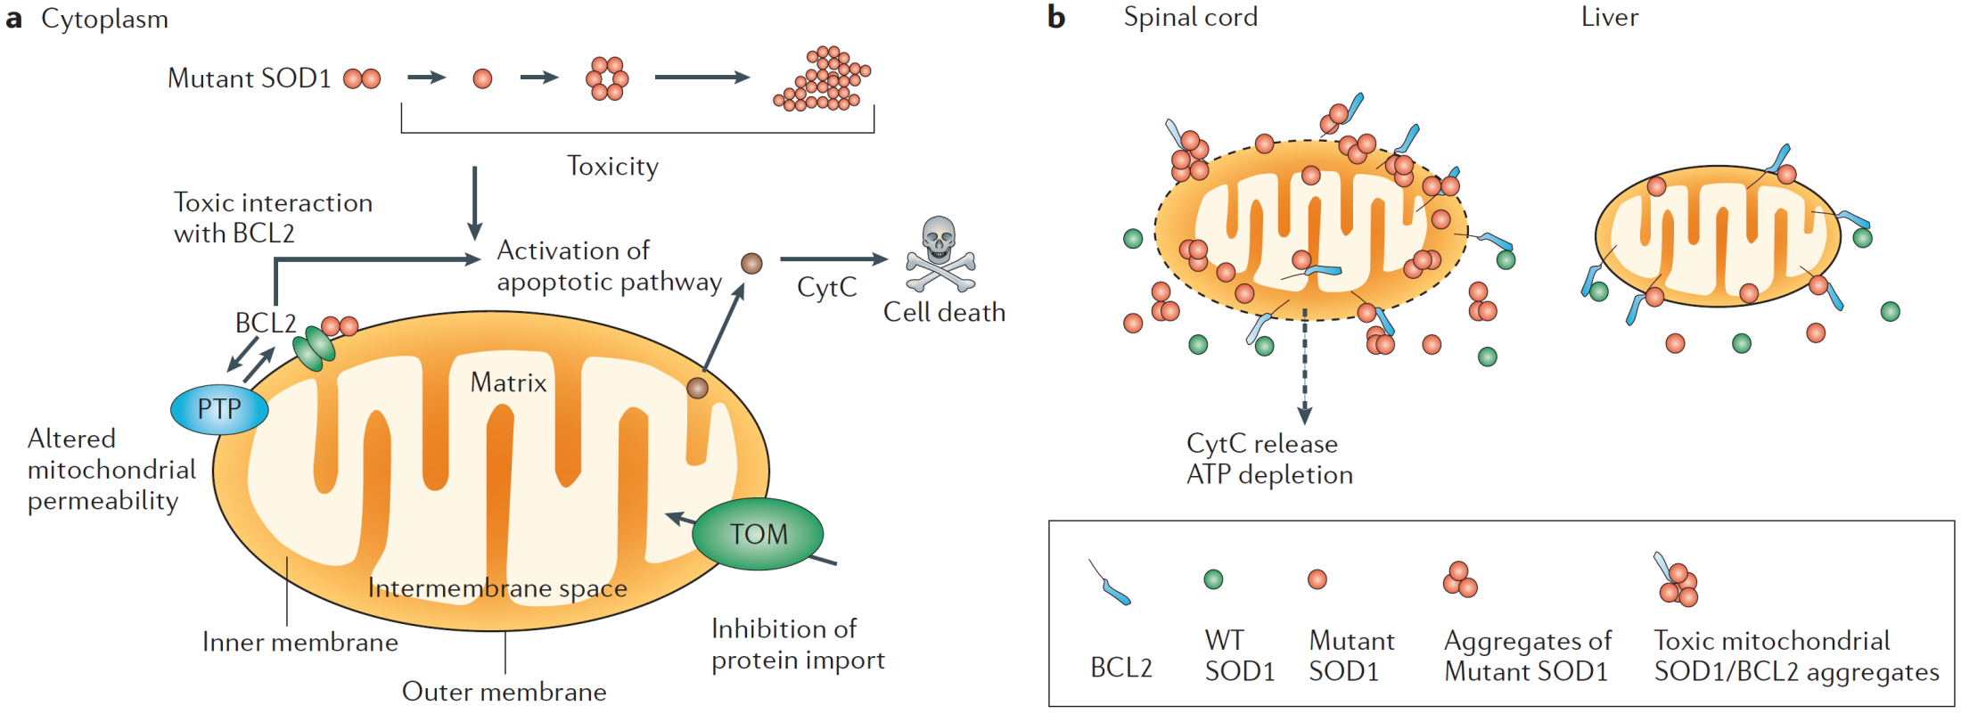
Mitochondrion as a target of mutant SOD1
Wiedemann, F. R. et al. J. Neurol. Sci. 156, 65–72 (1998)

Slide 13
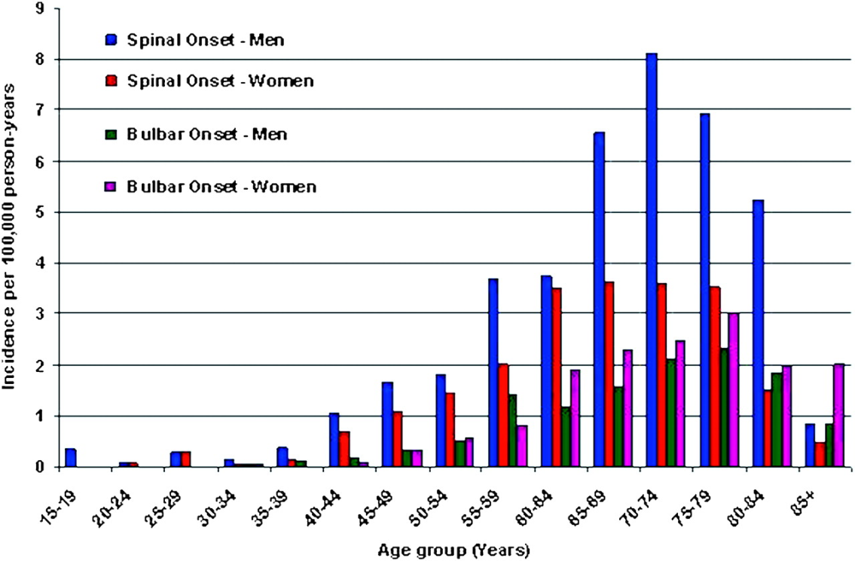
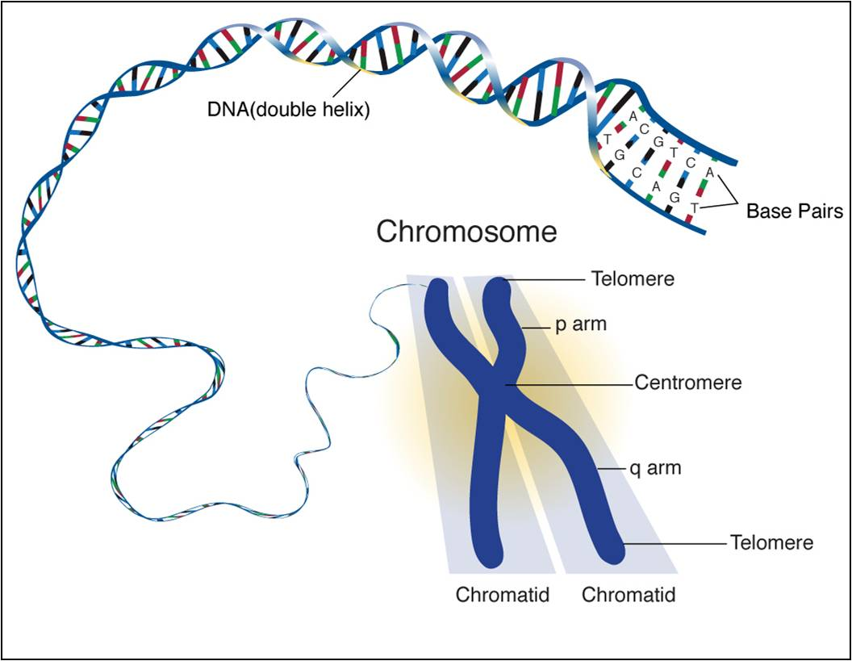
Risk Factors
Heredity. Up to 10 percent of the people who have ALS inherited it from their parents. If you have this type of ALS, your children have a 50-50 chance of developing the disease.
Age. ALS most commonly occurs in people between the ages of 40 and 60.
Sex. Before the age of 65, slightly more men than women develop ALS. This sex difference disappears after age 70.
http://www.alsinfo.com/What-Is-ALS/Risk-Factors.aspx

Slide 14

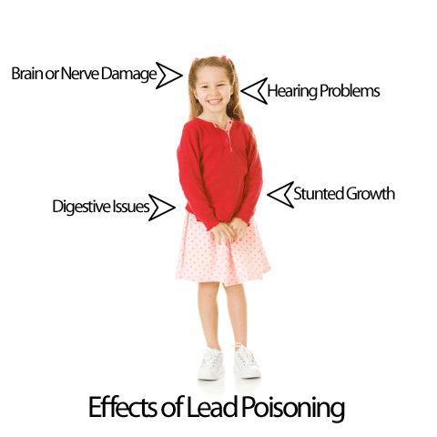

Environmental Factors
Smoking. Smoking cigarettes appears to increase a person's risk of ALS to almost twice the risk of nonsmokers.
Lead exposure. exposure to lead in the workplace may be associated with the development of ALS.
Military service. may trigger the development of ALS.
http://www.alsa.org/research/about-als-research/environmental-factors.html

Slide 15
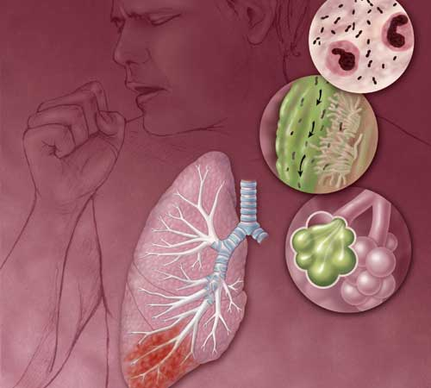

Expected outcomes and Possible complication
Expected outcomes :
Death usually occurs within two to seven years from the onset of symptoms.
Possiblecomplications:
Inability to move
Difficulty in swallowing
Paralysis of respiratory muscles.
Negative effects on relationships
http://www.mayoclinic.com/health/amyotrophic-lateral-sclerosis/DS00359/DSECTION=complications

Slide 16
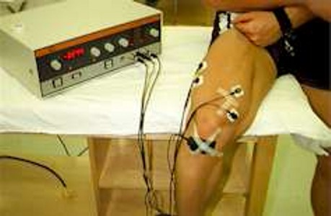
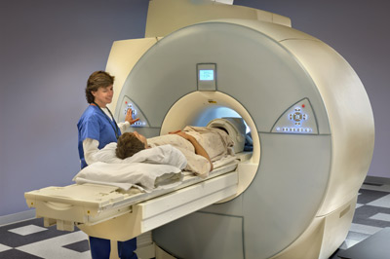
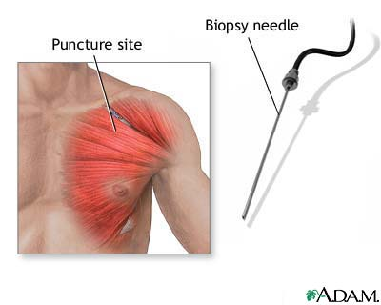
Diagnostic Studies for ALS
Investigations to exclude other causes
EMG
Muscle Biopsy
X-Rays, including MRI
UMN & LMN signs in three regions
ALS prediction software
De Carvalho MD, Swash M – Awaji diagnostic algorithm increases sensitivity of El Escorial criteria for ALS diagnosis Amyotroph Lateral Scler.10, 53-57, (2009).

Slide 17
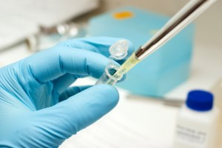
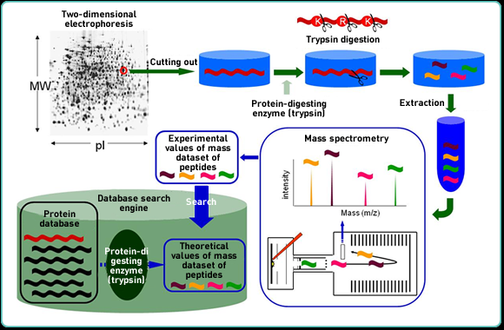
Nanotechnology Identifies Peptide "Fingerprint“ In ALS
Only nanotechnology is capable of identifying a species in billionth of a gram amounts.
In the ALS research, the UB researchers used trypsin, an enzyme, to digest or break down the unknown analyte into small peptide pieces that constitute the "fingerprint," which, in turn, allows researchers to identify the species through mass spectrometry.
http://www.sciencedaily.com/releases/2007/09/070908000105.htm

Slide 18
General principles for Treatment
Anti depression drugs
Rehabilitation medicine
Antibiotic
Nutritional support
Person with ALS
Respiratory care
District nursing
Speech therapy
physiotherapy
http://www.english.als-charite.de/VM/ALS/Therapy/Generalprinciplesoftreatment/tabid/1243/Default.aspx

Slide 19
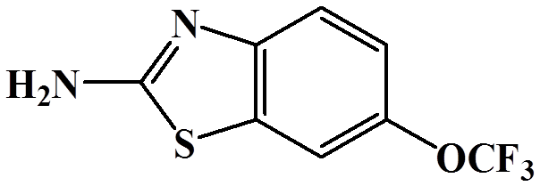
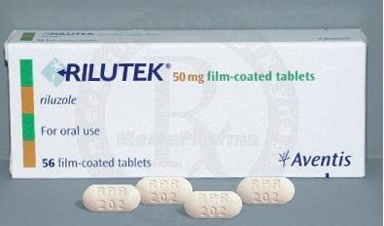
Drug Therapy for ALS
Riluzole (Rilutek)
Dose 50 mg po q 12 hrs
Prevents neural degeneration from over excitation
Side Effects
Slows progression by a few months
Glutamate inhibitor
Carlesi, C; Pasquali, L, Piazza, S, Lo Gerfo, A, Caldarazzo Ienco, E, Alessi, R, Fornai, F, Siciliano, G. 149, 151–67 (2011)

Slide 20
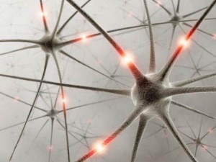
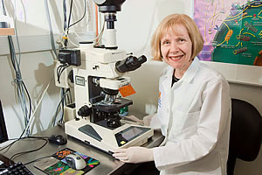
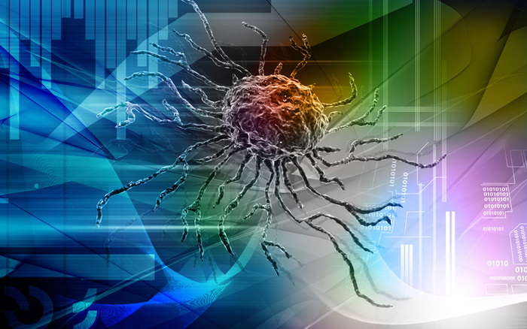
Treatment of ALS with stem cells
Prevent disease progression
Transfer of critical factors to damaged cells
Creation of synthetic RNA
Kim H, et al. Dose-dependent efficacy of ALS-human mesenchymal stem cells transplantation into cisterna magna in SOD1-G93A ALS mice. Neurosci. Lett. 46,190–194 (2010) .

Slide 21
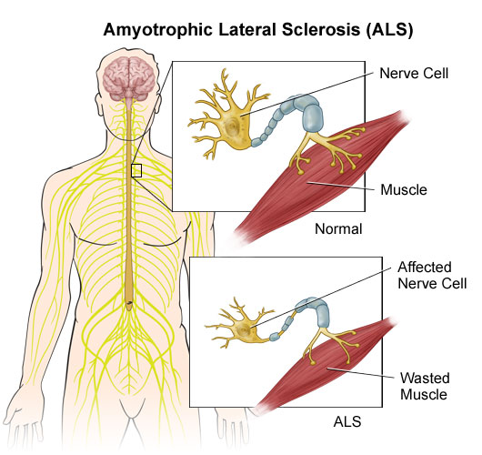
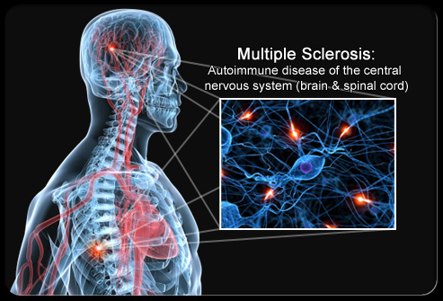
MS and ALS
ALS
Spinal involvement, specially cervical spinal
Medulla oblongata and respiratory center involvement
MS
Optic nerve
Different parts of brain
http://www.nursingcenter.com/prodev/ce_article.asp?tid=1003522

Slide 22
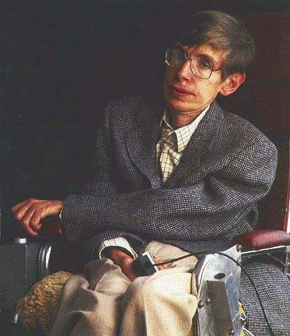
Famous people with ALS
Smartest man alive
Proved Einstein's Theory of Relativity
He currently uses an electric wheelchair to get around
A computerized voice synthesizer operated by facial muscles in order to speak
Steven Hawking
http://en.wikipedia.org/wiki/Stephen_Hawking

Slide 23

Global Day For ALS
Every year since 1997, the International Alliance has celebrated 21 June as the global day of recognition of ALS/MND – a disease that affects people in every country of the globe.
http://www.mndaust.asn.au/global-day/

