Slide 1
Physiology of Flowering

Slide 2
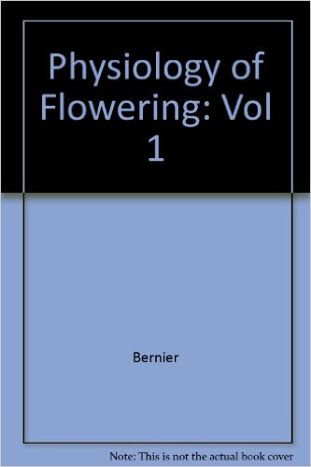
References

Slide 3
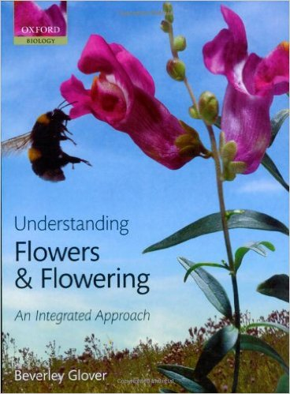
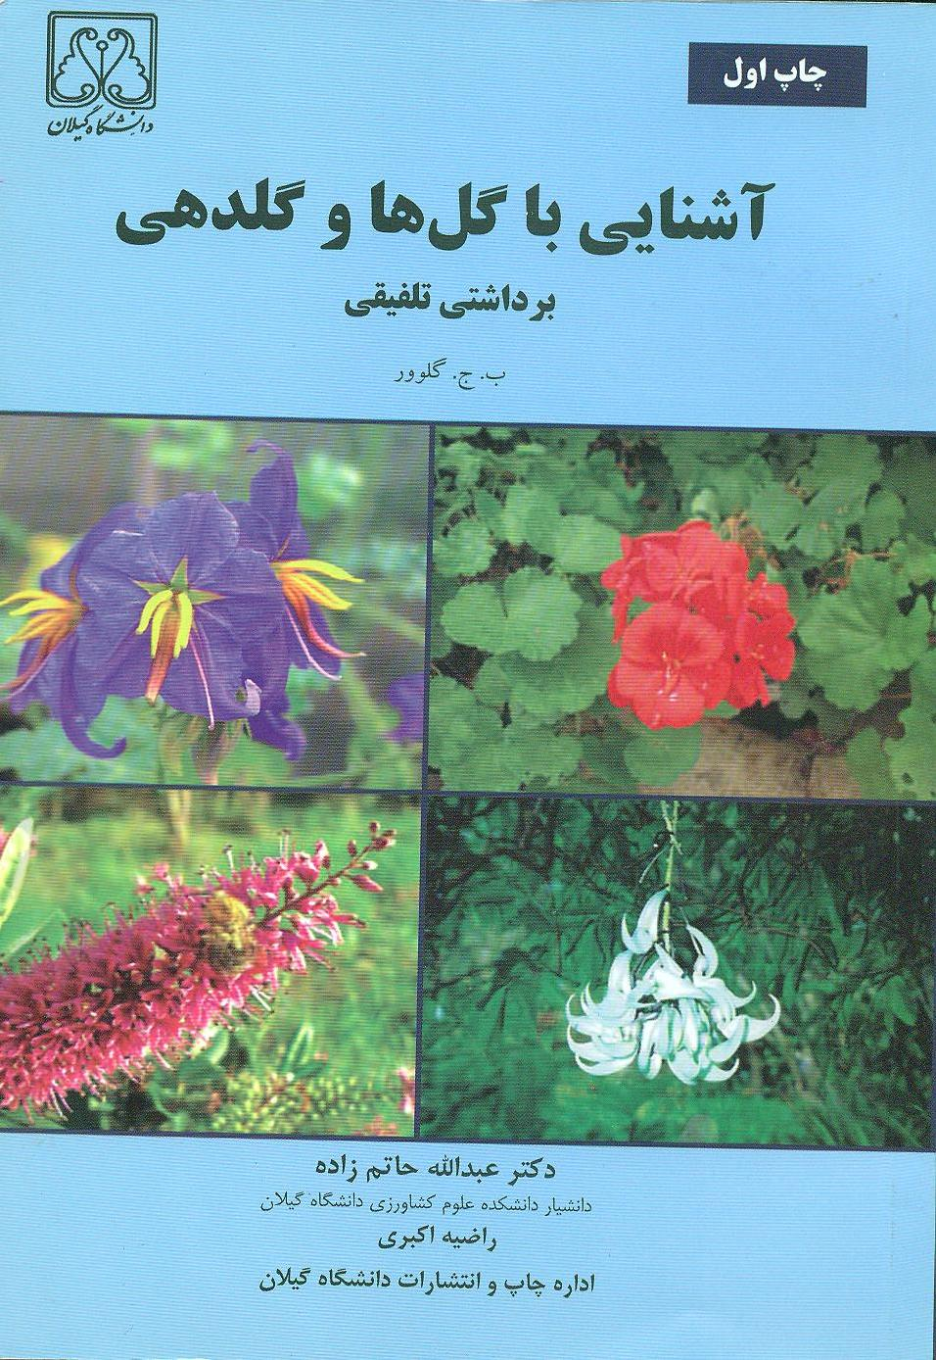
References

Slide 4
Contents
1- INTRODUCTION
The Evolution of Flowers
The origin of flowering plants
Early reproductive structures
The first flowers
Floral diversification

Slide 5
Contents
2- Historical Interpretations of Flower Induction and Flower Development
The foliar theory of the flower
The foliar theory in an evolutionary context
The transition to flowering
Developmental explanations of floral induction
Environmental explanations of floral induction
The florigen problem

Slide 6
Contents
3- Control by Nutriton and Water stress
The carbohydrate/Nitrogen relationship theory
Mineral Nutrition: Nitrogen
Mineral Nutrition: Trace Elements
Water Stress

Slide 7
Contents
4- Classical Theories of Induction
The Florigen Theory
Eperimental Evidence Concerning Florigen
Identity of Florigen
Modified Florigen Theories
The Theory of Floral Inhibitors
Eperimental Evidence Concerning Floral Inhibitors
Identity of Floral Inhibitors
Balance between inhibitors and promoters of Flower Initiation

Slide 8
Contents
5- Age and flower Initiation
The Juvenile Phase
Minimal Leaf Number
Genetical basis For Juvenility
Accounting for the juvenile Phase
Insufficient Leaf Area
Unfavorable ratio of immature to mature leaves
Leaf insensitivity to daylength
Influence of the Root System
Meristem insensitivity of floral Promoters

Slide 9
Contents
6- The Photoperiodic Pathway of Floral Induction
Sensing daylight
Measuring time
Integrating light and clock signals

Slide 10
Contents
7- The Vernalization Pathway of Floral Induction and the Role of Gibberellin
The vernalization promotion pathway
The gibberellin promotion pathway
Does gibberellin act in the vernalization promotion pathway as well as independently?

