Slide 1
Introduction to GAMS part II
vikasargod@psu.edu
Research Computing and Cyberinfrastructure

Slide 2
Sets
Simple sets: S = {l,k,w} → Set S /l,k,w/
It can also be written as:
.
Set S “first three factors”
/l “Labour index”
k “Production index”
w “welfare index”/;
Catch the error!
set prices prices of fingerling fish/pound in 10 scenarios /P1*P10/

Slide 3
Multiple names for a set
Let us consider the following example:
Set c /c1,c2/
Parameter FoodPrices(c,c)
c1 c2
c1 1 5
c2 5 1;
Parameter cost(c,c);
cost(c,c) = 2.5+10*FoodPrices(c,c);
Display cost;
What do you expect? Cost = 12.5 52.5
52.5 12.5
But answer will be Cost = 12.5 .
. 12.5

Slide 4
Alias – multiple names of a set
Set c /c1,c2/
alias(c,cp);
Parameter FoodPrices(c,c)
c1 c2
c1 1 5
c2 5 1;
Parameter cost(c,c);
cost(c,cp) = 2.5+10*FoodPrices(c,cp);
Display cost;

Slide 5
Multi-dimensional sets
GAMS allows up to 10 dimensions
set multidimset(set1name,set2name) /set1elementname.set2elementname /;
e.g
Sets
Origins Originating Places /"New York", Boston/
Destinations Demand points/Portland,London,Houston/
Linkedbyroad(origins,destinations)
/ "NEW York" .Portland,
"New York" .Houston,
boston.Portland,
boston.Houston/;

Slide 6
Assigning data for higher dimensions
The elements in the n-tuple are separated by dots(.)
Parameter
Salaries(employee.manager.department)
/anderson.murphy.toy 6000
hendry .smith .toy 9000
hoffman.morgan.cosmetics 8000/;

Slide 7
Tables with more dimensions
Sets
i /land,labor/
j /corn,wheat,cotton/
state /al,in/;
Table avariant2(i,j,state) crop data
al in
land.corn 1 1
labor.corn 6 5
land.wheat 1 1
labor.wheat 4 7
land.cotton 1 1
labor.cotton 8 2;

Slide 8
Logical and numerical relationship operators
lt, < | Strictly less than
le, <= | Less than-or-equal to
eq, = | Equal to
ne, <> | Not equal to
ge, >= | Greater than or equal to
not | not
and | and
or | inclusive or
xor | exclusive or
x = (1<2) + (2<3) → x = 2
x = (1<2) or (2 <3) → x = 1
x = (4 and 5) + (2*3 <=6) → x = 2
x = (4 and 0) +)2*3 < 6) → x = 0

Slide 9
The Dollar Condition
$(condition) means ‘such that condition is valid’
if ( cost > 100), then discount = 0.35 can be written as
discount$(cost>100) = 0.35
Dollar logical conditions cannot contain variables
Dollar condition can also be nested
$(condition1$(condition2)) means $(condition1 and condition2)

Slide 10
Dollar on the left
Consider rho(i)$(sig(i) ne 0) = (1./sig(i)) – 1.;
No assignment is made unless the logical condition is satisfied
If the parameter on left hand side has not been initialized, then zero will be assigned
The equation above can also be written as
rho(i)$sig(i) = (1./sig(i)) – 1.;

Slide 11
Dollar on the Right
Consider labor = 2$(market > 1.5)
An assignment is always made in this case
If the logical condition is not satisfied, then the corresponding term will evaluates to 0
The expression above is equivalent to
  if(market > 1.5) then (labor = 2),
else (labor = 0)

Slide 12
Dollar to filter assignments in a set
Consider
Variable shipped(i,j), total_cost;
Equation costcalc;
costcalc ..
total_cost =e= sum((i,j)$newset(i,j), shipcost(i,j)*shipped(i,j));

Slide 13
Ord and Card
Ord returns relative position in a one-dimensional and ordered set
set t “time periods” /2001*2012/
parameter val(t);
val(t) = ord(t);
Card returns the number of elements in a set
parameter s;
s = card(t);

Slide 14
Control structures in GAMs
If, Else, and Elseif
  If (logical condition,
  statements to be executed If true ;
  Elseif logical condition,
  statements executed If this conditional
  is true and the earlier one is false;
  else
  executed when all the previous conditionals were not satisfied;);

Slide 15
Control structures in GAMs
If (key <= 0,
data1(i) = -1 ;
key2=case1;
Elseif ((key > -1) and (key < 1)),
data1(i) = data1(i)**2 ;
key2=case2;
Elseif ((key >= 1) and (key < 2)),
data1(i) = data1(i)/2 ;
key2=case3;
else
data1(i) = data1(i)**3 ;
key2=case4;
) ;

Slide 16
Loop
Loop((sets_to_vary),
statement or statements to execute
);
Syntax
Loop (i,
mainprice=priceindex(i);
Solve marketmodel using lp maximizing optim;
result(i)=optim.l;
) ;
Example

Slide 17
While
While(logical condition,
statement or statements to execute
);
Syntax
While (converge = 0 and iter lt lim,
root=(maxroot+minroot)/2;
iter=iter+1;
function_value=a-b*root+c*sqr(root);
If(abs(function_value) lt tolerance,
converge=1;
else
If(sign(function_value1)=sign(function_value),
minroot=root;
function_value1=function_value;
else
maxroot=root;
function_value2=function_value;
);
);
);
Example

Slide 18
For
for (scalar_arg = start_val to(downto) end_val by increment,
statements;
);
Syntax
for (iter = 1 to iterlimit,
root=(maxroot+minroot)/2;
function_value=a-b*root+c*sqr(root);
If(abs(function_value) lt tolerance,
iter=iterlim;
else
If(sign(function_value1)=sign(function_value),
minroot=root;
function_value1=function_value;
else
maxroot=root;
function_value2=function_value;);
);
);
Example

Slide 19
Repeat
repeat ( statements to be executed;
until logical condition is true );
Syntax
repeat (
root=root+inc;
function_value2= a-b*root+c*sqr(root);
If((sign(function_value1) ne sign(function_value2)
and abs(function_value1) gt 0
and abs(function_value2) gt tolerance),
maxroot=root;
signswitch=1
else
If(abs(function_value2) gt tolerance,
function_value1=function_value2;
minroot=root;));
until (signswitch>0 or root > maxroot) ;);
Example

Slide 20
Include External files
$Include externalfilename
The whole content of the files gets imported
Include path of the file if it doesn’t exist in current working directory
If extension is not specified, .gms will be added automatically
To suppress listing of include files
  $offinclude (in main gams file)
  $offlisting (in included file)

Slide 21
Writing to a file
file factors /factors.dat/, results /results.dat/ ;
put factors ;
put ’Transportation Model Factors’///
’Freight cost ’, f,
@1#6, ’Plant capacity’/;
loop(i, put @3, i.tl, @15, a(i)/);
put /’Market demand’/;
loop(j, put @3, j.tl, @15, b(j)/);
put results;
put ’Transportation Model Results’// ;
loop((i,j), put i.tl, @12, j.tl, @24, x.l(i,j):8:4 /);
#n Move cursor position to row n of current page
@n Move cursor position to column n of current line
/ Move cursor to first column of next line
.ts Displays the text associated with any identifier
.tl Displays the individual element labels of a set
.te(index) Displays the text associated with an element of a set
.tf Used to control the display of missing text for set elemnts

Slide 22
Writing to a file
file factors /factors.dat/, results /results.dat/ ;
put factors ;
put ’Transportation Model Factors’///
’Freight cost ’, f,
@1#6, ’Plant capacity’/;
loop(i, put @3, i.tl, @15, a(i)/);
put /’Market demand’/;
loop(j, put @3, j.tl, @15, b(j)/);
put results;
put ’Transportation Model Results’// ;
loop((i,j), put i.tl, @12, j.tl, @24, x.l(i,j):8:4 /);

Slide 23
Options
Allows users to make run time overrides of a number of internal GAMS settings
They can
  Control Solver Choice
  Add debugging output to the LST file
  Alter LST file contents
  Influence procedures used by solvers
  Change other GAMS settings
  Eliminate items from memory
  Form projections of data items

Slide 24
Options to control solver choice
Option | Basic Description
LP | Names LP solver
MCP | Names MCP solver
MINLP | Names MINLP solver
MIP | Names MIP solver
NLP | Names NLP solver
RMINLP | Names RMINLP solver
RMIP | Names RMIP solver
example: option MIP=DICOPT

Slide 25
Options for influencing solver function
Iterlim | Maximum number of solver iterations. | Option Iterlim=number;
Optca | Absolute optimality tolerance in a MIP. The solver will stop the solution process when a solution is found whose objective value is guaranteed to be within optca of the best possible solution | Option Optca = realnumber; (0.0 is the default)
Optcr | Relative optimality tolerance in a MIP. The solver will stop the solution process when the proportional difference between the solution found and the best theoretical objective function is guaranteed to be smaller than optcr | Option Optcr=realnumber; (0.10 is the default)
Reslim | Maximum seconds job can execute. | Option Reslim=realnumber; (1000 is the default)
Solprint | Suppress solution printout in LST file. (‘Silent’ suppresses all solution information) | Option Solprint=text; Text can be On, Off, Silent

Slide 26
MINLP in GAMS
Default solver – DICOPT
  Uses CPLEX (MIP solver) for integer part
  Other solvers available: SBB, BARON
  Option MINLP=solvername
Set a good initial value
  variablename.l(set) = startingvalue;
  Zero is a bad initial value

Slide 27
Imposing priorities
In MIP models users can specify an order for picking variables to branch on during a branch and bound search
Priorities are set for individual variables through the use of the .prior variable attribute
  mymodel.prioropt = 1 ;
  z.prior(i,j) = 3 ;
  Closer to 1 higher the priority
  Higher the value of, lower the priority for branching

Slide 28
Model attributes for MIP solver performance
modelname.cheat=x;
  Requires each new integer solution to be at least x better than the previous one
  Reduces number of nodes that the MIP solver examines
  Default is zero and it is an absolute value
  Setting a positive might cause some integer solution to miss
  Only for improving solver efficiency by limiting number of nodes

Slide 29
Model attributes for MIP solver performance
modelname.cutoff=x;
  In branch and bound, the parts of the tree with an objective worse than the cutoff value x are ignored
  Speeds up initial phase of branch and bound algorithm
  Zero is the default and it is an absolute value
  Might miss true integer optimum if cutoff value is not set properly
    For maximization, worse means lower than the cutoff
    For minimization, worse means higher than the cutoff

Slide 30
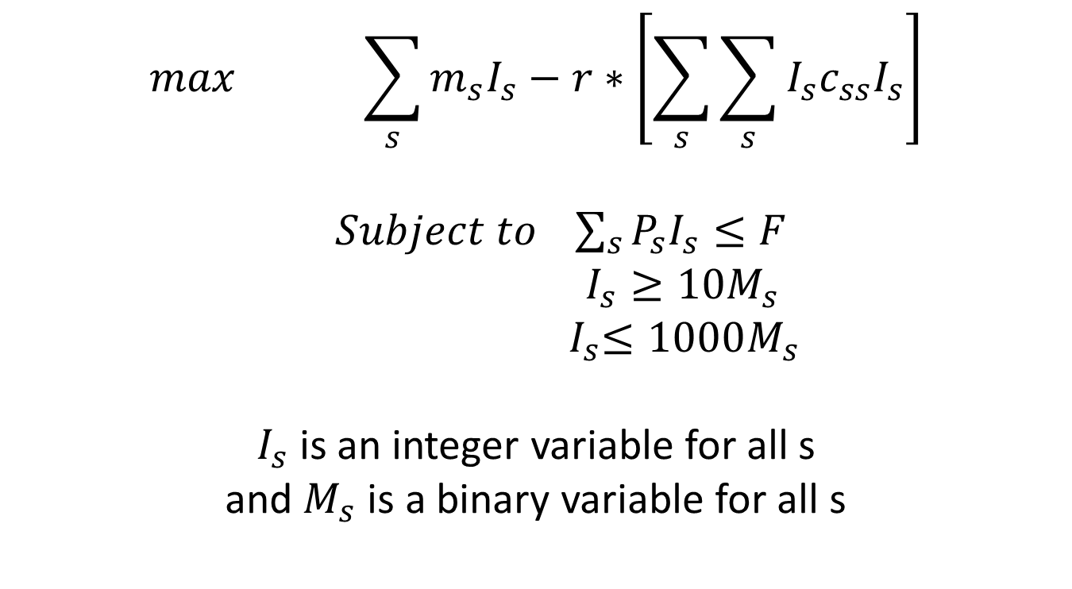
Example problem
$$\max{ \sum_{s}{m_{s}I_{s}}−r∗\left[\sum_{s}{\sum_{s}{I_{s}c_{ss}I_{s}}}\right]}$$
$Subject to \sum_{s}{P_{s}I_{s}}≤F$
$I_{s}≥10M_{s}$
${ I}_{s}≤1000M_{s}$
$I_{s}$ is an integer variable for all s
and $M_{s}$ is a binary variable for all s
More details are in simple_minlp.gms file

Slide 31
For Further reading
McCarl GAMS User Guide
  http://www.gams.com/mccarl/mccarlhtml/index.html
Example problem
Copy simple_minlp.gms from /usr/global/seminar/econ/
cp /usr/global/seminar/econ/simple_minlp.gms .
gvim simple_minlp.gms

