Slide 1

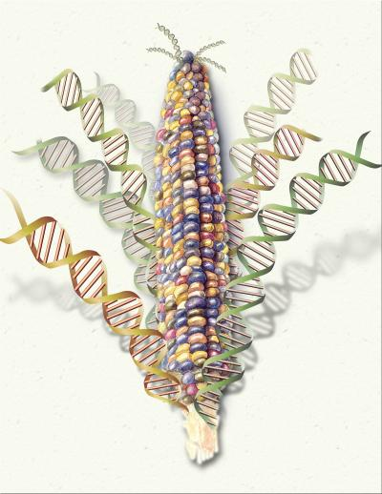
Isfahan University of Technology
College of Agriculture
Department of Agronomy
Principles of Genetics
3 credits; )2 lectures and 1-2 hour lab).
Prerequisite: General Biology.
Instructor: Dr. A.F. Mirlohi
Office: North wing, Agriculture building
Telephone: 391-3450
E-mail: Mirlohi@cc.iut.ac.ir
Office hours: Presented on my office door.

Slide 2
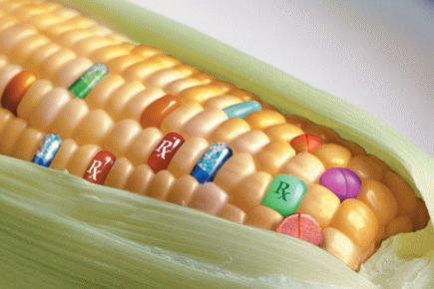
Textbook: Maybodi A. M. and A.F. Mirlohi. Principles of Genetics. Available in jahad daneshgahi bookstore.
Lab. Manual: Mirlohi, A.F. and A. Ghanati. Problems and Experiments of Genetics. Available in campus bookstore.
Lists of additional references will be given in the lab.
Course requirements & evaluation: Students registered in this course are expected to attend and participate in lecture and laboratory sessions. Evaluation will be based on a midterm exam, a final exam, quizzes, and assignments given in the lab. and class sessions.

Slide 3
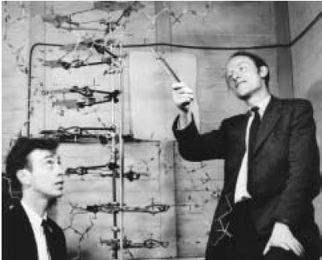
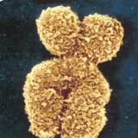
Course content
*Introduction
*History of genetics.
*Evolution in living organism (Microevolution).
* Factors effecting microevolution.
* Mendelian genetics
*Monohybrid crosses
*Dihybrid crosses
* Segregation and independent assortment.
*Cellular reproduction (Mitosis and Meiosis)
* Linkage and crossing over (Genetic map construction)
* Inter-allelic relations (Dominance, Over-dominance, Co-dominance, Incomplete-dominance)
* Lethal alleles or genes
* Gene interaction or Epistasis
* Qualitative and Quantitative inheritance
* Chromosome structure
* Molecular genetics
*DNA structure
*DNA replication
* Transcription
* Translation
*Mutation in genetics materials
* If time limitation allows, we may look into some introductions to biotechnology

Slide 4
Laboratory Work includes:
Crossing fruit flies to study the inheritance of different characteristics.
Solving genetic problems.
Genetic related videos and slides, others.
Midterm exam and final exam:
The exams will evaluate your knowledge and understanding of topics discussed in class and lab sessions. You will be expected to use and synthesize information from various sources: lectures, discussions, student presentations, the textbook and other readings. The final exam will require more synthesis of information than the midterm.
Course evaluation | By Dr. Mirlohi and Mr. Ghanati | %
Quizzes and class attendance | Quizzes will not be announced in advance | 5%
Lab. assignments | Complete assignments must be returned on time | 15%
Midterm exam | ………………… | 30%
Final exam | ………………….. | 50%

Slide 5
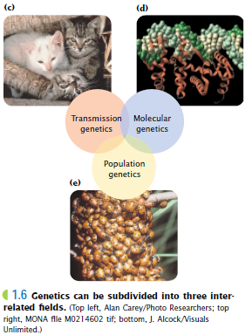
ژنتیک:
شاخه ای از علم زیست شناسی که در مورد انتقال اطلاعات ارثی از نسلي به نسل دیگر بحث می کند.
Genetics: The study of how hereditary information is organized, expressed, and inherited.
ویژگی های علم ژنتیک
Central to modern biology
Rapidly progressing
Broad reaching implications for all areas of biology, especially agriculture & medicine
Fear of abuse can be properly addressed only with understanding of principles and applications
تمام موجودات زنده تحت تاثیر 3 عامل:
محیط
تغذیه
ژنتیک

Slide 6
اهمیت علم ژنتیک:
علوم گیاهی – اصلاح نباتات (ازدیاد جمعیت جهان)
علوم جانوری – اصلاح نژادهای برتر
علوم انسانی – در زمینه پزشکی

Slide 7
تاریخچه:
قبل از مندل
بعد از اکتشافات مندل (دوره یClassical Genetic )
کشف زبان رمز و پایه شیمیایی وراثت، DNA
قبل از اینکه انسان ها به ژنتیک به صورت یک علم نگاه کنند:
همواره سوالاتی برایشان مطرح بوده است. چگونگی انتقال صفات از پدر و مادر به فرزندان
بصورت تجربی از علم ژنتیک استفاده می کردند
1- اهلی کردن گیاهان
2- اهلی کردن حیوانات
از معروفترین افرادی که در زمینه علم ژنتیک تحقیق می کردند:
لامارک Lamarck
داروین Darwin
تحقیقات این 2 نفر دو نظریه متفاوت در مورد مکانیزم تکامل را به وجود آورد:
Lamarck ➔ Inheritance of Acquired Characteristics
تحت عنوان: وراثت خصوصیات اکتسابی
قبل از لامارک باور کلی بر این بود که موجودات به همین شکل آفریده شده اند.

Slide 8
French naturalist Jean-Baptiste Lamarck published a theory of evolution in 1809, the year Charles Darwin was born and 50 years before Darwin would finally publish his own ideas on evolution. While working at the Natural History Museum in Paris, where he was in charge of the invertebrate collections, Lamarck compared current species of animals with fossil forms.

Slide 9
He noted that lands that have similar climates seemed to have unrelated plants and animals. Darwin and many others in his time wondered why it was that if all organisms originated from a single act of creation, there existed this distinctive clustering of similar organisms in different regions of the world. Why weren’t organisms randomly distributed across Earth? Darwin also found several important fossil remains, including that of a glyptodont, an extinct armadillo-like animal. He wondered if this fossil was somehow related to the living forms of armadillos that lived in the same region (see Figure 10.6). Why would there be living and fossilized organisms that were directly related to one another in the same region? Could one have risen from the other?
In summary, Darwin’s experience in the Galápagos Islands, particularly the information gathered on tortoises and finches, demonstrated a mechanism for how new species could arise from ancestral ones in response to the local environment.

Slide 10
شواهد حاکی از تکاملی بودن پروسه حیات :
آثار فسیلی
تدریج در زمین شناسی
زمین قدیمی تر از 6000 سال است.
میلیون ها سال اجازه تکامل تدریجی را می دهد.
طبقه بندی گیاهی و جانوری
داروین از این شواهد و بررسی ها شخصی خود از قاره آمریکا به 2 نتیجه رسید
حیات به طور تدریجی به صورت فعلی در آمده (Evolved).
مکانیزم عمل تکامل، انتخاب طبیعی است.
در همین زمینه نظریه خود را تحت عنوان ”مبدا گونه ها بوسیله انتخاب طبیعی“ یا
On The Origine Of Species by Means Of Natural Selectionبیان کرد

Slide 11
Darwin did not use the word “evolution” in the original edition of The Origin of Species. (“Evolved” is used once — it is the final word in the book.) Instead, Darwin spoke of descent with modification. One reason he did not use the word “evolution” is that he felt it implied progress —that each generation was somehow getting better (that is, was improving in some way).
اساس انتخاب طبیعی بر چند رکن استوار است:
افراد هر جمعیت با یکدیگر از نظر بسیاری از خصوصیات فرق می کنند. حتی خواهر و برادر – برادر و برادر
این تنوع یا خصوصیات قابل ارث هستند.
افراد یک جمعیت بیشتر از آن مقداری که طبیعت می تواند از آن ها نگهداری کند تولید مثل می کنند.
در هر جمعیت، آن افرادی که خصوصیات ارثی آن ها را با طبیعت بهتر وفق می دهد از خود فرزندان بیشتری باقی می گذارند.

Slide 12
شواهد موجود بر تکامل – بر اساس علم امروز:
جغرافیای زیستی Biogeography: چرا 2 جزیره با آب و هوای مشابه دارای گونه های متفاوت است؟
Biogeography is the study of the geographical distribution of species. Darwin’s thinking was influenced by the distribution of animals. Recall that he wondered why the birds in the Galápagos Islands so closely resembled those on the closest continent, South America. This suggests that animals on islands have evolved from mainland migrants, with populations adapting over time to adjust to the environmental conditions of their new home. Originally, New Zealand and Australia were part of the supercontinent Gondwana. As these countries drifted away from Gondwana, due to the shifting of the continental plates, they became isolated from other land masses. Once isolated, populations unique, or endemic, to these islands evolved.

Slide 13
2-آثار فسیلی: قدیمی ترین آثار فسیلي بیانگر وجود تک سلولی ها است. ماهی ها، دوزیستان، خزندگان، پرندگان و پستانداران

Slide 14
3- طبقه بندی Taxonomy
4- آناتومی مقایسه ای Comparative anatomy- جد مشترک را می توان از مقایسه استنباط نمود.
Such anatomical signs of evolution are called homologous structures. Homologous structures have not only similar numbers of bones but also similar numbers of muscles, ligaments, tendons, and blood vessels. They also have the same developmental origin

Slide 15
5- جنین شناسی مقایسه ای Comparative Embryology
Embryology has also been used to determine evolutionary relationships among animals. When the embryos of organisms are examined, similar stages of embryonic development are evident. For example, all vertebrate embryos (including humans) go through a stage in which they have gill pouches (as shown in Figure 10.17). At certain
stages in the development of the embryo, the similarities among fish, birds, humans, and all other vertebrates are more apparent than their differences.

Slide 16
6- بیولوژی مولکولی Molecular Biology- هر مقدار دو گونه نزدیک تر باشند، DNA و پروتئین آن ها نیز باید مشابه باشد.
    Human , Chimpanzee : %2.5
    Human , Gibbon : %5.11
    Human , Green monkey : %9
Macro-evolution is evolution on a grand scale; it is large evolutionary change such as the evolution of new species from a common ancestor or the evolution of one species into two. The modern camel, for example, evolved over 65 million years from a small ancestor that was not much larger than a rabbit.
Micro-evolution is the change in the gene frequencies within a population over time. It is evolution within a species, or evolution on a small scale.

Slide 17
عوامل موثر بر تکامل یا تغییر در یک جمعیت (Microevolution):
Genetic Drift (رانده شدن ژنتیکی): تغییرات تصادفی در فراوانی ژنی از یک نسل به نسل دیگر در جوامع کوچک. عواملی که با عث کوچک شدن جمعیت ها می شوند:
*:زلزله ها – سیل ها- آتش سوزی ها و غیره
In small populations, the frequencies of particular alleles can be changed drastically by chance alone. This is called genetic drift.
The Bottleneck Effect
Populations can be subject to near extinction as a result of natural disasters such as earthquakes, floods, or fires, or of human interferences such as overhunting or habitat destruction. The surviving population is unlikely to represent the gene pool
of the original population. The bottleneck effect is a situation in which, as a result of chance, certain alleles are overrepresented and others are underrepresented (or even absent) in the reduced population. Genetic drift then follows and the genetic
variation in the surviving population is reduced.
The Founder Effect
When a small number of individuals colonize a new area, chances are high that they do not contain all the genes represented in the parent population. The change in allele frequencies that result in this new population is called the founder effect. The
particular alleles carried by these founders are dictated by chance only.

Slide 18
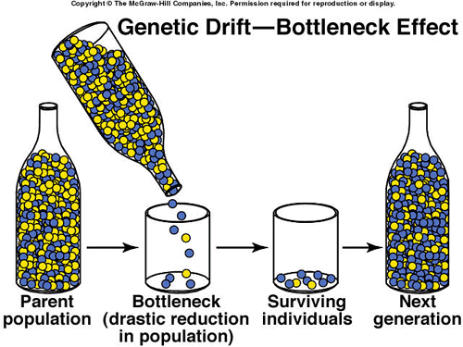
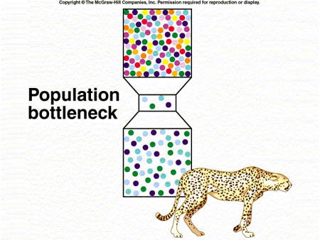

Slide 19
Overhunting can result in future generations that have a higher proportion of individuals without the favourable trait. For example, in the 1970s and 1980s, between 10 and 20 percent of all wild elephants in Africa were being killed by ivory poachers each year. Since poachers preferred elephants with large tusks, elephants with smaller tusks were less likely to be killed. Elephants with no tusks were not shot at all. Since that period, elephant watchers and biologists have noticed more and more tuskless elephants in the areas that experienced the most intense poaching pressure.

Slide 20
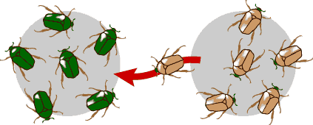
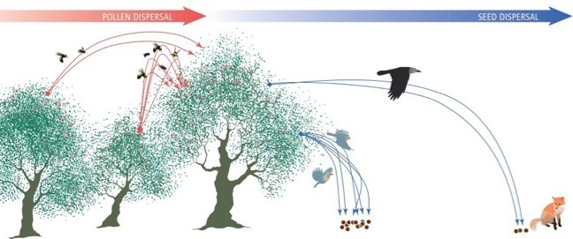
Gene Flow (جریان ژنی): اضافه یا کم شدن آلل ها در یک جمعیت، جمعیت ها را یکنواخت می کند ولیکن جمعیت بوجود آمده با دو جمعیت قبلی فرق دارد.
A windstorm or tornado can
deliver new seeds or pollen to a population. This movement of new alleles into a gene pool, and the movement of genes out of a gene pool, is called gene flow.

Slide 21
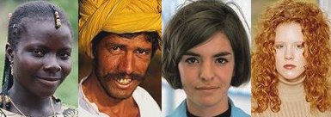
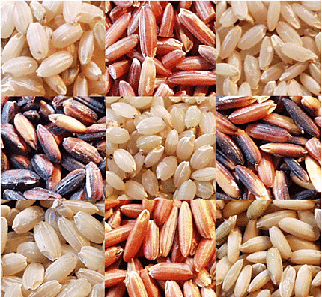
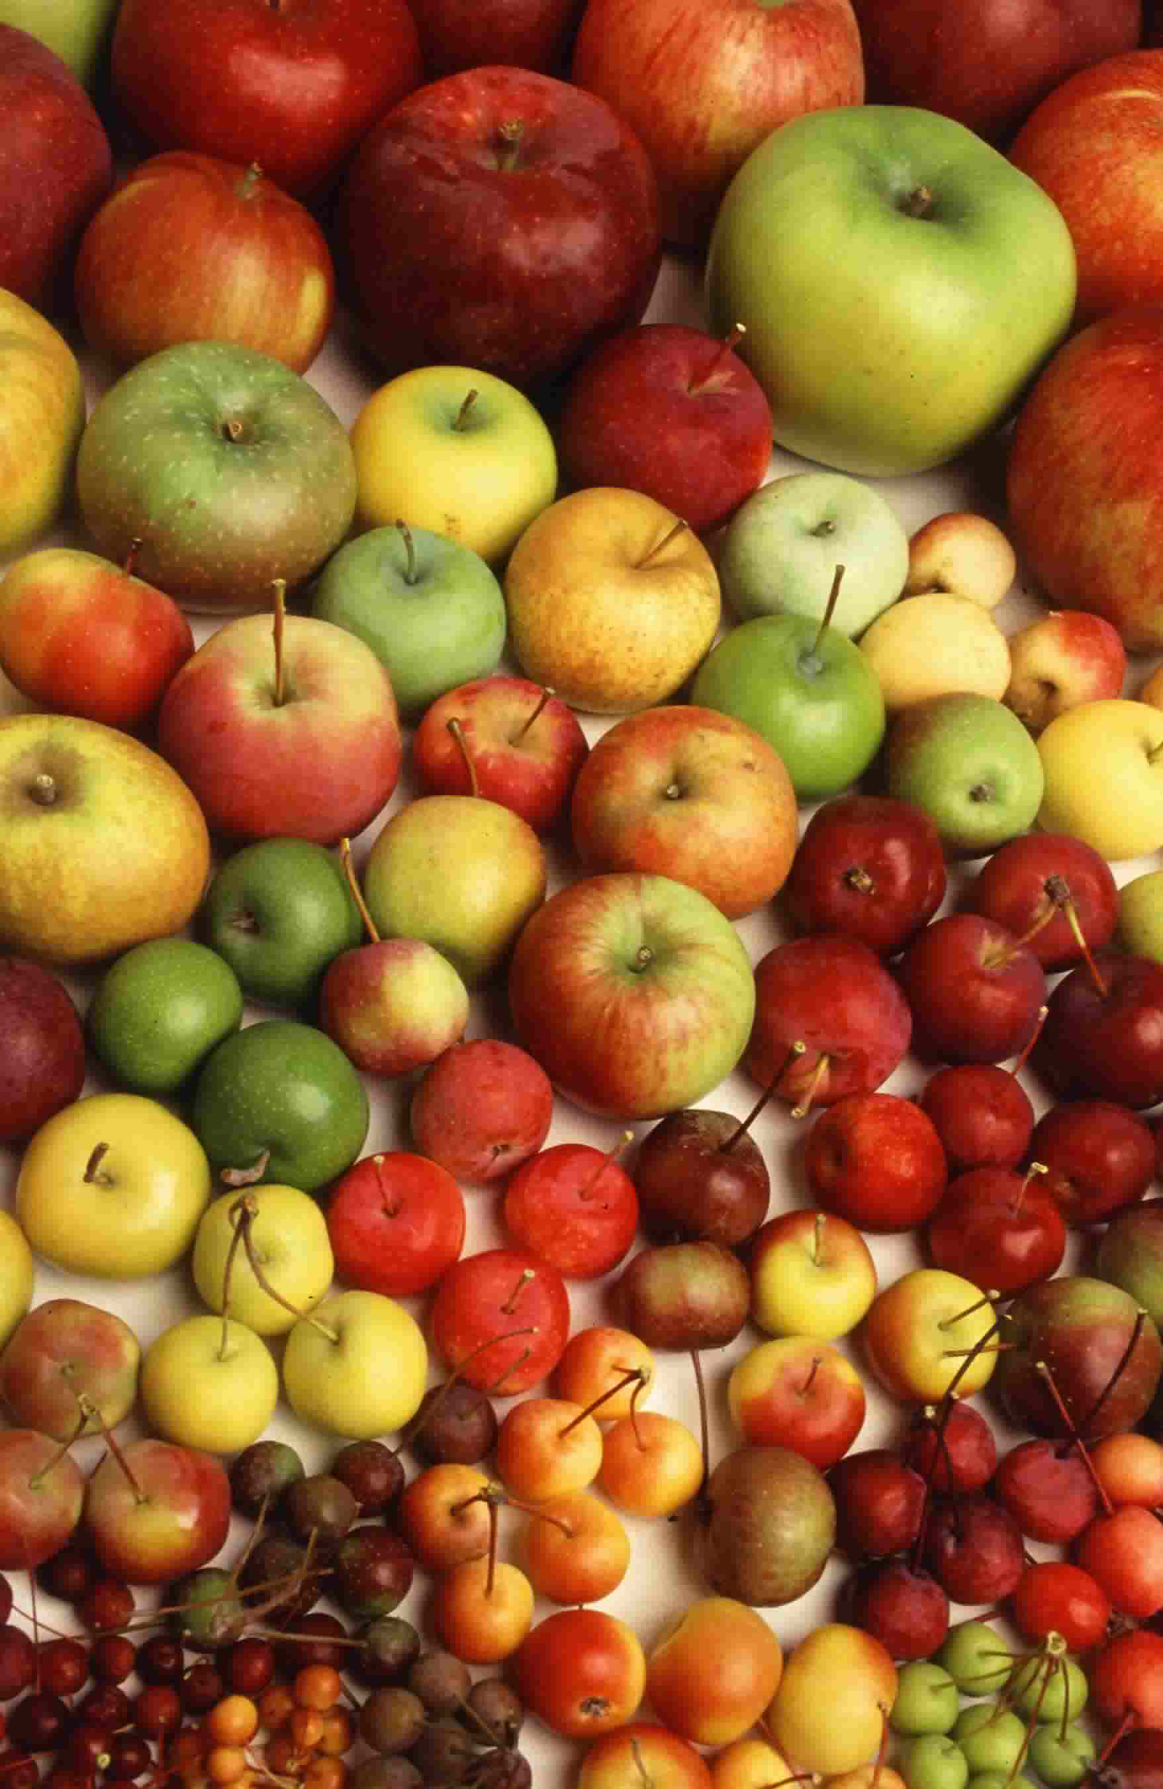
Assorative mating (تلاقی های جور شده): شدت آن خودگشنی است (Selfing).

Slide 22
Mutation Pressure (فشار موتاسیونی): فشار موتاسیونی تاثیرش در بوجود آوردن تغییر در یک جمعیت نسبت به عوامل دیگر کمتر است.
ولی در حالتی که انتخاب طبیعی به نفع آن موتاسیون باشد، مهم می شود چون نتاج نسل های بعدی با این ژن در جمعیت زیاد می شوند.
مهم ترین و اصلی ترین منبع تنوع ژنتیکی در تکامل موتاسیون است.
Natural selection (انتخاب طبیعی)

Slide 23
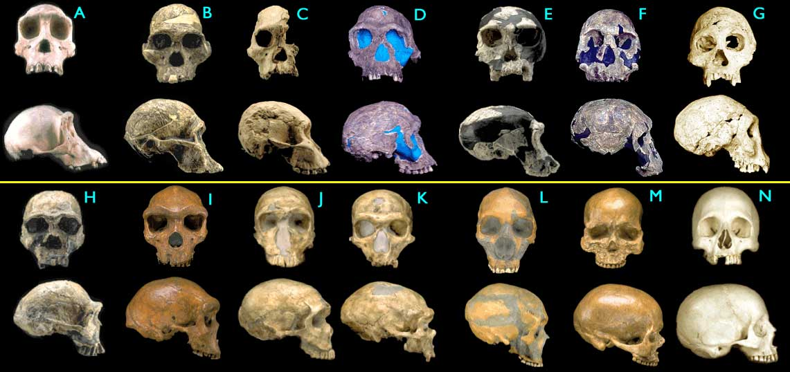
Images © 2000 Smithsonian Institution.
(A) Pan troglodytes, chimpanzee, modern (B) Australopithecus africanus, STS 5, 2.6 My
(C) Australopithecus africanus, 2.5 My (D) Homo habilis, KNM-ER 1813, 1.9 My
(E) Homo habilis, 1.8 My (F) Homo rudolfensis, KNM-ER 1470, 1.8 My
(G) Homo erectus, Dmanisi cranium 1.75 My (H) Homo ergaster (early H. erectus), 1.75 My
(I) Homo heidelbergensis, 125,000 y
(J) Homo sapiens neanderthalensis, La Ferrassie 1, 70,000 y
(K) Homo sapiens neanderthalensis, La Chappelle-aux-Saints, 60,000 y
(L) Homo sapiens neanderthalensis, Le Moustier, 45,000 y
(M) Homo sapiens sapiens, Cro-Magnon I, 30,000 y

