Slide 1
photosynthesis
Part 3

Slide 2
C4 plants utilize two distinct metabolic compartments for fixing CO2
Not all organisms that contain the Calvin–Benson cycle produce 3‐PGA as the first stable photosynthetic intermediate.
several plant species form large amounts of four‐carbon organic acids as the first products of CO2 fixation. On this basis, plants are classified as C3 or C4 plants based on the primary product of carbon fixation in photosynthesis: three‐carbon (3‐PGA) and four‐carbon (oxaloacetic acid, OAA) compounds are the primary products of carbon fixation in C3 and C4 plants, respectively.

Slide 3
C4 photosynthesis involves the primary carboxylation of a three‐carbon precursor (phosphoenolpyruvate, PEP) to OAA, catalyzed by PEP carboxylase, followed by the decarboxylation of the four‐carbon intermediate prior to secondary (final) carboxylation at the active site of Rubisco. These two biochemical functions are separated between two intracellular compartments, which allow the primary and the secondary carboxylations to occur simultaneously.
Sugar cane (Saccharum sp.), maize (Zea mays), and numerous tropical grasses are among the species that exhibit the C4 labeling pattern. The leaves of these and almost all C4 species exhibit an unusual anatomy involving two different types of chloroplast‐containing cells: mesophyll cells surround enlarged bundle sheath cells, which in turn are arranged concentrically with respect to vascular tissues

Slide 4
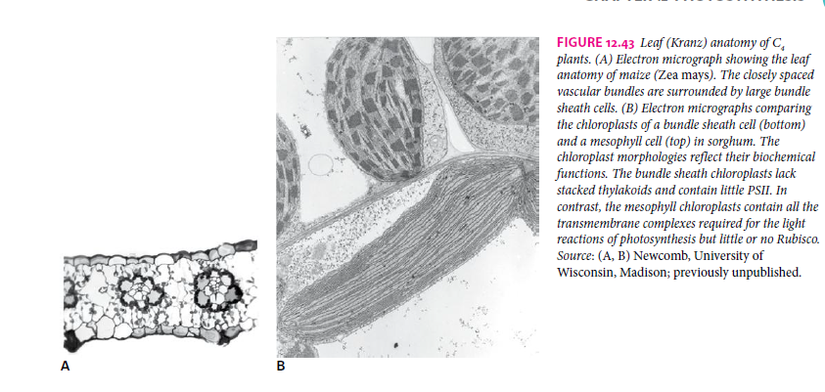

Slide 5
Reduced interveinal distance and limited leaf thickness maximize the contact between mesophyll and bundle sheath cells. The 19th‐century German botanists who originally described this feature called it Kranz anatomy (German: wreath). The biochemical differentiation of mesophyll cells and bundle sheath cells is essential for the effective operation of C4 photosynthesis:
PEP carboxylase (PEPCase) accumulates in the cytosol of mesophyll cells (external compartment), and Rubisco in the chloroplasts of bundle sheath cells (internal compartment). The biphasic C4 system reduces photorespiration dramatically by increasing levels of CO2 near Rubisco to enable Rubisco carboxylation to outcompete the oxygenation reaction. The low photosystem II activity in the bundle sheath also minimizes the Rubisco oxygenation reaction.
C4 photosynthesis also occurs, however, in numerous organisms devoid of Kranz anatomy, including a number of aquatic and land plants. In some of these cases, photosynthetic enzymes and dimorphic chloroplasts occur in separate cytoplasmic domains within a single photosynthetic cell (Fig.). ×

Slide 6
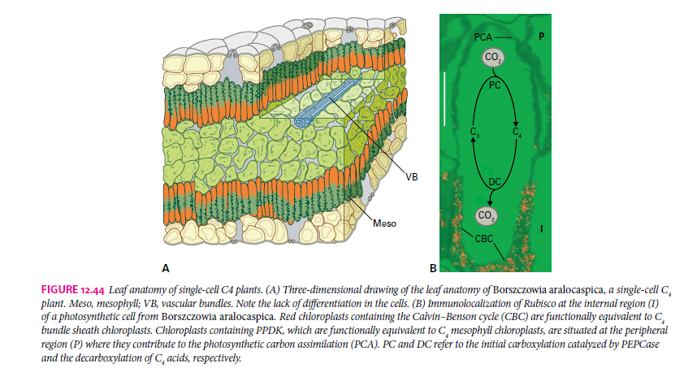
×
×

Slide 7
The C4 pathway increases the concentration of CO2 in internal compartments close to vascular tissues
The C4 pathway of CO2 fixation requires a complex interaction between two different compartments and involves the following steps:

Slide 8
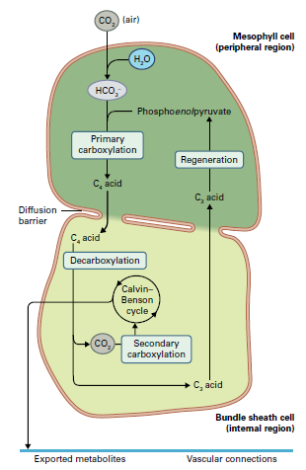

Slide 9
In the context of the two‐cell C4 pathway, all carbon fixation begins in the cytosol of mesophyll cells, where carbonic anhydrase catalyzes the conversion of atmospheric CO2 into HCO3–for subsequent carboxylation.
OAA is generated from HCO3 − and PEP in the cytosol of the outer compartment (i.e., mesophyll cells), catalyzed by PEPCase. Whereas
enzymes unique to the Calvin–Benson cycle are located only in chloroplasts of the internal compartment (i.e., bundle sheath cells).
In accordance with distinct functions, electron micrographs of bundle sheath and mesophyll chloroplasts (Fig. 12.43) show structural differences:
chloroplasts of (internal) bundle sheath cells lack stacked membranes and exhibit little PSII activity, whereas chloroplasts of (peripheral) mesophyll cells have retained stacked membranes as well as PSII and PSI activities (Fig. 12.43B).

Slide 11
Three different types of C4 photosynthesis are known
Three types of C4 photosynthesis are known, differing both in the four‐carbon acids transported between mesophyll and bundle sheath cells, and the mechanism of decarboxylation in the bundle sheath cells (Table).

Slide 12
The C3 and C4 pathways have different energy costs
In C3 plants, the Calvin–Benson cycle consumes nine ATP and six NADPH to assimilate three molecules of CO2 into triose phosphate (3 ATP : 2 NADPH : 1 CO2).
In C4 photosynthesis, continuous operation of the C4/C3 shuttle requires restitution of PEP in mesophyll cells, which consumes two additional molecules of ATP in the successive reactions catalyzed by PPDK and adenylate kinase (AMP + ATP → 2 ADP).
Thus, at least five molecules of ATP and two molecules of NADPH are needed for assimilation of one molecule of CO2 (5 ATP : 2 NADPH : 1 CO2).
C4 photosynthesis evolved to minimize energetically wasteful photorespiration; however, avoidance of photorespiration came with a penalty for photosynthetic efficiency.
In keeping with an increased metabolic flux across the envelope membranes of C4 chloroplasts, substrate‐specific transporters of these membranes are more abundant in C4 than in C3 plants.

Slide 14
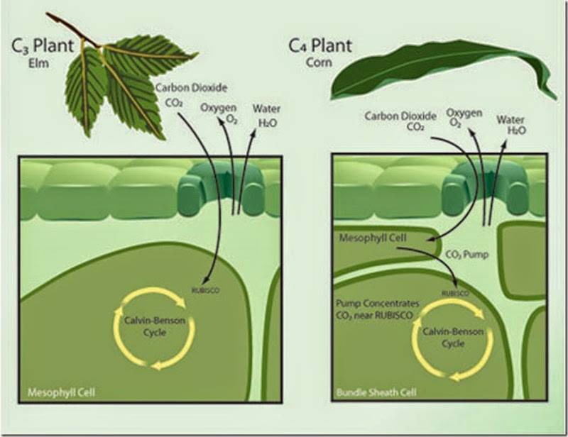
p372

Slide 15
Critical enzymes of the C4 pathway are also regulated by light
Light‐mediated regulation of enzymes coordinates the activities of mesophyll and bundle sheath cells to ensure that four‐carbon acids are available for CO2 fixation in bundle sheath cells. In C4 photosynthesis, regulation of Calvin–Benson cycle enzymes by light is similar to C3 plants.

Slide 16
CAM photosynthesis involves the temporal separation of CO2 capture and carbon fixation
Another modification of the C3 pathway occurs in plants utilizing Crassulacean acid metabolism (CAM).
Named after the Crassulaceae family of succulent plants, this pathway has evolved mechanisms for maximizing carbon uptake under environmental conditions that limit productivity, such as high temperature or shortage of water.
Thus, CAM photosynthesis is commonly associated with plants that inhabit arid environments (e.g., succulents, including cacti and some commercially significant plants, such as pineapple and agave).
To enhance water conservation, these plants have evolved anatomical and morphological structures, such as thick cuticles, that prevent water loss.
They have also evolved mechanisms for ensuring a high concentration of CO2 at the active site of Rubisco to minimize photorespiration.

Slide 17
The biochemical pathway of CO2 fixation in terrestrial CAM plants is similar to the C4 pathway, but instead of a spatial separation of the two carboxylations necessary for CO2 fixation, terrestrial CAM plants use a temporal separation of the initial fixation reaction from the assimilation by Rubisco (Fig.).
At night, when it is cold and leaf stomata are open, CO2 is fixed initially into OAA and then malate via PEPCase and NADP‐malate dehydrogenase. The malic acid is stored in vacuoles, where it can reach high concentrations.
During the day, stomata close to prevent the loss of water, and malic acid is transported out of the vacuole. At this stage, NADP‐ME catalyzes the decarboxylation of malate, yielding CO2 and pyruvate, and the released CO2 is fixed by Rubisco via the Calvin–Benson cycle, while pyruvate is used to form starch. The starch confined to photosynthesizing tissues of terrestrial CAM plants, named transitory starch, is broken down at night via glycolysis and serves as a source of PEP for the fixation of CO2 via PEPCase.
In this circadian rhythm, the opening/closing of stomata, variations of organic acids and storage carbohydrates, and the activities of carboxylation and decarboxylation enzymes modulate the proportion of CO2 taken up via PEPCase at night and Rubisco during the day.

Slide 18
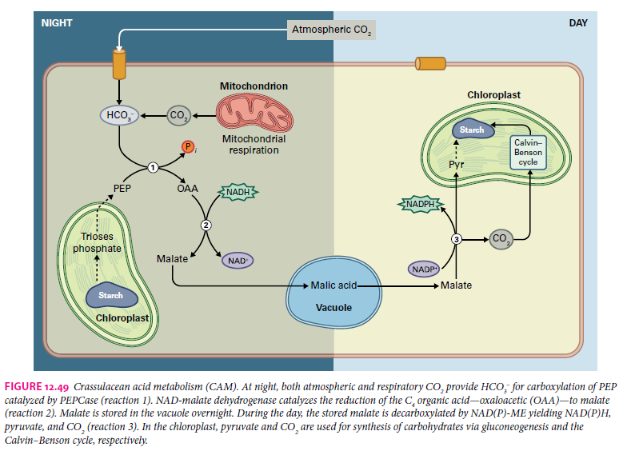

Slide 19
A notable feature of terrestrial CAM plants is the alternation between stomatal opening and closing. Stomata remain open during the cool and relatively humid night, allowing uptake of atmospheric CO2 while sustaining minimal water loss. During the heat and dryness of the day, the stomata close, preventing not only water loss but also the entry of atmospheric CO2. Malate becomes the internal source of CO2 in leaves. The decarboxylation of malate raises the concentration of CO2 to high levels because CO2 cannot escape through the closed stomata. These high concentrations of CO2 further increase the efficiency of Rubisco as a carboxylase. The Calvin–Benson cycle is regulated as in C3 plants.

Slide 20
For aquatic plants, water is readily available, but the concentration of CO2 is low for some that exhibit CAM photosynthesis. Freshwater CAM plants (Isoetes, Littorella, Crassula, Sagitaria, Vallisneria) lack stomata and capture CO2 24 hours a day. Generally, the concentration of HCO−3 in most freshwaters exceeds that of CO2; however, CO2 is the preferred source of inorganic carbon of submerged CAM plants because it is more readily taken up. More importantly, respiratory CO2 makes a substantial contribution to the nocturnal uptake of carbon through CAM when dissolved levels of CO2 are depleted. Freshwater CAM plants thus capture CO2 derived from both the surrounding milieu and respiration for transformation to HCO3– used in the primary fixation catalyzed by PEPCase. In short, aquatic CAM photosynthesis maximizes carbon uptake in plants that prosper in water with a highly variable supply of inorganic carbon by (i) concentrating CO2 released in the decarboxylation reaction and (ii) preventing the loss of respiratory carbon.

Slide 21
CAM PEPCase is active in the dark
CAM photosynthesis provides a fascinating example of enzyme regulation. CAM PEPCase must function at night and reduce its activity during the day, so the mechanisms that inhibit its activity in dark‐treated C4 plants do not operate here. Endogenous circadian rhythms, rather than exogenous light–dark signals, mediate PEPCase activation at night and deactivation during the day (see Fig. 12.47B). Conversions between nocturnal and the diurnal forms correlate with the cessation and onset of malate accumulation. Malate, which is present at high concentrations when it leaves the vacuole, inhibits the diurnal form of the enzyme, whereas the nocturnal form is insensitive to malate, thereby allowing the accumulation of this metabolite.

Slide 23
Limiting Factors
Factors affecting the rate of photosynthesis.
As the rate of photosynthesis increases so will the plants growth rate.
Three factors limit photosynthesis from going any faster: Light level, carbon dioxide level, and temperature.
Without enough light a plant cannot photosynthesize very fast, even if there is plenty of water and carbon dioxide. Increasing the light intensity will make photosynthesis faster.

Slide 24
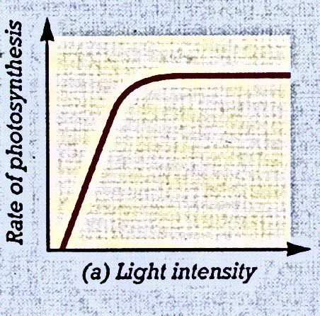
This plateau represents the maximum rate of photosynthesis ---as seen in the diagram.
Higher light intensity initially causes more electrons in the chlorophyll molecules to become excited (gain energy).

Slide 25
As more and more electrons are excited, the light reactions occur more rapidly.
At a certain light intensity, however, all the available electrons are excited and a further increase in light intensity will not increase the rate of photosynthesis.

Slide 26
Limiting Factors
Sometimes photosynthesis is limited by the level of carbon dioxide. Even if there is plenty of light a plant cannot photosynthesize if it has run out of carbon dioxide.
Temperature can be a limiting factor too. If it gets too cold the rate of photosynthesis will slow right down; equally, plants cease to be able to photosynthesize if it gets

Slide 27
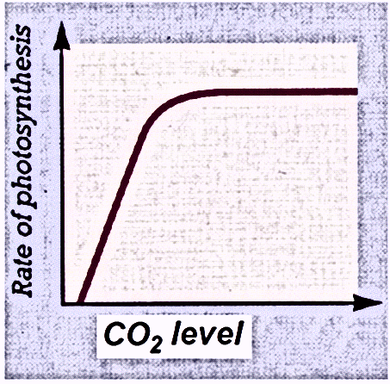
2) Carbon dioxide
Like increasing light intensity, increasing levels of carbon dioxide around the plant stimulates photosynthesis until it reaches a plateau. This graph would resemble that of light intensity.

Slide 28
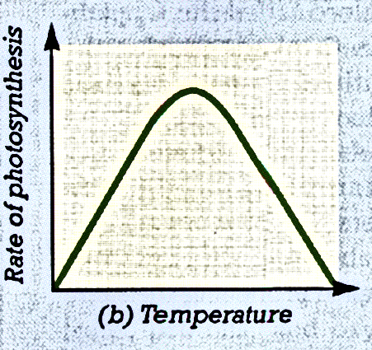
3) Temperature
a) Raising the temperature accelerates various chemical reactions of photosynthesis. As a result, the rate of photosynthesis increases, over a certain range.

Slide 29
b) The rate of photosynthesis generally peaks at a certain temperature, as seen in the graph.
c) Above this temperature, the rate decreases.

Slide 30
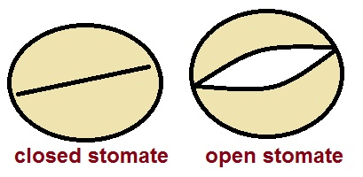
d) As the temperature increases, the stomates begin to close, to limit water loss. This will have the effect of stopping the carbon dioxide from entering the leaf. This will also decrease the rate of photosynthesis. (Also: Enzymes do not function well at too high a temperature.)

Slide 31
4) Water
A lack of water will also slow the rate of photosynthesis. Stomata can close from water loss.
Plants such as the cactus have adaptations to prevent water loss in dry, desert climates.

Slide 32
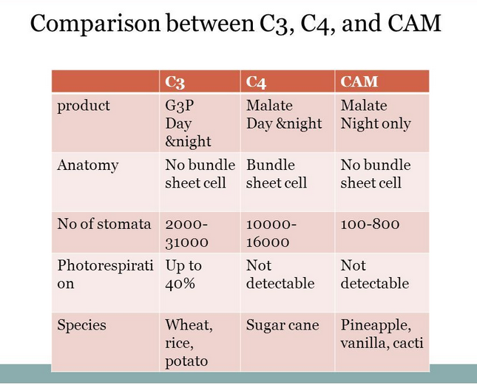

Slide 33
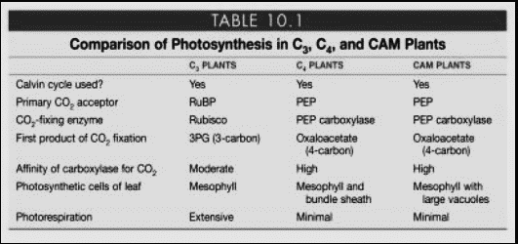

Slide 35
Summary
Photosynthesis produces organic compounds from inorganic carbon by using the energy of sunlight.
These redox processes are carried out in plants, algae, and various bacteria.
In all cases, the photosynthetic reactions may be divided into two phases:
the light reactions and the carbon reactions.
In eukaryotic organisms, photosynthesis takes place in the chloroplast.
The two phases of photosynthesis occur simultaneously but take place in different regions of the chloroplast
The light reactions being localized to the thylakoid membranes and the carbon reactions to the stroma

Slide 36
Summary
The light reactions of photosynthesis involve the photosynthetic pigments, the photosynthetic electron transport chain, and the ATP synthesis machinery
Light is absorbed by pigments localized in pigment–protein complexes (photosystems) within the thylakoid membrane.
This light energy can be transferred from antenna pigments to special pigment–protein complexes, known as reaction centers, where the light energy is converted
into chemical products (photochemistry)
Oxygenic photosynthetic organisms contain two reaction centers and two photosystems, PSII and PSI.
In plants the two photosystems are spatially separated: PSII is localized in appressed thylakoids, and PSI is localized in stroma‐exposed thylakoids.

Slide 37
Summary
During noncyclic electron transfer, the two photosystems cooperate in the transfer of electrons from water to NADP+ via a series of redox reactions
In addition to O2, reduced ferredoxin, and NADPH, the noncyclic electron transfer reactions are coupled to the formation of ATP
In addition to the noncyclic mechanism for ATP synthesis, chloroplasts synthesize ATP via two cyclic pathways that involve only PSI.
The reduction of CO2 to carbohydrates requires the reduced ferredoxin, NADPH, and ATP that are synthesized by the photosynthetic light reactions.
All plants employ the C3 photosynthetic pathway (Calvin–Benson cycle) to fix CO2, using the enzyme Rubisco to convert CO2 and RuBP into the C3 product, 3‐PGA.

Slide 38
Summary
Calvin–Benson cycle occurs in three phases—carboxylation, reduction, and regeneration—and requires three ATP and two NADPH molecules per molecule of CO2 fixed.
Reactions of the Calvin–Benson cycle reactions are catalyzed by soluble enzymes localized in the chloroplast stroma.
Regulation of the cycle is linked to multiple light‐dependent mechanisms, including the active removal of Rubisco inhibitors, changes in pH and Mg2+, and disulfide redox transitions catalyzed by the ferredoxin–thioredoxin system.
Variants of C3 photosynthesis exist in many plants.

Slide 39
Summary
In one variation, the C4 pathway, plants fix CO2 into a C4 acid in mesophyll cells, and transport this fixed CO2 to anatomically distinct bundle sheath cells, where the CO2 is released, refixed, and assimilated by Rubisco and other enzymes of the Calvin–Benson cycle.
This sequence of reactions enhances the productivity of C4 plants by (i) providing a higher concentration of CO2 for Rubisco in the bundle sheath cell, and (ii) decreasing the oxygenase activity of Rubisco—a reaction that competes with the fixation of CO2 in C3 chloroplasts.
In another variant, CAM metabolism, CO2 is fixed at night into malate, which is decarboxylated during the day to provide CO2 for Rubisco.
CAM photosynthesis aids in the retention of water and enables plant to grow in arid environments.
Several photosynthetic enzymes in C4 and CAM plants are regulated to ensure efficient interaction of the CO2‐ concentrating mechanisms with the Calvin–Benson cycle.

