Slide 1
Respiration

Slide 2
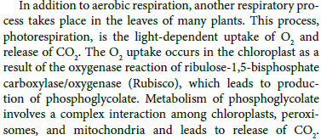
Introduction
plants use light energy to assimilate carbon into sugars and starch, and these molecules are subsequently broken down and converted into organic acids and other compounds.
In this chapter, we address aerobic respiration—the further oxidation of these compounds to carbon dioxide (CO2) and water (H2O) in the mitochondrion—and review the mechanisms by which the energy released during respiration is conserved as ATP, a process called oxidative phosphorylation.

Slide 3
Type of Respiration
Dark respiration
Photo respiration

Slide 4
Overview of respiration
a process common to almost all eukaryotic organisms.
controlled oxidation of reduced organic substrates to CO2 and H2O.
Numerous compounds can serve as substrates for respiration, including carbohydrates, lipids, proteins, amino acids, and organic acids.
Respiration releases a large amount of free energy, which is conserved in ATP molecules.
This chemical bond energy can be used to drive metabolic reactions involved in the growth, development, and maintenance of the plant.
The primary pathways of respiration provide metabolic intermediates that serve as substrates for the synthesis of nucleic acids, amino acids, fatty acids, and many secondary metabolites.
Although the general process of respiration in plants is the same as in other eukaryotes, several features are unique to plants.
These modifications apparently evolved to cope with the environmental and metabolic circumstances commonly faced by plants.

Slide 5
Plant mitochondria
The mitochondrion is the principal organelle of eukaryotic respiration.
The number of mitochondria per plant cell varies and is related primarily to the metabolic activity of the tissue. however, usually remains similar during different developmental stages of the same cell type. For example, the small cells of the root cap of maize seedlings contain approximately 200 mitochondria each, whereas the much larger mature root tip cells may have 2,000 or so mitochondria per cell. In very active cells such as phloem companion cells, secretory cells, and transfer cells, up to 20% of the volume of the cytoplasm may be occupied by mitochondria.

Slide 6
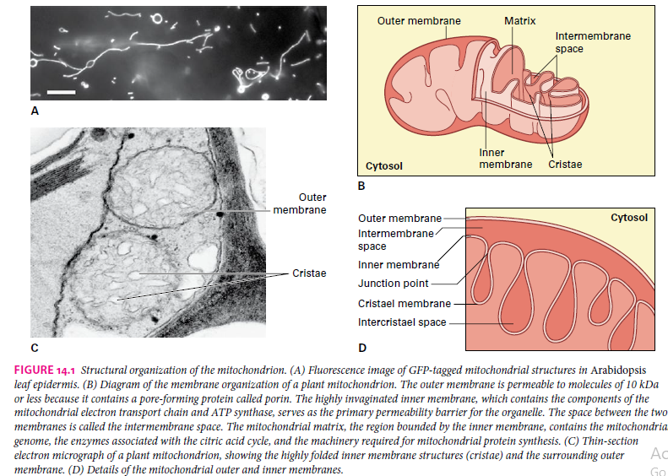
Mitochondria contain two sets of membranes that divide the organelle into four compartments: the outer membrane, the region between the two membranes (intermembrane space), a highly invaginated inner membrane, and the aqueous phase contained within the inner membrane (mitochondrial matrix) (Fig.). Invaginations of the inner membrane give rise to cristae, which appear as sac‐like structures under the electron microscope

Slide 7

The principal products of respiration are CO2, H2O, and free energy conserved as ATP
process of oxidizing food to release energy inside cells
Although respiration can oxidize many compounds, the principal substrates provided by photosynthesis for plant respiration are sucrose and starch.
Using sucrose as an example of a respiratory substrate, one can represent the overall process of aerobic respiration as follows:
This reaction scheme is the reverse of photosynthesis, and it represents a coupled pair of redox reactions in which sucrose is completely oxidized to CO2, while O2, the terminal electron acceptor, is reduced to H2O (Fig. 14.2). The standard free energy change (ΔG°′) for this exergonic reaction, −5764 kJ mol–1, provides the thermodynamic driving force for the production of ATP.

Slide 8
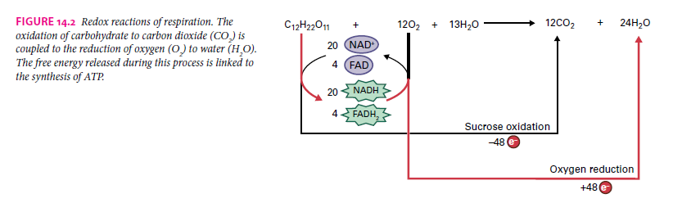

Slide 9
Investigation 1
To Show the Release of Carbon Dioxide by Germinating Seeds

Slide 10
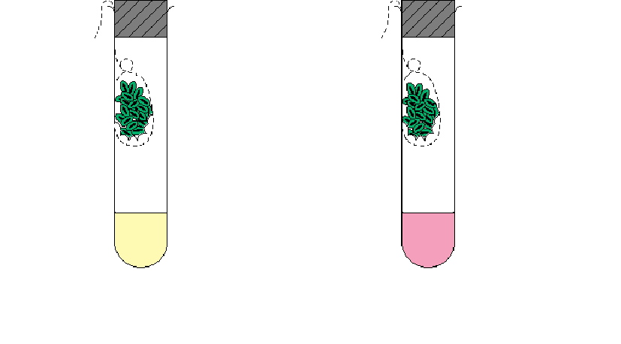
thread
thread
muslin bag
seeds (heat-killed)
germinating seeds
moist cotton wool
Hydrogen carbonate indicator solution
B
A
What is the function of the moist cotton wool inside the muslin bag ?
Ans: It prevents the seeds from drying out.

Slide 11
thread
thread
muslin bag
seeds (heat-killed)
germinating seeds
moist cotton wool
hydrogencarbonate indicator solution
B
A
What has happened to the hydrogen carbonate indicator solution in the two tubes ?
Ans: Indicator solution in tube A turns yellow while the indicator solution in tube B remains unchanged.

Slide 12
Investigation 2
To Demonstrate Heat Production by Germinating Seeds using Thermos Flasks

Slide 13
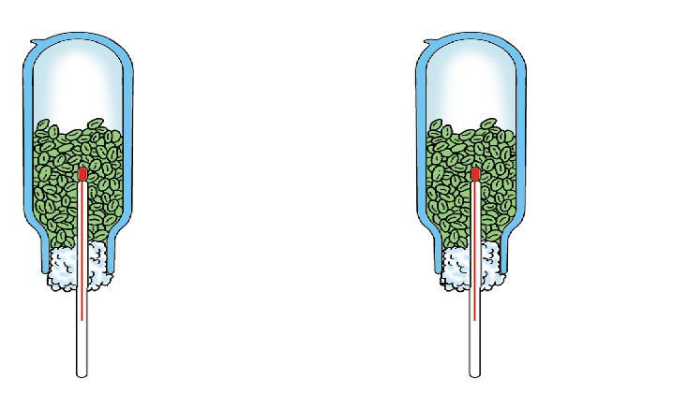
A
B
thermos flask
germinating seeds
Seeds killed
by boiling
cotton wool
thermometer
Which thermos flask shows a higher temperature
at the end of the experiment ?
Ans: Flask A showed a higher temperature at the end of the experiment.

Slide 14
A
B
thermos flask
germinating seeds
Seeds killed
by boiling
cotton wool
thermometer
It is advisable not to fill the flasks completely with seeds. Why ?
Ans: To provide air for the seeds to respire.

Slide 15
A
B
thermos flask
germinating seeds
Seeds killed
by boiling
cotton wool
thermometer
Why are the flasks supported in the upside-down position ?

Slide 16
Ans: The flasks are supported in the upside-down position because
carbon dioxide, produced during respiration of the living seeds, is a heavier gas and may escape through the cotton wool.
hot air rises up, and inverting it will ensure that heat will not escape through the cotton wool.
it is easier to read the thermometer as the thermos flasks are not transparent.

Slide 17
ATP
energy is mainly released as heat and ATP during respiration in cells
however, during respiration, some ATP should be consumed first before other ATP can be formed
the ATP consumed is used to form other ATP from ADP and phosphate groups

Slide 18
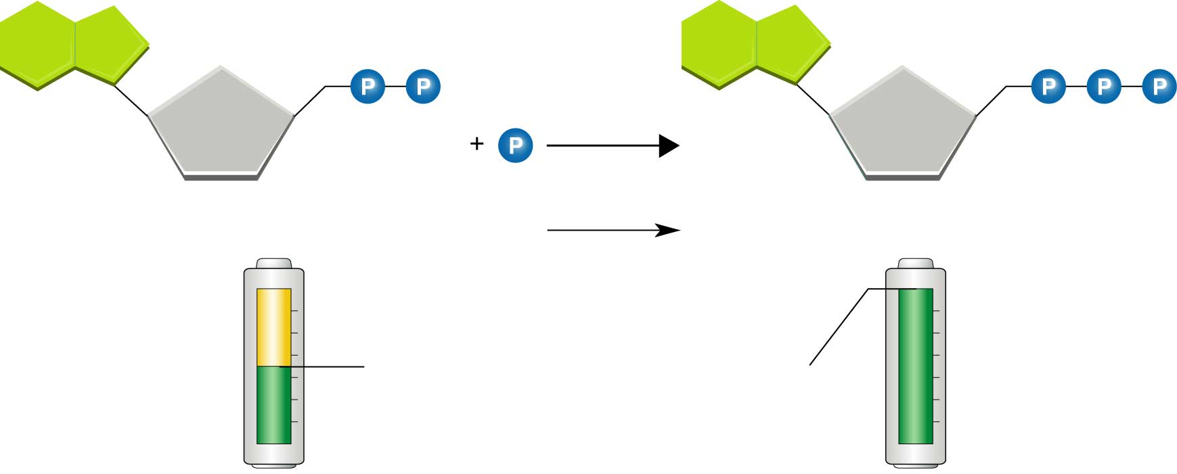
ADP to ATP!
Energy is released when ATP is changed into ADP.
Energy is stored when ADP is converted to ATP.
ADP + Phosphate
Partially
charged
battery
Fully
charged
battery

Slide 19
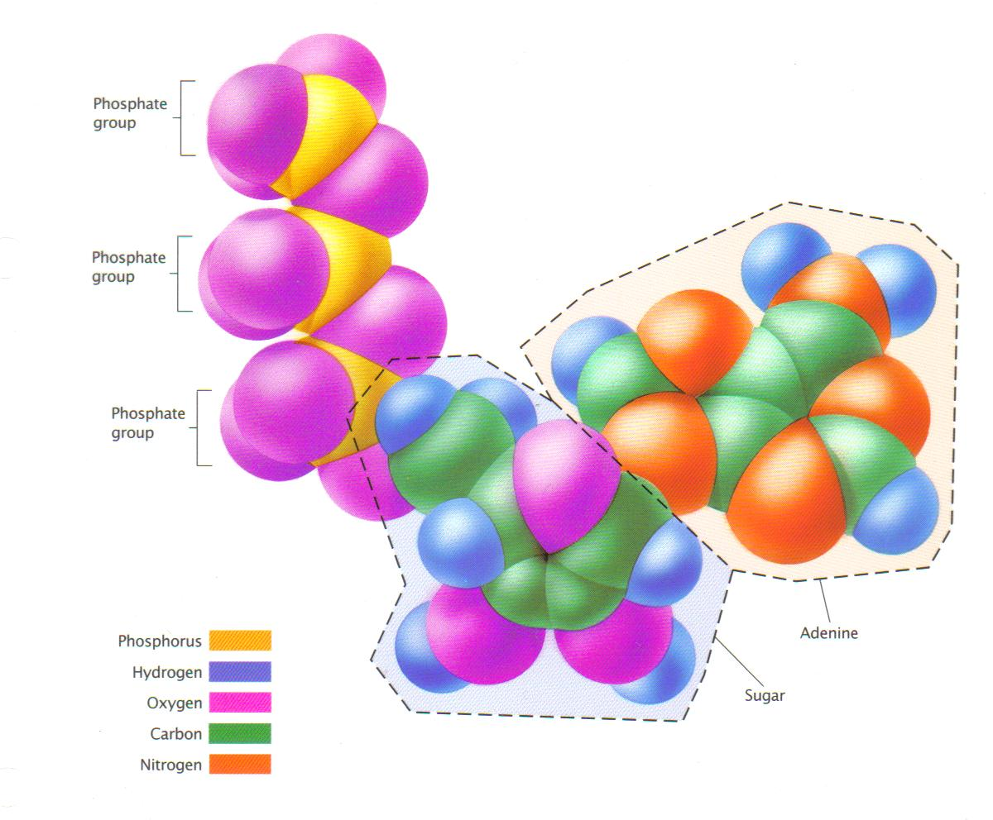
ATP = adenosine triphosphate

Slide 20
ADP
+ phosphate
+ energy (from breakdown of glucose)
ATP
ATP is a high-energy compound while ADP is a low-energy one
ATP can only store energy for a short period
ATP is made inside organelles, mitochondria, which is scattered in the cytoplasm of a cell

Slide 21

The three stages of respiration—glycolysis, the citric acid cycle, and electron transfer/oxidative phosphorylation— take place in different subcellular locations.
Glycolysis involves a series of soluble cytosolic enzymes that oxidize sugars to organic acids. In the reaction above, one sucrose molecule is broken into two hexoses, which are then converted by glycolysis to four molecules of the three‐carbon (C3) compound pyruvate.
The reactions of the citric acid cycle occur within the mitochondrial matrix and can completely oxidize pyruvate to CO2; The electrons are transferred to NAD+ and another cofactor, FAD, yielding NADH and FADH2. The citric acid cycle also phosphorylates ADP directly.
Finally, in the inner mitochondrial membrane, the reduced cofactors generated during glycolysis and the citric acid cycle are oxidized by a set of electron transfer proteins that ultimately donate the electrons to O2, producing H2O. The energy stored in this electrochemical gradient subsequently drives the conversion of ADP and Pi to ATP by a process known as oxidative phosphorylation.
Not every molecule of sucrose or C6 unit of starch metabolized via glycolysis and the citric acid cycle, however, is completely oxidized in this manner; many intermediates from these two pathways are diverted along the way to provide the primary carbon building blocks for other important cellular compounds (Fig.).

Slide 22
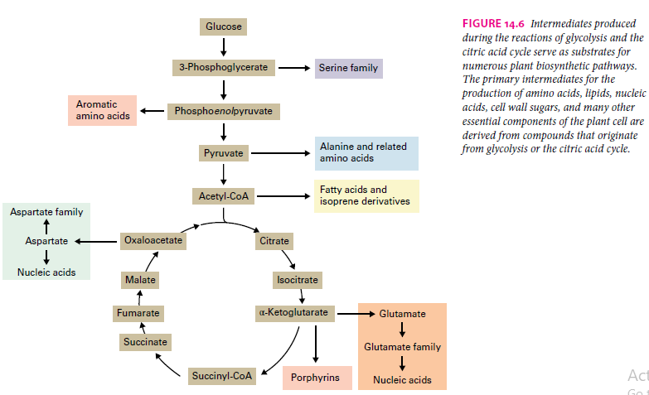

Slide 23
glycolysis
The reactions of the lower half of glycolysis, triose phosphate molecules are oxidized to form pyruvate and energy is conserved in high‐energy phosphate compounds that can be used to synthesize ATP from ADP.
These high‐energy compounds are generated by two enzymes, glyceraldehyde‐3‐ phosphate dehydrogenase, which forms the mixed acid anhydride 1,3‐bisphosphoglycerate (Reaction 13.32), and enolase, which generates a phosphate ester linked to the enol form of pyruvic acid, phosphoenolpyruvate (Fig. 13.34; see also Section 13.9.3).
Because the instability of the enol form of pyruvate gives the phosphate ester a high negative free energy of hydrolysis, the phosphate group can be transferred to ADP, yielding ATP.

Slide 24
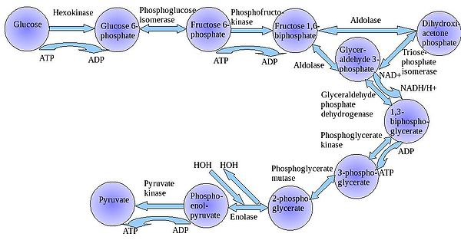
1
×2
1

Slide 25
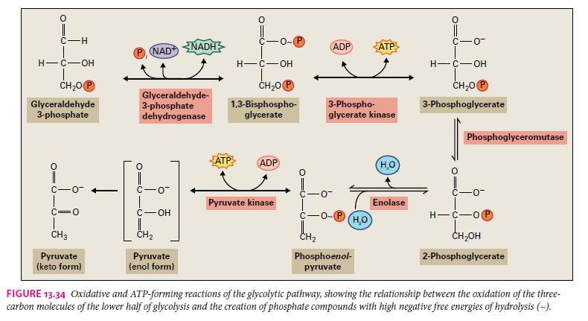

Slide 26
Glycolysis
Occurs in all living organisms
Only stage which can occur without oxygen
Oldest stage of respiration
  operated for billions of years in anaerobic organisms
Converts glucose to 2 pyruvates in cytosol
  with O₂ goes on to TCA cycle
  without O₂ pyruvate is converted to lactate or ethanol (fermentation)

Slide 27
Glycolysis
Glucose (6C)
2 Pyruvate 3C)
CO₂
-O₂ -O₂
+O₂
Ethanol Lactate
TCA Cycle

Slide 28
Citric acid cycle
Known by several names, including the tricarboxylic acid cycle and Krebs cycle (after its discoverer, Hans Krebs), the citric acid cycle oxidizes organic acids to produce CO2 and transfers the resulting electrons to reduce the redox cofactors NAD+ and FAD, forming NADH and FADH2.
Cytosolic reactions generate products that are transported into the mitochondria to feed the citric acid cycle
Pyruvate is transported directly into the mitochondrion.
OAA is either transported directly into the mitochondrion or first reduced to malate by cytosolic malate dehydrogenase.
The mitochondrial inner membrane contains separate carriers by which malate and pyruvate are taken into the mitochondrial matrix.

Slide 29
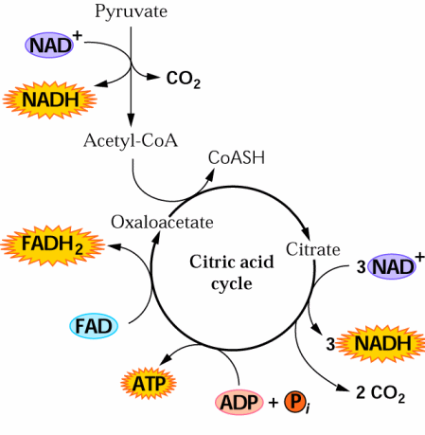
TCA cycle

Slide 30
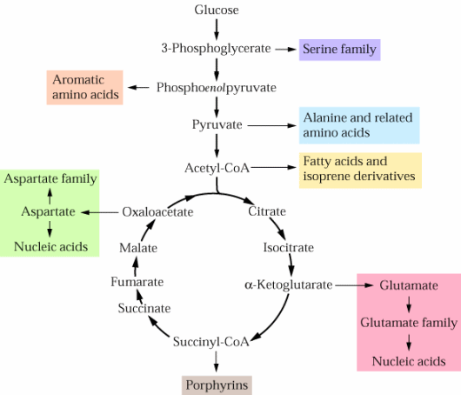

Slide 31
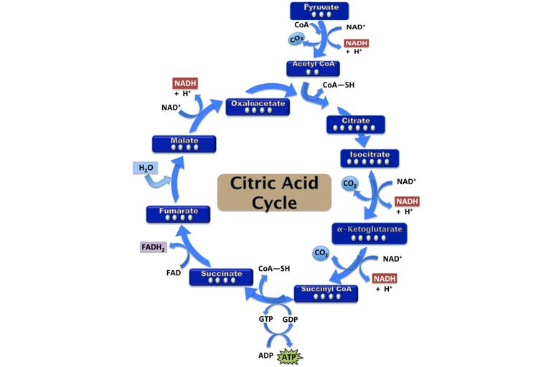

Slide 32
Plant mitochondrial electron transport
The mitochondrial electron transport chain conserved among eukaryotes consists of four membrane‐bound, multiple subunit protein complexes, commonly referred to as complexes I–IV (Fig. 14.12).
These protein complexes catalyze the multistep transfer of electrons from NADH and FADH2 to O2, forming H2O and translocating protons from the matrix to the intermembrane space.
In this way, an endergonic (energy‐consuming) reaction—proton pumping—is driven by the exergonic (energy‐releasing) transfer of electrons from strong reducing agents to a strong oxidant.
The reduction of ½ O2 by two electrons from NADH involves a reduction potential difference (ΔE°′) of 1.14 V (Fig.).
This translates to 219.2 kJ of free energy released for every mole of NADH oxidized.
If NADH or FADH2 reduced O2 directly, the heat released would not be biologically useful.
The electron transport chain facilitates several modestly exergonic redox reactions, rather than a single explosive one, and conserves energy through proton translocation.

Slide 33
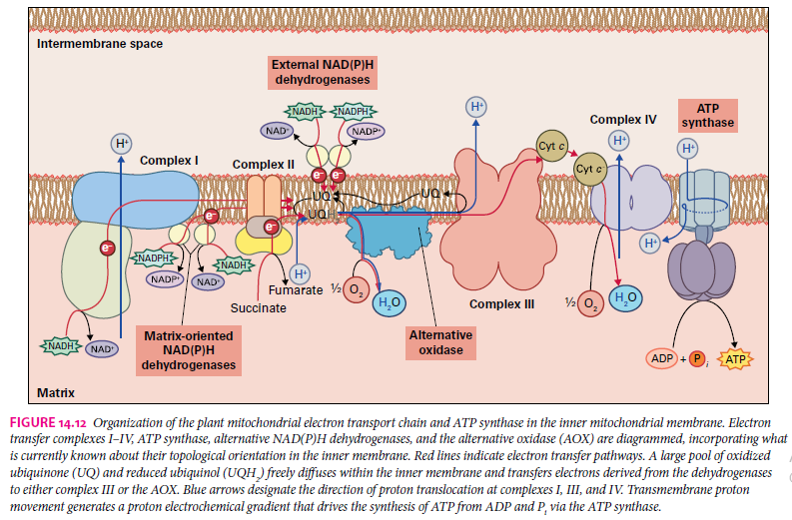

Slide 34
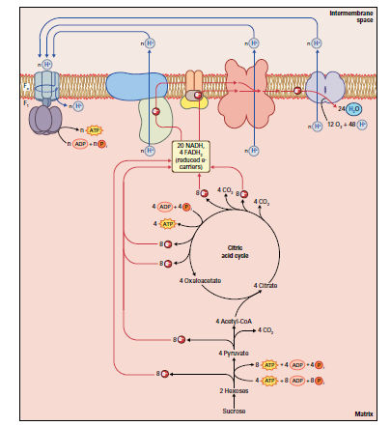
General mechanism of oxidative phosphorylation in mitochondria. Electrons released during the oxidative steps of glycolysis and the citric acid cycle produce 20 molecules of NADH and 4 molecules of FADH2. These reduced coenzymes are subsequently oxidized bythe mitochondrial electron transport chain. The free energy released during mitochondrial electron transfer is coupled to the translocation of protons across the inner mitochondrial membrane (from the matrix into the intermembrane space), which generates a proton electrochemical gradient (ΔμH+) across the inner membrane. As protons move back across the inner membrane through the Fo proton channel of the ATP synthase complex, the free energy released is used by the complex’s F1 component to catalyze conversion of ADP and Pi to ATP in the mitochondrial matrix. The efficiency of net H+ transfer and ATP synthesis can vary (n),

Slide 35
Electron Transport System
NADH and FADH₂
e⁻
H⁺
ATP
e⁻
H⁺
4e⁻ + 4H⁺ + O₂ 2H₂O
NADH + H⁺ + ½ O₂ NAD + H₂O

Slide 36
3 Stages of Respiration
Glycolysis
  cytoplasm
  with or without oxygen present
  breaks glucose (6C) into 2 pyruvates (3C)
TCA Cycle
  mitochondrial matrix
  only if oxygen present
  converts pyruvate via acetyl CoA into CO₂; generates NADH and FADH₂
Electron Transport Chain
  mitochondrial membranes = cristae
  transfers electrons from NADH and FADH₂ to reduce O₂ to H₂O and generate ATP

Slide 37
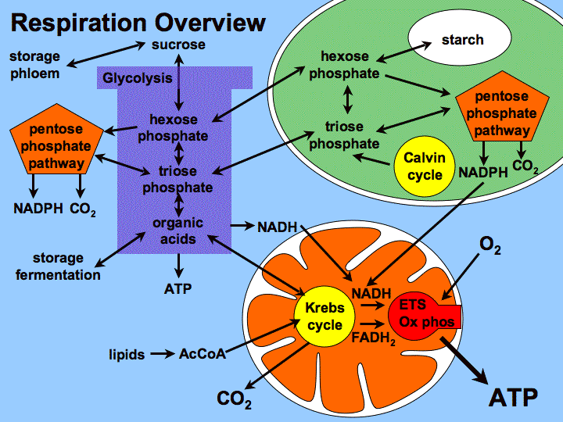

Slide 38
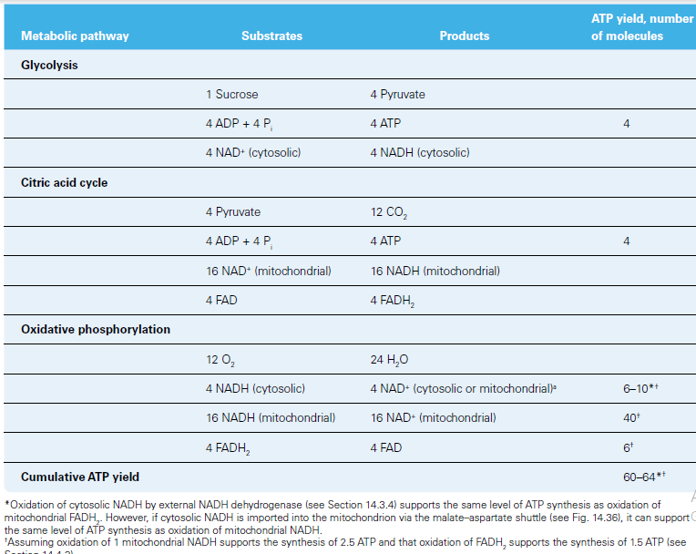

Slide 39

Summary
Aerobic respiration involves the controlled oxidation of reduced organic compounds to CO2 and H2O.
Much of the free energy released during respiration is conserved in the formation of ATP.
In glycolysis, the first stage of respiration, carbohydrates are oxidized to organic acids in the cytosol.
The organic acids produced during glycolysis are completely oxidized to CO2 in the mitochondrial
matrix via the citric acid cycle.
The electrons released during the operation of the citric acid cycle are transferred through a series of multiprotein complexes located in the inner mitochondrial membrane, ultimately reducing O2 to
H2O.

Slide 40

Summary
The free energy released during mitochondrial electron transfer is used to generate a proton electrochemical gradient across the inner membrane.
The energy available in the proton gradient is subsequently used by another protein
complex, ATP synthase, to synthesize ATP from ADP and Pi.
Mitochondrial respiration is regulated by the availability of ADP and Pi and by the presence of additional electron transfer complexes that allow respiration to proceed without forming a proton gradient.
Plant mitochondria participate in several metabolic processes besides respiration, including providing reducing equivalents to other cellular compartments and carbon skeletons for amino acid biosynthesis. Plant mitochondria also participate in the biosynthesis of sugars from lipids in some germinating seeds

Slide 41
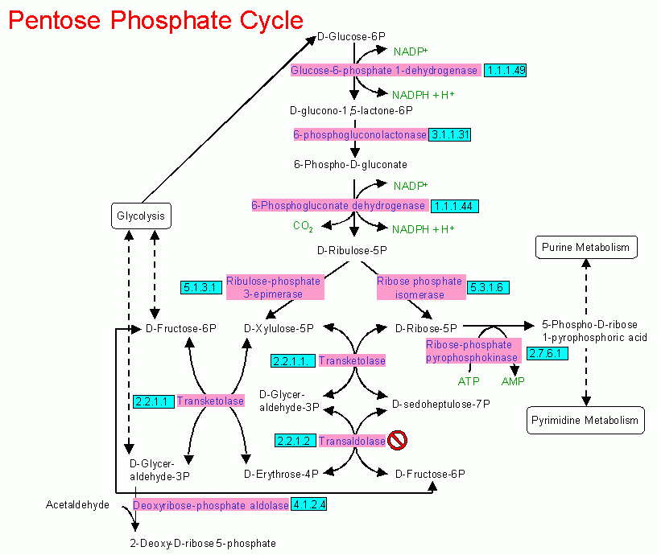
Sugar CO2
Does not produce ATP in ETS
Produce ribose-5-phosphate (nucleic acids), NADP (light reaction, fatty acid production), 3, 4, 5, 6, 7 carbon skeleton for biosynthesis reactions

Slide 43
Fermentation
The process by which a glucose is broken down in the absence of oxygen.
  Fermentation allows a cell to continue the supply of ATP, in anerobic (without oxygen) conditions.
  Lactic Acid Fermentation: Pyruvates can be converted into lactic acid, NAD+ is recycled by lactic acid when glucose runs out.

Slide 44
Glycolysis
Glucose (6C)
2 Pyruvate 3C)
CO₂
-O₂ -O₂
+O₂
Ethanol Lactate
TCA Cycle

Slide 45
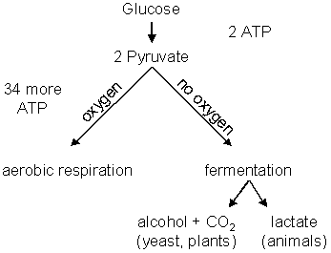
Pyrovic acid
Acetaldehyde
CH3-CHO
Ethanol
4 ATP
Net: 2
30
2
2

Slide 46
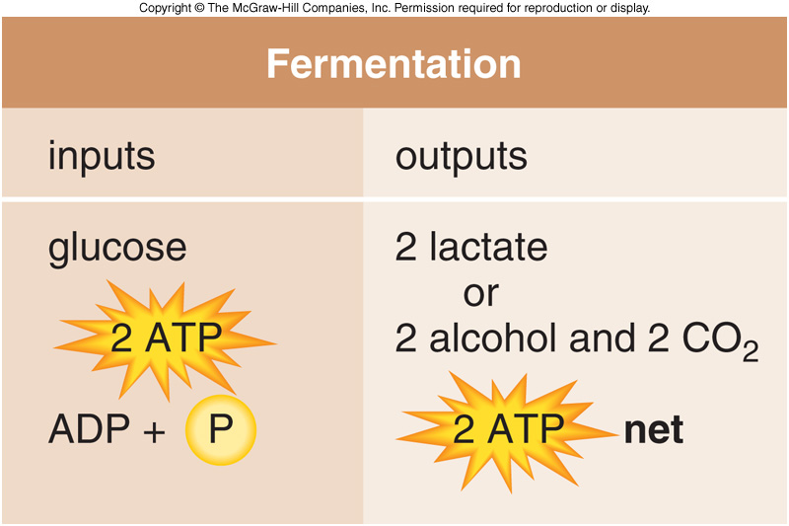

Slide 47
Comparison of Aerobic and Anaerobic Respiration
Similarity
Sugar is broken down to release energy
ATP is made
Both are controlled by enzymes

Slide 48
Differences
aerobic respiration
anaerobic respiration
oxygen requirement
essential
nil
oxidation of sugar
complete oxidation
incomplete oxidation
energy released
large amount
small amount

Slide 49
aerobic respiration
anaerobic respiration
organic: ethanol or lactic acid
end products
inorganic: CO₂ and H₂O
in lower organisms (e.g. bacteria and yeast) and vertebrate muscles
in most living cells
occurrence

Slide 50
Differences between Respiration and Photosynthesis
aerobic respiration
photosynthesis
produces carbon dioxide and water
requires carbon dioxide and water
energy is released
energy (light) is absorbed
an oxidative process
a reductive process

Slide 51
aerobic respiration
photosynthesis
a breaking down process
a synthetic process
occurs in all living cells at all times
occurs in green plants only when light is available
occurs in mitochondria
occurs in chloroplasts

Slide 52
Alternate Fates of Glucose C
Not all C respired to CO₂
Intermediates of respiration branch off:
  amino acids
  pentoses for cell wall structure
  nucleotides
  porphyrin biosynthesis
  fatty acid synthesis
  lignin precursors
  precursors for carotenoid synthesis, hormones

Slide 53
Uses of Energy
Biosynthesis
  Replacing body structures
  Growth
  Reproduction
  Storage (Fat, Glycogen)
  Exported Materials
Maintenance (homeostasis)
External Work (e.g, movement)

Slide 54
What Affects Metabolic Rate?
Chemical Activity
Environmental Temperature
Digestive Processing (Specific Dynamic Action)
Age
Gender
Circadian Rhythms
Aquatic Salinity (Osmoregulation)

Slide 55
How can we measure MR?
Aerobic metabolism:
Fuel + O₂ CO₂ + H₂O + ATP + heat
(C₆H₁₂O₆)
*
Indirect measures
Direct measures

Slide 56
Amount of CO₂ formed does not always equal amount of O₂ consumed
Respiratory Quotient (RQ)
  Amt. CO₂ produced/O₂ consumed
  Varies for different energy sources

Slide 57
BUT, heat production varies with foodstuff being oxidized…
HEAT PRODUCTION (KJ)
Per gram of food
Per liter of O₂ consumed
Per liter of CO₂ produced
RQ
carbohydrates
17.1
21.1
21.1
1.0
lipids
38.9
27.9
19.8
0.7
17.6
23.3
18.7
0.8
Proteins
What if you aren’t sure what animal ate?
“Respiratory Quotient” = Rate of CO₂ production
Rate of O₂ production

Slide 58
~ END ~

Slide 59
Summary

Slide 60
Summary

Slide 61
Summary

