Slide 1
Parallel programming languages
Hossein Bastan
Isfahan University of Technology

Slide 2
outline
Parallel programming tools
  Shared memory programming tools
    OpenMP
    POSIX Threads
  Distributed memory programming tools
    MPI
  Parallel Programming Languages
    Linda
    Erlang
    Unified parallel C
    Charm++
    OpenCL

Slide 3
Shared memory programming
OpenMP
POSIX Thread

Slide 4
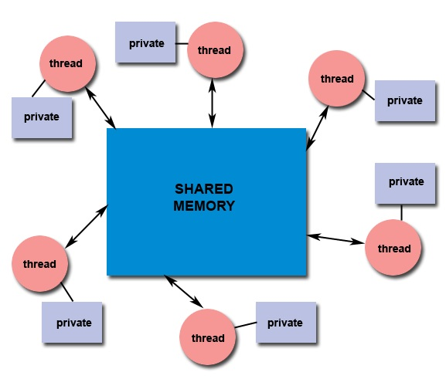
Shared memory model

Slide 5
OpenMP
an API
C, C++, and Fortran
OpenMP is
  managed by the nonprofit technology consortium OpenMP Architecture Review Board ( OpenMP ARB)
  AMD, IBM, Intel, Cray, HP, Fujitsu, Nvidia, NEC, Microsoft, Texas Instruments, Oracle Corporation, and more
OpenMP uses a portable, scalable model
  simple and flexible interface
  standard desktop computer to the supercomputer

Slide 6
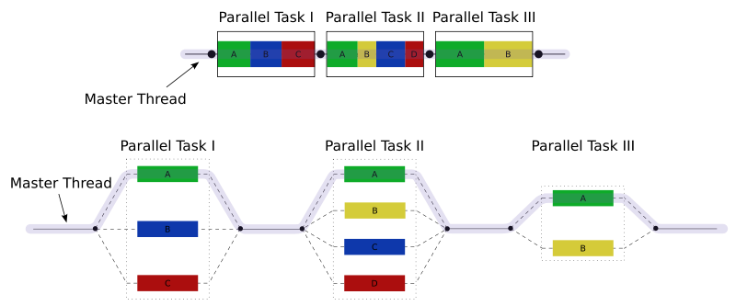
OpenMP

Slide 7
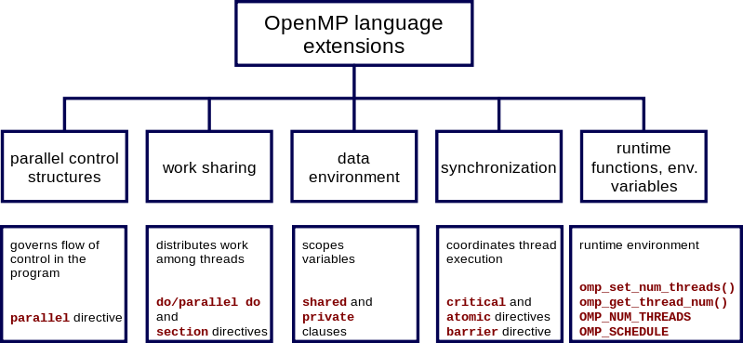
OpenMP

Slide 8
POSIX Threads
POSIX standard for threads
The standard, POSIX.1c, Threads extensions (IEEE Std 1003.1c-1995)
an API for creating and manipulating threads.
Pthreads defines a set of C programming language types, functions and constants
implemented with a pthread.h
There are around 100 Pthreads procedures, all prefixed "pthread_"

Slide 9
Distributed memory programming
Message Passing Interface (MPI)

Slide 10
Message Passing Interface
a standardized API typically used for parallel and/or distributed computing
researchers from academia and industry
MPI's goals
  high performance
  Scalability
  portability
MPI standard is comprised of 2 documents
  MPI-1 published in 1994
  MPI-2 published in 1996

Slide 11
Message Passing Interface
MPI imlementation
  MPICH
  MPICH-G2
  OpenMPI
  MPI.net , Pure MPI.net
  MPJ Express
  MatlabMPI , MPITB
  MPI for Python

Slide 12
Parallel Programming
Linda
ErLang
Unified Parallel C (UPC)
Charm++
OpenCL
Cilk

Slide 13
Linda
a model of coordination and communication among several parallel processes operating upon objects stored in and retrieved from shared, virtual, associative memory
developed by David Gelernter and Nicholas Carriero at Yale University
implemented as a “coordination language”

Slide 14
Linda
Tuple
Tuple space
Linda model requires four operations that individual workers perform on the tuples and the tuplespace
  In
  Rd
  out
  eval

Slide 15
ErLang
a general-purpose concurrent, garbage-collected programming language and runtime system
first version was developed by Joe Armstrong in 1986
  a proprietary language within Ericsson
  released as open source in 1998
  In 2006, native symmetric multiprocessing support was added to the runtime system and virtual machine

Slide 16
ErLang
designed by Ericsson to support distributed, fault-tolerant, soft-real-time, non-stop applications
Erlang provides language-level features
all concurrency is explicit in Erlang, processes communicate using message passing instead of shared variables, which removes the need for locks

Slide 17
Unified Parallel C
an extension of the C programming language designed for high-performance computing on large-scale parallel machines
The programmer is presented with a single shared, partitioned address space

Slide 18
Unified Parallel C
The programmer is presented
  a single shared
  partitioned address space
  variables may be directly read and written by any processor
  each variable is physically associated with a single processor

Slide 19
Charm++
a parallel object-oriented programming language based on C++ and developed in the Parallel Programming Laboratory at the University of Illinois
Programs written in Charm++
  decomposed into a number of cooperating message-driven objects called chares
designed with the goal of
  enhancing programmer productivity
  good performance on a wide variety of underlying hardware platforms

Slide 20
OpenCL
a framework for writing programs that execute across heterogeneous platforms
OpenCL includes
  a language (based on C99) for writing kernels
  APIs that are used to define and then control the platforms
was initially developed by Apple Inc
refined into an initial proposal in collaboration with technical teams at AMD, IBM, Intel, and Nvidia
an open standard maintained by the non-profit technology consortium Khronos Group

Slide 21
Cilk
general-purpose programming language designed for multithreaded parallel computing
has been developed since 1994 at the MIT Laboratory for Computer Science
based on ANSI C
July 2009, Intel Corporation acquired Cilk Arts, the Cilk++ technology and the Cilk trademark
In 2010, Intel released a commercial implementation in its compilers combined with some data parallel constructs with the name Intel Cilk Plus

Slide 22
summary
  Shared memory programming tools
    OpenMP
    POSIX Threads
  Distributed memory programming tools
    MPI
  Parallel Programming Languages
    Linda
    Erlang
    Unified parallel C
    Charm++
    OpenCL

Slide 23
refrences
http://en.wikipedia.org
http://openmp.org/wp/
https://computing.llnl.gov
http://www.hpclab.niu.edu/mpi
http://www.open-mpi.org/
http://mpj-express.org/
http://mpi4py.scipy.org
http://upc.gwu.edu
http://charm.cs.uiuc.edu
http://www.khronos.org

Slide 24


