Slide 1
Massively Parallel Processor Array
Presented by:
Samaneh Rabienia

Slide 2
Introduction
A Massively Parallel Processor Array (MPPA) is a type of integrated circuit which has a massively parallel array of hundreds or thousands of CPUs and RAM memories.

Slide 4
These processors pass work to one another through a reconfigurable interconnect of channels. By harnessing a large number of processors working in parallel, an MPPA chip can accomplish more demanding tasks than conventional chips.

Slide 5
Architecture
MPPA is a MIMD (Multiple Instruction streams, Multiple Data) architecture, with distributed memory accessed locally, not shared globally. Each processor is strictly encapsulated, accessing only its own code and memory. Point-to-point communication between processors is directly realized in the configurable interconnect.

Slide 6
Ambric’s programming model
Ambric developed a massively parallel processor array integrated circuit for high performance applications. Ambric’s parallel processor solution including a “structured object programming model” that allowed developers to effectively program the large number of cores.

Slide 7
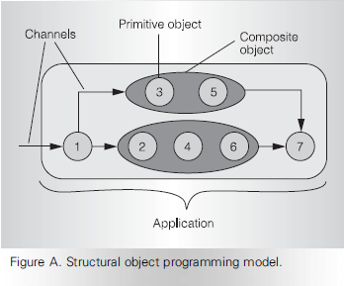
Ambric developed the Structural Object Programming Model (Figure A) to satisfy the parallel development problem first, then developed the hardware architecture, chip, and tools to faithfully realize this model.

Slide 8
Interconnect architecture
The basic building block of this interconnect is an Ambric register. Registers are chained together to form channels. Figure 1a shows a simple interconnect channel; Figure 1b shows a processing channel with objects (logic or processors) in each stage.

Slide 10
Alongside the parallel data are two control signals, valid and accept, that implement a hardware protocol for local forward and back pressure. In addition to carrying data forward, channels have forward and backward flow control signals: valid and accept.

Slide 11
When a register can accept an input, it asserts accept upstream; when it has output available, it asserts valid downstream. In a clock cycle when a pair of registers see their valid and accept signals are both true, they each independently execute their side of the transfer event, without negotiation or acknowledgment.

Slide 12
In cycles 1 and 2, X has word 1 valid on its output, but Y is not accepting.
In cycle 3, Y is accepting word 1 from the output of X, and both X and Y, observing their common valid and accept signals, execute the transfer.
In cycles 4 and 5, Y is still accepting, but X is empty.
In cycle 6, X has word 2, and Y is accepting, so word 2 is immediately transferred.
Next cycle, X has word 3, and Y is still accepting, so this word is transferred as well.

Slide 13
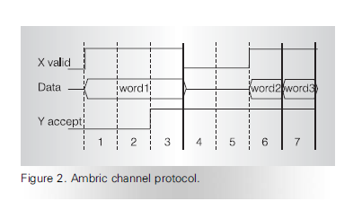

Slide 14
In each clock cycle, a register input only loads data that is valid, if it has room to accept it, otherwise the input stalls. When a register output is valid and the channel downstream is accepting, it knows its output is being transferred, otherwise the output stalls.
In fact, CPU only sends data when channel is ready, else it just stalls. CPU only receives when channel has data, else it just stalls. Sending a word from one CPU to another is also an event.

Slide 15
In a cycle when a register is accepting upstream, but the channel downstream is not accepting, the register must hold its output word and accept a new word. To handle this, each Ambric register can hold two words, one on its output and one buffered from its input.

Slide 16
A pair of processor objects in Figure 3 are connected through a channel. When a processor instruction issues a word of output to a channel, it asserts valid, but if the channel is not accepting, the instruction stalls until it is. When a processor accepts a word of input from a channel, it asserts accept, but if the channel isn’t valid, it stalls until it is.

Slide 18
Major functional units
Compute Unit
A cluster of four Ambric processors,
Two Streaming RISCs (SR) and
Two Streaming RISC/DSPs (SRD)
RAM Unit
RAM Units (RUs) are the main on-chip memory facilities.
Each RU is paired up with a CU.

Slide 20
Streaming RISC
A simple 32-bit CPU.
Used mainly for small or fast tasks, (forking and joining channels, generating complex address streams, and other utilities).
It has a single-integer ALU.
Accepts one input channel and feeds one output channel per cycle.
It has 64 words of local memory that hold up to 128 16-bit instructions and data.

Slide 21
SRD
A more capable 32-bit processor
For math-intensive processing and larger, more complex objects.
It has three ALUs— two in series and one in parallel—with individual instruction fields.
Local memory holds 256 32-bit instructions.

Slide 23
The CU interconnect joins two SRDs and two SRs with one another, and with CU input and output channels, which connect directly with neighbor CUs, and with the distant channel network.

Slide 25
Each SR and SRD processor has an input crossbar to feed its two input channels.
Each input crossbar can receive every CU input, and the processor outputs.
A output crossbar connects processor outputs and CU inputs to CU outputs.
The output crossbar is fully populated for processor outputs, and partially populated for CU inputs

Slide 26
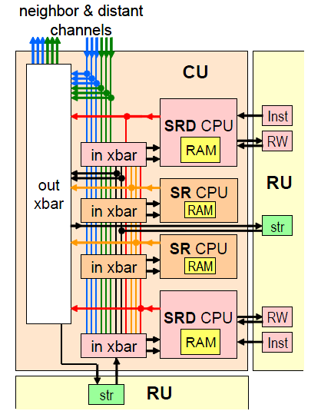

Slide 27
RAM Unit
RAM Units (RUs) are the main on-chip memory facilities.
Each RU is paired up with a CU.

Slide 29
It has four independent single-port RAM banks, each with 512 32-bit words.
It has six configurable RU access engines, which turn RAM regions into objects that stream addresses and data over channels.
Each SRD has a read/write engine (RW) for random access, and an instruction engine (Inst) for access to instructions in RAM.
Two Streaming engines (str) provide for channel-connected FIFOs, or random access over channels using packets. Engines access RAM banks on demand through a dynamic, arbitrating interconnect.

Slide 30
Brics and their interconnect
A bric is the physical building block that is replicated to make a core. Figure 5 shows part of a bric array, with two brics in the middle, and parts of two above and two below. Each bric has two CUs and two RUs, totaling eight CPUs and 21 Kbytes of SRAM. Interbric wires are located so that brics connect by abutment.

Slide 32
The core array’s interconnect is a configurable three-level hierarchy of channels. At the base of the hierarchy is the CU’s internal interconnect, shown in Figure 4.
At the next level, neighbor channels (Figure 5) directly connect CUs with nearby CUs, and RUs with nearby RUs. Each CU neighbor channel (gray arrows) directly connects the output crossbar of one CU to the input crossbar of another CU. Every CU has two input and two output channels each way with CUs to the north, south, east, and west.

Slide 33
At the top level, the network of distant channels for long connections is a circuit switched 2D mesh, shown by the heavy arrows in Figure 6. Each bric has a distant network switch, with four channels in and four out connecting with each CU.

Slide 35
Switches are interconnected with four channels each way. These bric-long channels are the longest signals in the core (except for the low-power clock tree and the reset), which makes this interconnect very scalable.
Channel connections through each switch are statically configured. Each switch is registered, so there is one channel stage per hop. The distant channel network always runs at the maximum clock rate, connecting to CUs through clock-crossing registers.

Slide 36
Figure 7a shows part of a simple distant network switch. The figure shows just two eastbound channels, choosing from the switches to the north, west, and south. The additional two CU connections (not shown) are similar.
A multiplexer feeds each outgoing channel register, selecting data (dark gray) and valid (light gray) signals from an incoming channel, and demultiplexing accept signals (black) to the selected channel.

Slide 37
Figure 7b shows the virtual-channel version of the distant channel switch, which is used in Am2045. Thanks to the channel protocol signals, this arrangement makes it easy to share parallel data wires between each switch, reducing the total wire length.

Slide 39
Am2045 is a standard-cell, 130-nm ASIC with 180 million transistors. Its core has 45 CU-RU brics in a five-by-nine array, containing 336 32-bit processors and 7.2 Mbits of distributed SRAM, dissipating 10 watts fully loaded, with a 300-MHz clock.
At full speed, all processors together are capable of 1.03 trillion operations per second. The Am2045’s energy efficiency is 12.6 MIPS/mW.
In contrast to FPGAs, the entire interconnect takes less than 10 percent of core area. Its minimum bisection bandwidth, through a horizontal cut line crossing nine columns, is 713 Gbps.

Slide 40
The core array of nine columns by five brics is surrounded by I/O interfaces connected to neighbor and distant channels:
a four-lane PCIe interface, available at power up, supporting chip configuration and debugging from the host.
128 bits of parallel general-purpose I/O (GPIO) ports, capable of glueless chip-to-chip channels.
Serial flash memory, microprocessor bus, and JTAG interfaces.

Slide 41
The left side of Figure 8 is a magnified bric, showing the stack of two CU-RU pairs. The physical design of a single bric is stepped and repeated to form the core. Each bric has its share of the neighbor and distant interconnect channels and switches.
Since the bric’s physical design was developed with automatic logic synthesis, placement, and routing, the interconnect architecture’s features are not visibly distinct from the rest of the bric’s logic and wiring.

Slide 43
THE END

