Slide 1
GPU Architecture
By: ali ajorian
Isfahan university of technology
2012

Slide 2
Age of parallelism
Single CPU performance
Doubled every 2 years for 30 years until 5 years ago.
Marginal improvement in the last 5 years.
2005 year and checking walls
Memory Wall
Power Wall
Processor Design Complexity
Sequential or parallel: this is the problem!!!
More cores rather than more clock rate

Slide 3
Early parallel computing
It was not a big idea
Main frames and super computers

Slide 4
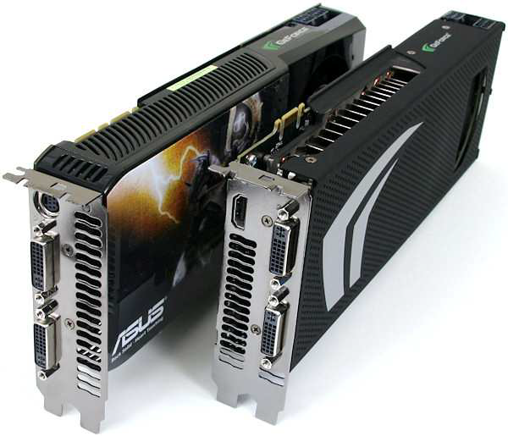
And now GPUs
Stands for “Graphics Processing Unit”
Integration Scheme: a card on the motherboard with Massively Parallel computing power

Slide 5
A desktop supper computer

Slide 6
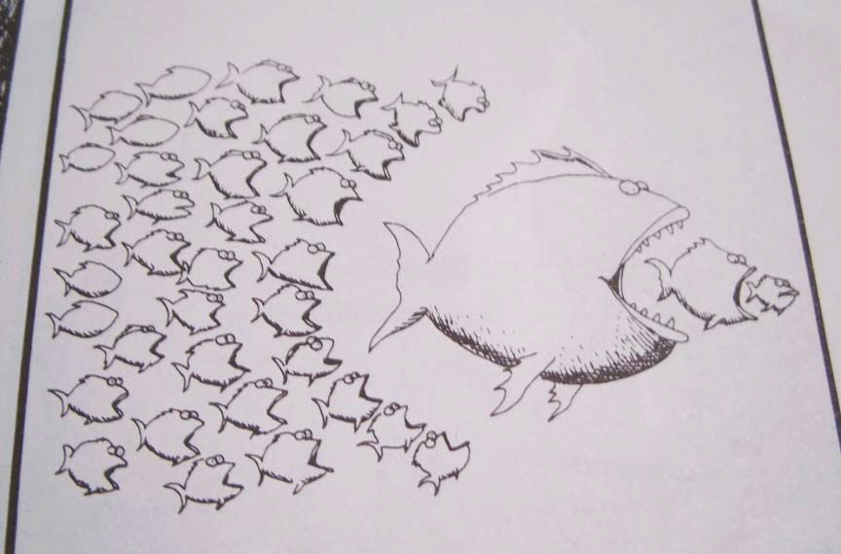
History of parallel computing

Slide 7
GPUs: A Brief History
Stage0: graphic accelerators
Early VGA cards accelerate 2D GUI
Just configurable
Stage1: Fixed Graphics Hardware
Graphics-only platform
Very limited programmability
Stage2: GPGPU
Trick GPU to do general purpose computing
Programmable, but requires knowledge on computer
graphics
Stream Processing Platforms
High-level programming interface
No knowledge on Computer Graphics is required
Examples: NVIDIA’s CUDA, OpenCL

Slide 8
Stream Processing Characteristics
Fairly simple computation on huge amount of data (streams)
Single Program Multiple Data (SPMD)
Data Parallelism
e.g., Matrix Operations, Image Processing

Slide 9
Graphic accelerators to CUDA GPUs(cont)

Slide 10
CUDA programming model
CPU + GPU heterogeneous programming
Applications with sequential and parallel parts
Host : CPU
Sequential threads
Device : GPU
Parallel threads in SIMT architecture
some kernels that runs on a grid of threads.

Slide 11
CUDA programming model

Slide 12
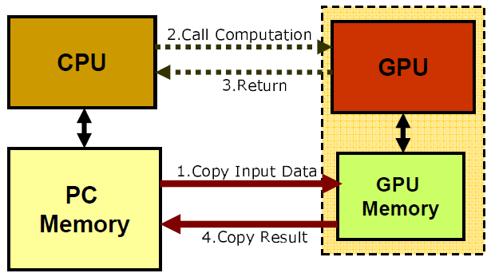
CUDA programming model(cont)

Slide 13
GPU Architecture (NVIDIA)

Slide 14
GPU Architecture (Fermi)

Slide 15
SM architecture

Slide 16
CUDA programming model

Slide 17
Memory types
Per block
registers
shared memory
Per thread
local memory
Per grid
Global memory
Constant memory
Texture memory

Slide 18
Memory types(cont)

Slide 19
Questions?

