Slide 1
CUDA GPU Programming
Shekoofeh Azizi
Spring 2012

Slide 2
What is CUDA ?
CUDA is a parallel computing platform and programming model invented by NVIDIA
With CUDA, you can send C, C++ and Fortran code straight to GPU, no assembly language required.

Slide 3
Outline
Development Environment
Introduction to CUDA C
CUDA programming model
Kernel call
Passing parameter
Parallel Programming in CUDA C
Example : summing vectors
Limitations
Hierarchy of blocks and threads
Shared memory and synchronizations
CUDA memory model
Example : dot product

Slide 4
Development Environment
The prerequisites to developing code in CUDA C :
CUDA-enabled graphics processor
NVIDIA device driver
CUDA development toolkit
Standard C compiler

Slide 5
CUDA-enabled GPU
Every NVIDIA GPU since the 2006 has been CUDA-enabled.
Frequently Asked Questions
How can I find out which GPU is in my computer?
Do I have a CUDA-enabled GPU in my computer?

Slide 6
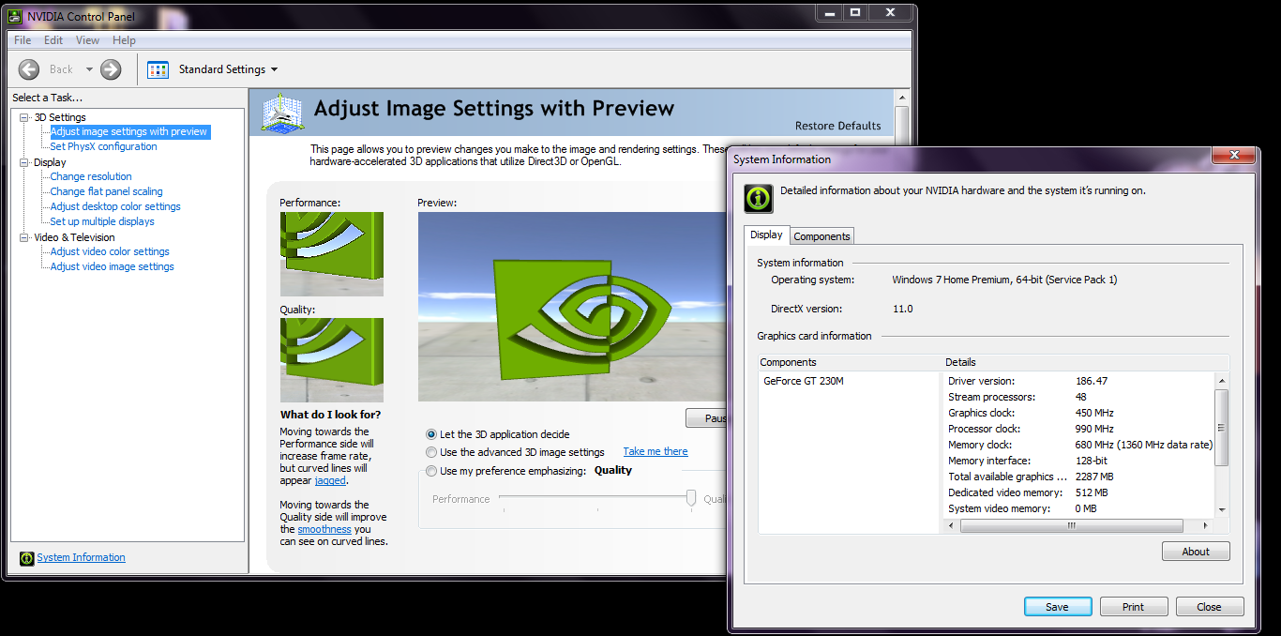
How can I find out which GPU is in my computer?
Control Panel → "NVIDIA Control Panel“ or "NVIDIA Display“

Slide 7
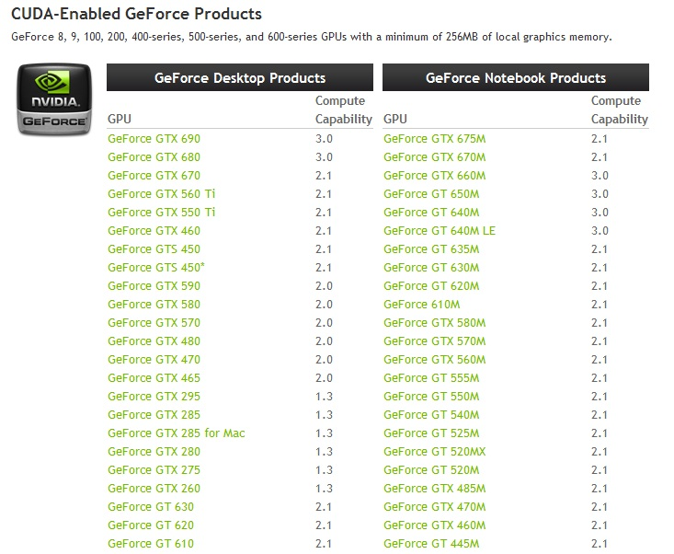
Do I have a CUDA-enabled GPU in my computer?
Complete list on http://developer.nvidia.com/cuda-gpus

Slide 8
NVIDIA device driver
System software that allows your programs to communicate with the CUDA-enabled hardware
Due to graphics card and OS can find on :
http://www.geforce.com/drivers
http://developer.nvidia.com/cuda-downloads
CUDA-enabled GPU + NVIDIA’s device driver = Run compiled CUDA C code.

Slide 9
CUDA development toolkit
Two different processors
CPU
GPU
Need two compilers
One compiler will compile code for your CPU.
One compiler will compile code for your GPU
NVIDIA provides the compiler for your GPU code on:
http://developer.nvidia.com/cuda-downloads
Standard C compiler : Microsoft Visual Studio C compiler

Slide 10
Outline
Development Environment
Introduction to CUDA C
CUDA programming model
Kernel call
Passing parameter
Parallel Programming in CUDA C
Example : summing vectors
Limitations
Hierarchy of blocks and threads
Shared memory and synchronizations
CUDA memory model
Example : dot product

Slide 11
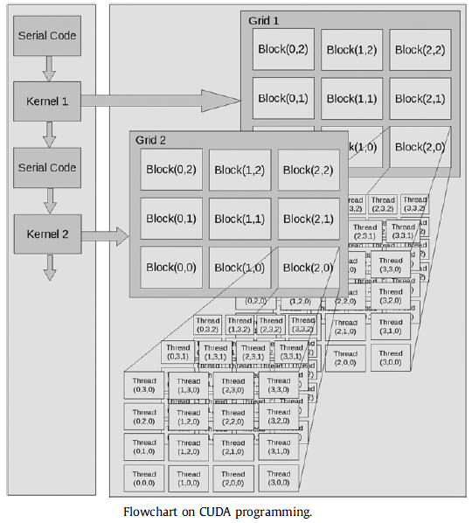
CUDA programming model
Host : CPU and System’s memory
Device : GPU and its memory
Kernel : Function that executes on device
Parallel threads in SIMT architecture

Slide 12
CUDA programming model (Cont.)

Slide 13
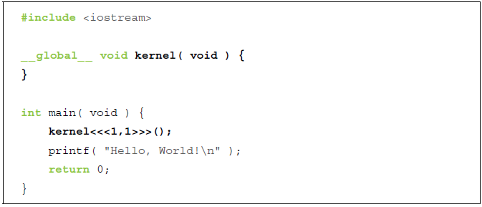
Kernel call
An empty function named kernel() qualified with __global__
A call to the empty function, embellished with <<<1,1>>>

Slide 14
Kernel call (cont.)
__global__
CUDA C needed a linguistic method for marking a function as device code
It is shorthand to send host code to one compiler and device code to another compiler.
<<<1,1>>>
Denote arguments we plan to pass to the runtime system
These are not arguments to the device code
These will influence how the runtime will launch our device code

Slide 15
Passing parameter

Slide 16
Passing parameter (cont.)
Allocate the memory on the device → cudaMalloc()
A pointer to the pointer you want to hold the address of the newly allocated memory
Size of the allocation you want to make
Access memory on a device → cudaMemcpy()
cudaMemcpyHostToDevice
cudaMemcpyDeviceToHost
cudaMemcpyDeviceToDevice
Release memory we’ve allocated with cudaMalloc()→ cudaFree()

Slide 17
Passing parameter (cont.)
Restrictions on the usage of device pointer:
You can pass pointers allocated with cudaMalloc() to functions that execute on the device.
You can use pointers allocated with cudaMalloc() to read or write memory from code that executes on the device.
You can pass pointers allocated with cudaMalloc() to functions that execute on the host.
You cannot use pointers allocated with cudaMalloc() to read or write memory from code that executes on the host.

Slide 18
Outline
Development Environment
Introduction to CUDA C
CUDA programming model
Kernel call
Passing parameter
Parallel Programming in CUDA C
Example : summing vectors
Limitations
Hierarchy of blocks and threads
Shared memory and synchronizations
CUDA memory model
Example : dot product

Slide 19
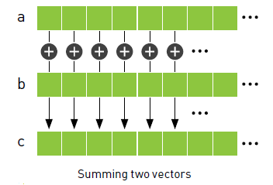
CUDA Parallel Programming
Example : Summing vectors

Slide 20
Example : Summing vectors (1)

Slide 21
Example : Summing vectors (2)
GPU Code : add<<<N,1>>>
GPU Code : add<<<1,N>>>

Slide 22
Example : Summing vectors (3)
Allocate 3 array on device → cudaMalloc()
Copy the input data to the device → cudaMemcpy()
Execute device code → add<<<N,1>>> (dev_a , dev_b , dev_c)
first parameter: number of parallel blocks
second parameter: the number of threads per block
N blocks x 1 thread/block = N parallel threads
Parallel copies→ blocks

Slide 23
Example : Summing vectors (4)

Slide 24
Limitations
The hardware limits the number of blocks in a single launch to 65,535 blocks per launch.
The hardware limits the number of threads per block with which we can launch a kernel to 512 threads per block.
$⟹$We will have to use a combination of threads and blocks

Slide 25
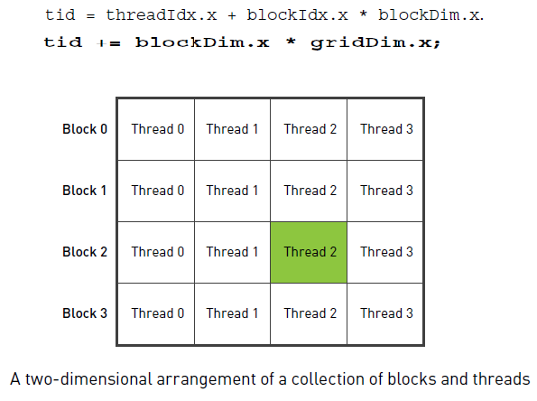
Limitations (cont.)
Change the index computation within the kernel
Change the kernel launch

Slide 26
Hierarchy of blocks and threads

Slide 27
Hierarchy of blocks and threads (cont.)
Grid : The collection of parallel blocks
Blocks
Threads

Slide 28
Outline
Development Environment
Introduction to CUDA C
CUDA programming model
Kernel call
Passing parameter
Parallel Programming in CUDA C
Example : summing vectors
Limitations
Hierarchy of blocks and threads
Shared memory and synchronizations
CUDA memory model
Example : dot product

Slide 29
CUDA Memory model

Slide 30
CUDA Memory model (cont.)
Per block
registers
shared memory
Per thread
local memory
Per grid
Global memory
Constant memory
Texture memory

Slide 31
Shared memory
__shared__
The CUDA C compiler treats variables in shared memory differently than typical variables.
Creates a copy of the variable for each block that you launch on the GPU.
Every thread in that block shares the memory
Threads cannot see or modify the copy of this variable that is seen within other blocks
Threads within a block can communicate and collaborate on computations

Slide 32
Shared memory (cont.)
The latency to access shared memory tends to be far lower than typical buffers
Shared memory effective as a per-block, software managed cache or scratchpad.
Communicate between threads→ mechanism for synchronizing between threads.
Example :
$\left.\begin{aligned}\text{Thread} \text{A} \text{writes} \text{a} \text{value} \text{to} \text{shared} \text{memory} \\ \\ \text{Thread} \text{B} \text{do} \text{something} \text{with} \text{this} \text{value} \end{aligned}\right\} ⟹synchronaziation$

Slide 33
Example : Dot product (1)
The computation consists of two steps:
First, we multiply corresponding elements of the two input vectors
Second, we sum them all to produce a single scalar output.
Dot product of two four-element vectors

Slide 34
Example : Dot product (2)

Slide 35
Example : Dot product (3)
Buffer of shared memory: cache→ store each thread’s running sum
Each thread in the block has a place to store its temporary result.
Need to sum all the temporary values we’ve placed in the cache.
Need some of the threads to read the values from this cache.
Need a method to guarantee that all of these writes to the shared array cache[] complete before anyone tries to read from this buffer.
When the first thread executes the first instruction after __syncthreads(), every other thread in the block has also finished executing up to the __syncthreads().

Slide 36
Example : Dot product (4)
Reduction: the general process of taking an input array and performing some computations that produce a smaller array of results a.
having one thread iterate over the shared memory and calculate a running sum and take time proportional to the length of the array
do this reduction in parallel and take time that is proportional to the logarithm of the length of the array

Slide 37
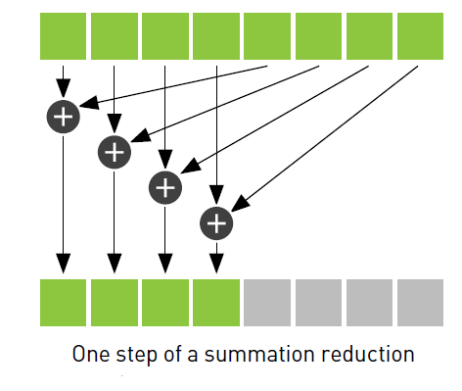
Example : Dot product (5)
Parallel reduction:
Each thread will add two of the values in cache and store the result back to cache.
Using 256 threads per block, takes 8 iterations of this process to reduce the 256 entries in cache to a single sum.
Before read the values just stored in cache, need to ensure that every thread that needs to write to cache has already done .

Slide 38
Example : Dot product (6)

Slide 39
Example : Dot product (7)
Allocate host and device memory for input and output arrays
Fill input array a[] and b[]
Copy input arrays to device using cudaMemcpy()
Call dot product kernel using some predetermined number of threads per block and blocks per grid

Slide 40
Thanks Any question?

Slide 41
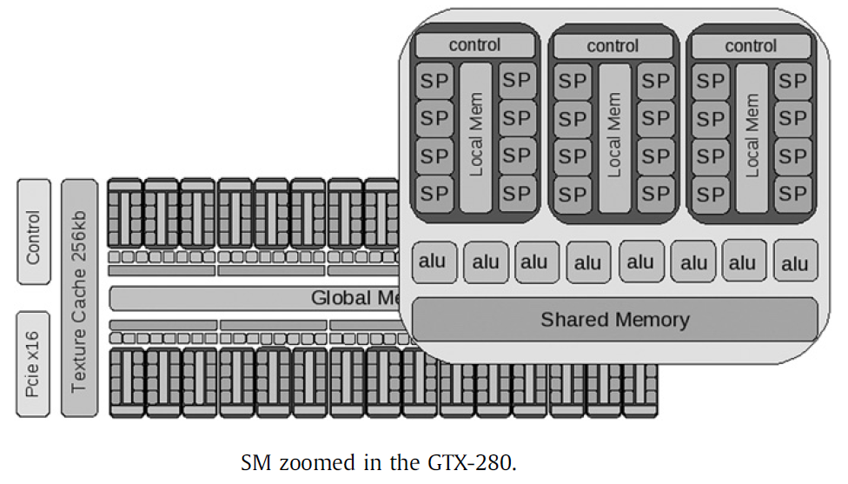
GPU Architecture

