Slide 1
مروري بر نفوذگري و امنيت در سيستم‌هاي كامپيوتري
تثبيت مواضع

Slide 2
روند نماي کلي انجام يک حملة کامپيوتري
شناسايي مواضع و نقاط ضعف سيستم هدف
تثبيت مواضع
برنامه ريزي مرحله بعد عمليات
هجوم اوليه
کسب دسترسي در سطح کاربر
ساير فعاليتهاي غير مجاز
دسترسی
برداشتن يا خراب کردن اطلاعات
پوشاندن ردپاها
نصب دريچه
کسب دسترسي در سطح مدير
حمله به اهداف ثانويه
شناسايي سيستم
تخريب
جلوگيري از سرويس

Slide 3
Contents
Definitions
Spywares & Trojan horses
Rootkits
Covert channels

Slide 4
Definitions
A general term for a program that secretly monitors your actions. While they are not sometimes malicious, but like a remote control program used by a hacker receive your private information. Software companies have been known to use Spyware to gather data about customers.
SPYWARE
Definition from: BlackICE Internet Security Systems - http://blackice.iss.net/glossary.php
TROJAN
HORSE
An apparently useful and innocent program containing additional hidden code which allows the unauthorized collection, exploitation, falsification, or destruction of data.
Definition from: Texas State Library and Archives Commission - http://www.tsl.state.tx.us/ld/pubs/compsecurity/glossary.html
Notes:
Exploitation سوء استفاده
Falsification ،تحريف

Slide 5
Summary of Effects
Collection of data from your computer without your agreement
Collection of data pertaining to your habitual use
Execution of code without your agreement
Installation on your computer without your agreement
Inability to remove the software
Performing other undesirable tasks without agreement

Slide 6
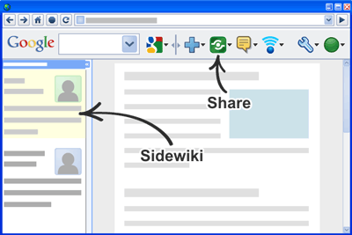


Spyware Software Examples
GAIN / Gator
Gator E-Wallet
Cydoor
BonziBuddy
Google Toolbar
Yahoo Toolbar
DownloadWare
BrowserAid
Dogpile Toolbar
Image Sources…
GAIN Logo – The Gator Corporation – http://www.gator.com
BonziBuddy Logo – Bonzi.com - http://images.bonzi.com/images/gorillatalk.gif
DownloadWare Logo – DownloadWare - http://www.downloadware.net

Slide 7
Spyware Defence
User Initiatives…
Use Legitimate S/W Sources
Improved Technical Ability
Choice of Browser
Choice of OS
Technical Initiatives...
Spyware Removal Programs
Firewall Technology
Disable ActiveX Controls
E-Mail Filters
Download Patches

Slide 8
Types of Trojan Horse
Remote Access Trojan: allow attacker to gain control over the victim’s pc.
Data sending Trojan: provide the attacker confidential data such as password, credit card information.
Destructive Trojan: designed to destroy or delete files.
Proxy Trojan: to use the victim’s computer as the proxy server for the attackers.
FTP Trojan: designed to open ftp port (port 21) on your computer, enable the attacker to connect your PC through File Transfer Protocol.
Security software disabler Trojan: designed to stop or kill security software program such as antivirus program and internet security program.
Denial of Service (DoS) attack: the attacker try to bring down the network service by flooding the useless traffic over the network.

Slide 9
Solutions
Use the following security mechanisms
Firewall
Virus Checker
Spyware Remover
Frequent OS updates
Frequent back-up
Learning problems

Slide 10
Similarities / Differences
Spyware | Trojan Horses
Commercially Motivated | Malicious
Internet connection required | Any network connection required
Initiates remote connection | Receives incoming connection
Purpose: To monitor activity | Purpose: To control activity
Collects data | Unauthorized access and control
Legal | Illegal
Not Detectable with Virus Checker | Detectable with Virus Checker
Age: Relatively New (< 10 Years) | Age: Relatively Old ( > 20 Years)
Memory Resident Processes
Secretly installed without user’s consent or understanding
Creates a security vulnerability
Source – Table derived and produced by; Andrew Brown, Tim Cocks and Kumutha Swampillai, February 2004.

Slide 11

Contents
Definitions
Spywares & Trojan horses
Rootkits
Covert channels

Slide 12
What is a Rootkit?
A rootkit is a tool that is designed to hide itself and other processes, data, and/or activity on a system.
“A tool used to protect backdoors and other tools from detection by administrators”
A rootkit is not
  An exploit
  A virus or worm

Slide 13
Rootkits - Why Should You Care?
If you can’t detect a backdoor on any given machine, how do you know your machine is clean?
New viruses will use new rootkit technology
Notes:
defunct
adj. no longer in use

Slide 14
Rootkits - How They Work?
To hide in a system you have to control a system
Act as a gatekeeper between what a user sees and what the system sees
Requires administrator privileges to install

Slide 15
How Rootkits Work - Hooking
A standard application

Slide 16
How Rootkits Work - Hooking
A hooked application

Slide 17
Rootkits – How They Work?
To hide what is taking place, an attacker wants to:
  Hide processes
  Hide services
  Hide listening TCP/UDP ports
  Hide kernel modules
  Hide drivers

Slide 18
Levels of Access in Windows
User Land
  User
  Administrator
  System
Kernel Land
  Drivers

Slide 19
What Happens When You Read a File?
Readfile() called on File1.txt
Transition to Ring 0
NtReadFile() processed
I/O Subsystem called
IRP generated
Data at File1.txt requested from ntfs.sys
Data on disk 2 requested from disk.sys

Slide 20
Userland Rootkits
Binary replacement eg modified Exe or Dll
Binary modification in memory eg He4Hook
User land hooking eg Hacker Defender
  IAT hooking

Slide 21
Kernel (Ring 0) Rootkits
Kernel Hooking
  E.g. NtRootkit
Driver replacement
E.g. replace ntfs.sys with ntfss.sys

Slide 22
Kernel (Ring 0) Rootkits
IO Request Packet (IRP) Hooking
  IRP Dispatch Table
E.g. He4Hook (some versions)

Slide 23
Kernel (Ring 0) Rootkits
Filter Drivers
Types
  File system filter
  Volume filter
  Disk Filter
  Bus Filter

Slide 24
Current Rootkit Capabilities
Hide processes
Hide files
Hide registry entries
Hide services
Completely bypass personal firewalls
Undetectable by anti virus
Covert channels - undetectable on the network
Install silently

Slide 25
Detection Methodologies
Traditional Detection
  Check integrity of important OS elements against a hash database (sigcheck)
  Look for unidentified processes (task manager)
  Check for open ports (netstat)

Slide 26
Detection Methodologies
Signature based
  Look for known rootkits, viruses, backdoors
  Antivirus
  Look for “bad things” living in memory
Problems
  Requires updated databases
  Doesn’t detect anything it hasn’t seen before

Slide 27
Detection Methodologies
Code verification
  Code sections are read only in all modern OSes
  Programs should not modify their own code
  Check to see if the files on disk match what is running in memory

Slide 28
Detection Methodologies: Code Verification

Slide 29
Hardware Rootkits
A OS reinstall won’t save you
Hard to remove.
  Device is usually destroyed
Difficult to implement

Slide 30
Contents
Definitions
Spywares & Trojan horses
Rootkits
Covert channels

Slide 31
Covert Channel
Covert channel: a communication path not intended as such by system’s designers
For example, resources shared at different levels could be used to “signal” information

Slide 32
Covert Channel Example
Alice has TOP SECRET, she wants to reveal it to Bob
Suppose the file space shared by all users
Alice creates file FileXYzW to signal “1” to Bob, and removes file to signal “0”
Bob lists the files
  If file FileXYzW does not exist, Alice sent 0
  If file FileXYzW exists, Alice sent 1
Alice can leak TOP SECRET info to Bob!

Slide 33
Covert Channel Example
Alice:
Create file
Delete file
Create file
Delete file
Bob:
Check file
Check file
Check file
Check file
Check file
Data:
1
0
1
1
0
Time:

Slide 34
Covert Channel
Other possible covert channels?
  Print queue
  ACK messages
  Network traffic, etc.
When does covert channel exist?
  Sender and receiver have a shared resource
  Sender able to vary some property of resource that receiver can observe
  “Communication” between sender and receiver can be synchronized

Slide 35
Covert Channel
So, covert channels are everywhere
“Easy” to eliminate covert channels:
  Eliminate all shared resources…
  …and all communication
Virtually impossible to eliminate covert channels in any useful system
  DoD guidelines: reduce covert channel capacity to no more than 1 bit/second
  Implication? DoD has given up on eliminating covert channels!
Notes:
The U.S. Department of Defense, or DoD,

Slide 36
Covert Channel
Consider 100MB TOP SECRET file
  Plaintext stored in TOP SECRET location
  Ciphertext (encrypted with AES using 256-bit key) stored in UNCLASSIFIED location
Suppose we reduce covert channel capacity to 1 bit per second
It would take more than 25 years to leak entire document thru a covert channel
But it would take less than 5 minutes to leak 256-bit AES key thru covert channel!

Slide 37
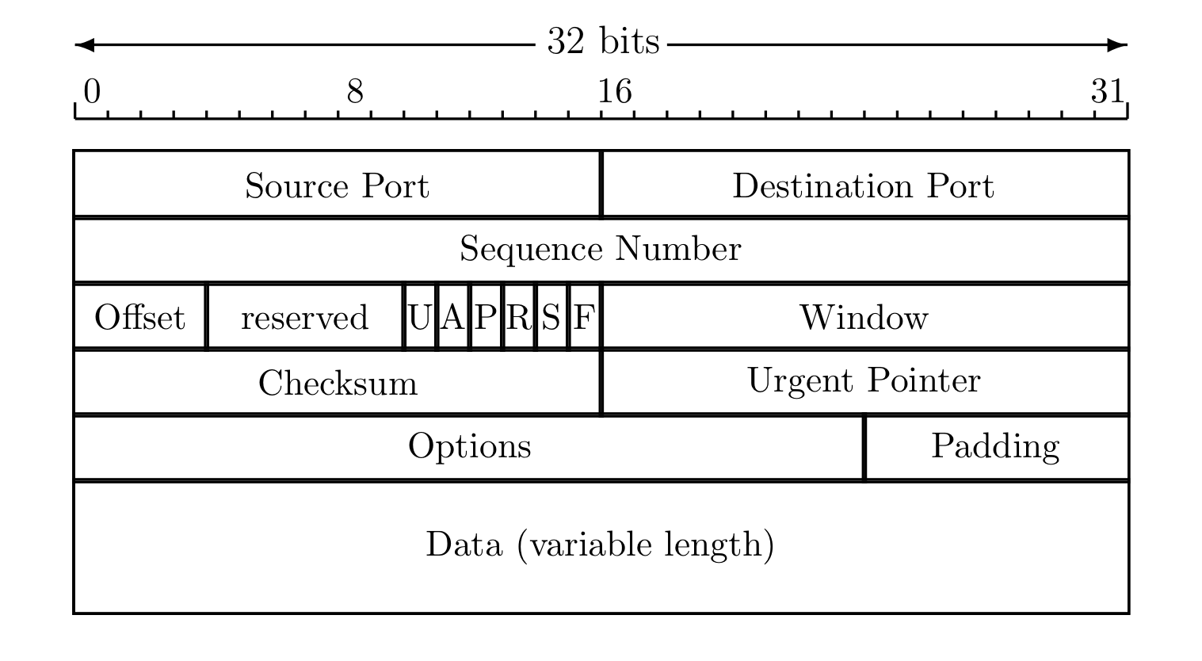
Real-World Covert Channel
Hide data in TCP header “reserved” field
Or use covert_TCP, tool to hide data in
  Sequence number
  ACK number

Slide 38

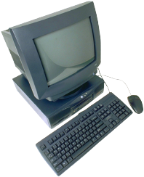
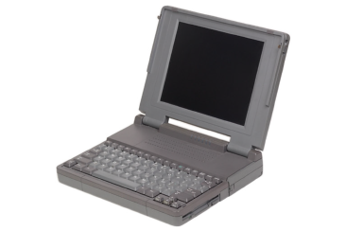
Real-World Covert Channel
Hide data in TCP sequence numbers
Tool: covert_TCP
Sequence number X contains covert info
ACK (or RST)
Source: B
Destination: C
ACK: X
SYN
Spoofed source: C
Destination: B
SEQ: X
B. Innocent
server
A. Covert_TCP
sender
C. Covert_TCP
receiver

