Slide 1
مروري بر نفوذگري و امنيت در سيستم‌هاي كامپيوتري
هجوم به قصد تخريب

Slide 2
روند نماي کلي انجام يک حملة کامپيوتري
شناسايي مواضع و نقاط ضعف سيستم هدف
تثبيت مواضع
برنامه ريزي مرحله بعد عمليات
هجوم اوليه
کسب دسترسي در سطح کاربر
ساير فعاليتهاي غير مجاز
دسترسی
برداشتن يا خراب کردن اطلاعات
پوشاندن ردپاها
نصب دريچه
کسب دسترسي در سطح مدير
حمله به اهداف ثانويه
شناسايي سيستم
تخريب
جلوگيري از سرويس

Slide 3
Contents
Denial of Service attacks
  Concepts
  Samples of attacks
Malicious Logic attacks
  Concepts
  Viruses

Slide 4
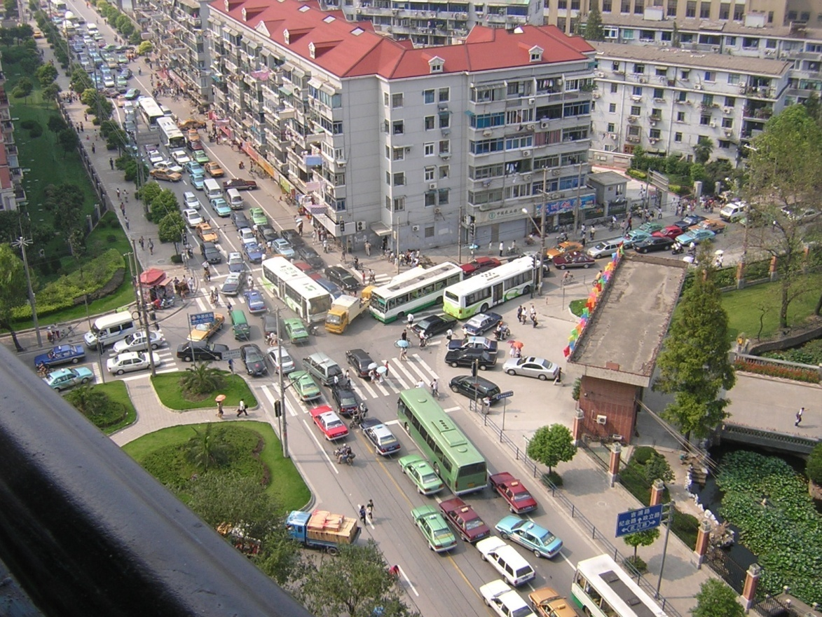
Denial of Service Attack
“Attack in which the primary goal is to deny the victim(s) access to a particular resource.”
Possible impacts:
reboot your computer, Slows down computers-Certain sites, Applications become inaccessible
**you are off.

Slide 5
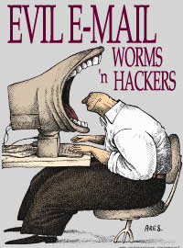
Results expected
Denial-of-service attacks can essentially disable your computer or your network. Depending on the nature of your enterprise.

Slide 6
Results expected
Some denial-of-service attacks can be executed with limited resources against a large, sophisticated site. This type of attack is sometimes called an "asymmetric attack“. For example, an attacker with an old PC and a slow modem may be able to disable much faster and more sophisticated machines or networks.

Slide 7


Saboteur vs. Restaurateur
How to take down a restaurant?
Table for four
at 8 o’clock.
Name of Mr. Smith.
Restaurateur
O.K.,
Mr. Smith
Saboteur

Slide 8
How to take down a restaurant?
Restauranteur
No More Tables!
Saboteur

Slide 9
Categories of DoS attack
Bandwidth attacks
  A bandwidth attack is the oldest and most common DoS attack. In this approach, the malicious hacker saturates a network with data traffic. A vulnerable system or network is unable to handle the amount of traffic sent to it and subsequently crashes or slows down, preventing legitimate access to users.

Slide 10
Categories of DoS attack
Protocol exceptions
  A protocol attack is a trickier approach, but it is becoming quite popular. Here, the malicious attacker sends traffic in a way that the target system never expected.
Logic attacks
  The third type of attack is a logic attack. This is the most advanced type of attack because it involves a sophisticated understanding of networking.

Slide 11
Samples
Ping of Death
Smurf & Fraggle
Land attack
Synchronous Flooding

Slide 12
Ping of Death
With a Ping of Death attack, an echo packet is sent that is larger than the maximum allowed size of 65,536 bytes. The packet is broken down into smaller segments, but when it is reassembled, it is discovered to be too large for the receiving buffer. Subsequently, systems that are unable to handle such abnormalities either crash or reboot.
You can perform a Ping of Death from within Linux by typing
ping –s 65537.
Tools:
  Jolt, Sping, ICMP Bug, IceNewk

Slide 13
Smurf
A Smurf attack is another DoS attack that uses ICMP. Here, a request is sent to a network broadcast address with the target as the spoofed source. When hosts receive the echo request, they send an echo reply back to the target.
  Sending multiple Smurf attacks directed at a single target in a distributed fashion might succeed in crashing it.

Slide 14
Smurf
ICMP Echo Request
Dest: 192.168.1.255
Source: V
T₁
A
T₂
ICMP Echo Reply
Source: T1; Dest V
T₃
V
T_{n}
192.168.1.0

Slide 15
LAND Attack
In a LAND attack, a TCP SYN packet is sent with the same source and destination address and port number. When a host receives this abnormal traffic, it often either slows down or comes to a complete halt as it tries to initiate communication with itself in an infinite loop.
Although this is an old attack (first reportedly discovered in 1997), both Windows XP with service pack 2 and Windows Server 2003 are vulnerable to this attack.
HPing can be used to craft packets with the same spoofed source and destination address.

Slide 16
LAND Attack
هنگامی که قربانی SYN را دریافت می کند، شماره ترتیب را به روز کرده، ACK می فرستد، سپس بسته ای با شماره ترتیب مشابه دریافت می کند و آن را با همان شماره ترتیب برای فرستنده می فرستد تا توسط او اصلاح شود
چون شماره ترتیب هرگز به روز نمی شود، قربانی دچار حلقه بی نهایت می شود!
SN=x
SYN
مهاجم
قربانی
SN=y
SYN/ACK
SN=y
SYN/ACK
Waiting for updated SN

Slide 17
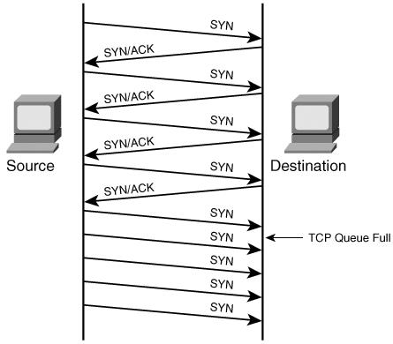
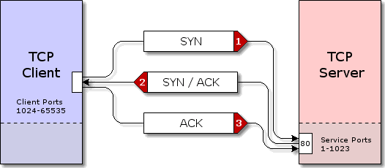
Synchronous flood
Attacker will send a flood of syn packet but will not respond with an ACK packet. The TCP/IP stack will wait a certain amount of time before dropping the connection, a syn flooding attack will therefore keep the syn_received connection queue of the target machine filled.

Slide 18
Synchronous flood
SYN floods are still successful today for three reasons:
  1) SYN packets are part of normal, everyday traffic, so it is difficult for devices to filter this type of attack.
  2) SYN packets do not require a lot of bandwidth to launch an attack because they are relatively small.
  3) SYN packets can be spoofed because no response needs to be given back to the target. As a result, you can choose random IP addresses to launch the attack, making filtering difficult for security administrators.

Slide 19
Return to our Restaurant
“TCP connection, please.”
“O.K. Please send ack.”
“TCP connection, please.”
Buffer
“O.K. Please send ack.”

Slide 20
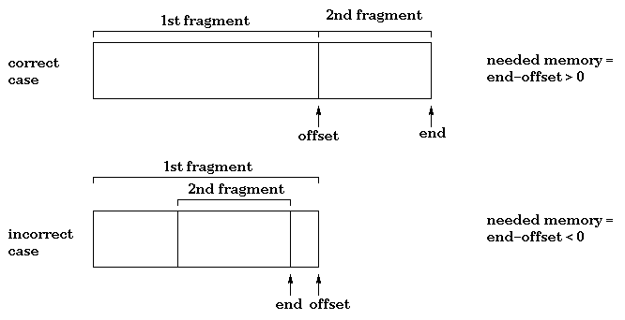
IP related attacks
IP Packet options
  در این روش برخی از فیلد های انتخابی بسته به صورت تصادفی تغییر داده می شوند و بسته حاصل برای قربانی ارسال می شود مثلاً بیت های مربوط به کیفیت خدمات یک می شوند و لذا باعث بالا رفتن زمان پردازش CPU می شود
Tear drop
  در این حمله بسته ی IP در اثر یک افراز غلط، به قطعه هایی تقسیم می شود که همپوشانی دارند لذا قربانی نمی تواند این بسته را دوباره از قطعه هایش بسازد. این کار باعث می شود سیستم Crash کند.

Slide 21
Tiny Fragment Attack
uses small fragments to force some of the TCP header information into the next fragment.
TCP flags field is forced into the second fragment and filters will be unable to test these flags in the first octet thereby ignoring them in subsequent fragments.
can be prevented at the router by enforcing rules, which govern the minimum size of the first fragment, large enough to ensure it contains all the necessary header information

Slide 22
Overlapping Fragment Attack
not a denial of service attack but used to bypass firewalls to gain access to the victim host
can be used to overwrite part of the TCP header information of the first fragment, which contained data that was allowed to pass through the firewall, with malicious data in subsequent fragments.
  overwriting destination port number to change from port 80 (HTTP) to port 23 (Telnet) which would not be allowed to pass the router in normal circumstances

Slide 23
The Unnamed Attack
attempts to cause a denial of service to the victim host, there is a gap created in the fragments.
done by manipulating the offset values to ensure there are parts of the fragment, which have been skipped.

Slide 24
X-tire Dos Attacks
Single-tier DoS Attacks
  Straightforward 'point-to-point' attack, that means we have 2 actors: hacker and victim.
    Examples: Ping of Death, SYN floods, Other malformed packet attacks
Dual-tier DoS Attacks
  A more complex attack model
  Difficult for victim to trace and identify attacker
    Examples: Smurf
Triple-tier DDoS Attacks
  Highly complex attack model, known as Distributed Denial of Service (DDoS).
  DDoS exploits vulnerabilities in the Internet, making it virtually impossible to protect networks against this level of attack.
    Examples: TFN2K, Stacheldraht, Mstream

Slide 25
Components of a DDoS Flood Network
Attacker
  Often a hacker with good networking and routing knowledge.
Master servers
  Handful of back-doored machines running DDoS master software, controlling and keeping track of available zombie hosts.
Zombie hosts
  Thousands of back-doored hosts over the world

Slide 26
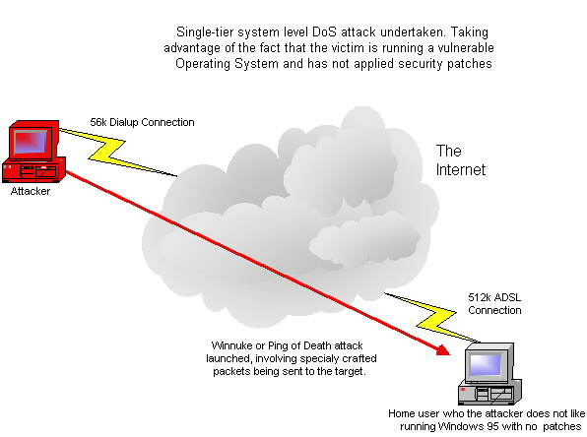
Single-tier DoS Attacks

Slide 27
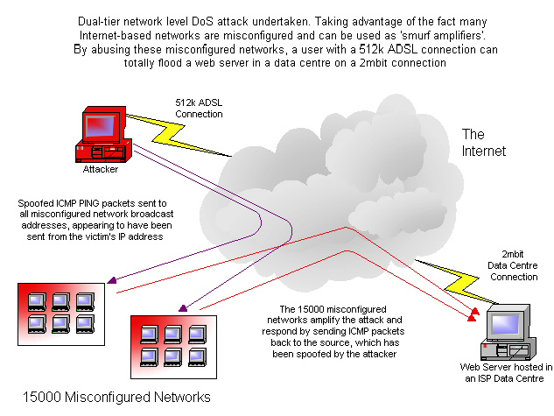
Dual-tier DoS Attacks

Slide 28
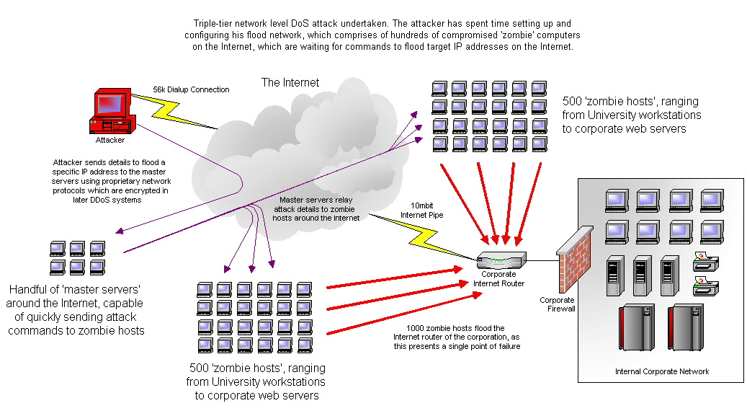
Triple-tier DDoS Attacks

Slide 29
Contents
Denial of Service attacks
  Concepts
  Samples of attacks
Malicious Logic attacks
  Concepts
  Viruses

Slide 30
Program Security
Secure Programs: behave as expected
  Unexpected behavior is a “program security flaw”
  Happens because of an existing “vulnerability”
IEEE Terminology
  Human error →
  Fault (incorrect code) →
  Failure (incorrect system behavior; external)
Notes:
Fault اشتباه
Failure شکست

Slide 31
Patching
One way of addressing faults: test, discover faults, patch them
Problems:
  No guarantee all faults are found
  No guarantee the patch does not add another fault
    Pressure leads to hurried patches
  Because the entire system cannot be redesigned, there’s a limit to how much a single patch can fix because it is constrained not to affect the rest of the system (for example, a definition of a variable that is passed on to several different modules, but creates a fault only in one)

Slide 32
Faults will always exist
Human error
Complexity of system
  The study of security finds more possibilities for flaws while software engineering proceeds to find new software techniques
Non-malicious and malicious faults

Slide 33
Malicious Logic
Pfleeger definition: “Hardware, software, or firmware capable of performing an unauthorized function on an information system.”
Bishop definition: “a set of instructions that cause a site’s policy to be violated”
Also known as malicious code or malware
Unintentionally faulty code can cause the same/similar effects
Notes:
Firmware
Software that is stored in the ROM - half way between hardware and software.

Slide 34
Types of malicious logic
Trojan Horses
  Bishop definition: “a program with an overt effect (documented or known) and a covert effect (undocumented or unexpected)
  Propagating/replicating Trojan Horse: one that creates a copy of itself
    Might modify compiler to insert itself into programs, including future version of compiler

Slide 35
Types of malicious logic
Virus
  Bishop definition: “a program that inserts itself into one or more files and then performs some (possibly null) action”
  Self replicating code, parasitic (attaches to “good” code)
  Can be
    “resident” (attaches itself to memory and can execute after its host program is done) or
    “transient” (active only while its host is executing)

Slide 36
Types of malicious logic – contd.
Worms
  Self replicating, spread through networks
  Stand-alone, not attached to another piece of logic
Logic Bombs
  Bishop definition: “a program that performs an action that violates the security policy when some external event occurs”
  Waits for a trigger condition and “detonates”
  Time bomb!

Slide 37
Types of malicious logic – contd.
Trapdoors
  Alternative means of executing code
    Intentional – legitimate and malicious purposes
ActiveX, Java code
  Execution of malicious code via Java applets, ActiveX scripts
  Malicious mobile code

Slide 38
Types of malicious logic – contd.
Bacteria
  Virus or worm that “absorbs all of some class of resource”
  For example: self-replicating piece of code fills up disk
Hybrids
  Usually a mixture of above

Slide 39
What we talk about now
Virus (used as a generic term for malicious code)
  Types of viruses
  Means of attaching
  Anatomy of a simple virus
  More sophisticated virus
  Virus detection methods
  Antivirus mechanisms

Slide 40
Types of virus
Classification by where they attach
  Boot sector viruses
  Parasitic viruses
Classification by type of code
  Binary viruses: usually written in assembly language then assembled to form executable image (binary file); attaches to other binary files or boot sector.
  Macro viruses: written in high-level macro language then interpreted (possibly after pre-processing); attaches to other files that support same macro language

Slide 41
Types of viruses – contd.
A general classification
  Boot sector viruses
    Modify and reside in boot sector
    Bishop definition: “a virus that inserts itself into the boot sector of a disk”
  Parasitic viruses
    Attach itself to files
    Infect executable programs
  Multipartite
    Can infect either boot sectors or applications

Slide 42
Types of viruses – contd.
  Polymorphic viruses
    Mutate like biological viruses
  Stealth Viruses
    Hard to detect
  TSRs (Terminate Stay Resident)
    Memory resident viruses
    Stay active in memory after application has terminated
  LKMs (Loadable Kernel Modules)
    Future of Unix based viruses
  Encrypted viruses
    Encrypts all virus code except a small decryption routine
Notes:
stealth
نهان ،خفا،خفيه کارى ،حرکت دزدکى

Slide 43
Example: Boot sector virus
Computer starts with firmware testing all hardware and then initializing a specified OS and transferring control to it.
Code copies the OS from disk to memory; starts with bootstrap loader, which is a small set of instructions that then copies the rest of the OS. Initial part of bootstrap loader is contained in boot sector
Because OS length is not pre-determined, and to allow flexibility, the bootstrap loader consists of non-contiguous blocks on disk chained together with pointers.
Virus can easily insert itself in the chain, on disk.
Very effective, as difficult to detect

Slide 44
Virus logic
Infection:
Infection is the act of replicating from a host to another host
Incubation:
The time between infection and activation of payload
Virulence:
Number of infections per copy
Payload
Trigger
Propagation Engine
Infection
Mutation Engine
Incubation Engine
Incubation

Slide 45
Virus logic
Virus includes code to
  Search for files to infect
  Replicate
    Make copy of self
    Attach to file/boot sector
  Reduce evidences of detection
    Ideally, should execute quickly then pass control to infected program’s normal code
    Intercept system calls
    Fool antiviral tools

Slide 46
Means of attaching: overwriting
(virus replaces part of program)
Structured
execution
image
damaged
image
virus
virus
Virus overwrites an executable file
Easiest mechanism
Since original program is damaged easily detected

Slide 47
Means of attaching: at the beginning
(virus is appended to program)
Executable
image
virus
Executable
image
virus
Improved stealth because original program is intact
  If original program is large, copying it may be slow
  File size grows if multiple infections occur
Notes:
intact
دست نخورده ،

Slide 48
Means of attaching: beginning and end
(virus surrounds program)
Executable
image
virus (a)
Executable
image
virus
virus (b)
Properties of appended virus
  Ability to clean up and avoid detection

Slide 49
Means of attaching: intersperse
(virus is integrated into program)
P
jump to V
Execution
image
Execution
image
V
virus
virus
Harder to cleanup

Slide 50
Means of attaching: companions
Execution
image
rename to
Program
call with exec
Execution
image
(renamed
& hidden)
virus

Slide 51
Invoking a virus
Virus invoked because:
  It has replaced part of a program code within the file structure
  It has appended itself to the code within a file
  It has overwritten the file in storage
  It has changed the pointer in the file table, so that it is located instead of a particular file
  It has changed the table of pointers to typical operating system parts (such as interrupt handler)

Slide 52
Memory residents or TSRs
(Terminate and Stay Resident)
Infect memory-resident code (e.g. frequently used parts of the OS), which remains in memory while the computer is running
Resident code usually activated many times, giving virus many opportunities to spread
Example: attach to interrupt-handler and check whether any new flash memory have been inserted; if so, infect the flash memory.
Also many other homes for viruses: libraries, application program startup macros, compilers, virus detection software!

Slide 53
Five major detection methods
Integrity checking
  Look for modified files by comparing old and new checksum
  No software updates required
  Requires maintenance of virus free checksums
  Unable to detect stealth viruses
Interrupt monitoring
  Attempts to locate and prevent a viruses’ interrupt calls
  Poor system utilization
  Obstructive, because of false positives
Memory detection
  Depends on recognition of known viruses’ location and code in memory

Slide 54
Five major detection methods
Signature scanning
  Recognizes viruses’ unique “signature”: a pre-identified hex
  Need to maintain current signature files and scanning engine refinements
  False positives
Heuristics/Rule based
  Faster than traditional scanners
  Uses a set of rules to effectively parse through files and identify code
  Uses expert systems or neural networks
  Depends on current rule-set
(Detection can be performed on-access or on-demand)

Slide 55
Properties of a good signature
Should always appear in the virus, so there won’t be any false negatives
Should not appear in (m)any other files, so there won’t be (m)any false positives
Should be reasonably short, for efficient scanning
For simple viruses, it’s easy to find good signatures but for complicated ones …!

Slide 56
Polymorphic Viruses
Polymorphic = “many forms”
Goal: Foil virus scanners by changing virus code each time virus replicates, so that it will be difficult to find a good signature
Approaches:
  Encrypt virus with random key
    Note: Goals and techniques are different than in the encryption techniques we studied earlier. XOR with stored key is sufficient.
  “Mutate” virus by making small changes that don’t affect the semantics of the code
  Nearly 2 billion similar codes can be evolved from a single code
  Requires algorithm based matching instead of simple string based matching
Notes:
Foil ،خنثى کردن

Slide 57
Replication of encrypted virus
Copy decryption engine to infected file
Select new key and copy it to the infected file
For each byte of the encrypted portion of the virus:
  take decrypted byte
  encrypt it with the new key
  copy it to the infected file
Result: different replicas of virus have different byte patterns, so difficult to find signature

Slide 58
Anti-virus tools’ answer to encryption
Select the signature from the unencrypted portion of the code, i.e. the decryption engine
Problems:
  Anti-virus tools usually want to determine which virus is present, not just determine that some virus is present (in order to “disinfect”).
    Can emulate the decryption then further analyze the decrypted code.
  virus writers have responded by obscuring the encryption engine through mutations
It’s a game of cat and mouse!
Notes:
Disinfect ضد عفونی کردن
obscuring مبهم کردن

Slide 59
Virus Analysis
Analysis of virus by human expert
  slow: by the time signature has been extracted, posted to AV tool database, downloaded to users, virus may have spread widely.
    pre-1995: 6 months to a year for virus to spread world-wide
    now: days or hours
  labor-intensive: too many new viruses
    currently, 8-10 new viruses per day
  can’t handle epidemics:
    queue of viruses to be analyzed overflows
Automated analysis, e.g. “Immune System”
    developed at IBM Research
    licensed to Symantec
Notes:
labor intensive
requires a lot of work

Slide 60
Immune System Architecture
new virus
active network:
controls “flooding”
Virus
Analysis
Center
local
administrators
signature and disinfection instructions

Slide 61
Signature Extraction at VAC
Virus allowed (encouraged) to replicate in controlled environment in immune center
This yields collection of infected files
In addition, a collection of “clean” files is available
Machine learning techniques used to find strings that appear in most infected files and in few clean files (e.g. award/punishment learning):
  search files for candidate strings
    add points if found in infected file
    subtract points if found in clean file

Slide 62
Macro-viruses
Written in macro-language
Infect documents (as opposed to programs), such as word-processor docs, etc.
“Attach” by modifying commonly used macros, or start-up macros
  popular target is Normal.dot, which is opened when MS Office applications are executed
Spread when documents are transmitted, via disks, file transfer, e-mail attachments, ...
Macro virus dependencies:
  Application popularity
  Macro language depth
  Macro implementation

Slide 63
A case Study: The Blaster Worm
Multi-stage worm exploiting Windows vulnerability
2003: July |  |  |  |  |  |  |  |  |  |  | August
 | 16 |  | 17 |  |  | 25 |  |  | 31 |  |  | 11 |  |  | 13 |  |  | 15 |  |  | 17 |  |  | 19
Blaster appears
1.2 million hosts infected

Slide 64
Blaster: Attack Vector
Uses a Microsoft Windows RPC DCOM vulnerability.
Coding flaw:
  The RPC service passes part of the request to function GetMachineName().
  GetMachineName() copies machine name to a fixed 32-byte buffer.

Slide 65


Blaster: Attack Vector
Exploit
1
“tftp GET msblast.exe”
2
“GET msblast.exe”
3
TFTP
Server
4
“start msblast.exe”
5

Slide 66
Blaster: Payload
Worm installs itself to start automatically.
All infected hosts perform DDoS against windowsupdate.com .
  SYN flood attack with spoofed source IP,

Slide 67
Blaster: Effect on Local Host
RPC/DCOM disabled:
  Inability to cut/paste.
  Add/Remove Programs list empty.
  DLL errors in most Microsoft Office programs.
  Generally slow, or unresponsive system performance.

Slide 68
Blaster: Spreading Algorithm
Build IP address list:
  40% chance to start with local IP address.
  60% chance to generate random IP address.
Probe 20 IPs at a time.
Exploit type:
  80% Windows XP.
  20% Windows 2000.

Slide 69
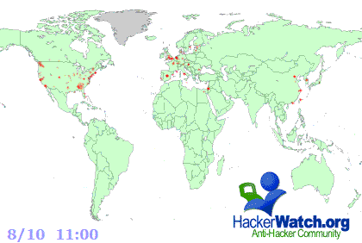
Blaster: Infection Rate

