Slide 1

Time and Global States
based on Distributed Systems: Concepts and Design, Edition 5
Ali Fanian
Isfahan University of Technology
www.Fanian.iut.ac.ir

Slide 2
Titles
Introduction
Clocks, events and process states
Synchronizing physical clocks
Logical time and logical clocks
Global states
Distributed debugging
Summary

Slide 3
Why time?
Time is important because:
  time is a quantity we often want to measure accurately, e.g. in e-commerce transactions
  consistency of distributed data, checking the authenticity of a request sent to a server, eliminating the processing of duplicate updates
But time is Problematic in DS.
Each computer has its own physical clock, clocks typically deviate, we cannot synchronize them perfectly.

Slide 4
What we study?
We will examine algorithms for synchronization physical clocks using message passing
We will study logical clocks: vector clocks.
We will also look at algorithms to capture global states of DS as they execute.

Slide 5
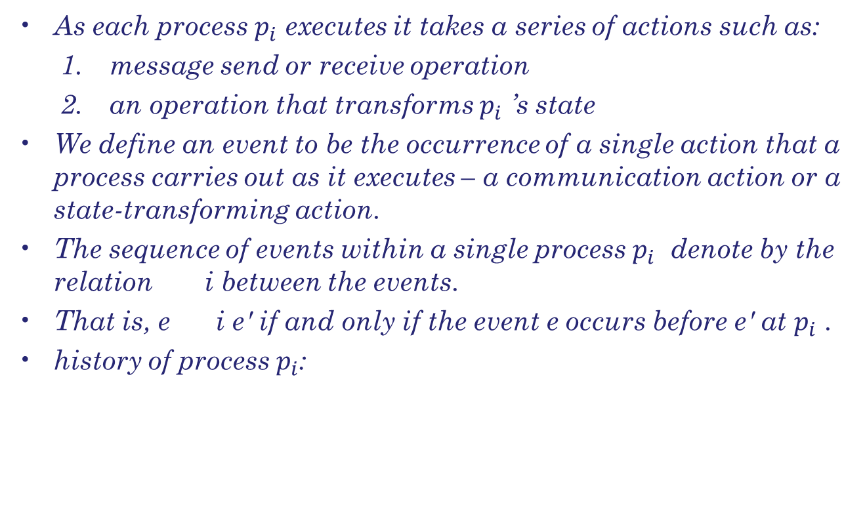

Events

Slide 6
Clock skew and clock drift
The instantaneous difference between the readings of any two clocks is called their skew.
Clock drift means that clocks count time at different rates.
Skew between computer clocks

Slide 7
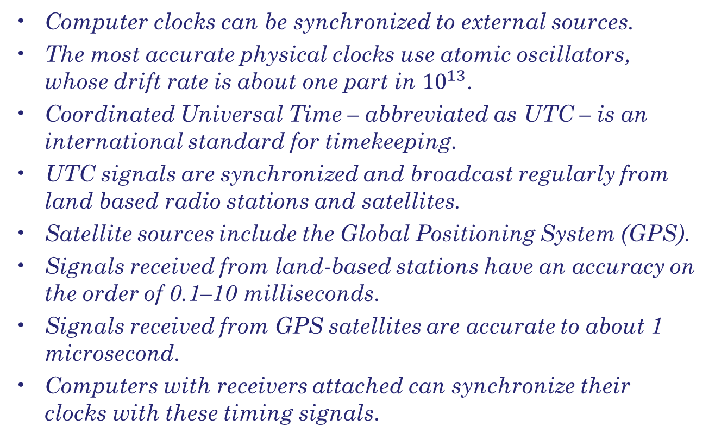
Coordinated Universal Time

Slide 8
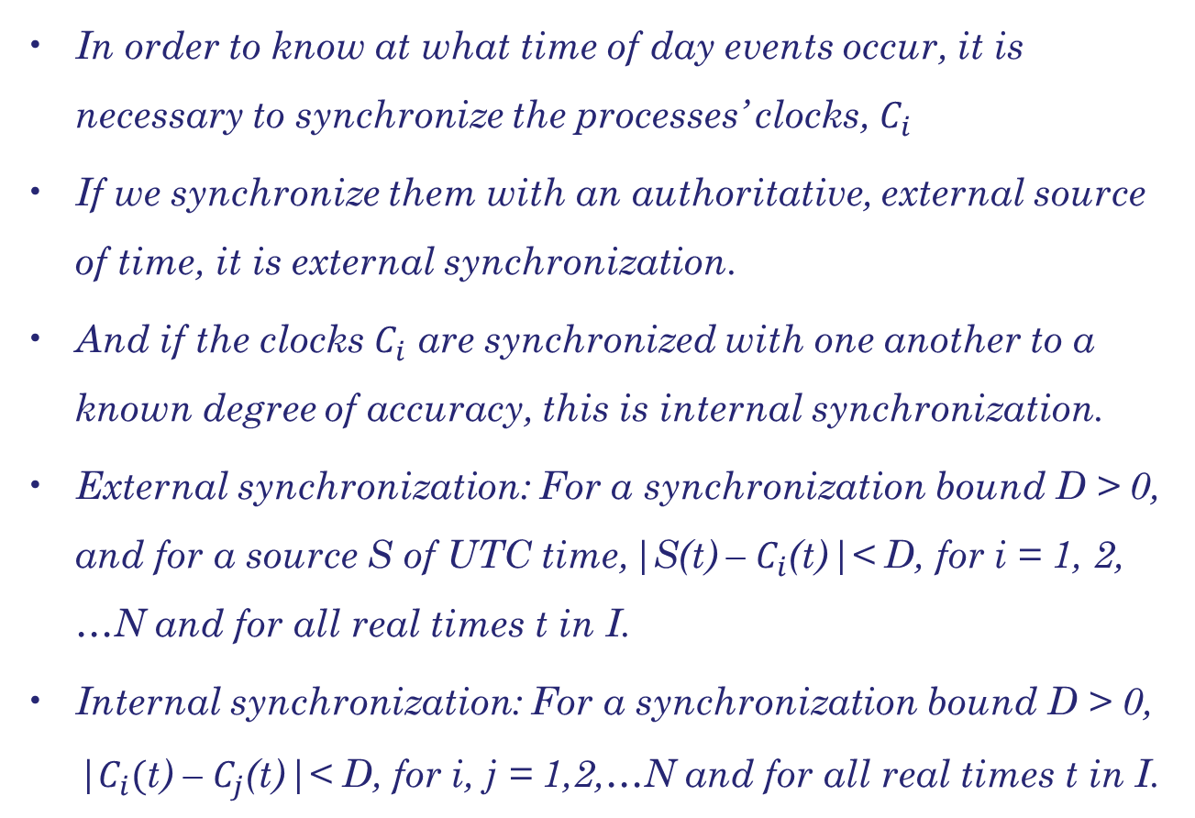
Synchronizing physical clocks

Slide 9
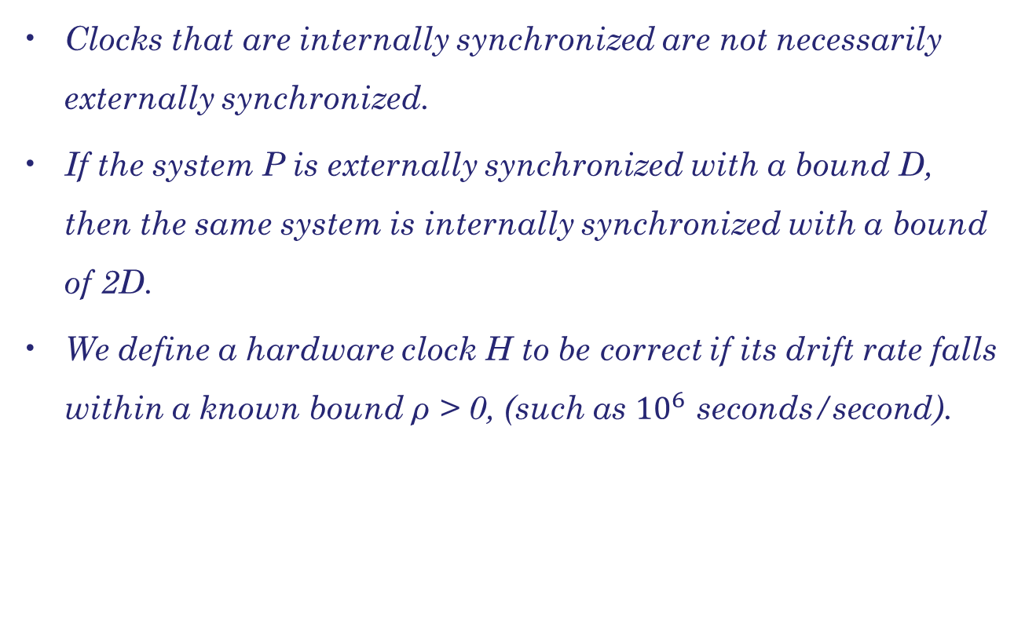
Synchronizing physical clocks

Slide 10
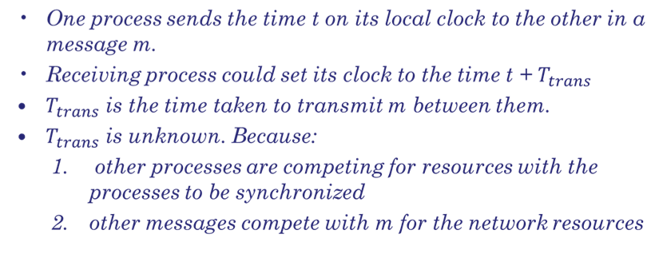
Internal Synchronization

Slide 11
Synchronization in a synchronous system
There is always a minimum transmission time, min.
It is obtained if no other processes executed and no other network traffic existed.
There is also an upper bound max on the time taken to transmit any message.
Uncertainty in the message transmission time = u,
      u = (max–min)
If the receiver sets its clock to be t + min, then the clock skew may be as much as u.
If it sets its clock to t + max, the skew may be as large as u.
If it sets its clock to the halfway point, t + (max + min) / 2 , then the skew is at most u / 2.

Slide 12
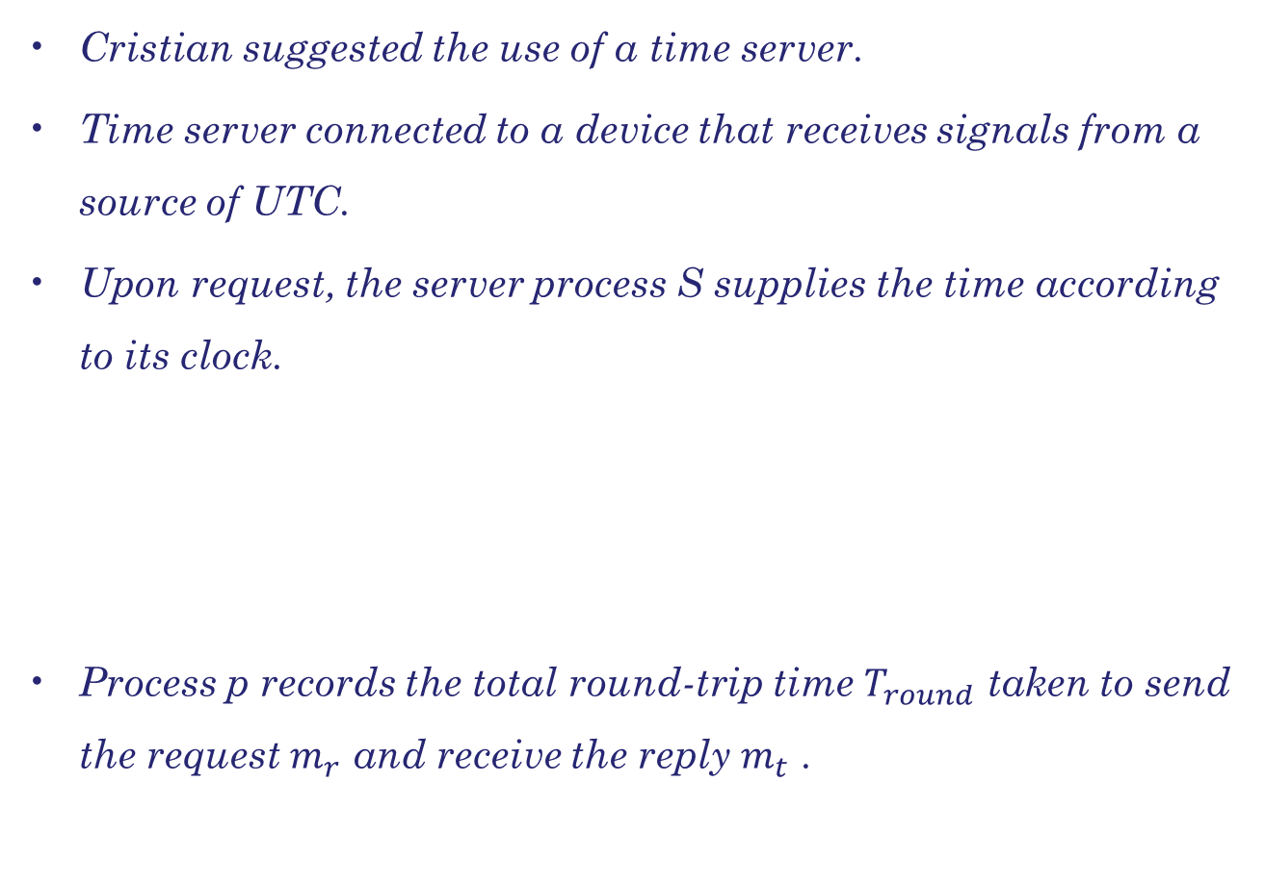
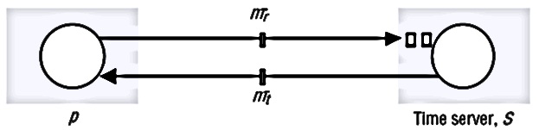
Cristian’s method for synchronizing clocks

Slide 13
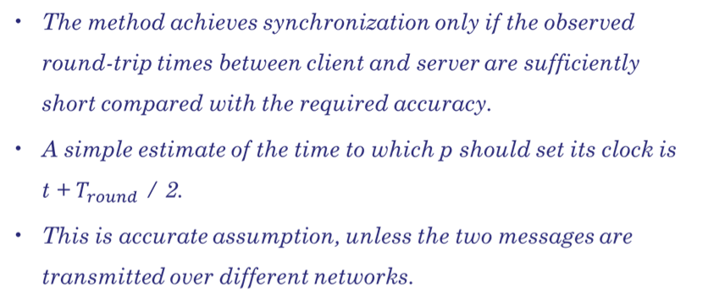
Cristian’s method for synchronizing clocks

Slide 14
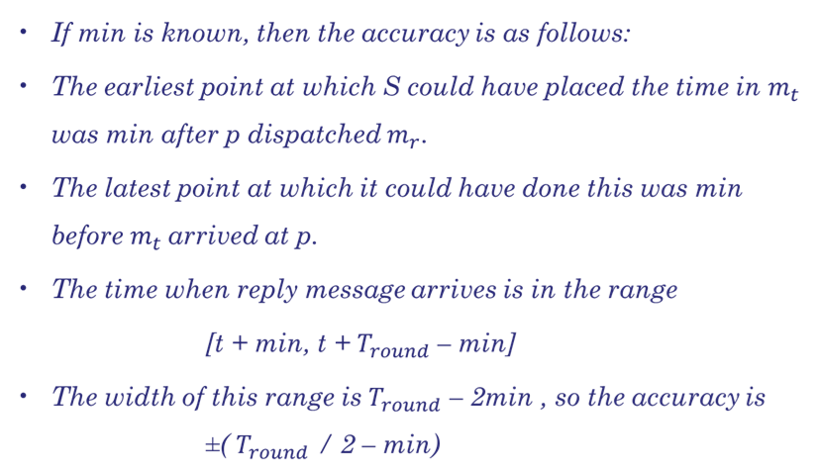
Cristian’s method for synchronizing clocks

Slide 15
Discussion of Cristian’s algorithm
Single time server might fail and thus render synchronization temporarily impossible.
  Cristian suggested, that time should be provided by a group of synchronized time servers, each with a receiver for UTC time signals.
  For example, a client could multicast its request to all servers and use only the first reply obtained.
Faulty time server: These problems were beyond the scope of the work described by Cristian, which assumes that sources of external time signals are self-checking.

Slide 16
The Berkeley algorithm
Gusella and Zatti describe an algorithm for internal synchronization.
A coordinator computer is chosen to act as the master.
This computer periodically polls the other computers whose clocks are to be synchronized, called slaves.
The slaves send back their clock values to it.
The master estimates their local clock times by observing the round-trip times and it averages the values obtained.
Instead of sending the updated current time back to the other computers, the master sends the amount by which each individual slave’s clock requires adjustment.
This can be a positive or negative value.

Slide 17
The Berkeley algorithm
The Berkeley algorithm eliminates readings from faulty clocks.
  A subset is chosen of clocks that do not differ from one another by more than a specified amount, and the average is taken of readings from only these clocks.
If the master fail, then another can be elected.
These are not guaranteed to elect a new master in bounded time, so the difference between two clocks would be unbounded.

Slide 18
The network time protocol
Cristian’s method and the Berkeley algorithm are intended primarily for use within intranets.
The NTP defines an architecture for a time service and a protocol to distribute time information over the Internet.

Slide 19
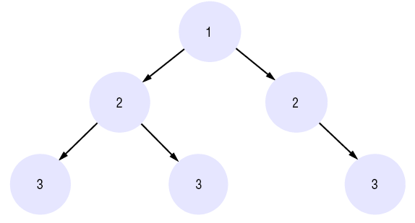
The network time protocol
Primary servers occupy stratum 1: they are at the root.
Stratum 2 servers are secondary servers that are synchronized directly with the primary servers;
stratum 3 servers are synchronized with stratum 2 servers, and so on. The lowest-level (leaf) servers execute in users’ workstations.
The NTP service is provided by a network of servers located across the Internet. Primary servers are connected directly to a time source such as a radio clock receiving UTC; secondary servers are synchronized, ultimately, with primary servers.
The servers are connected in a logical hierarchy called a synchronization subnet whose levels are called strata.

Slide 20
The network time protocol
Multicast mode is intended for use on a high-speed LAN. One or more servers periodically multicasts the time to the other computers connected by the LAN, which set their clocks assuming a small delay.
Procedure-call mode is similar to the operation of Cristian’s algorithm. In this mode, one server accepts requests from other computers, which it processes by replying with its timestamp. This mode is suitable where higher accuracies are required than can be achieved with multicast, or where multicast is not supported in hardware.
Symmetric mode is intended for use by the servers that supply time information in LANs and by the higher levels (lower strata) of the synchronization subnet, where the highest accuracies are to be achieved. A pair of servers operating in symmetric mode exchange messages bearing timing information.

Slide 21
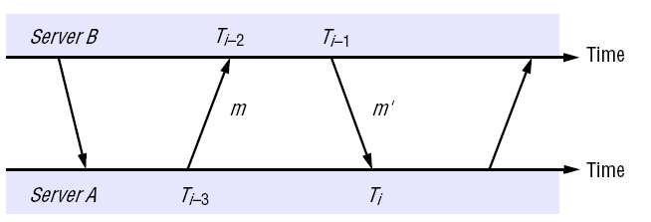
The network time protocol
In procedure-call mode and symmetric mode, processes exchange pairs of messages.
Each message bears timestamps of recent message events.
Time of receiving request
Time of sending respond
Time of sending request
Time of receiving respond

Slide 22
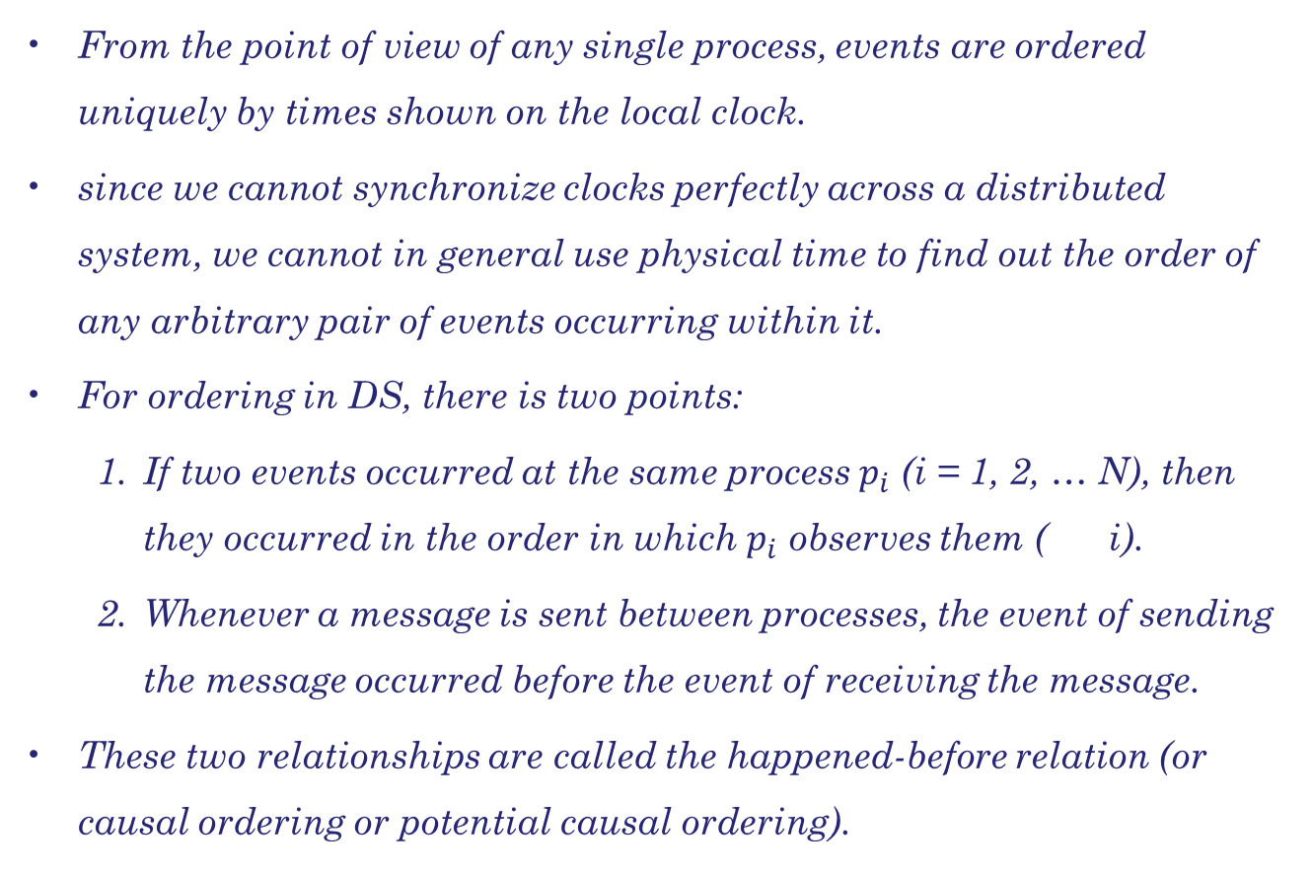
Happend-before relation

Slide 23
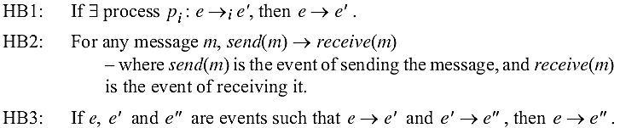
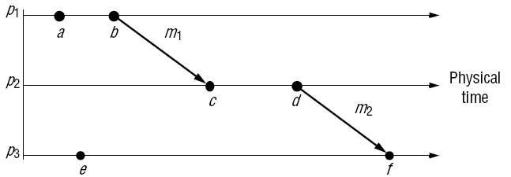


Happend-before relation
happened-before relation, denoted by

Slide 24
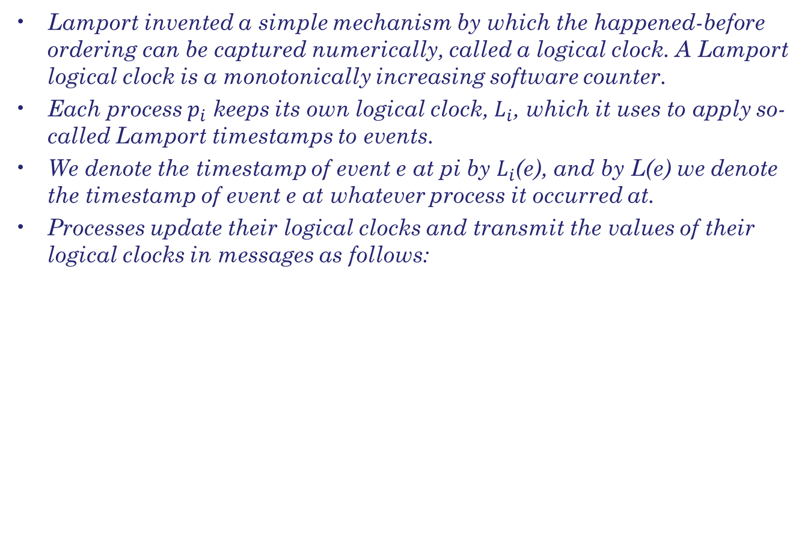
Logical clocks
LC1: Li is incremented before each event is issued at process pi : Li := Li + 1.
LC2:
(a) When a process pi sends a message m, it piggybacks on m the value t = Li .
(b) On receiving (m, t), a process pj computes Lj := max(Lj, t) and then
applies LC1 before timestamping the event receive(m).

Slide 25
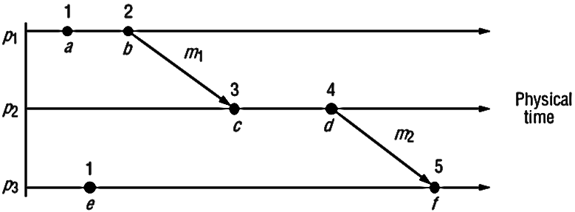
Logical clocks
Although we increment clocks by 1, we could have chosen any positive value.
If e e´ then L(e) < L(e´)
The converse is not true. If L(e) < L(e´) then we can not say e e´

Slide 26
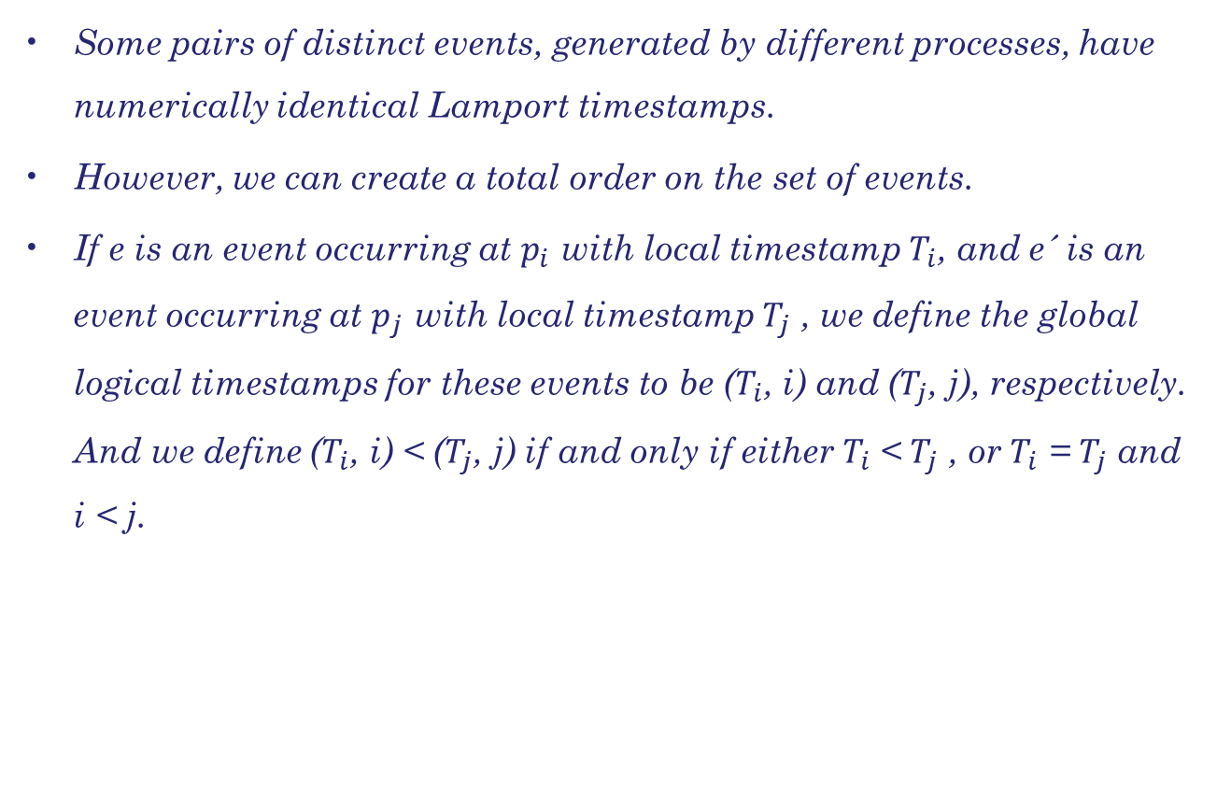
Logical clocks

Slide 27
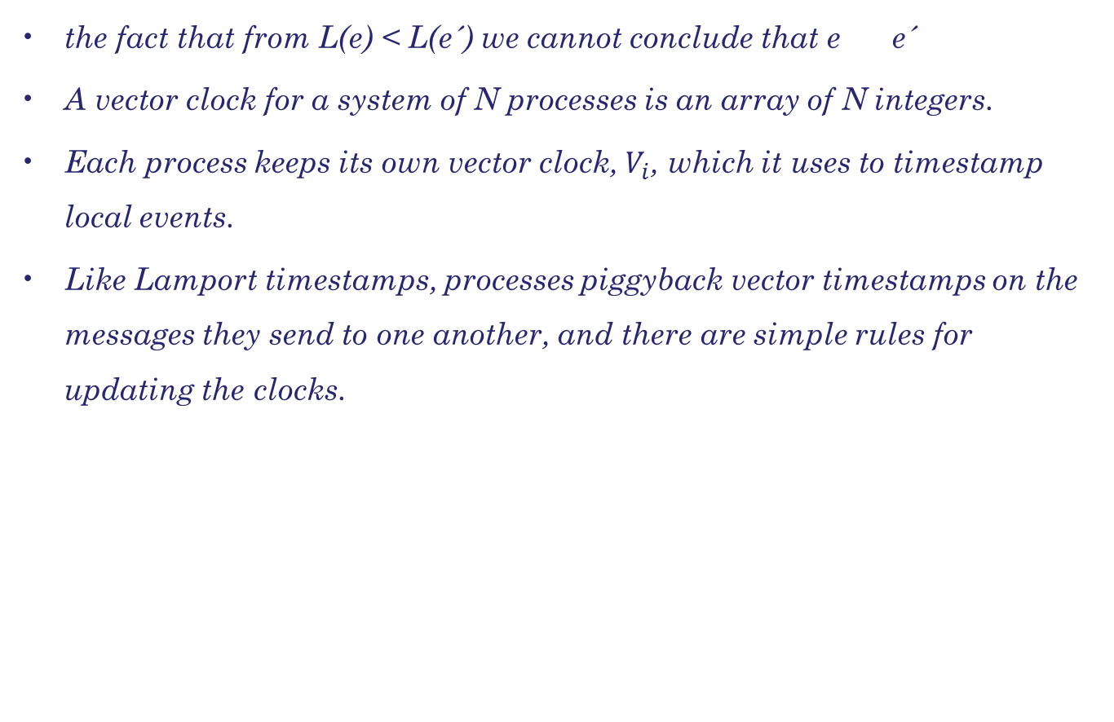
Vector clocks

Slide 28
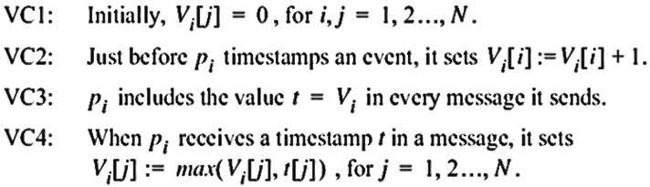
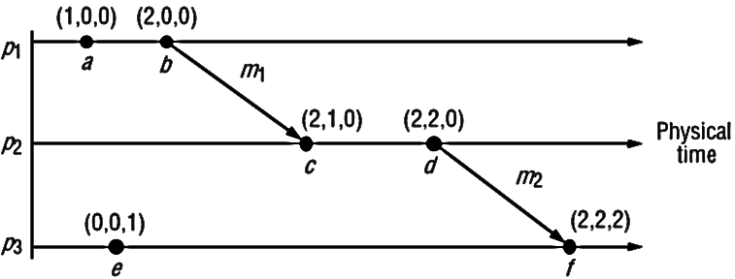
Vector clocks

Slide 29
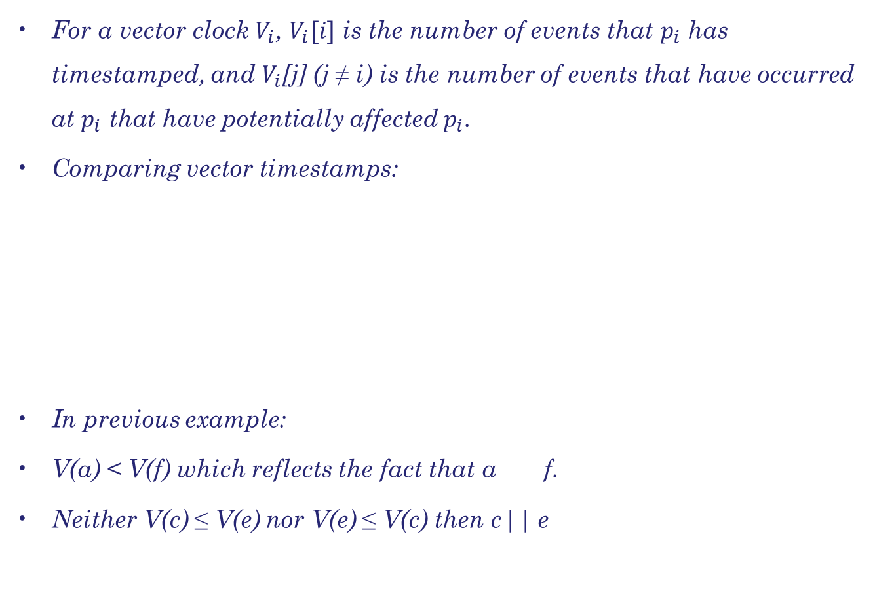
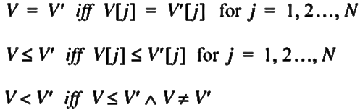
Vector clocks

Slide 30
Vector clocks
Vector timestamps have the disadvantage, compared with Lamport timestamps, of taking up an amount of storage and message payload that is proportional to N, the number of processes.
However, techniques exist for storing and transmitting smaller amounts of data.

Slide 31
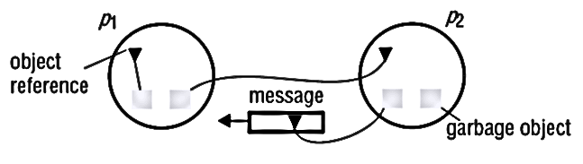
Garbage collection
Distributed garbage collection: An object is considered to be garbage if there are no longer any references to it anywhere in the DS.
The memory taken up by that object can be reclaimed once it is known to be garbage.
When we consider properties of a system, we must include the state of communication channels as well as the state of the processes.

Slide 32
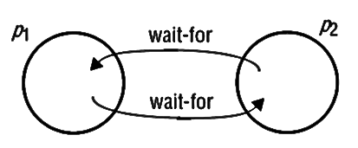
Deadlock detection
Distributed deadlock detection: A distributed deadlock occurs when each of a collection of processes waits for another process to send it a message, and where there is a cycle in the graph of this ‘waits-for’ relationship.

Slide 33
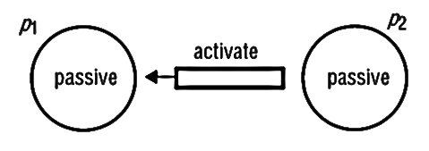
Termination detection
Distributed termination detection: The problem here is how to detect that a distributed algorithm has terminated.
It sounds easy to solve at first: it seems at first only necessary to test whether each process has halted.
But this is not so.
A process is either active or passive.
a passive process is not engaged in any activity of its own but is prepared to respond with a value requested by the other.

Slide 34
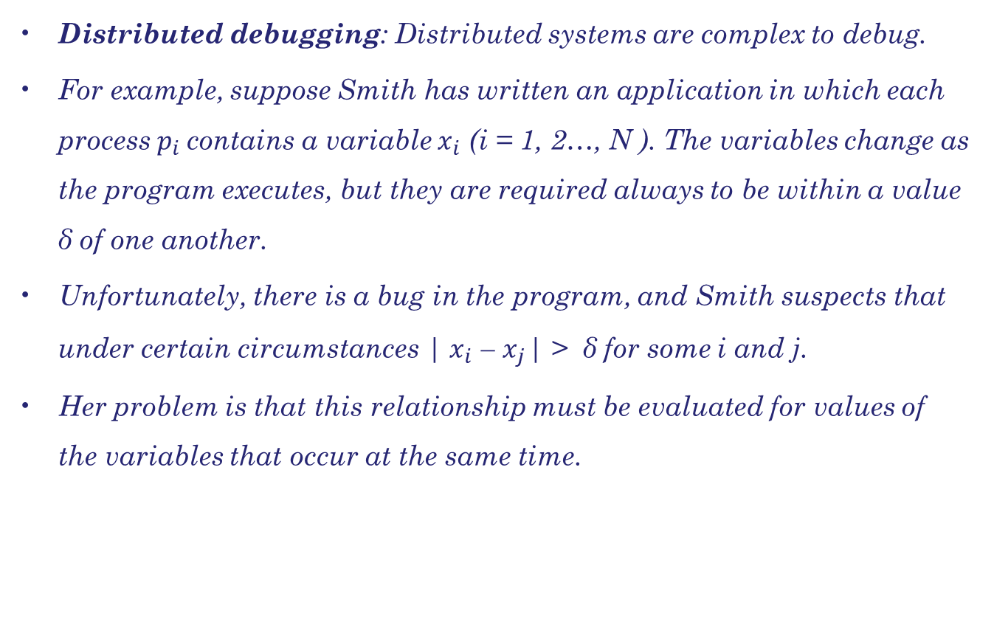
Debugging

Slide 35
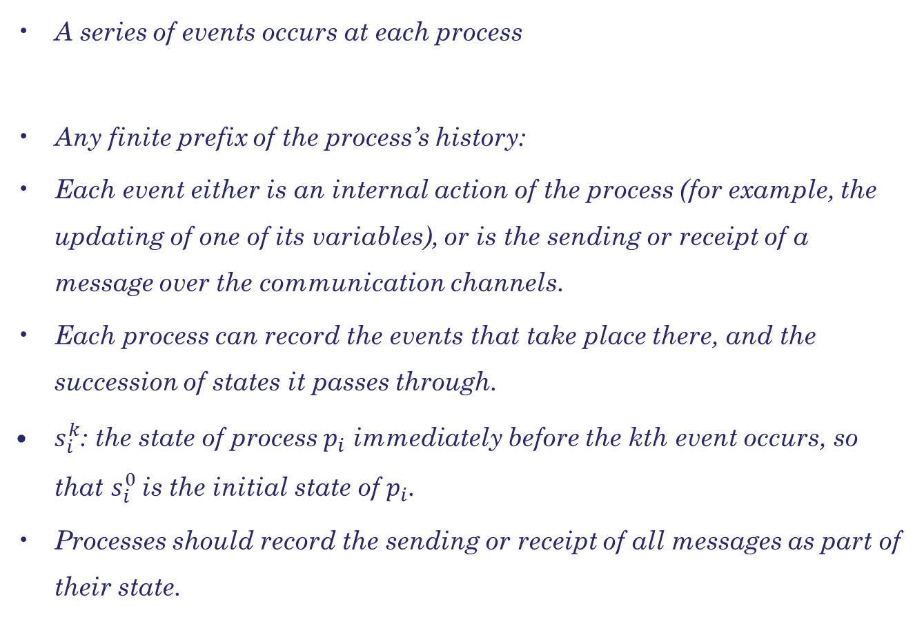

Global states & Consistent cuts

Slide 36
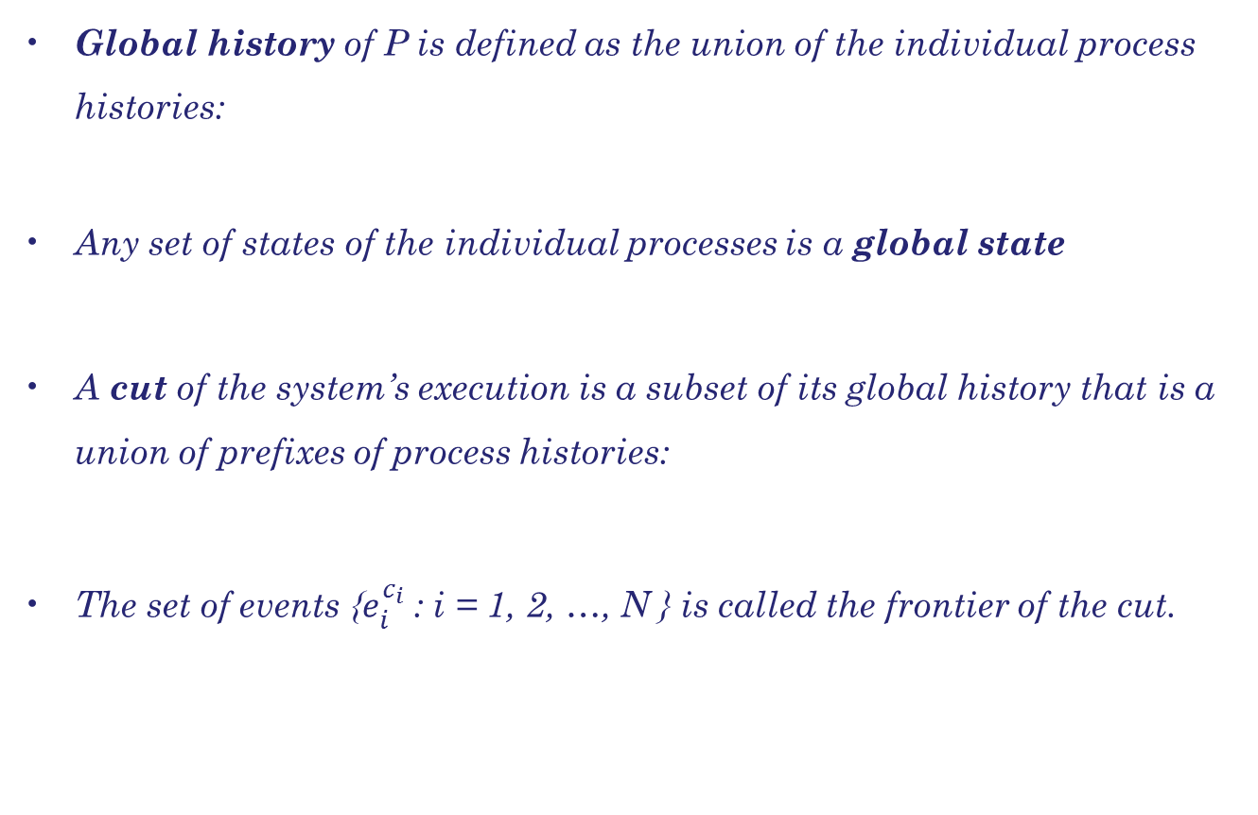



Global states & Consistent cuts

Slide 37
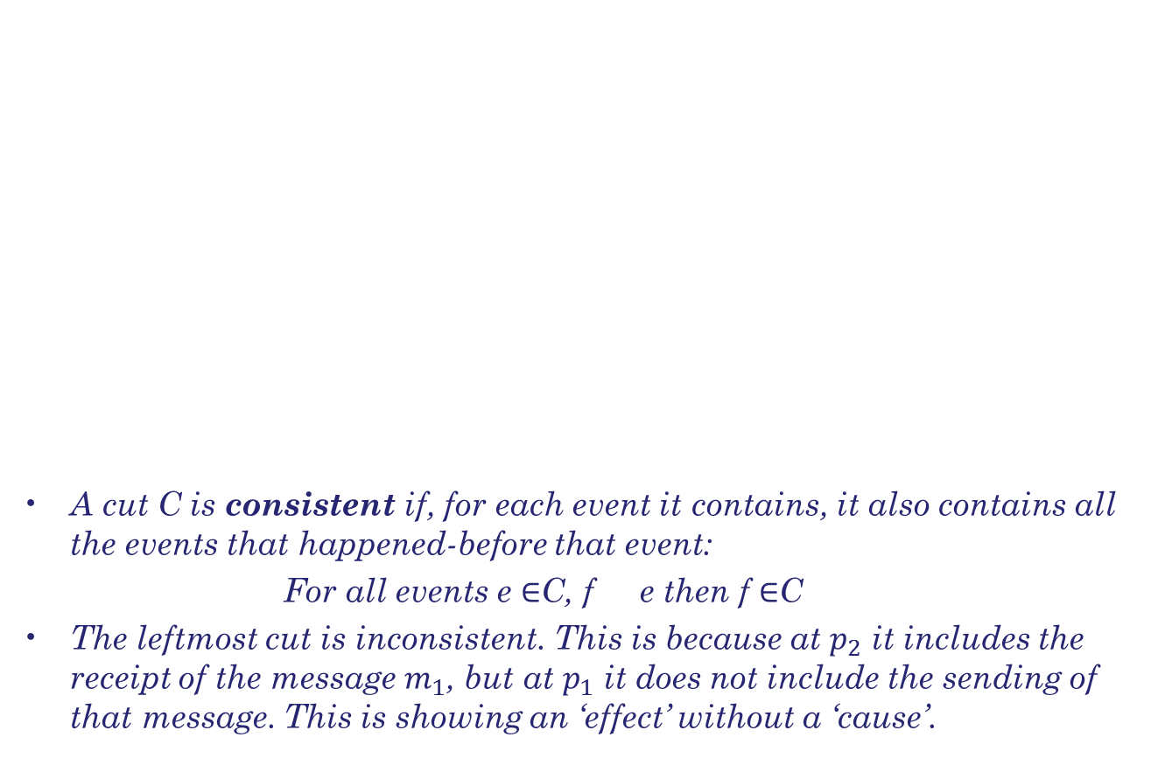
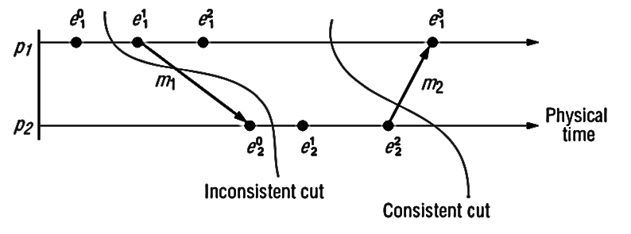


Consistent cuts

Slide 38
Distributed debugging
The challenge is to monitor the system’s execution over time – to capture ‘trace’ information rather than a single snapshot.
Snapshot algorithm collects state in a distributed fashion, and the processes in the system could send the state they gather to a monitor process for collection.
Next algorithm is centralized. The observed processes send their states to a process called a monitor, which assembles globally consistent states from what it receives.

Slide 39
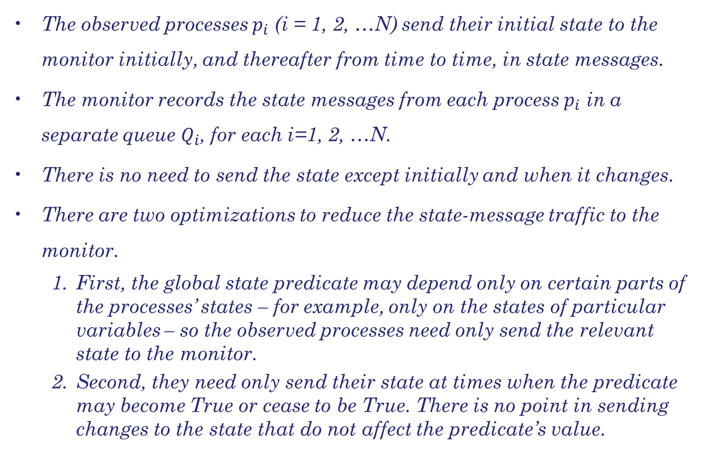

Collecting the state

Slide 40
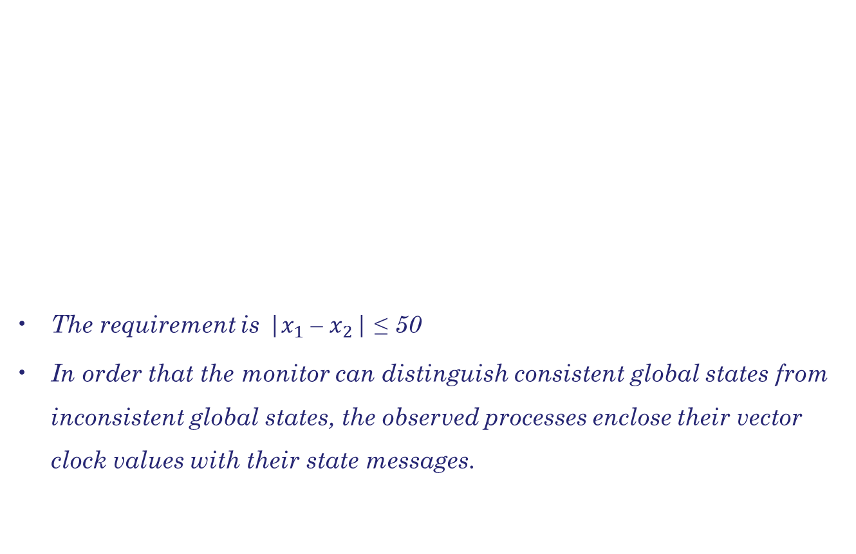
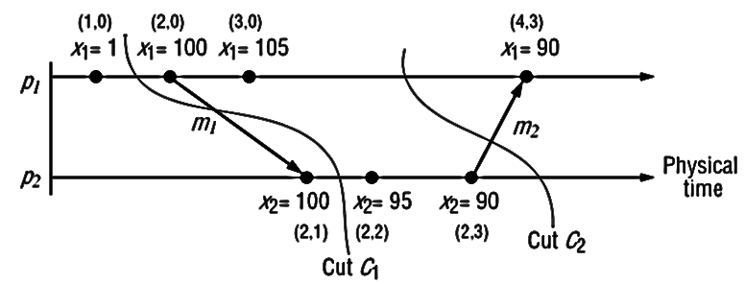
Observing consistent global states

Slide 41
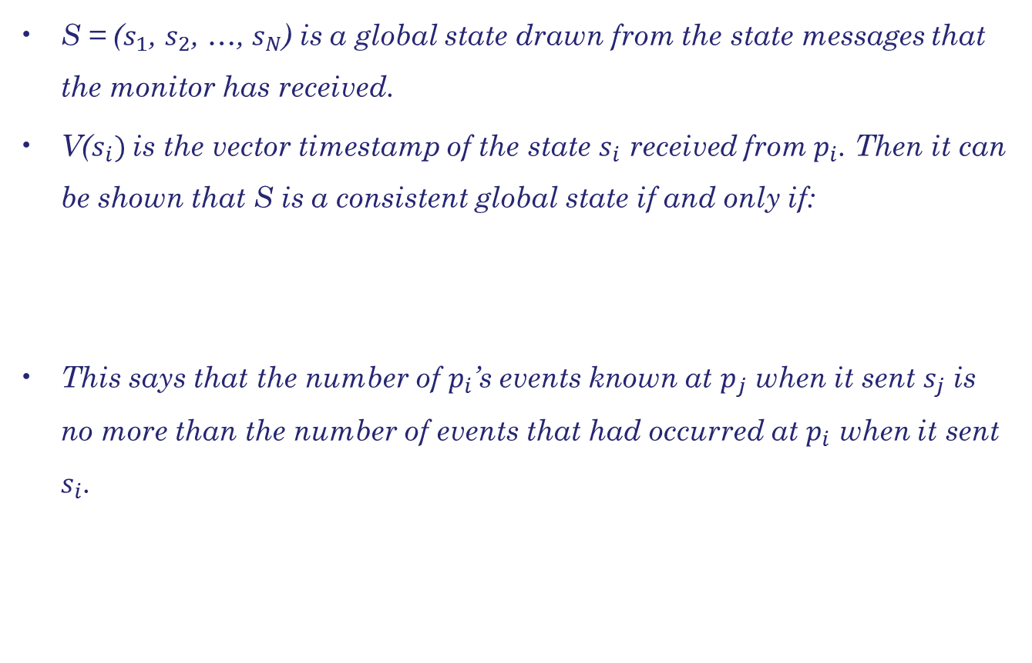
Observing consistent global states

Slide 42
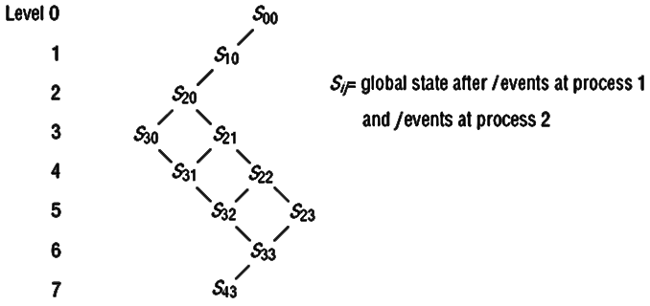
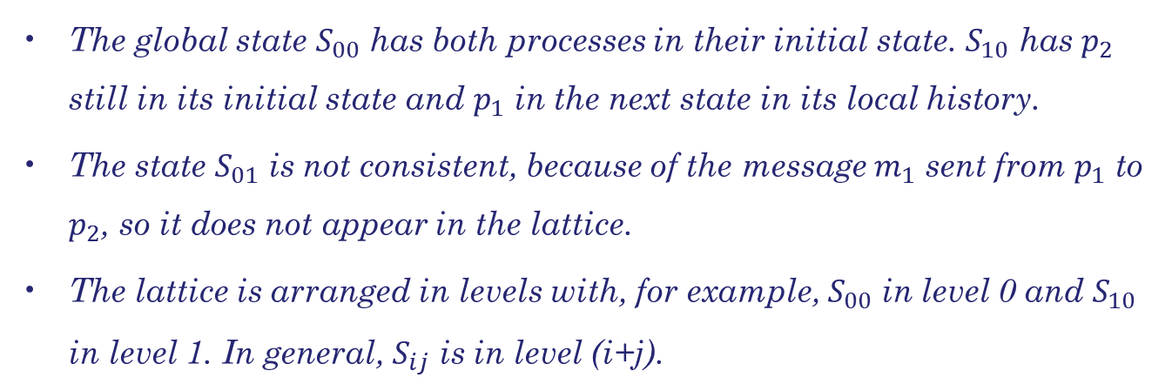
Observing consistent global states
This structure captures the relation of reachability between consistent global states.
The nodes denote global states, and the edges denote possible transitions between these states.

Slide 43
Summary
Describing the importance of accurate timekeeping for DS.
We then described algorithms for synchronizing clocks despite the drift between them and the variability of message delays between computers.
The happened-before relation within a process, or via messages between processes
Lamport clocks are counters that are updated in accordance with the happened-before relationship between events.
Vector clocks are an improvement on Lamport clocks.

Slide 44
Summary
The concepts of events has been introduced, local and global histories, cuts, local and global states, runs, consistent states, linearizations (consistent runs) and reachability.
We went on to give algorithm that employs a monitor process to collect states. The monitor examines vector timestamps to extract consistent global states.

