Slide 1
Chapter 1: Introduction

Slide 2
Organization
Lectures
Homework
  Several homeworks with a few correction sessions
Quiz
  Several quizzes
Mid-term exam
Final Exam
Grading

Slide 3
Exams and Grading
Mid-term: 35%
Final exam: 40%
Homeworkes : 20%
Quizzes (bonus): 10%
Note: The number of quizzes vastly exceeds the required minimum. There is no replacement for the quizzes.

Slide 4
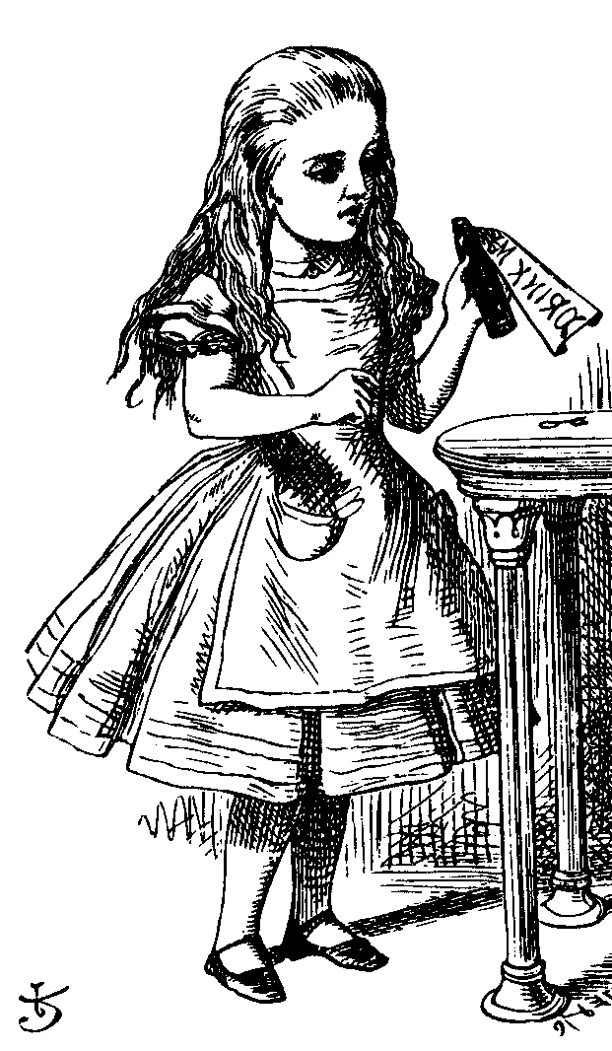
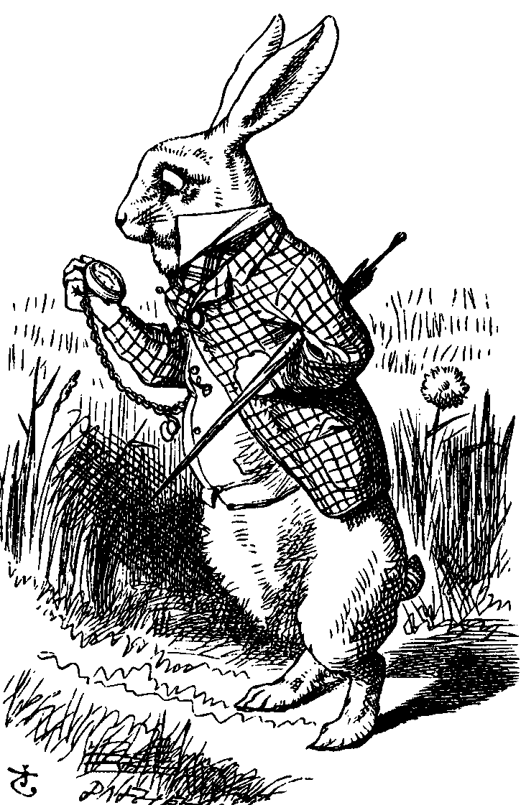
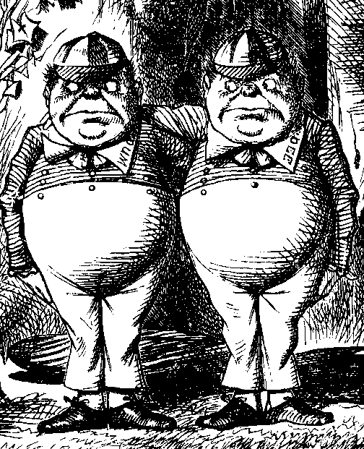
The Cast of Characters
Alice and Bob are the good guys
Trudy is the bad “guy”
Trudy is our generic “intruder”

Slide 5
Alice’s Online Bank
Alice opens Alice’s Online Bank (AOB)
What are Alice’s security concerns?
If Bob is a customer of AOB, what are his security concerns?
How are Alice’s and Bob’s concerns similar? How are they different?
How does Trudy view the situation?

Slide 6
CIA
CIA == Confidentiality, Integrity, and Availability
AOB must prevent Trudy from learning Bob’s account balance
Confidentiality: prevent unauthorized reading of information
  Cryptography used for confidentiality

Slide 7
CIA
Trudy must not be able to change Bob’s account balance
Bob must not be able to improperly change his own account balance
Integrity: detect unauthorized writing of information
  Cryptography used for integrity

Slide 8
CIA
AOB’s information must be available whenever it’s needed
Alice must be able to make transaction
  If not, she’ll take her business elsewhere
Availability: Data is available in a timely manner when needed
Availability is a “new” security concern
  Denial of service (DoS) attacks

Slide 9
Beyond CIA: Crypto
How does Bob’s computer know that “Bob” is really Bob and not Trudy?
Bob’s password must be verified
  This requires some clever cryptography
What are security concerns of pwds?
Are there alternatives to passwords?

Slide 10
Beyond CIA: Protocols
When Bob logs into AOB, how does AOB know that “Bob” is really Bob?
As before, Bob’s password is verified
Unlike the previous case, network security issues arise
How do we secure network transactions?
  Protocols are critically important
  Crypto plays critical role in protocols

Slide 11
Beyond CIA: Access Control
Once Bob is authenticated by AOB, then AOB must restrict actions of Bob
  Bob can’t view Charlie’s account info
  Bob can’t install new software, etc.
Enforcing these restrictions: authorization
Access control includes both authentication and authorization

Slide 12
Beyond CIA: Software
Cryptography, protocols, and access control are implemented in software
What are security issues of software?
  Real world software is complex and buggy
  Software flaws lead to security flaws
  How does Trudy attack software?
  How to reduce flaws in software development?
  And what about malware?

Slide 13
Your Textbook
The text consists of four major parts
  Cryptography
  Access control
  Protocols
  Software
Note: Our focus is on technical issues

Slide 14
The People Problem
People often break security
  Both intentionally and unintentionally
  Here, we consider the unintentional
For example, suppose you want to buy something online
  To make it concrete, suppose you want to buy Information Security: Principles and Practice, 2nd edition from amazon.com

Slide 15
The People Problem
To buy from amazon.com…
  Your Web browser uses SSL protocol
  SSL relies on cryptography
  Access control issues arise
  All security mechanisms are in software
Suppose all of this security stuff works perfectly
  Then you would be safe, right?

Slide 16
The People Problem
What could go wrong?
Trudy tries man-in-the-middle attack
  SSL is secure, so attack doesn’t “work”
  But, Web browser issues a warning
  What do you, the user, do?
If user ignores warning, attack works!
  None of the security mechanisms failed
  But user unintentionally broke security

Slide 17
Cryptography
“Secret codes”
The book covers
  Classic cryptography
  Symmetric ciphers
  Public key cryptography
  Hash functions++
  Advanced cryptanalysis

Slide 18
Access Control
Authentication
  Passwords
  Biometrics
  Other methods of authentication
Authorization
  Access Control Lists/Capabilities
  Multilevel security (MLS), security modeling, covert channel, inference control
  Firewalls, intrusion detection (IDS)

Slide 19
Protocols
“Simple” authentication protocols
  Focus on basics of security protocols
  Lots of applied cryptography in protocols
Real-world security protocols
  SSH, SSL, IPSec, Kerberos
  Wireless: WEP, GSM

Slide 20
Software
Security-critical flaws in software
  Buffer overflow
  Race conditions, etc.
Malware
  Examples of viruses and worms
  Prevention and detection
  Future of malware?

Slide 21
Software
Software reverse engineering (SRE)
  How hackers “dissect” software
Software and testing
  Open source, closed source, other topics

Slide 22
Software
Operating systems
  Basic OS security issues
  “Trusted OS” requirements
Software is a BIG security topic
  Lots of material to cover
  Lots of security problems to consider
  But not nearly enough time available…

Slide 23
Think Like Trudy
In the past, no respectable sources talked about “hacking” in detail
  After all, such info might help Trudy
Recently, this has changed
  Lots of books on network hacking, evil software, how to hack software, etc.
  Classes teach virus writing, SRE, etc.

Slide 24
Think Like Trudy
Good guys must think like bad guys!
A police detective…
  …must study and understand criminals
In information security
  We want to understand Trudy’s methods
  Might think about Trudy’s motives
  We’ll often pretend to be Trudy

Slide 25
Think Like Trudy
We must try to think like Trudy
We must study Trudy’s methods
We can admire Trudy’s cleverness
Often, we can’t help but laugh at Alice’s and/or Bob’s stupidity
But, we cannot act like Trudy
  Except in this class…

Slide 26
In This Course…
Think like the bad guy
Always look for weaknesses
  Find the weak link before Trudy does
It’s OK to break the rules
  What rules?
Think like Trudy
But don’t do anything illegal!

