Slide 1
GUID Partition Table (GPT)
Advanced Operating Systems - IUT 95-96
Shayan Hashemi

Slide 2
Partition Tables
Forms a low level structure that must presend before a hard disk can be formated
Allow multiple file systems to work on single media
There are two popular bootable partition table
  MBR
  GPT
Usually the OS decide which one to use

Slide 3
MBR
Older one ( Introduced in 1983 )
Most compatible
Allow only 4 partitions in one media ( You can use LVM for more )
Allow 1 to change to extended partition ( 23 more partition in MS-DOS )
Support up to 2TB media storage ( Limited to 2TB )
Use 32-bit LBA
More than 2TB will be loss

Slide 4
GPT
Newer one
More feature
Require UEFI/EFI and 64-bit processor too boot
However you can hack legacy BIOS to boot GPT
Allow up to 128 partitions in a media
Use 64-bit LBA
Support media storage with capacity of ZB ( Zetta Byte )
Tera Byte -> Peta Byte -> Exa Byte -> Zetta Byte

Slide 5
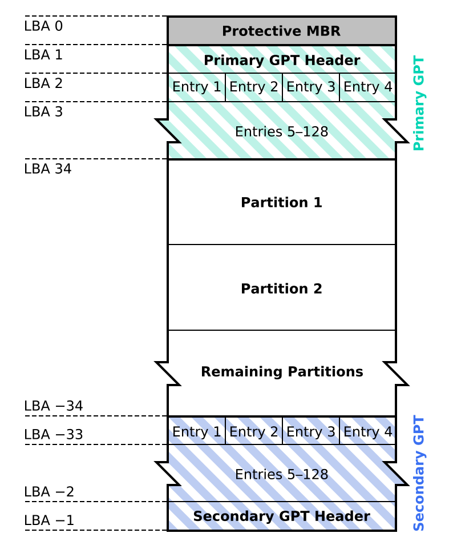
GPT Scheme
Each LBA is 512 bytes
LBA -1 to -34 is backup of LBA 1 to 34
File system starts from LBA 34
Protective MBR lets older systems mount partitions without corrupting GPT
Multiple backups of GPT can also exists between partitions
All GPTs have a checksum to validate

Slide 6
GPT Header
Signiture ( 0x5452415020494645 )
Revision ( 0x00000100 for GPT 1.0 )
Header size in little endian
Cyclic redundancy check of header
Backup LBA
Disk GUID
Starting LBA of array of partitions
Number of partitions in array
Cyclic redundancy check of array
Size of each element in array ( 128 bits )
Some reserved bit

Slide 7
GPT Entry
Partition type GUID ( 16 bytes )
Unique partition GUID ( 16 bytes )
First LBA ( 8 bytes = 64 bits )
Last LBA ( 8 bytes )
Attribute flags ( 8 bytes )
Partition name ( 72 bytes = 32 characters in UTF-16 )
128 bytes total

Slide 8
GPT Entry Attributes
0 System partition
1 EFI ignore
2 Legacy BIOS bootable
3-47 Reserved
48-63 Used by partition type
  Microsoft Defenitions:
    60 Read-only
    62 Hidden
    63 Do not automount

Slide 9
Some Familiar Partition Type GUID
Partition Type | GUID
EFI System Partition | C12A7328-F81F-11D2-BA4B-00A0C93EC93B
Windows Recovery Environment | DE94BBA4-06D1-4D40-A16A-BFD50179D6AC
RAID partition | A19D880F-05FC-4D3B-A006-743F0F84911E
Swap partition | 0657FD6D-A4AB-43C4-84E5-0933C84B4F4F
Logical Volume Manager (LVM) partition | E6D6D379-F507-44C2-A23C-238F2A3DF928

Slide 10
Operating Systems Support for GPT
Unix based vs Windows

Slide 11
Unix Based
Operating System | Read and Write | Boot Support
Free BSD | Yes | Yes
Linux | Yes | Yes
OSX | Yes | Yes
Solaris | Yes | Yes
Midnight BSD | Yes | Require BIOS

Slide 12
Windows ( 32 bit )
Operating System | Read and Write | Boot Support
Windows XP | No | No
Windows Server 2003 | No | No
Windows Server 2003 SP1 | Yes | No
Windows Vista | Yes | No
Windows Server 2008 | Yes | No
Windows 7 | Yes | No
Windows 8 | Yes | Require UEFI
Windows 8.1 | Yes | Require UEFI
Windows 10 | Yes | Require UEFI

Slide 13
Windows ( 64 bit )
Operating System | Read and Write | Boot Support
Windows XP | Yes | No
Windows Server 2003 | Yes | No
Windows Server 2003 SP1 | Yes | Yes
Windows Vista | Yes | Require UEFI
Windows Server 2008 | Yes | Yes
Windows 7 | Yes | Require UEFI
Windows 8 | Yes | Require UEFI
Windows 8.1 | Yes | Require UEFI
Windows 10 | Yes | Require UEFI

Slide 14
Any Question?
shayan.hashemi@ec.iut.ac.ir

