Slide 1
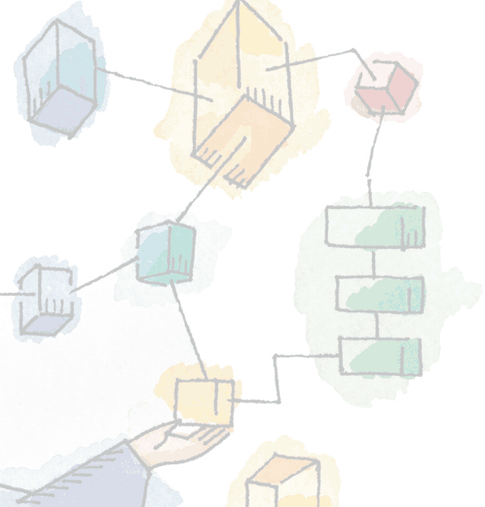
Chapter 6
Concurrency: Deadlock and Starvation
Operating Systems:
Internals and Design Principles, 6/E
William Stallings

Slide 2
Deadlock
Permanent blocking of a set of processes that either compete for system resources or communicate with each other
No efficient solution
Involve conflicting needs for resources by two or more processes

Slide 3
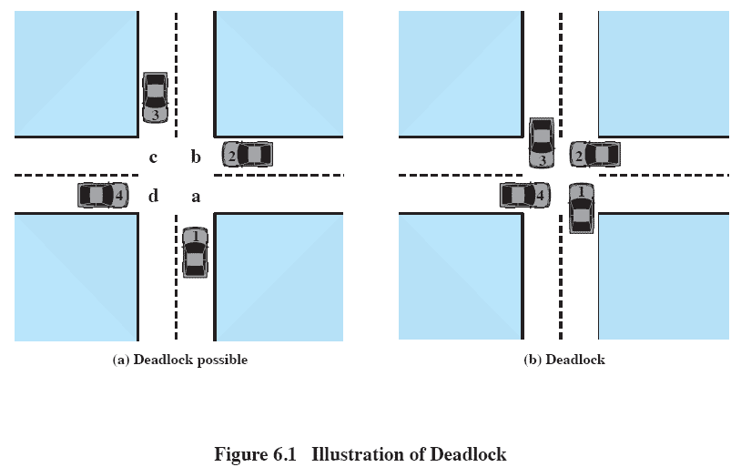
Deadlock

Slide 4
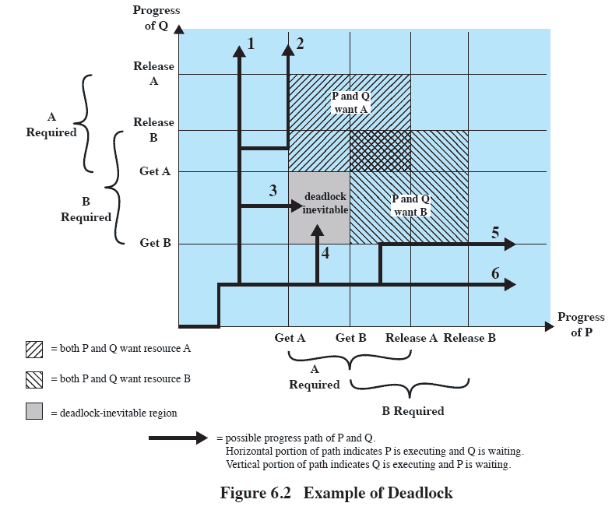
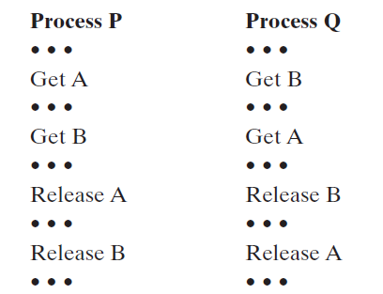
Deadlock

Slide 5
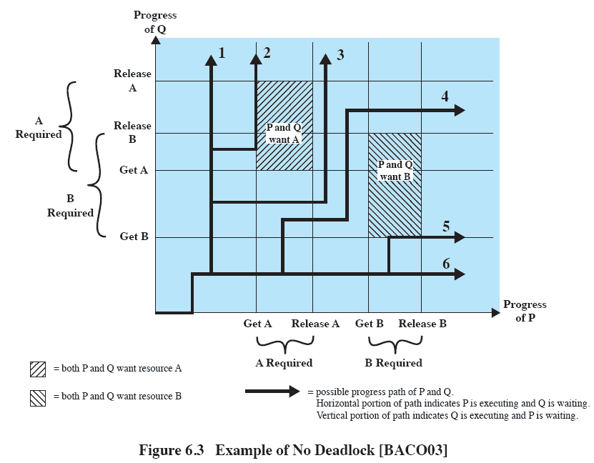
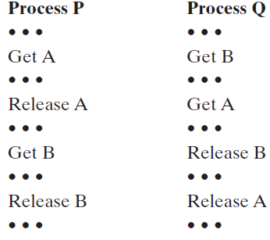
Deadlock

Slide 6
Reusable Resources
Used by only one process at a time and not depleted by that use
Processes obtain resources that they later release for reuse by other processes

Slide 7
Reusable Resources
Processors, I/O channels, main and secondary memory, devices, and data structures such as files, databases, and semaphores
Deadlock occurs if each process holds one resource and requests the other

Slide 8
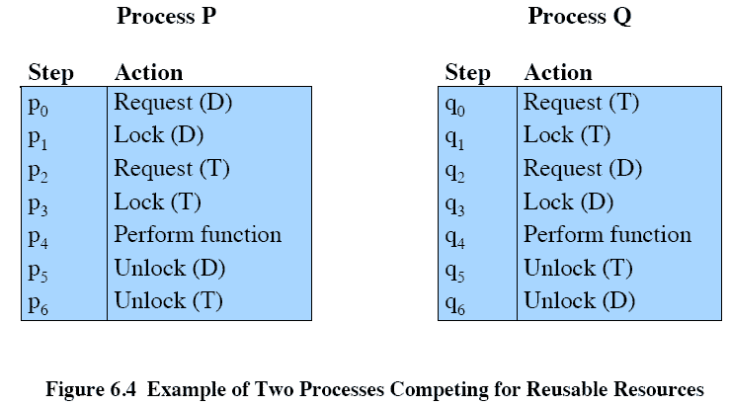
Reusable Resources

Slide 9
Reusable Resources
Space is available for allocation of 200Kbytes, and the following sequence of events occur
Deadlock occurs if both processes progress to their second request
P1
P2
. . .
. . .
Request 80 Kbytes;
Request 70 Kbytes;
. . .
. . .
Request 60 Kbytes;
Request 80 Kbytes;

Slide 10
Consumable Resources
Created (produced) and destroyed (consumed)
Interrupts, signals, messages, and information in I/O buffers
Deadlock may occur if a Receive message is blocking
May take a rare combination of events to cause deadlock

Slide 11
Example of Deadlock
Deadlock occurs if receives blocking
P1
P2
. . .
. . .
Receive(P2);
Receive(P1);
. . .
. . .
Send(P2, M1);
Send(P1, M2);

Slide 12
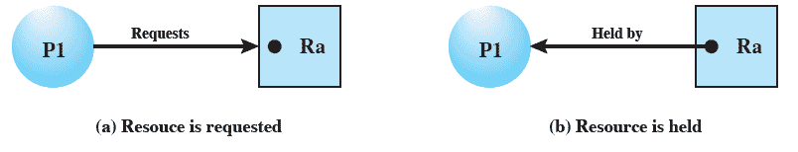
Resource Allocation Graphs
Directed graph that depicts a state of the system of resources and processes

Slide 13
Conditions for Deadlock
Mutual exclusion
  Only one process may use a resource at a time
Hold-and-wait
  A process may hold allocated resources while awaiting assignment of others

Slide 14
Conditions for Deadlock
No preemption
  No resource can be forcibly removed form a process holding it
Circular wait
  A closed chain of processes exists, such that each process holds at least one resource needed by the next process in the chain

Slide 15
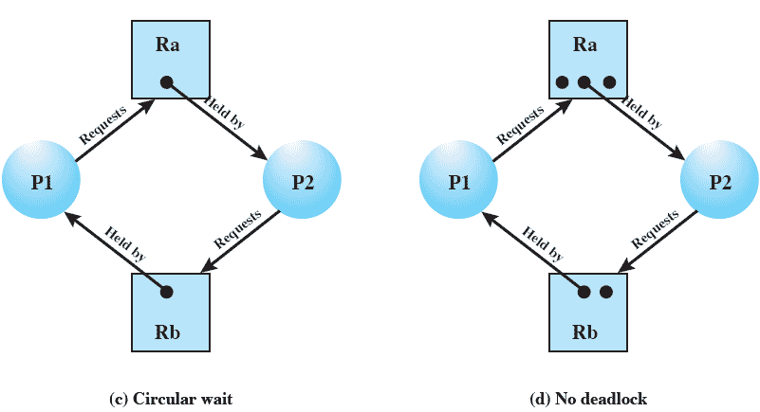
Resource Allocation Graphs

Slide 16
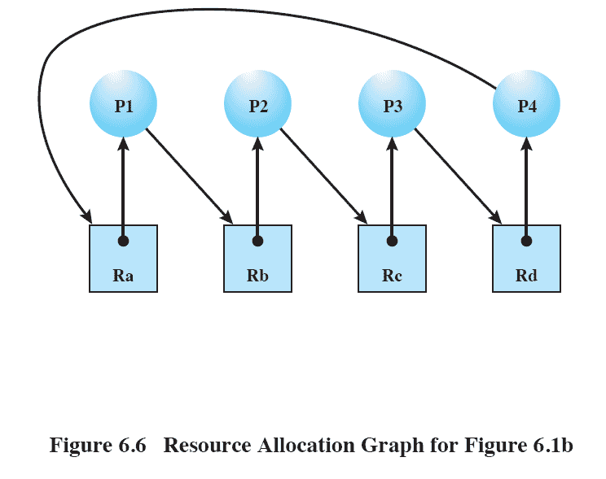
Resource Allocation Graphs

Slide 17
Possibility of Deadlock
Mutual Exclusion
No preemption
Hold and wait

Slide 18
Existence of Deadlock
Mutual Exclusion
No preemption
Hold and wait
Circular wait

Slide 19
Deadlock Prevention
Mutual Exclusion
  Must be supported by the OS
Hold and Wait
  Require a process request all of its required resources at one time

Slide 20
Deadlock Prevention
No Preemption
  Process must release resource and request again
  OS may preempt a process to require it releases its resources
Circular Wait
  Define a linear ordering of resource types

Slide 21
Deadlock Avoidance
A decision is made dynamically whether the current resource allocation request will, if granted, potentially lead to a deadlock
Requires knowledge of future process requests

Slide 22
Two Approaches to
Deadlock Avoidance
Do not start a process if its demands might lead to deadlock
Do not grant an incremental resource request to a process if this allocation might lead to deadlock

Slide 23
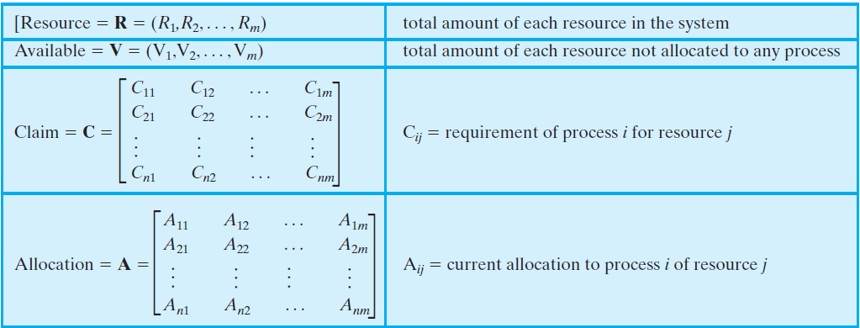
Process Initiation Denial
Consider a system of n processes and m different types of resources. Let us define the following vectors and matrices

Slide 24
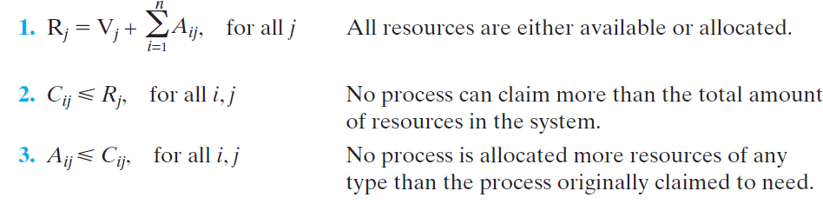
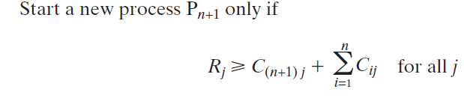
Process Initiation Denial

Slide 25
Resource Allocation Denial
Referred to as the banker’s algorithm
State of the system is the current allocation of resources to process
Safe state is where there is at least one sequence that does not result in deadlock
Unsafe state is a state that is not safe

Slide 26
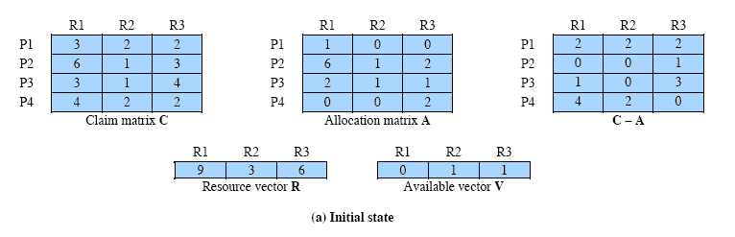
Determination of a Safe State

Slide 27
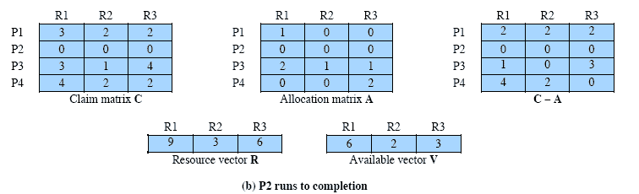
Determination of a Safe State

Slide 28
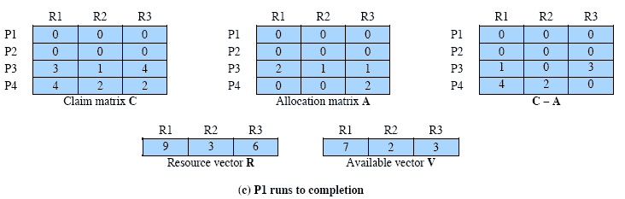
Determination of a Safe State

Slide 29
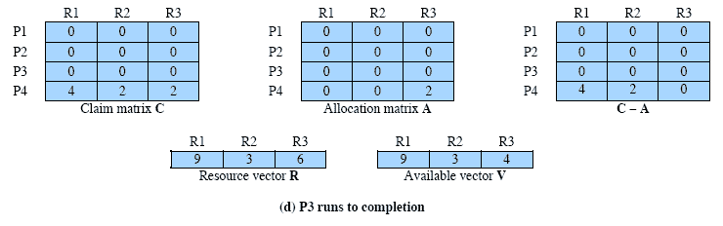
Determination of a Safe State

Slide 30
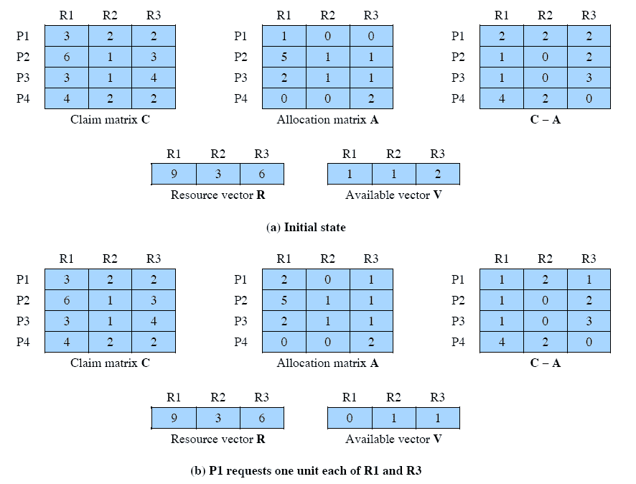
Determination of an Unsafe State

Slide 31
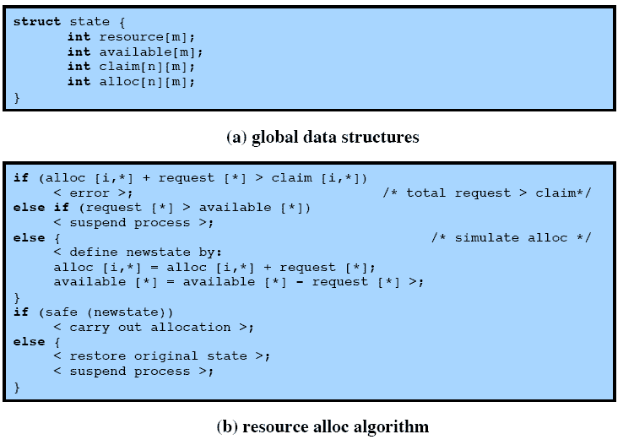
Deadlock Avoidance Logic

Slide 32
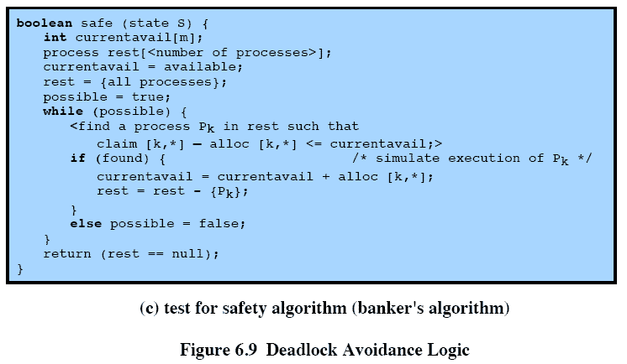
Deadlock Avoidance Logic

Slide 33
Deadlock Avoidance
Maximum resource requirement must be stated in advance
Processes under consideration must be independent; no synchronization requirements
There must be a fixed number of resources to allocate
No process may exit while holding resources

Slide 34
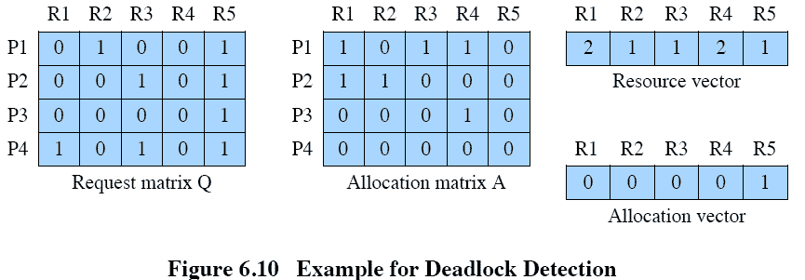
Deadlock Detection

Slide 35
Strategies Once Deadlock Detected
Abort all deadlocked processes
Back up each deadlocked process to some previously defined checkpoint, and restart all process
  Original deadlock may occur

Slide 36
Strategies Once Deadlock Detected
Successively abort deadlocked processes until deadlock no longer exists
Successively preempt resources until deadlock no longer exists

Slide 37
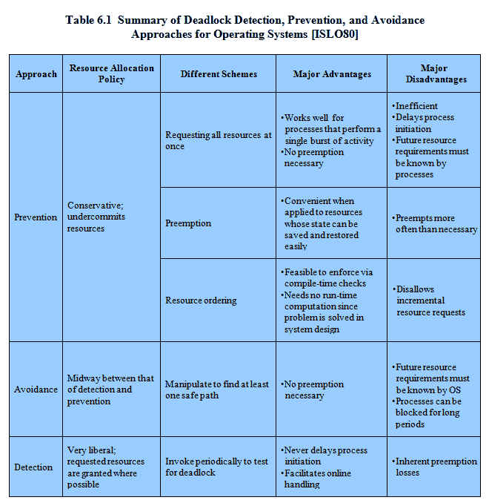
Advantages and Disadvantages

Slide 38
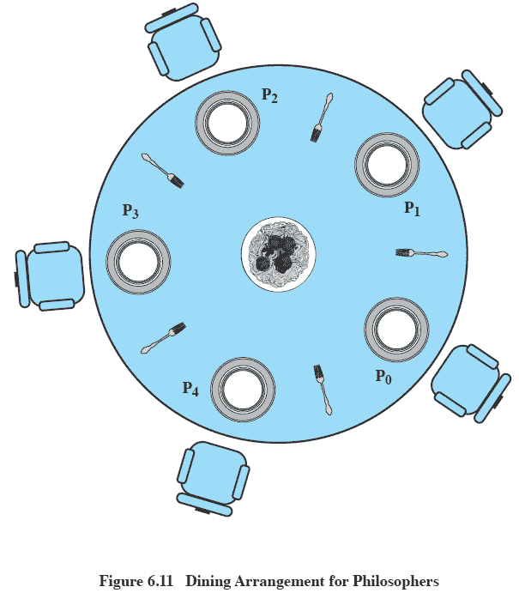
Dining Philosophers Problem

Slide 39
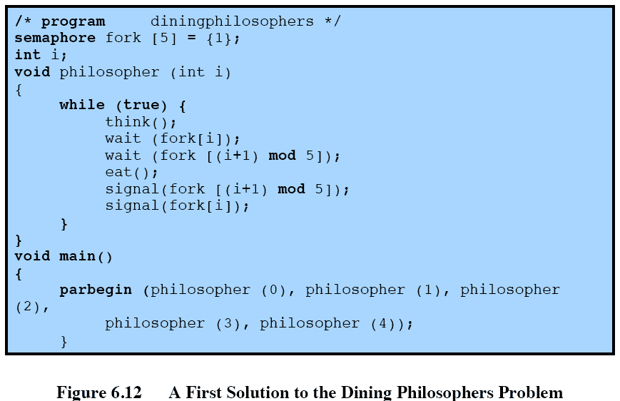
Dining Philosophers Problem

Slide 40
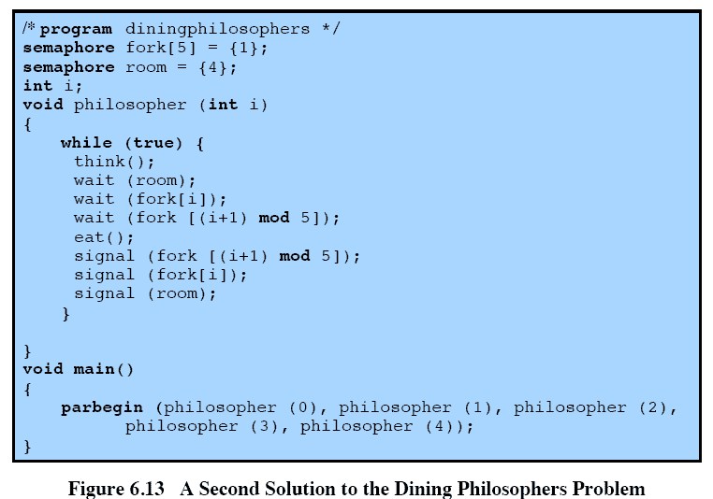
Dining Philosophers Problem

Slide 41
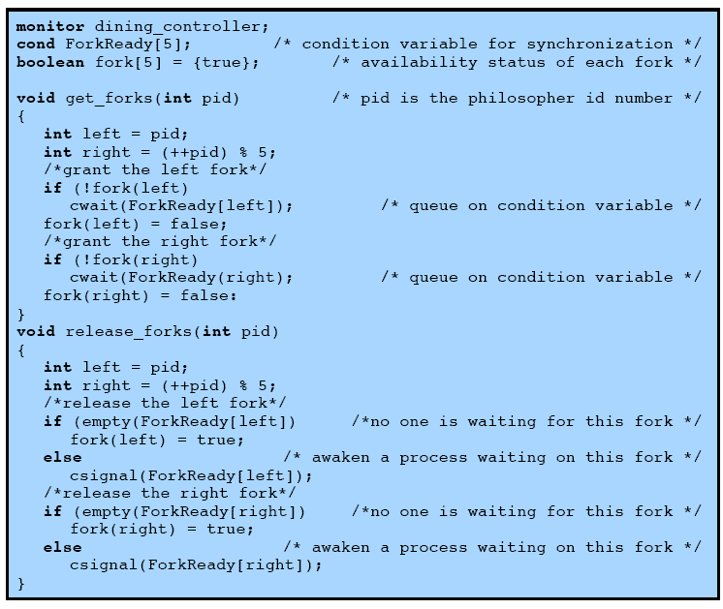
Dining Philosophers Problem

Slide 42
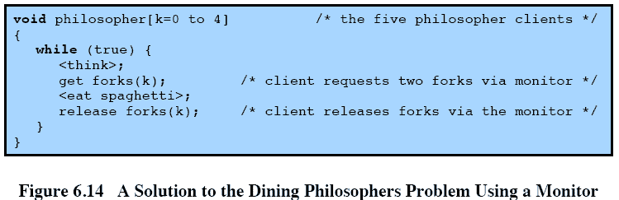
Dining Philosophers Problem

Slide 43
UNIX Concurrency Mechanisms
Pipes
Messages
Shared memory
Semaphores
Signals

Slide 44
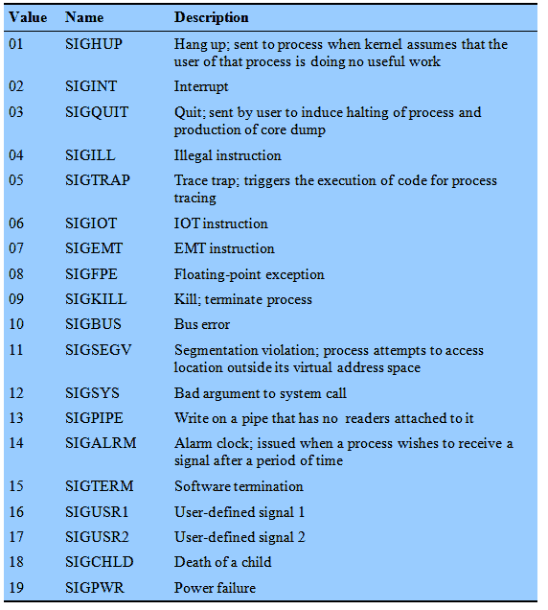
UNIX Signals

Slide 45
Linux Kernel Concurrency Mechanism
Includes all the mechanisms found in UNIX
Atomic operations execute without interruption and without interference

Slide 46
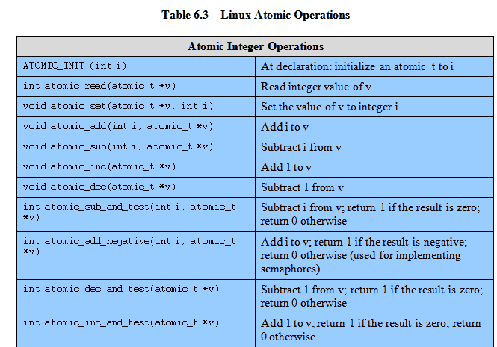
Linux Atomic Operations

Slide 47
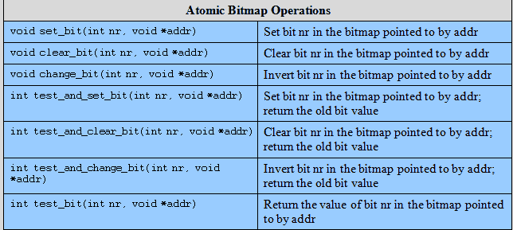
Linux Atomic Operations

Slide 48
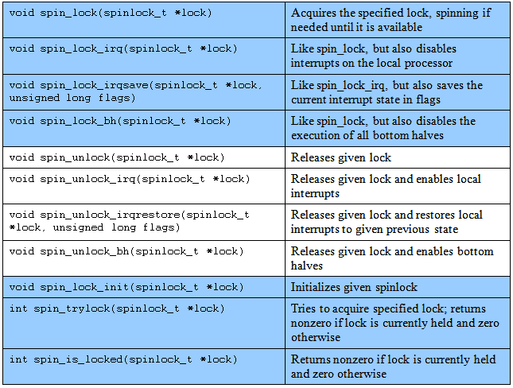
Linux Spinlocks

Slide 49
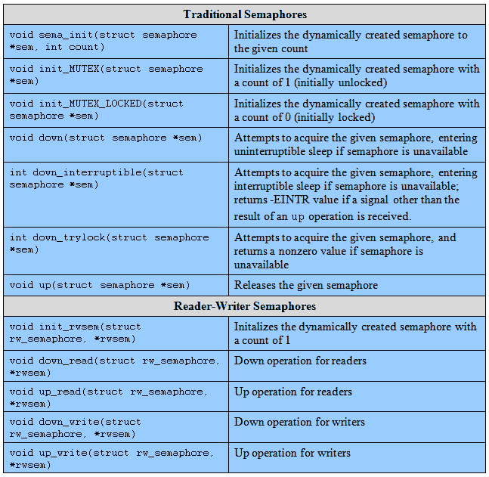
Linux Semaphores

Slide 50
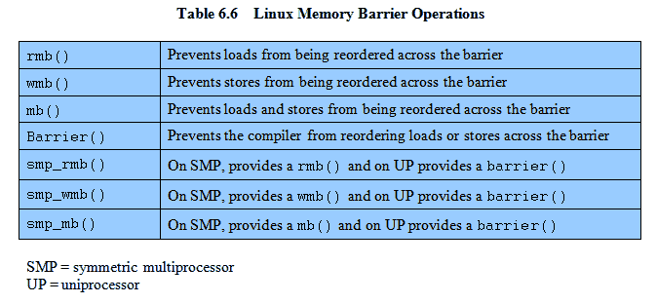
Linux Memory Barrier Operations

Slide 51
Solaris Thread Synchronization Primitives
Mutual exclusion (mutex) locks
Semaphores
Multiple readers, single writer (readers/writer) locks
Condition variables

Slide 52
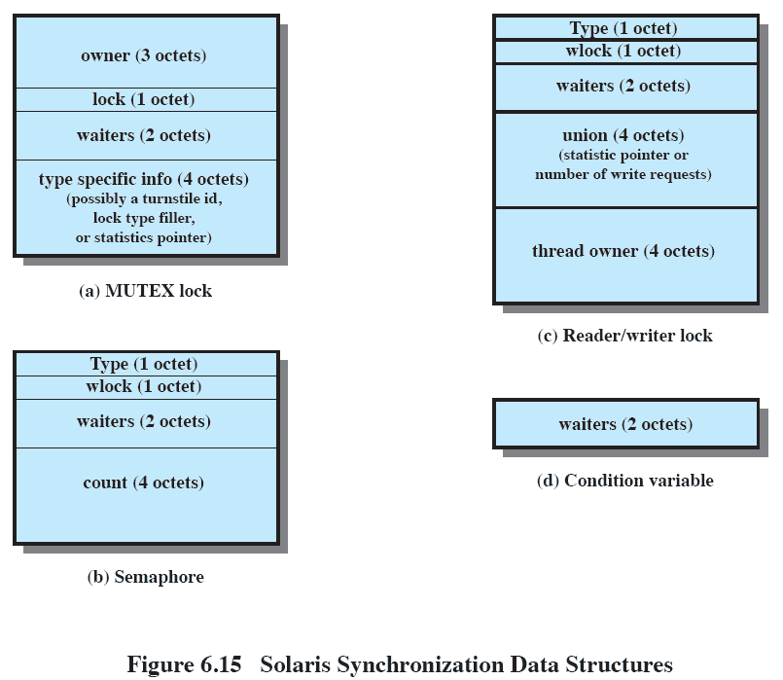
Solaris Synchronization Data Structures

Slide 53
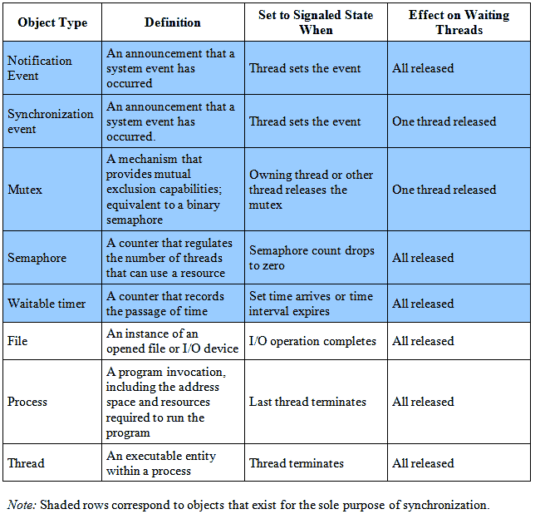
Windows Synchronization Objects

