Slide 1

Chapter 5
Concurrency: Mutual Exclusion and Synchronization
Operating Systems:
Internals and Design Principles, 6/E
William Stallings
Notes:
These slides are intended to help a teacher develop a presentation. This PowerPoint covers the entire chapter and includes too many slides for a single delivery. Professors are encouraged to adapt this presentation in ways which are best suited for their students and environment.

Slide 2
Roadmap
Principals of Concurrency
Mutual Exclusion: Hardware Support
Semaphores
Monitors
Message Passing
Readers/Writers Problem

Slide 3
Multiple Processes
Central to the design of modern Operating Systems is managing multiple processes
  Multiprogramming
  Multiprocessing
  Distributed Processing
Big Issue is Concurrency
  Managing the interaction of all of these processes
Notes:
The central themes of operating system design are all concerned with the management of processes and threads:
• Multiprogramming:
The management of multiple processes within a uniprocessor system.
• Multiprocessing:
The management of multiple processes within a multiprocessor.
• Distributed processing:
The management of multiple processes executing on multiple, distributed computer systems.
E. G clusters
Concurrency encompasses a host of design issues, including
communication among processes,
sharing of and competing for resources (such as memory, files, and I/O access),
synchronization of the activities of multiple processes, and
allocation of processor time to processes.

Slide 4
Concurrency
Concurrency arises in:
Multiple applications
  Sharing time
Structured applications
  Extension of modular design
Operating system structure
  OS themselves implemented as a set of processes or threads
Notes:
• Multiple applications:
Multiprogramming was invented to allow processing time to be dynamically shared among a number of active applications.
• Structured applications:
As an extension of the principles of modular design and structured programming, some applications can be effectively programmed as a set of concurrent processes.
• Operating system structure:
The same structuring advantages apply to systems programs, and we have seen that operating systems are themselves often implemented as a set of processes or threads.

Slide 5
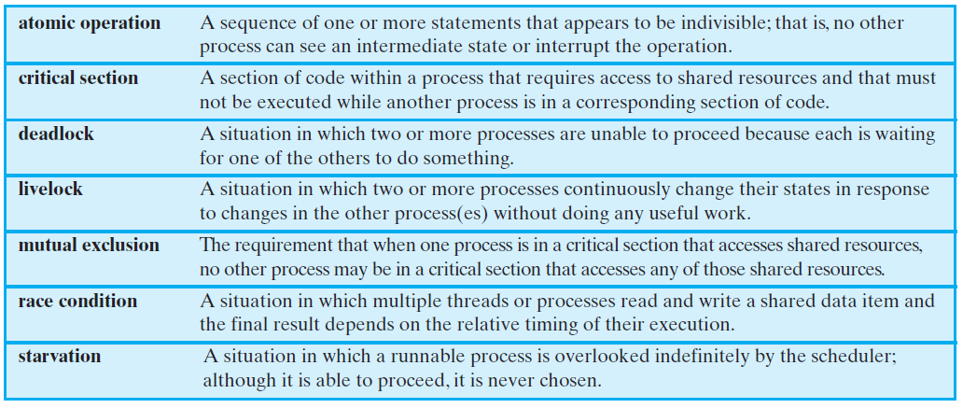
Key Terms
Notes:
These terms will be explained throughout this chapter – do not labor this table.
It may be best skipped over and given as a reference point for students.

Slide 6
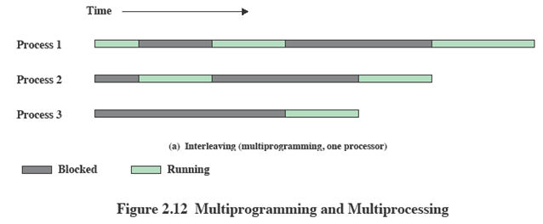
Interleaving and
Overlapping Processes
Earlier (Ch2) we saw that processes may be interleaved on uniprocessors

Slide 7
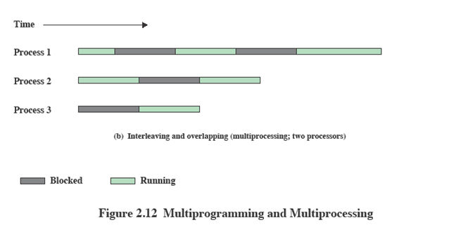
Interleaving and
Overlapping Processes
And not only interleaved but overlapped on multi-processors

Slide 8
Difficulties of
Concurrency
Sharing of global resources
Optimally managing the allocation of resources
Difficult to locate programming errors as results are not deterministic and reproducible.
Notes:
The sharing of global resources
If two processes both make use of the same global variable
and both perform reads and writes on that variable,
then the order in which the various reads and writes are executed is critical.
Managing Resources
It is difficult for the OS to manage the allocation of resources optimally.
E.G. A process may request use of, and be granted control of, a particular I/O channel and then be suspended before using that channel.
It may be undesirable for the OS simply to lock the channel and prevent its use by other processes;
indeed this may lead to a deadlock condition,
Locating Programming Errors
It becomes very difficult to locate a programming error because results are typically not deterministic and reproducible

Slide 9
A Simple Example
void echo()
{
chin = getchar();
chout = chin;
putchar(chout);
}
Notes:
A program that will provide a character echo procedure;
input is obtained from a keyboard one keystroke at a time.
Each input character is stored in variable chin.
It is then transferred to variable chout
and finally sent to the display.
Any program can call this procedure repeatedly to accept user input and display it on the user’s screen.
Now consider that we have a single-processor multiprogramming system supporting a single user.
The user can jump from one application to another, and each application uses the same keyboard for input and the same screen for output.
Each application needs to use the procedure echo,
So it makes sense for it to be a shared procedure that is loaded into a portion of memory global to all applications.
Thus, only a single copy of the echo procedure is used, saving space.

Slide 10
A Simple Example:
On a Multiprocessor
Process P1 Process P2
. .
chin = getchar(); .
. chin = getchar();
chout = chin; chout = chin;
putchar(chout); .
. putchar(chout);
. .
Notes:
The result is that the character input to P1 is lost before being displayed,
and the character input to P2 is displayed by both P1 and P2.

Slide 11
Enforce Single Access
If we enforce a rule that only one process may enter the function at a time then:
P1 & P2 run on separate processors
P1 enters echo first,
  P2 tries to enter but is blocked – P2 suspends
P1 completes execution
  P2 resumes and executes echo
Notes:
Processes P1 and P2 are both executing, each on a separate processor.
P1 invokes the echo procedure.
2. While P1 is inside the echo procedure, P2 invokes echo.
Because P1 is still inside the echo procedure (whether P1 is suspended or executing), P2 is blocked from entering the procedure.
Therefore, P2 is suspended awaiting the availability of the echo procedure.
3. At a later time, process P1 completes execution of echo, exits that procedure, and continues executing.
Immediately upon the exit of P1 from echo, P2 is resumed and begins executing echo.

Slide 12
Race Condition
A race condition occurs when
  Multiple processes or threads read and write data items
  They do so in a way where the final result depends on the order of execution of the processes.
The output depends on who finishes the race last.

Slide 13
Operating System
Concerns
What design and management issues are raised by the existence of concurrency?
The OS must
  Keep track of various processes
  Allocate and de-allocate resources
  Protect the data and resources against interference by other processes.
  Ensure that the processes and outputs are independent of the processing speed

Slide 14
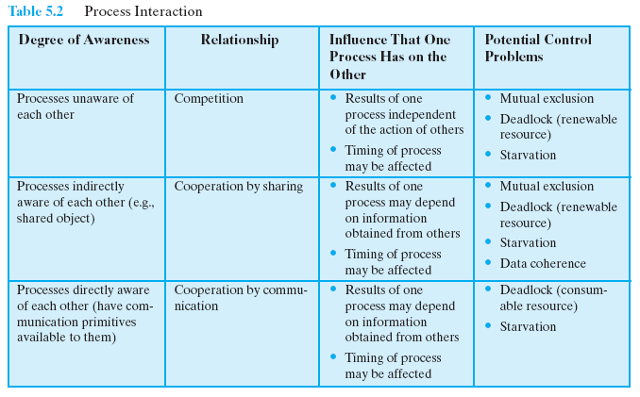
Process Interaction
Notes:
We can classify the ways in which processes interact on the basis of the degree to which they are aware of each other’s existence.
This table (continues on the next slide) lists three possible degrees of awareness plus the consequences of each.
Introduce each degree of awareness briefly – mention that things are often as clear cut as in this table.
Processes unaware of each other:
Independent processes that are not intended to work together.
E.G. multiprogramming of multiple independent processes.
Although the processes are not working together, the OS needs to be concerned about competition for resources.
E.G. two independent applications may both want to access the same disk or file or printer.
Processes indirectly aware of each other:
Processes that are not necessarily aware of each other by their respective process IDs but that share access to some object, such as an I/O buffer.
Such processes exhibit cooperation in sharing the common object.
Processes directly aware of each other:
Processes that are able to communicate with each other by process ID and that are designed to work jointly on some activity.
Again, such processes exhibit cooperation.

Slide 15
Competition among
Processes for Resources
Three main control problems:
Need for Mutual Exclusion
  Critical resource
  Critical sections
Deadlock
Starvation
Notes:
Need for mutual exclusion.
Suppose two or more processes require access to a single nonsharable resource, such as a printer.
During the course of execution, each process will be sending commands to the I/O device, receiving status information, sending data, and/or receiving data.
We will refer to such a resource as a critical resource, and the portion of the program that uses it a critical section of the program.
It is important that only one program at a time be allowed in its critical section.
We cannot simply rely on the OS to understand and enforce this restriction because the detailed requirements may not be obvious.
In the case of the printer, for example, we want any individual process to have control of the printer while it prints an entire file.
Otherwise, lines from competing processes will be interleaved.
The enforcement of mutual exclusion creates two additional control problems:
deadlock.
Two processes is waiting for the same resources (or each waiting for a resource that the other has exclusive use to)
Neither will release the resource that it already owns until it has acquired the other resource and performed the function requiring both resources.
The two processes are deadlocked.
starvation.
The OS may grant access to resources to a number of processes while neglecting another

Slide 16
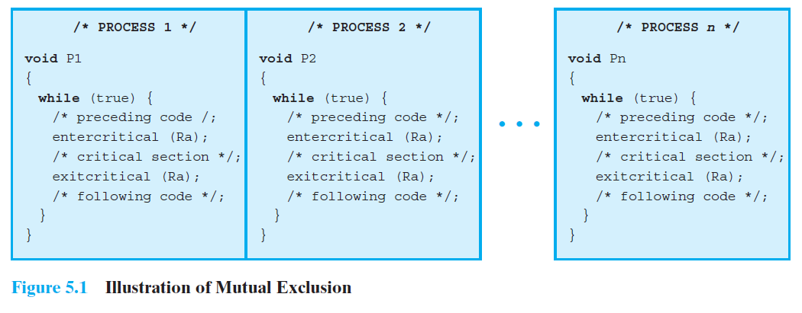

Slide 17
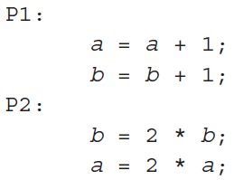
Cooperation among Processes by Sharing
The case of cooperation by sharing covers processes that interact with other processes without being explicitly aware of them.
Suppose two items of data a and b are to be maintained in the relationship a b

Slide 18
Cooperation among Processes by Communication
In the first case, the processes are sharing resources without being aware of the other processes
In the second case, they are sharing values, and although each process is not explicitly aware of the other processes, it is aware of the need to maintain data integrity.
In the last one, processes cooperate by communication

Slide 19
Requirements for
Mutual Exclusion
Only one process at a time is allowed in the critical section for a resource
A process that halts in its noncritical section must do so without interfering with other processes
No deadlock or starvation

Slide 20
Requirements for
Mutual Exclusion
A process must not be delayed access to a critical section when there is no other process using it
No assumptions are made about relative process speeds or number of processes
A process remains inside its critical section for a finite time only

Slide 21
Software solutions based on Shared variables
Two cooperating processes, each of the form:
  while (TRUE) {
  entry section // each using the same shared
  critical section // variables in common
  exit section
  . . . .
  }
Solution 1 ?
  shared variable : turn = 1;
  process 1 process 2
  while (TRUE) { while (TRUE) {
  while (turn==2) { /* wait */ } while (turn==1) { /* wait */ }
  critical section 1 critical section 2
  turn = 2; turn = 1;
  . . . . . . . .
  } }

Slide 22
Solution 2 ?
  shared variable c1 = 1, c2 = 1;
  process 1 process 2
  while (TRUE) { while (TRUE) {
  while (c2==0) { /* wait */ } while (c1==0) { /* wait */ }
  c1 = 0; c2 = 0;
  critical section 1 critical section 2
  c1 = 1; c2 = 1;
  . . . . . . . .
  } }

Slide 23
Solution 3 ?
  shared variable c1 = 1, c2 = 1;
  process 1 process 2
  while (TRUE) { while (TRUE) {
  c1 = 0; c2 = 0;
  while (c2==0) { /* wait */ } while (c1==0) { /* wait */ }
  critical section 1 critical section 2
  c1 = 1; c2 = 1;
  . . . . . . . .
  } }

Slide 24
Solution 4 ?
  shared variable c1 = 1, c2 = 1;
  process 1 process 2
  while (TRUE) { while (TRUE) {
  c1 = 0; c2 = 0;
  while (c2==0) { while (c1==0) {
  c1 = 1; c2=1;
  delay ; delay;
  c1 = 0; c2=0;
  } }
  critical section 1 critical section 2
  c1 = 1; c2 = 1;
  . . . . . . . .
  } }

Slide 25
Solution 5 (Dekker)
  shared variable c1 = 1, c2 = 1, turn = 1;
  process 1 process 2
  while (TRUE) { while (TRUE) {
  L1: c1 = 0; L2: c2 = 0;
  while (c2==0) { while (c1==0) {
  if (turn==1) continue; if (turn==2) continue;
  c1 = 1; c2 = 1;
  while (turn==2) { /* wait */ } while (turn==1) { /* wait */ }
  goto L1; goto L2;
  } }
  critical section 1 critical section 2
  turn = 2; turn = 1;
  c1 = 1; c2 = 1;
  . . . . . . . .
  } }

Slide 26
Solution 6 (Peterson)
  shared variable c1 = 1, c2 = 1, turn = 1;
  process 1 process 2
  while (TRUE) { while (TRUE) {
  c1 = 0; c2 = 0;
  turn = 2; turn = 1;
  while (c2==0 && turn==2) { while (c1==0 && turn==1) {
  // wait // wait
  } }
  critical section 1 critical section 2
  c1 = 1; c2 = 1;
  . . . . . . . .
  } }

Slide 27
Roadmap
Principals of Concurrency
Mutual Exclusion: Hardware Support
Semaphores
Monitors
Message Passing
Readers/Writers Problem

Slide 28
Disabling Interrupts
Uniprocessors only allow interleaving
Interrupt Disabling
  A process runs until it invokes an operating system service or until it is interrupted
  Disabling interrupts guarantees mutual exclusion
  Will not work in multiprocessor architecture
Notes:
In a uniprocessor system, concurrent processes cannot have overlapped execution;
they can only be interleaved.
To guarantee mutual exclusion, it is sufficient to prevent a process from being interrupted.

Slide 29
Pseudo-Code
while (true) {
  /* disable interrupts */;
  /* critical section */;
  /* enable interrupts */;
  /* remainder */;
}
Notes:
Because the critical section cannot be interrupted, mutual exclusion is guaranteed.
The price of this approach, however, is high.
The efficiency of execution could be noticeably degraded because the processor is limited in its ability to interleave processes.

Slide 30
Special Machine
Instructions
Compare&Swap Instruction
  also called a “compare and exchange instruction”
Exchange Instruction
Notes:
More details on these approaches in the following slides

Slide 31
Compare&Swap
Instruction
int compare_and_swap (int *word,
int testval, int newval)
{
  int oldval;
  oldval = *word;
  if (oldval == testval) *word = newval;
  return oldval;
}
Notes:
This version of the instruction checks a memory location (*word) against a test value (testval).
If the memory location’s current value is testval, it is replaced with newval;
otherwise it is left unchanged.
The old memory value is always returned;
thus, the memory location has been updated if the returned value is the same as the test value.
A compare is made between a memory value and a test value;
if the values differ a swap occurs.
The entire compare&swap function is carried out atomically;
Ie it is not subject
to interruption.

Slide 32
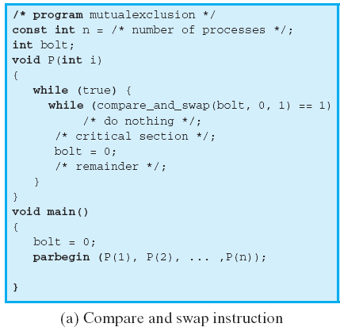
Mutual Exclusion (fig 5.2)
Notes:
This shows a mutual exclusion protocol based on the use of this instruction.
A shared variable bolt is initialized to 0.
The only process that may enter its critical section is one that finds bolt equal to 0.
All other processes that enter their critical section go into a busy waiting mode.

Slide 33
Exchange instruction
void exchange (int register, int memory)
{
  int temp;
  temp = memory;
  memory = register;
  register = temp;
}
Notes:
The instruction exchanges the contents of a register with that of a memory location.
Both the Intel IA-32 architecture (Pentium) and the IA-64 architecture (Itanium) contain an XCHG instruction.

Slide 34
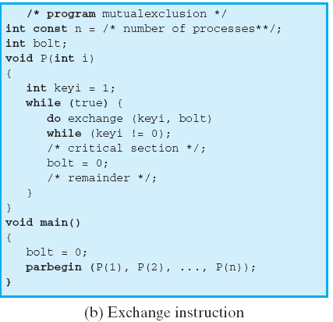
Exchange Instruction
(fig 5.2)
Notes:
This shows a mutual exclusion protocol based on the use of an exchange instruction.
A shared variable bolt is initialized to 0.
Each process uses a local variable key that is initialized to 1.
The only process that may enter its critical section is one that finds bolt equal to 0.
It excludes all other processes from the critical section by setting bolt to 1.
When a process leaves its critical section, it resets bolt to 0, allowing another process to gain access to its critical section.

Slide 35
Hardware Mutual
Exclusion: Advantages
Applicable to any number of processes on either a single processor or multiple processors sharing main memory
It is simple and therefore easy to verify
It can be used to support multiple critical sections

Slide 36
Hardware Mutual
Exclusion: Disadvantages
Busy-waiting consumes processor time
Starvation is possible when a process leaves a critical section and more than one process is waiting.
  Some process could indefinitely be denied access.
Deadlock is possible
Notes:
Busy waiting
While a process is waiting for access to a critical section, it continues to consume processor time.
Starvation is possible.
When a process leaves a critical section and more than one process is waiting, the selection of a waiting process is arbitrary.
Thus, some process could indefinitely be denied access.
Deadlock is possible.
Example (on a uniprocessor).
Process P1 executes the special instruction (e.g., compare&swap, exchange) and enters its critical section.
P1 is then interrupted to give the processor to P2, which has higher priority.
If P2 now attempts to use the same resource as P1, it will be denied access because of the mutual exclusion mechanism.
Thus it will go into a busy waiting loop.
However, P1 will never be dispatched because it is of lower priority than another ready process, P2.

Slide 37
Roadmap
Principals of Concurrency
Mutual Exclusion: Hardware Support
Semaphores
Monitors
Message Passing
Readers/Writers Problem

Slide 38
Semaphore
Semaphore:
  An integer value used for signalling among processes.
Only three operations may be performed on a semaphore, all of which are atomic:
  initialize,
  Decrement (semWait)
  increment. (semSignal)
Notes:
1. A semaphore may be initialized to a nonnegative integer value.
2. The semWait operation decrements the semaphore value.
If the value becomes negative, then the process executing the semWait is blocked.
Otherwise, the process continues execution.
3. The semSignal operation increments the semaphore value.
If the resulting value is less than or equal to zero, then a process blocked by a semWait operation, if any, is unblocked.

Slide 39
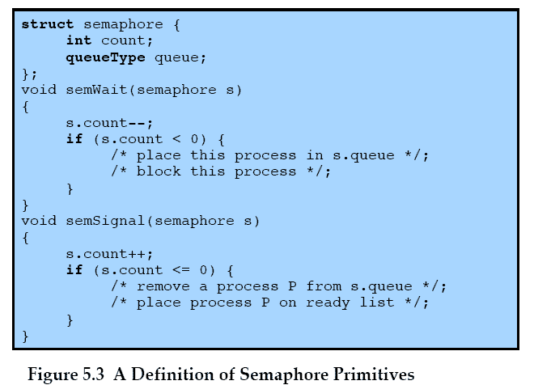
Semaphore Primitives
Notes:
An example of a semaphore

Slide 40
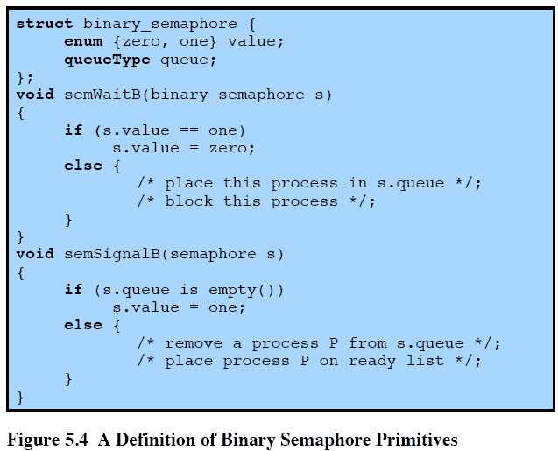
Binary Semaphore
Primitives
Notes:
A more restrictive semaphore which may only have the value of 0 or 1
A similar concept related to the binary semaphore is the mutex.
A key difference between the two is that the process that locks the mutex (sets the value to zero) must be the one to unlock it (sets the value to 1).
In contrast, it is possible for one process to lock a binary semaphore and for another to unlock it.

Slide 41
Strong/Weak
Semaphore
A queue is used to hold processes waiting on the semaphore
  In what order are processes removed from the queue?
Strong Semaphores use FIFO
Weak Semaphores don’t specify the order of removal from the queue
Notes:
For both counting semaphores and binary semaphores, a queue is used to hold processes waiting on the semaphore.
The question arises of the order in which processes are removed from such a queue.
The fairest removal policy is first-in-first-out (FIFO):
The process that has been blocked the longest is released from the queue first; a semaphore whose definition includes this policy is called a strong semaphore.
A semaphore that does not specify the order in which processes are removed from the queue is a weak semaphore.

Slide 42
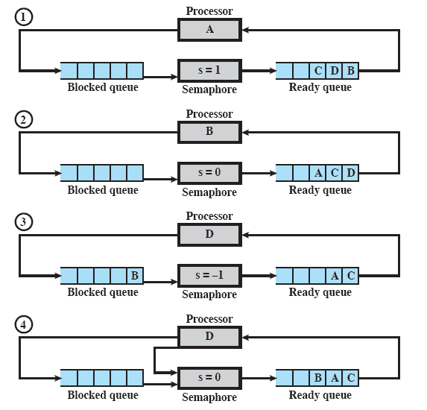
Example of Strong
Semaphore Mechanism
Notes:
Animated Slide – animation shows sections of the diagram to focus and remove distraction
Processes A, B, and C depend on a result from process D.
Initially (1), A is running;
B, C, and D are ready;
the semaphore count is 1, indicating that one of D’s results is available.
When A issues a semWait instruction on semaphore s, the semaphore decrements to 0, and A can continue to execute;
subsequently it rejoins the ready queue.
Then B runs (2), eventually issues a semWait instruction, and is blocked,
allowing D to run (3).
When D completes a new result, it issues a semSignal instruction,
which allows B to move to the ready queue (4).
D rejoins the ready queue and …

Slide 43
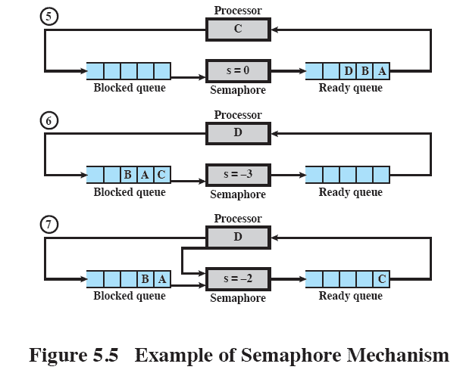
Example of Semaphore Mechanism
Notes:
C begins to run (5)
but is blocked when it issues a semWait instruction.
Similarly, A and B run and are blocked on the semaphore,
allowing D to resume execution (6).When D has a result, it issues a semSignal, which transfers C to the ready queue. Later cycles of D will release A and B from the Blocked state.

Slide 44
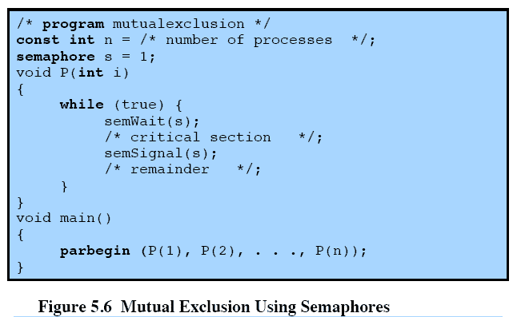
Mutual Exclusion Using Semaphores
Notes:
This shows a straightforward solution to the mutual exclusion problem using a semaphore
Consider n processes, identified in the array P(i), all of which need access to the same resource s.
Each process has a critical section used to access the resource.
In each process, a semWait(s) is executed just before its critical section.
If the value of s becomes negative, the process is blocked.
If the value is 1, then it is decremented to 0 and the process immediately enters its critical section;
because s is no longer positive, no other process will be able to enter its critical section.

Slide 45
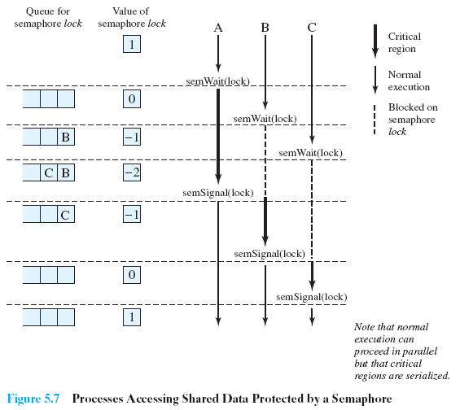
Processes Using
Semaphore
Notes:
Figure 5.7, shows a possible sequence for three processes using the mutual exclusion discipline of Figure 5.6.
Three processes (A,B, C) access a shared resource protected by the semaphore lock.
Process-A executes semWait(lock);
because the semaphore has a value of 1 at the time of the semWait operation, A can immediately enter its critical section and the semaphore takes on the value 0.
While A is in its critical section, both B and C perform a semWait operation and are blocked pending the availability of the semaphore.
When A exits its critical section and performs semSignal(lock), B, which was the first process in the queue, can now enter its critical section.

Slide 46
Producer/Consumer
Problem
General Situation:
  One or more producers are generating data and placing these in a buffer
  A single consumer is taking items out of the buffer one at time
  Only one producer or consumer may access the buffer at any one time
The Problem:
  Ensure that the Producer can’t add data into full buffer and consumer can’t remove data from empty buffer
Producer/Consumer Animation
Notes:
The general statement is this:
There are one or more producers generating some type of data (records, characters) and placing these in a buffer.
There is a single consumer that is taking items out of the buffer one at a time.
The system is to be constrained to prevent the overlap of buffer operations. That is, only one agent (producer or consumer) may access the buffer at any one time.
The problem is to make sure that the producer won’t try to add data into the buffer if it’s full and that the consumer won’t try to remove data from an empty buffer.
We will look at a number of solutions to this problem to illustrate both the power and the pitfalls of semaphores.

Slide 47
Functions
Assume an infinite buffer b with a linear array of elements
Producer | Consumer
while (true) { /* produce item v */ b[in] = v; in++; } | while (true) { while (in <= out) /*do nothing */; w = b[out]; out++; /* consume item w */ }

Slide 48
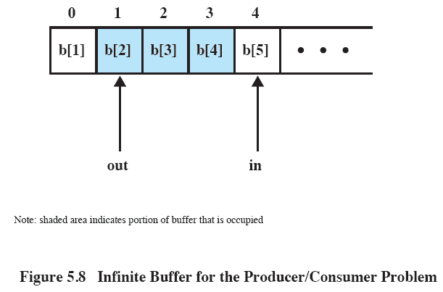
Buffer
Notes:
The producer can generate items and store them in the buffer at its own pace.
Each time, an index (in) into the buffer is incremented.
The consumer proceeds in a similar fashion but must make sure that it does not attempt to read from an empty buffer.

Slide 49
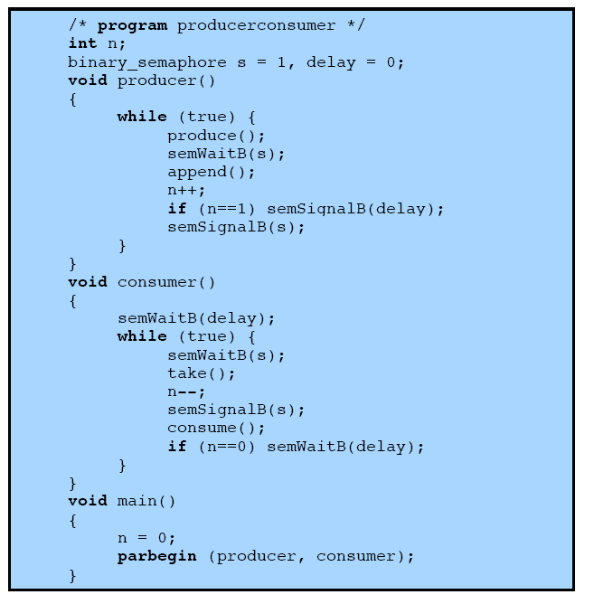
Incorrect Solution
Notes:
Rather than deal with the indices in and out, we can simply keep track of the number of items in the buffer, using the integer variable n (= in - out).
The semaphore s is used to enforce mutual exclusion;
the semaphore delay is used to force the consumer to semWait if the buffer is empty.

Slide 50
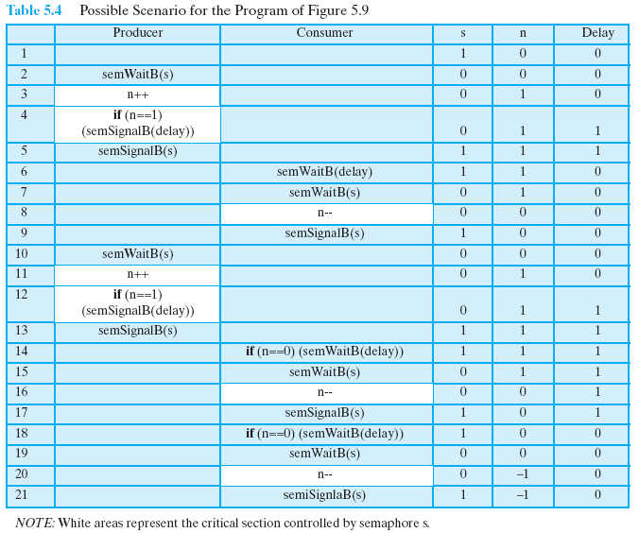
Possible Scenario
Notes:
There is, however, a flaw in this program.
When the consumer has exhausted the buffer, it needs to reset the delay semaphore so that it will be forced to wait until the producer has placed more items in the buffer.
This is the purpose of the statement: if n == 0 semWaitB (delay).
In line 14, the consumer fails to execute the semWaitB operation.
The consumer did indeed exhaust the buffer and set n to 0 (line 8),
but the producer has incremented n before the consumer can test it in line 14.
The result is a semSignalB not matched by a prior semWaitB.
The value of -1 for n in line 20 means that the consumer has consumed an item from the buffer that does not exist. It would not do simply to move the conditional statement inside the critical section of the consumer because this could lead to deadlock (e.g., after line 8 of the table).

Slide 51
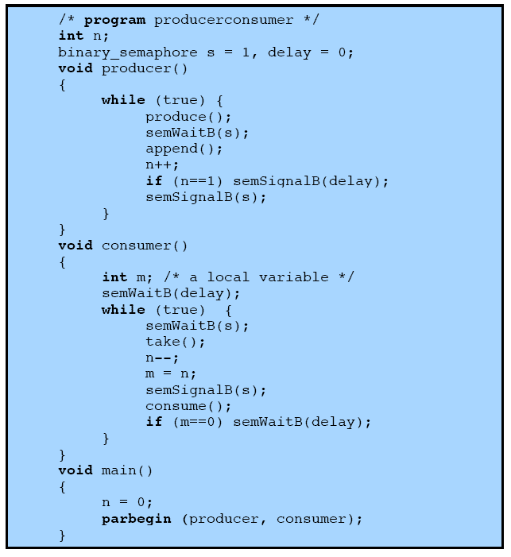
Correct Solution
Notes:
A fix for the problem is to introduce an auxiliary variable that can be set in the consumer’s critical section for use later on.

Slide 52
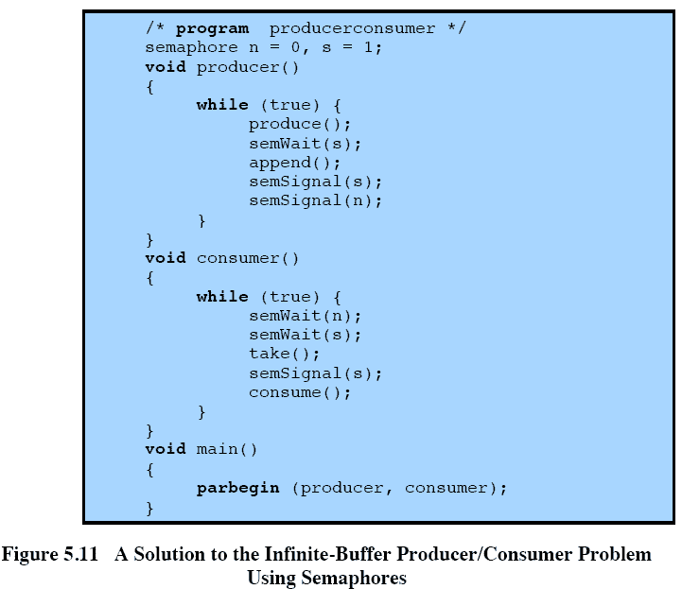
Semaphores
Notes:
A somewhat cleaner solution can be obtained if general semaphores (also called counting semaphores) are used
The variable n is now a semaphore.
Its value still is equal to the number of items in the buffer.
Suppose now that in transcribing this program, a mistake is made and the operations semSignal(s) and semSignal(n) are interchanged.
This would require that the semSignal(n) operation be performed in the producer’s critical section without interruption by the consumer or another producer.
Would this affect the program?
No, because the consumer must wait on both semaphores before proceeding in any case.

Slide 53
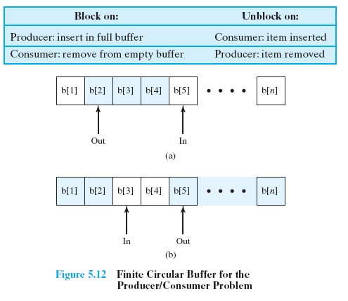
Bounded Buffer
Notes:
Finally, let us add a new and realistic restriction to the producer/consumer problem:
namely, that the buffer is finite.
The buffer is treated as a circular storage, and pointer values must be expressed modulo the size of the buffer.

Slide 54
Functions in a
Bounded Buffer
.
Producer | Consumer
while (true) { /* produce item v */ while ((in + 1) % n == out) /* do nothing */; b[in] = v; in = (in + 1) % n } | while (true) { while (in == out) /* do nothing */; w = b[out]; out = (out + 1) % n; /* consume item w */ }

Slide 55
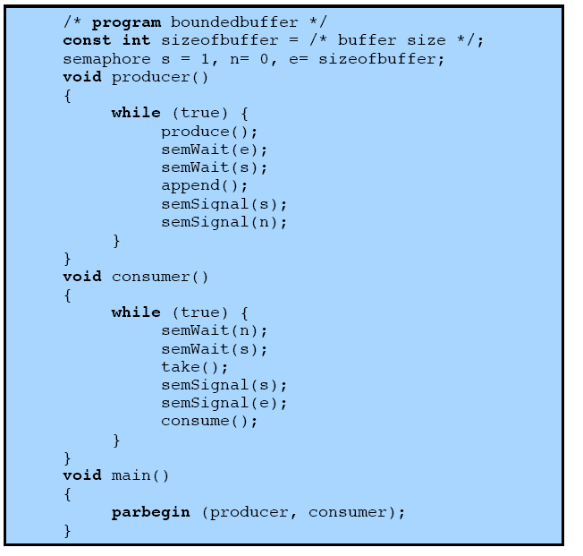
Semaphores

Slide 56
Demonstration
Animations
Producer/Consumer
  Illustrates the operation of a producer-consumer buffer.
Bounded-Buffer Problem Using Semaphores
  Demonstrates the bounded-buffer consumer/producer problem using semaphores.
Notes:
Introduction to the Animations http://williamstallings.com/OS/Animations-intro.html

Slide 57
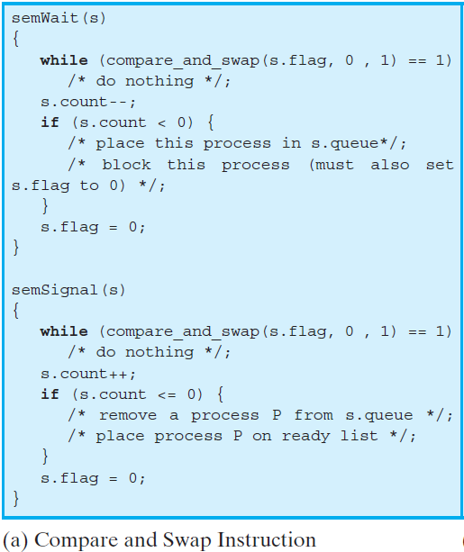
Implementation of Semaphores

Slide 58
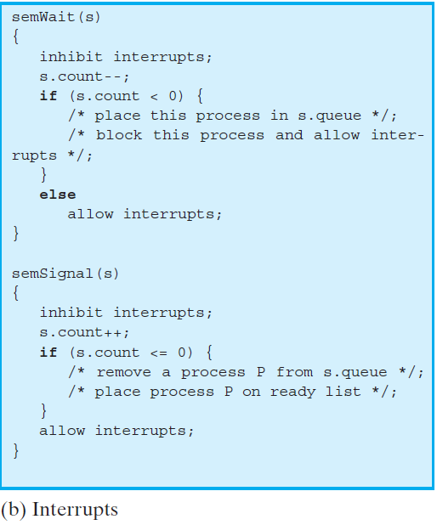
Implementation of Semaphores

Slide 59
Roadmap
Principals of Concurrency
Mutual Exclusion: Hardware Support
Semaphores
Monitors
Message Passing
Readers/Writers Problem

Slide 60
Monitors
The monitor is a programming-language construct that provides equivalent functionality to that of semaphores and that is easier to control.
Implemented in a number of programming languages, including
  Concurrent Pascal, Pascal-Plus,
  Modula-2, Modula-3, and Java.

Slide 61
Chief characteristics
Local data variables are accessible only by the monitor
Process enters monitor by invoking one of its procedures
Only one process may be executing in the monitor at a time
Notes:
The chief characteristics of a monitor are the following:
1. The local data variables are accessible only by the monitor’s procedures and not by any external procedure.
2. A process enters the monitor by invoking one of its procedures.
3. Only one process may be executing in the monitor at a time; any other processes that have invoked the monitor are blocked, waiting for the monitor to become available.

Slide 62
Synchronization
Synchronisation achieved by condition variables within a monitor
  only accessible by the monitor.
Monitor Functions:
  Cwait(c): Suspend execution of the calling process on condition c
  Csignal(c) Resume execution of some process blocked after a cwait on the same condition
Notes:
A monitor supports synchronization by the use of condition variables that are
contained within the monitor and accessible only within the monitor.
cwait(c): Suspend execution of the calling process on condition c.
The monitor is now available for use by another process.
csignal(c): Resume execution of some process blocked after a cwait on the same condition.
If there are several such processes, choose one of them; if there is no such process, do nothing.

Slide 63
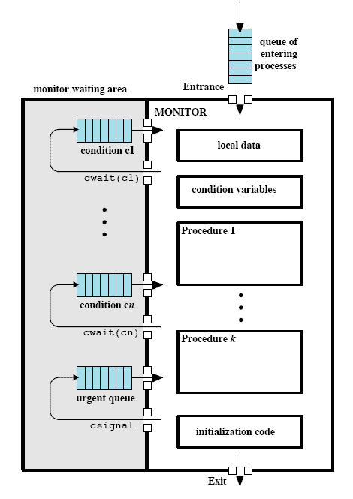
Structure of a Monitor
Notes:
Although a process can enter the monitor by invoking any of its procedures, we can think of the monitor as having a single entry point that is guarded so that only one process may be in the monitor at a time.
Other processes that attempt to enter the monitor join a queue of processes blocked waiting for monitor availability.
Once a process is in the monitor, it may temporarily block itself on condition x by issuing cwait(x);
it is then placed in a queue of processes waiting to re-enter the monitor when the condition changes, and resume execution at the point in its program following the cwait(x) call.
If a process that is executing in the monitor detects a change in the condition variable x, it issues csignal(x),
which alerts the corresponding condition queue that the condition has changed.

Slide 64
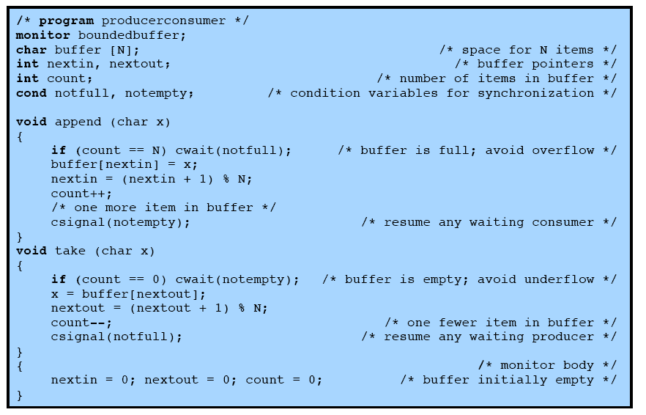
Bounded Buffer Solution
Using Monitor
Notes:
Returning to the bounded-buffer producer/consumer problem – this is a solution using a monitor.
The module, boundedbuffer, controls the buffer used to store and retrieve characters.
The monitor includes two condition variables (declared with the construct cond):
notfull is true when there is room to add at least one character to the buffer,
and notempty is true when there is at least one character in the buffer.
This example points out the division of responsibility with monitors compared to semaphores.
In the case of monitors, the monitor construct itself enforces mutual exclusion:
It is not possible for both a producer and a consumer simultaneously to access the buffer.
However, the programmer must place the appropriate cwait and csignal primitives inside the monitor to prevent processes from depositing items in a full buffer or removing them from an empty one.
In the case of semaphores, both mutual exclusion and synchronization are the responsibility of the programmer.

Slide 65
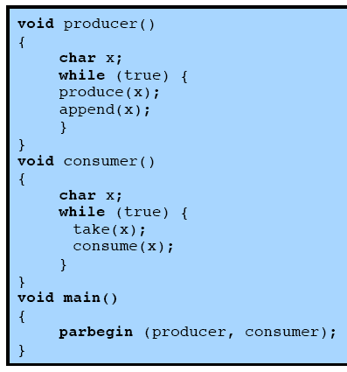
Solution Using Monitor
Notes:
Note here that a process exits the monitor immediately after executing the csignal function.
One language, ConcurrentPascal, insists that nothing follows a csignal call

Slide 66
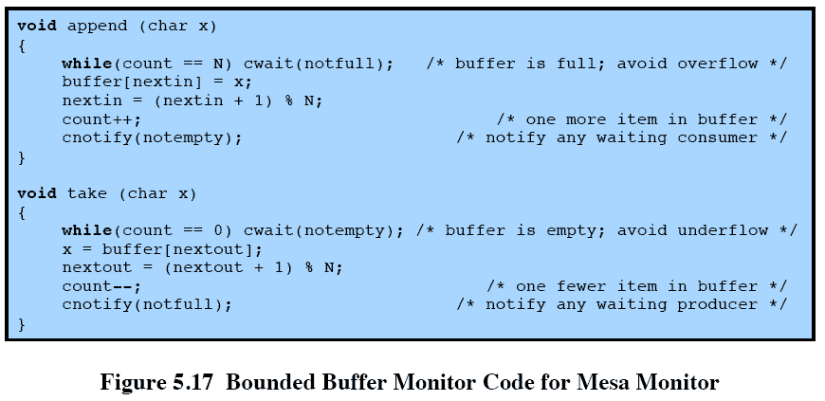
Bounded
Buffer Monitor
Notes:
Lampson and Redell developed an approach known as MESA
When a process executing in a monitor executes cnotify(x),
it causes the x condition queue to be notified, but the signalling process continues to execute.
The result of the notification is that the process at the head of the condition queue will be resumed at some convenient future time when the monitor is available.
However, because there is no guarantee that some other process will not enter the monitor before the waiting process, the waiting process must recheck the condition.
E.G. the procedures in the boundedbuffer monitor would now have the code in this slide

Slide 67
Roadmap
Principals of Concurrency
Mutual Exclusion: Hardware Support
Semaphores
Monitors
Message Passing
Readers/Writers Problem

Slide 68
Process Interaction
When processes interact with one another, two fundamental requirements must be satisfied:
  synchronization and
  communication.
Message Passing is one solution to the second requirement
  Added bonus: It works with shared memory and with distributed systems
Notes:
When processes interact with one another, two fundamental requirements must be satisfied:
synchronization and
communication.
Processes need to be synchronized to enforce mutual exclusion;
cooperating processes may need to exchange information.
One approach to providing both of these functions is message passing.
Message passing has the further advantage that it lends itself to implementation in distributed systems as well as in shared-memory multiprocessor and uniprocessor systems.

Slide 69
Message Passing
The actual function of message passing is normally provided in the form of a pair of primitives:
send (destination, message)
receive (source, message)
Notes:
Emphasize that message-passing systems come in many forms. We provide a general introduction that discusses features typically found in such systems.
These primitives are a minimum set of operations needed for processes to engage in message passing.
A process sends information in the form of a message to another process designated by a destination.
A process receives information by executing the receive primitive, indicating the source and the message.

Slide 70
Synchronization
Communication requires synchronization
  Sender must send before receiver can receive
What happens to a process after it issues a send or receive primitive?
  Sender and receiver may or may not be blocking (waiting for message)
Notes:
The communication of a message between two processes implies some level of synchronization between the two: the receiver cannot receive a message until it has been sent by another process.
When a send primitive is executed in a process, there are two possibilities:
Either the sending process is blocked until the message is received,
or it is not.
Similarly, when a process issues a receive primitive, there are two possibilities:
If a message has previously been sent, the message is received and execution continues.
If there is no waiting message, then either
the process is blocked until a message arrives, or
the process continues to execute, abandoning the attempt to receive.

Slide 71
Blocking send,
Blocking receive
Both sender and receiver are blocked until message is delivered
Known as a rendezvous
Allows for tight synchronization between processes.
Notes:
Both the sender and receiver are blocked until the message is delivered;
this is sometimes referred to as a rendezvous.
This combination allows for tight synchronization between processes.

Slide 72
Non-blocking Send
More natural for many concurrent programming tasks.
Nonblocking send, blocking receive
  Sender continues on
  Receiver is blocked until the requested message arrives
Nonblocking send, nonblocking receive
  Neither party is required to wait
Notes:
Nonblocking send, blocking receive:
Although the sender may continue on, the receiver is blocked until the requested message arrives.
This is probably the most useful combination.
It allows a process to send one or more messages to a variety of destinations as quickly as possible.
A process that must receive a message before it can do useful work needs to be blocked until such a message arrives.
• Nonblocking send, nonblocking receive:
Neither party is required to wait.

Slide 73
Addressing
Sendin process need to be able to specify which process should receive the message
  Direct addressing
  Indirect Addressing
Notes:
it is necessary to have a way of specifying in the send primitive which process is to receive the message.
Similarly, most implementations allow a receiving process to indicate the source of a message to be received.

Slide 74
Direct Addressing
Send primitive includes a specific identifier of the destination process
Receive primitive could know ahead of time which process a message is expected
Receive primitive could use source parameter to return a value when the receive operation has been performed

Slide 75
Indirect addressing
Messages are sent to a shared data structure consisting of queues
Queues are called mailboxes
One process sends a message to the mailbox and the other process picks up the message from the mailbox
Notes:
A strength of the use of indirect addressing is that, by decoupling the sender and receiver, it allows for greater flexibility in the use of messages.

Slide 76
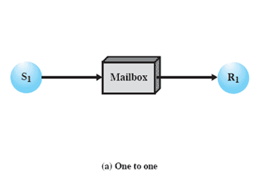
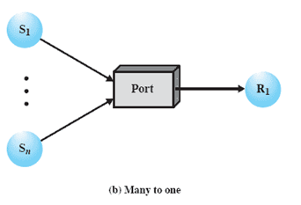
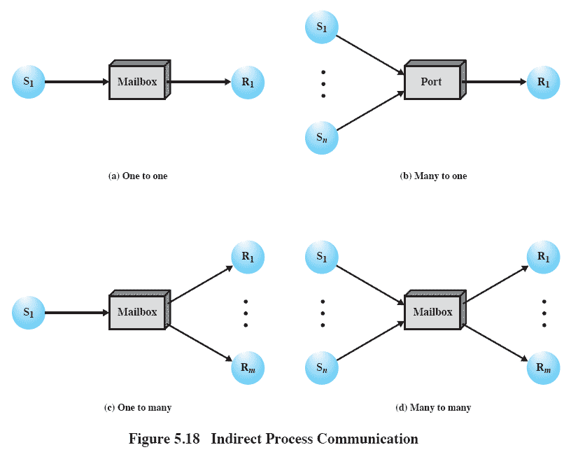
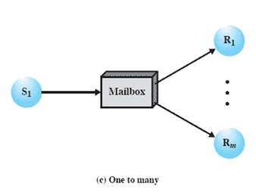
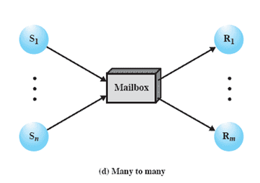
Indirect Process Communication
Notes:
Animated Slide – each item below is magnified for instructor to address separately
1) A one-to-one relationship
allows a private communications link to be set up between two processes.
This insulates their interaction from erroneous interference from other processes.
2) A many-to-one relationship is useful for client/server interaction;
one process provides service to a number of other processes.
In this case, the mailbox is often referred to as a port.
3) A one-to-many relationship allows for one sender and multiple receivers;
it is useful for applications where a message or some information is to be broadcast to a set of processes.
4) A many-to-many relationship
allows multiple server processes to provide concurrent service to multiple clients.
The association of processes to mailboxes can be either static or dynamic.
Ports are often statically associated with a particular process; that is, the port is created and assigned to the process permanently.
Similarly, a one-to-one relationship is typically defined statically and permanently. When there are many senders, the association of a sender to a mailbox may occur dynamically. Primitives such as connect and disconnect may be used for this purpose

Slide 77
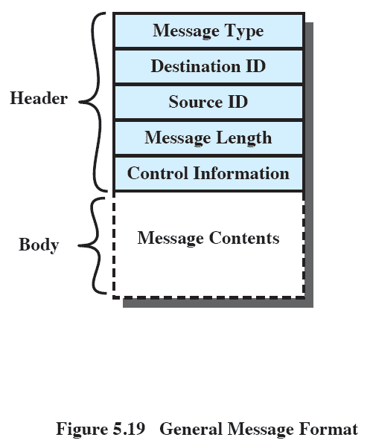
General Message Format
Notes:
The format of the message depends on the objectives of the messaging facility and whether the facility runs on a single computer or on a distributed system.
This is a typical message format for operating systems that support variable-length messages.
The message is divided into two parts:
a header, which contains information about the message.
The header may contain an identification of the source and intended destination of the message, a length field, and a type field to discriminate among various types of messages.
additional control information, e.g. pointer field so a linked list of messages can be created; a sequence number, to keep track of the number and order of messages passed between source and destination; and a priority field.
a body, which contains the actual contents of the message.

Slide 78
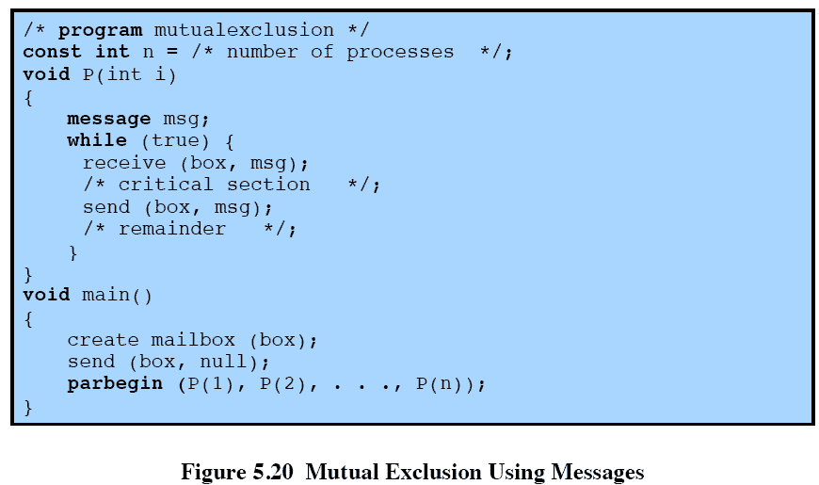
Mutual Exclusion Using Messages
Notes:
This is one way in which message passing can be used to enforce mutual exclusion.
We assume the use of the blocking receive primitive and the non-blocking send primitive.
This assumes that if more than one process performs the receive operation concurrently, then
• If there is a message, it is delivered to only one process and the others are blocked, or
• If the message queue is empty, all processes are blocked; when a message is available, only one blocked process is activated and given the message.

Slide 79
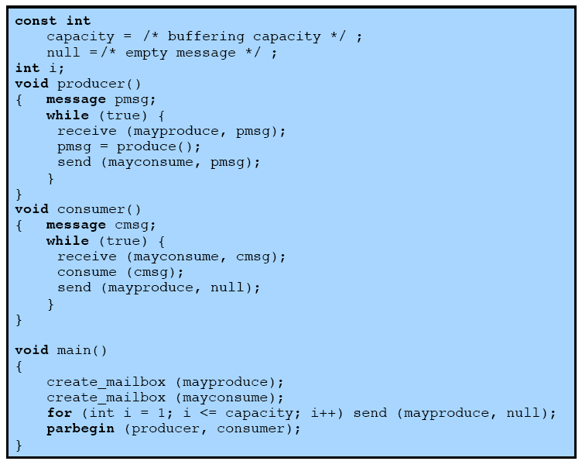
Producer/Consumer
Messages
Notes:
This is an example of the use of message passing to the bounded-buffer producer/consumer problem.
This program takes advantage of the ability of message passing to be used to pass data in addition to signals.
Two mailboxes are used.
As the producer generates data, it is sent as messages to the mailbox mayconsume.
As long as there is at least one message in that mailbox, the consumer can consume.
Hence mayconsume serves as the buffer; the data in the buffer are organized as a queue of messages.
The “size” of the buffer is determined by the global variable capacity. Initially, the mailbox mayproduce is filled with a
number of null messages equal to the capacity of the buffer. The number of messages in mayproduce shrinks with each production and grows with each consumption.

Slide 80
Roadmap
Principals of Concurrency
Mutual Exclusion: Hardware Support
Semaphores
Monitors
Message Passing
Readers/Writers Problem

Slide 81
Readers/Writers Problem
A data area is shared among many processes
  Some processes only read the data area, some only write to the area
Conditions to satisfy:
  Multiple readers may read the file at once.
  Only one writer at a time may write
  If a writer is writing to the file, no reader may read it.
interaction of readers and writers.
Notes:
The readers/writers problem is:
There is a data area shared among a number of processes.
The data area could be a file, a block of main memory,or even a bank of processor registers.
There are a number of processes that only read the data area (readers) and a number that only write to the data area (writers).
The conditions that must be satisfied are as follows:
1. Any number of readers may simultaneously read the file.
2. Only one writer at a time may write to the file.
3. If a writer is writing to the file, no reader may read it.

Slide 82
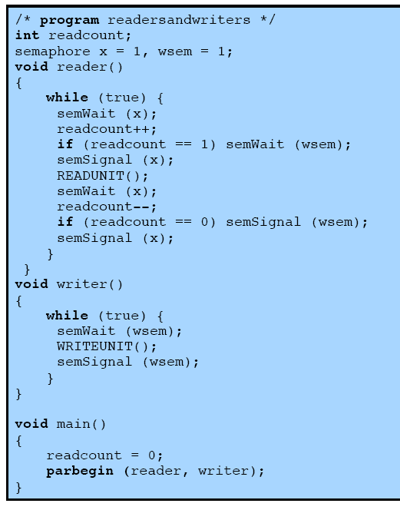
Readers have Priority
Notes:
This solution uses semaphores, showing one instance each of a reader and a writer; the solution does not change for multiple readers and writers.
Once a single reader has begun to access the data area, it is possible for readers to retain control of the data area as long as there is at least one reader in the act of reading.
Therefore, writers are subject to starvation.

Slide 83
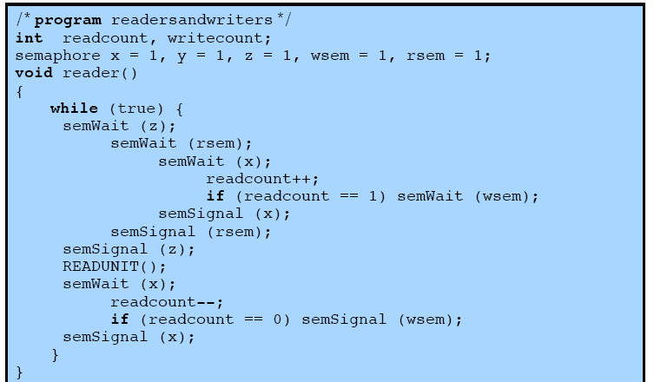
Writers have Priority
Notes:
This solution guarantees that no new readers are allowed access to the data area once at least one writer has declared a desire to write.
Continued on next slide

Slide 84
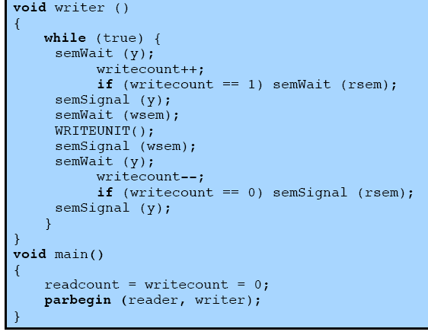
Writers have Priority

Slide 85
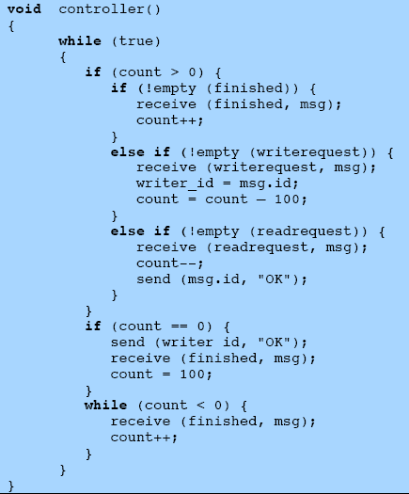
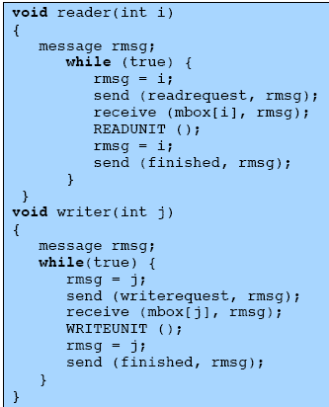
Message Passing
Notes:
This shows an alternative solution, which gives writers priority and which is implemented using message passing.

Slide 86
Message Passing

