Slide 1

Chapter 3
Process Description and Control
Operating Systems:
Internals and Design Principles, 6/E
William Stallings
Notes:
These slides are intended to help a teacher develop a presentation. This PowerPoint covers the entire chapter and includes too many slides for a single delivery. Professors are encouraged to adapt this presentation in ways which are best suited for their students and environment.

Slide 2
Roadmap
  How are processes represented and controlled by the OS.
  Process states which characterize the behaviour of processes.
  Data structures used to manage processes.
    Ways in which the OS uses these data structures to control process execution.
Notes:
Note: In this chapter, reference is occasionally made to virtual memory. Much of the time, we can ignore this concept in dealing with processes, but at certain
points in the discussion, virtual memory considerations are pertinent. Virtual memory is not discussed in detail until Chapter 8.
Refer students to a brief overview which is provided in Chapter 2.

Slide 3
Requirements of an
Operating System
Fundamental Task: Process Management
The Operating System must
  Interleave the execution of multiple processes
  Allocate resources to processes, and protect the resources of each process from other processes,
  Enable processes to share and exchange information,
  Enable synchronization among processes.
Notes:
Explain that:
on a multiprogramming uniprocessor, the execution of multiple processes can be interleaved in time.
on a multiprocessor, not only may process execution be interleaved, but also multiple processes can execute simultaneously.
Explain that process management is compounded by the introduction of the concept of thread. In a multithreaded system,
the process retains the attributes of resource ownership,
The thread retains the attributes of multiple, concurrent execution streams running within a process.

Slide 4
Process Elements
While the process is running it has a number of elements including
  Identifier
  State
  Priority
  Program counter
  Memory pointers
  Context data
  I/O status information
  Accounting information
Notes:
Mention that this list is not necessarily complete, and may include optional elements (e.g. not all OS’s may need a process to have accounting information)

Slide 5
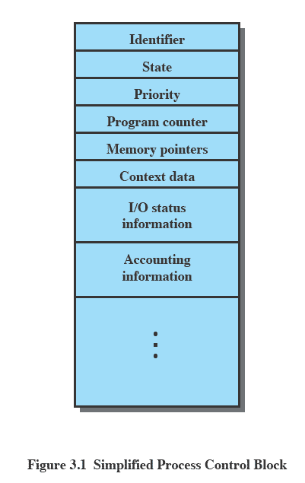
Process Control Block
Contains the process elements
Created and manage by the operating system
Allows support for multiple processes
Notes:
Emphasise that the Process Control Block contains sufficient information so that it is possible to interrupt a running process and later resume execution as if the interruption had not occurred.

Slide 6
Trace of the Process
The behavior of an individual process is shown by listing the sequence of instructions that are executed
This list is called a Trace
Dispatcher is a small program which switches the processor from one process to another

Slide 7
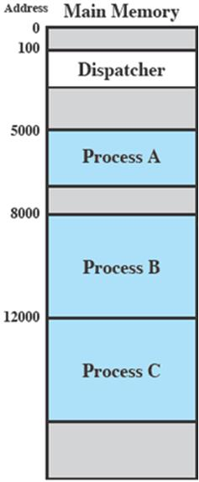
Process Execution
Consider three processes being executed
All are in memory (plus the dispatcher)
Lets ignore virtual memory for this.

Slide 8
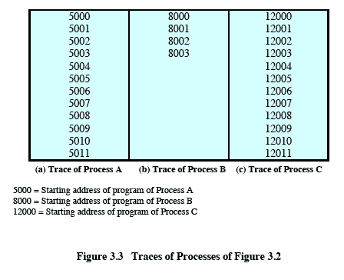
Trace from the processes point of view:
Each process runs to completion
Notes:
Animated slide
Wipes down to give impression of process progression

Slide 9
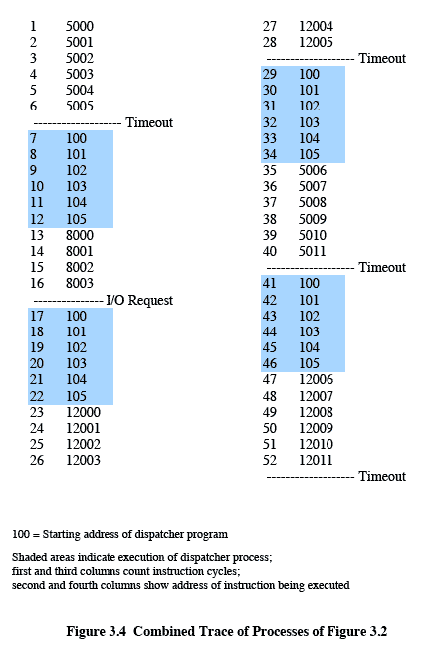
Trace from Processors point of view
Timeout
Timeout
Timeout
I/O
Notes:
Animated slide
Explain the scenario then click for the animation
The shaded areas represent code executed by the dispatcher.
The same sequence of instructions is executed by the dispatcher in each instance because the same functionality of the dispatcher is being executed.
We assume that the OS only allows a process to continue execution for a maximum of six instruction cycles, after which it is interrupted; this prevents any single process from monopolizing processor time.
Animate here
The first six instructions of process A are executed, followed by a time-out and the execution of some code in the dispatcher, which executes six instructions before turning control to process B2.
After four instructions are executed, process B requests an I/O action for which it must wait. Therefore, the processor stops executing process B and moves on, via the dispatcher, to process C.
After a time-out, the processor moves back to process A. When this process times out, process B is still waiting for the
I/O operation to complete, so the dispatcher moves on to process C again.

Slide 10
Roadmap
  How are processes represented and controlled by the OS.
  Process states which characterize the behaviour of processes.
  Data structures used to manage processes.
  Ways in which the OS uses these data structures to control process execution.
  Discuss process management in UNIX SVR4.
Notes:
Progress indicator

Slide 11
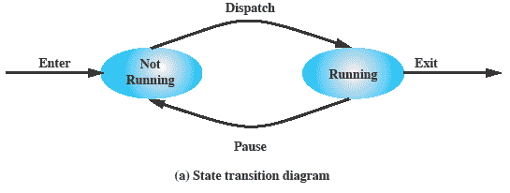
Two-State Process Model
Process may be in one of two states
  Running
  Not-running
Notes:
Emphasize that you are introducing a Simple model and that this will be expanded.
The operating system’s principal responsibility is controlling the execution of processes;
this includes determining the interleaving pattern for execution and allocating resources to processes.
The first step in designing an OS to control processes is to describe the behaviour that we would like the processes to exhibit. In the most simple model, a process is either running, or it is not.

Slide 12
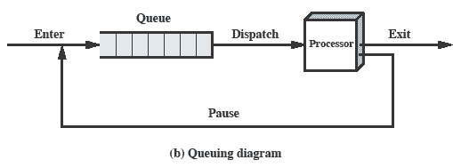
Queuing Diagram
Etc … processes moved by the dispatcher of the OS to the CPU then back to the queue until the task is competed
Notes:
Animated slide The animation only shows one process moving.
There needs to be some structure so that the OS can keep track of the processes. This could be a simple queue which is managed by the dispatcher routine of the OS.

Slide 13
Process Birth and Death
Creation | Termination
New batch job | Normal Completion
Interactive Login | Memory unavailable
Created by OS to provide a service | Protection error
Spawned by existing process | Operator or OS Intervention
See tables 3.1 and 3.2 for more
Notes:
There are many reasons why a process may be created or terminated.

Slide 14
Process Creation
The OS builds a data structure to manage the process
Traditionally, the OS created all processes
  But it can be useful to let a running process create another
This action is called process spawning
  Parent Process is the original, creating, process
  Child Process is the new process
Notes:
Typically, the “related” processes need to communicate and cooperate with each other. Achieving this cooperation is a difficult task for the programmer; discussed further in Chapter 5.

Slide 15
Process Termination
There must be some way that a process can indicate completion.
This indication may be:
  A HALT instruction generating an interrupt alert to the OS.
  A user action (e.g. log off, quitting an application)
  A fault or error
  Parent process terminating

Slide 16
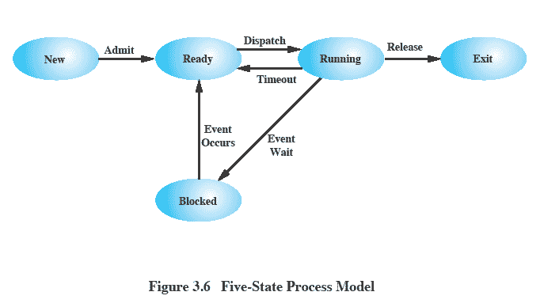
Five-State
Process Model
Notes:
If all processes were always ready to execute, then the simple FIFO queuing model would suffice.
However, even with simple examples, this implementation is inadequate:
some processes in the Not Running state are ready to execute,
while others are blocked, waiting for an I/O operation to complete.
In a two state model, the dispatcher would have to scan the list looking for the process that is not blocked and that has been in the queue the longest.
But we could split the Not Running state into two states:
Ready and
Blocked.
For good measure, we have added two additional states that will prove useful (new and exit)
Suggestion:
Mention that “Wait” and “Blocked” have the same meaning here.
Talk through the state transitions.

Slide 17
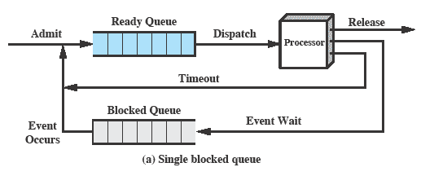
Using Two Queues
Notes:
In the simplest solution, this model would require an additional queue for the blocked processes.
But when an event occurs the dispatcher would have to cycle through the entire queue to see which process is waiting for the event.
This can cause huge overhead when their may be 100’s or 1000’s of processes

Slide 18
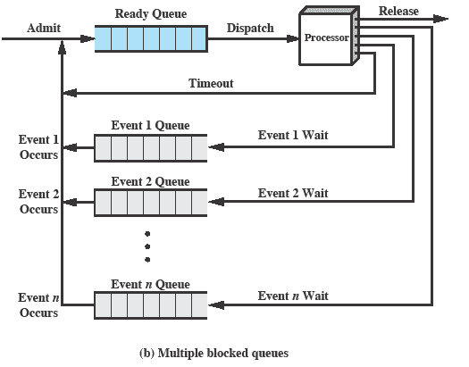
Multiple Blocked Queues
Notes:
More efficient to have a separate ‘blocked’ queue for each type of event.

Slide 19
Suspended Processes
Processor is faster than I/O so all processes could be waiting for I/O
  Swap these processes to disk to free up more memory and use processor on more processes
Blocked state becomes suspend state when swapped to disk
Two new states
  Blocked/Suspend
  Ready/Suspend
Notes:
Mention that the aim is to fully utilize the processor.

Slide 20
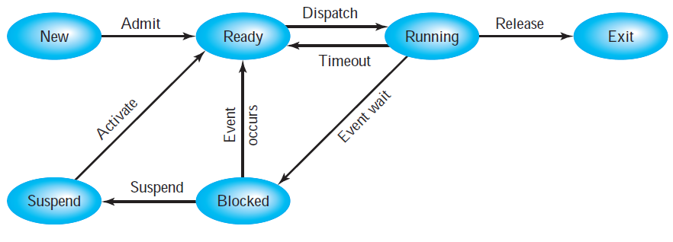
One Suspend State
Notes:
Again, the simple solution is to add a single state – but this only allows processes which are blocked to be swapped out.

Slide 21
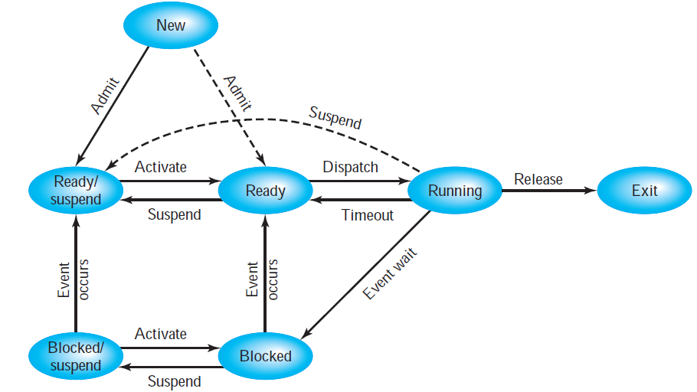
Two Suspend States
Notes:
Two suspend states allow all processes which are not actually running to be swapped.
Run through the four states:
Ready: The process is in main memory and available for execution.
• Blocked: The process is in main memory and awaiting an event.
• Blocked/Suspend: The process is in secondary memory and awaiting an event.
• Ready/Suspend: The process is in secondary memory but is available for execution as soon as it is loaded into main memory.
It would be useful to also summarise the main transitions (abridged)
Blocked → Blocked/Suspend: If there are no ready processes, then at least one blocked process is swapped out to make room for another process that is not blocked. This transition can be made even if there are ready processes available, if the OS determines that the currently running process or a ready process that it would like to dispatch requires more main memory to maintain adequate performance.
Blocked/Suspend → Ready/Suspend: A process in the Blocked/Suspend state is moved to the Ready/Suspend state when the event for which it has been waiting occurs.
Ready/Suspend S → Ready: When there are no ready processes in main memory, or if a suspended process has a higher priority, the OS will need to bring one in to continue execution.
Ready → Ready/Suspend: Normally, the OS would prefer to suspend a blocked process rather than a ready one, because the ready process can now be executed, whereas the blocked process is taking up main memory space and cannot be executed. However, it may be necessary to suspend a ready process if that is the only way to free up a sufficiently large block of main memory.
Several other transitions that are worth considering are the following:
New → Ready/Suspend and New →Ready: When a new process is created, it can either be added to the Ready queue or the Ready/Suspend queue. In either case, the OS must create a process control block and allocate an address space to the process. It might be preferable for the OS to perform these housekeeping duties at an early time, so that it can maintain a large pool of processes that are not blocked. With this strategy, there would often be insufficient room in main memory for a new process; hence the use of the (New → Ready/Suspend) transition.
Blocked/Suspend → Blocked: Inclusion of this transition may seem to be poor design. After all, if a process is not ready to execute and is not already in main memory, what is the point of bringing it in? But consider the following scenario:
A process terminates, freeing up some main memory.
There is a process in the (Blocked/Suspend) queue with a higher priority than any of the processes in the (Ready/Suspend) queue and
the OS has reason to believe that the blocking event for that process will occur soon.
Under these circumstances, it would seem reasonable to bring a blocked process into main memory in preference to a ready process.
Running → Ready/Suspend: Normally, a running process is moved to the Ready state when its time allocation expires. If, however, the OS is pre-empting the process because a higher-priority process on the Blocked/Suspend queue has just become unblocked, the OS could move the running process directly to the (Ready/Suspend) queue and free some main memory.
Any State → Exit: Typically, a process terminates while it is running, either because it has completed or because of some fatal fault condition. However, in some operating systems, a process may be terminated by the process that created it or when the parent process is itself terminated. If this is allowed, then a process in any state can be moved to the Exit state.

Slide 22
Reason for Process Suspension
Reason | Comment
Swapping | The OS needs to release sufficient main memory to bring in a process that is ready to execute.
Other OS Reason | OS suspects process of causing a problem.
Interactive User Request | e.g. debugging or in connection with the use of a resource.
Timing | A process may be executed periodically (e.g., an accounting or system monitoring process) and may be suspended while waiting for the next time.
Parent Process Request | A parent process may wish to suspend execution of a descendent to examine or modify the suspended process, or to coordinate the activity of various descendants.
Table 3.3 Reasons for Process Suspension
Notes:
The comments are summarized due to space on slide

Slide 23
Roadmap
  How are processes represented and controlled by the OS.
  Process states which characterize the behaviour of processes.
  Data structures used to manage processes.
  Ways in which the OS uses these data structures to control process execution.
  Discuss process management in UNIX SVR4.
Notes:
Progress indicator

Slide 24
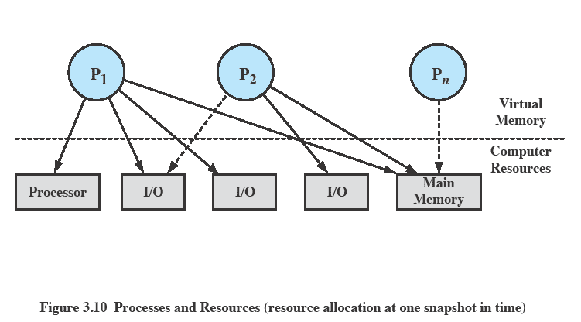
Processes and Resources
Notes:
The OS controls events within the computer system. It schedules and dispatches processes for execution by the processor, allocates resources to processes, and responds
to requests by user processes for basic services.
Fundamentally, we can think of the OS as that entity that manages the use of system resources by processes.
In this slide –
There are a number of processes (P1, . . ., Pn,) that have been created and exist in virtual memory.
Each process, during the course of its execution, needs access to certain system resources, including the processor, I/O devices, and main memory.
In the figure, process P1 is running; at least part of the process is in main memory, and it has control of two I/O devices.
Process P2 is also in main memory but is blocked waiting for an I/O device allocated to P1.
Process Pn has been swapped out and is therefore suspended.

Slide 25
Operating System
Control Structures
For the OS is to manage processes and resources, it must have information about the current status of each process and resource.
Tables are constructed for each entity the operating system manages

Slide 26
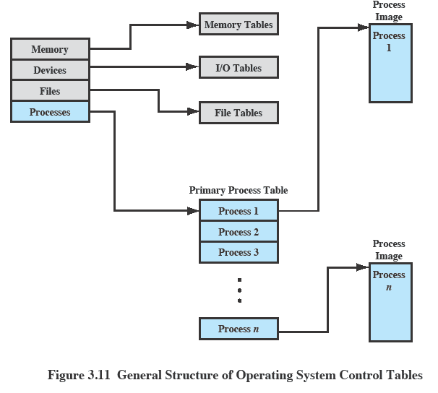
OS Control Tables
Notes:
A general idea of the scope of the tables is in Figure 3.11, which shows four different types of tables maintained by the OS:
memory,
I/O,
file,
process.
Although the details will differ from one OS to another, fundamentally, all operating systems maintain information in these four categories.
The next few slides mention details of these four tables.
You may prefer to stick with this diagram and discuss each from here

Slide 27
Memory Tables
Memory tables are used to keep track of both main and secondary memory.
Must include this information:
  Allocation of main memory to processes
  Allocation of secondary memory to processes
  Protection attributes for access to shared memory regions
  Information needed to manage virtual memory
Notes:
Memory tables are used to keep track of both main (real) and secondary (virtual) memory.
Some of main memory is reserved for use by the OS; the remainder is available for use by processes.
Processes are maintained on secondary memory using some sort of virtual memory or simple swapping mechanism.

Slide 28
I/O Tables
Used by the OS to manage the I/O devices and channels of the computer.
The OS needs to know
  Whether the I/O device is available or assigned
  The status of I/O operation
  The location in main memory being used as the source or destination of the I/O transfer
Notes:
I/O tables are used by the OS to manage the I/O devices and channels of the computer system.
At any given time, an I/O device may be available or assigned to a particular process.
If an I/O operation is in progress, the OS needs to know the status of the I/O operation and the location in main memory being used as the
source or destination of the I/O transfer.

Slide 29
File Tables
These tables provide information about:
  Existence of files
  Location on secondary memory
  Current Status
  other attributes.
Sometimes this information is maintained by a file management system
Notes:
The OS may also maintain file tables.
Much, if not all, of this information may be maintained and used by a file management system, in which case the OS has little or no knowledge of files.
In other operating systems, much of the detail of file management is managed by the OS itself.

Slide 30
Process Tables
To manage processes the OS needs to know details of the processes
  Current state
  Process ID
  Location in memory
  etc
Process control block
  Process image is the collection of program. Data, stack, and attributes
Notes:
Finally, the OS must maintain process tables to manage processes.
The remainder of this section is devoted to an examination of the required process tables.
Note: Although Figure 3.11 (earlier slide ) shows four distinct sets of tables, it should be clear that these tables must be linked or cross-referenced in some fashion.
Memory, I/O, and files are managed on behalf of processes, so there must be some reference to these resources, directly or indirectly, in the process tables.
The files referred to in the file tables are accessible via an I/O device and will, at some times, be in main or virtual memory.
The tables themselves must be accessible by the OS and therefore are subject to memory management.

Slide 31
Process Attributes
We can group the process control block information into three general categories:
  Process identification
  Processor state information
  Process control information
Notes:
A sophisticated multiprogramming system requires a great deal of information about each process.
Different systems will organize this information in different ways
For now, let us simply explore the type of information that might be of use to an OS without considering in any detail how that information is organized.
Table 3.5 in the book (not in this slide set) lists the typical categories of information required by the OS for each process.
We can group the process control block information into three general categories:
• Process identification
• Processor state information
• Process control information

Slide 32
Process Identification
Each process is assigned a unique numeric identifier.
Many of the other tables controlled by the OS may use process identifiers to cross-reference process tables
Notes:
In virtually all operating systems, each process is assigned a unique numeric identifier,
which may simply be an index into the primary process table (see Figure 3.11);
otherwise there must be a mapping that allows the OS to locate the appropriate tables based on the process identifier.
This identifier is useful in several ways.
Many of the other tables controlled by the OS may use process identifiers to cross-reference process tables.
For example,
The memory tables may be organized so as to provide a map of main memory with an indication of which process is assigned to each region.
Similar references will appear in I/O and file tables.
When processes communicate with one another, the process identifier informs the OS of the destination of a particular communication.
When processes are allowed to create other processes, identifiers indicate the parent and descendents of each process.
In addition to these process identifiers, a process may be assigned a user identifier that indicates the user responsible for the job.

Slide 33
Processor State
Information
This consists of the contents of processor registers.
  User-visible registers
  Control and status registers
  Stack pointers
Program status word (PSW)
  contains status information
  Example: the EFLAGS register on Pentium processors
Notes:
Processor state information consists of the contents of processor registers.
While a process is running the information is in the registers.
When a process is interrupted, all of this register information must be saved so that it can be restored when the process resumes execution. Nature and number of processes vary by processor design
Typically, the register set will include user-visible registers, control and status registers, and stack pointers.

Slide 34
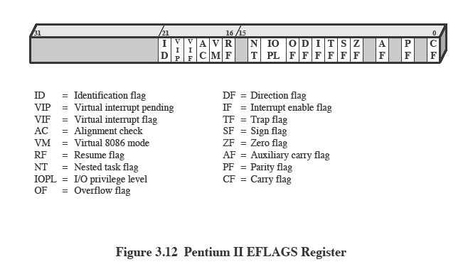
Pentium II
EFLAGS Register
Also see Table 3.6
Notes:
All processor designs include a register or set of registers, often known as the program status word (PSW), that contains status information.
The PSW typically contain condition codes plus other status information.
A good example of a processor status word is that on Pentium processors, referred to as the EFLAGS register
This structure is used by any OS (including UNIX and Windows) running on a Pentium processor.

Slide 35
Process Control
Information
This is the additional information needed by the OS to control and coordinate the various active processes.
  See table 3.5 for scope of information
Notes:
This is the additional information needed by the OS to control and coordinate the various active processes.
The last part of Table 3.5 indicates the scope of this information.
As we examine the details of operating system functionality in succeeding chapters, the need for the various items on this list should become clear.

Slide 36
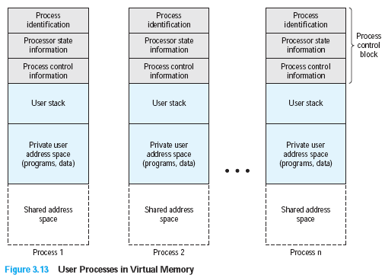
Structure of Process
Images in Virtual Memory
Notes:
Figure 3.13 suggests the structure of process images in virtual memory.
Each process image consists of
a process control block,
a user stack,
the private address space of the process, and
any other address space that the process shares with other processes.
In the figure, each process image appears as a contiguous range of addresses. In an actual implementation, this may not be the case; it will depend on the memory management scheme and the way in which control structures are organized by the OS.
The process control block may contain structuring information, including pointers that allow the linking of process control blocks.
Thus, the queues that were described in the preceding section could be implemented as linked lists of process control blocks.

Slide 37
Role of the
Process Control Block
The most important data structure in an OS
  It defines the state of the OS
Process Control Block requires protection
  A faulty routine could cause damage to the block destroying the OS’s ability to manage the process
  Any design change to the block could affect many modules of the OS
Notes:
The process control block is the most important data structure in an OS.
Each process control block contains all of the information about a process that is needed by the OS.
The blocks are read and/or modified by virtually every module in the OS, including those involved with scheduling, resource allocation, interrupt processing, and performance monitoring and analysis.
One can say that the set of process control blocks defines the state of the OS.
Important design issue.
A number of routines within the OS will need access to information in process control blocks.
The difficulty is not access but rather protection.
Two problems present themselves:
A bug in a single routine, such as an interrupt handler, could damage process control blocks, which could destroy the system’s ability to manage the affected processes.
A design change in the structure or semantics of the process control block could affect a number of modules in the OS.

Slide 38
Roadmap
  How are processes represented and controlled by the OS.
  Process states which characterize the behaviour of processes.
  Data structures used to manage processes.
  Ways in which the OS uses these data structures to control process execution.
  Discuss process management in UNIX SVR4.
Notes:
Progress indicator

Slide 39
Modes of Execution
Most processors support at least two modes of execution
User mode
  Less-privileged mode
  User programs typically execute in this mode
System mode
  More-privileged mode
  Kernel of the operating system
Notes:
The less-privileged mode is often referred to as the user mode, because user programs typically would execute in this mode.
Mention that System Mode is also known as
Control Mode
Kernel Mode
Protected Mode
Certain instructions can only be executed in the more-privileged mode.
Including reading or altering a control register, such as the program status word;
primitive I/O instructions;
Instructions that relate to memory management.
In addition, certain regions of memory can only be accessed in the more-privileged mode.
Table 3.7 lists the functions typically found in the kernel of an OS.
Questions: How does the processor know in which mode it is to be executing? And how does it change
Answer:
Typically a flag (single bit) in the program status word (PSW). This bit is changed in response to certain events.
Typically, when a user makes a call to an operating system service or when an interrupt triggers execution of an operating system routine, the mode is set to the kernel mode and, upon return from the service to the user process, the mode is set to user mode.

Slide 40
Process Creation
Once the OS decides to create a new process it:
  Assigns a unique process identifier
  Allocates space for the process
  Initializes process control block
  Sets up appropriate linkages
  Creates or expand other data structures

Slide 41
Switching Processes
Several design issues are raised regarding process switching
  What events trigger a process switch?
  We must distinguish between mode switching and process switching.
  What must the OS do to the various data structures under its control to achieve a process switch?

Slide 42
When to switch processes
A process switch may occur any time that the OS has gained control from the currently running process. Possible events giving OS control are:
Mechanism | Cause | Use
Interrupt | External to the execution of the current instruction | Reaction to an asynchronous external event
Trap | Associated with the execution of the current instruction | Handling of an error or an exception condition
Supervisor call | Explicit request | Call to an operating system function
Table 3.8 Mechanisms for Interrupting the Execution of a Process
Notes:
A process switch may occur any time that the OS has gained control from the currently running process.
Table 3.8 suggests the possible events that may give control to the OS.
Two kinds of system interrupts,
one is simply called an interrupt,
and the other called a trap.
“interrupts” are due to some sort of event that is external to and independent of the currently running process, such as the completion of an I/O operation.
With an ordinary interrupt, control is first transferred to an interrupt handler, which does some basic housekeeping and then branches to an OS routine that is concerned with
the particular type of interrupt that has occurred.
“Traps” relate to an error or exception condition generated within the currently running process, such as an illegal file access attempt.
With traps, the OS determines if the error or exception condition is fatal.
If so, then the currently running process is moved to the Exit state and a process switch occurs.
If not, then the action of the OS will depend on the nature of the error and the design of the OS.
It may attempt some recovery procedure or simply notify the user.
It may do a process switch or resume the currently running process.
Finally, the OS may be activated by a supervisor call from the program being executed.
For example, a user process is running and an instruction is executed that requests an I/O operation, such as a file open.
This call results in a transfer to a routine that is part of the operating system code. The use of a system call may place the user process in the Blocked state.

Slide 43
Change of
Process State …
The steps in a process switch are:
  Save context of processor including program counter and other registers
  Update the process control block of the process that is currently in the Running state
  Move process control block to appropriate queue – ready; blocked; ready/suspend
Notes:
If the currently running process is to be moved to another state (Ready, Blocked, etc.), then the OS must make substantial changes in its environment.
The steps involved in a full process switch are as follows:
1. Save the context of the processor, including program counter and other registers.
2. Update the process control block of the process that is currently in the Running state.
This includes changing the state of the process to one of the other states (Ready; Blocked; Ready/Suspend; or Exit). Other relevant fields must also be updated, including the reason for leaving the Running state and accounting information.
3. Move the process control block of this process to the appropriate queue (Ready;Blocked on Eventi; Ready/Suspend).
More next slide

Slide 44
Change of
Process State cont…
Select another process for execution
Update the process control block of the process selected
Update memory-management data structures
Restore context of the selected process
Notes:
4. Select another process for execution;
5. Update the process control block of the process selected. This includes changing the state of this process to Running.
6. Update memory management data structures. This may be required, depending on how address translation is managed;
7. Restore the context of the processor to that which existed at the time the selected process was last switched out of the Running state, by loading in the previous values of the program counter and other registers.

Slide 45
Is the OS a Process?
If the OS is just a collection of programs and if it is executed by the processor just like any other program, is the OS a process?
If so, how is it controlled?
  Who (what) controls it?
Notes:
If the OS is just a collection of programs and if it is executed by the processor just like any other program, is the OS a process?
If so, how is it controlled? These interesting questions have inspired a number of design approaches.

Slide 46
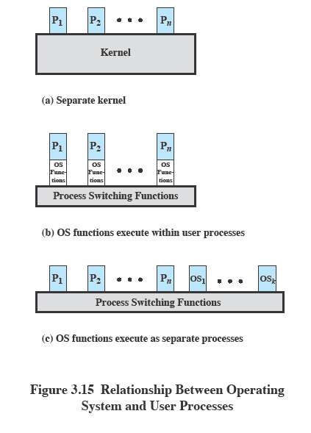
Execution of the
Operating System
Notes:
This figure is explained in the following slides

Slide 47
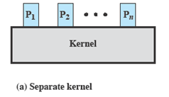
Non-process Kernel
Execute kernel outside of any process
The concept of process is considered to apply only to user programs
  Operating system code is executed as a separate entity that operates in privileged mode
Notes:
The key point is that the concept of process is considered to apply only to user programs. The operating system code is executed as a separate entity that operates in privileged mode.
Common on many older operating systems,
Execute the kernel of the OS outside of any process.
When the currently running process is interrupted or issues a supervisor call,
the mode context of this process is saved and control is passed to the kernel.
The OS has its own region of memory to use and its own system stack for controlling procedure calls and returns.
The OS can perform any desired functions and restore the context of the interrupted process, which causes execution to resume in the interrupted user process.
Or, the OS can complete the function of saving the environment of the process and proceed to schedule and dispatch another process. Whether this happens depends on the reason for the interruption and the circumstances at the time.
The key point is that the concept of process is considered to apply only to user programs. The operating system code is executed as a separate entity that operates in privileged mode.

Slide 48
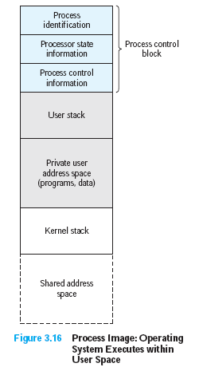
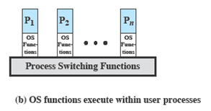
Execution Within
User Processes
Execution Within User Processes
  Operating system software within context of a user process
  No need for Process Switch to run OS routine
Notes:
Common with operating systems on smaller computers (PCs, workstations)
Execute virtually all OS software in the context of a user process
The view is that the OS is primarily a collection of routines that the user calls to perform various functions, executed within the environment of the user’s process.
At any given point, the OS is managing n process images.
Each image includes not only the regions illustrated, but also program, data, and stack areas for kernel programs.
Figure 3.16 suggests a typical process image structure for this strategy.
A separate kernel stack is used to manage calls/returns while the process is in kernel mode.
Operating system code and data are in the shared address space and are shared by all user processes.
When an interrupt, trap, or supervisor call occurs, the processor is placed in kernel mode and control is passed to the OS.
To pass control from a user program to the OS, the mode context is saved and a mode switch takes place to an operating system routine.
However, execution continues within the current user process. Thus, a process switch is not performed, just a mode switch within the same process.
If the OS, upon completion of its work, determines that the current process should continue to run, then a mode switch resumes the interrupted program within the current process.
This is one of the key advantages of this approach:
A user program has been interrupted to employ some operating system routine, and then resumed, and all of this has occurred without incurring the penalty of two process switches.

Slide 49
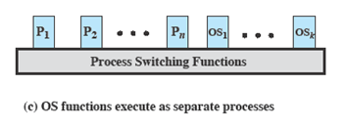
Process-based
Operating System
Process-based operating system
  Implement the OS as a collection of system process
Notes:
Another alternative is to implement the OS as a collection of system processes.
As in the other options, the software that is part of the kernel executes in a kernel mode.
In this case, however, major kernel functions are organized as separate processes.
Again, there may be a small amount of process switching code that is executed outside of any process.
This approach has several advantages.
It imposes a program design discipline that encourages the use of a modular OS with minimal, clean interfaces between the modules.
Some noncritical operating system functions are conveniently implemented as separate processes.
Implementing the OS as a set of processes is useful in a multiprocessor or multicomputer environment, in which some of the operating system services can be shipped out to dedicated processors, improving performance.

