Slide 1
Operating System
Isfahan University of Technology
Note: most of the slides used in this course are derived from those of the textbook (see slide 4)

Slide 2
Organization
Lectures
Homework
Several homeworks with a few correction sessions
Quiz
Several quizzes
Mid-term exam
Final Exam
Grading

Slide 3
Exams and Grading
Mid-term: 40%
Final exam: 50%
Homeworkes : 10%
Quizzes (bonus): 10%
Note: The number of quizzes vastly exceeds the required minimum. There is no replacement for the quizzes.

Slide 4
Textbook
Operating Systems: Internals and Design Principles, 6/E William Stallings

Slide 5
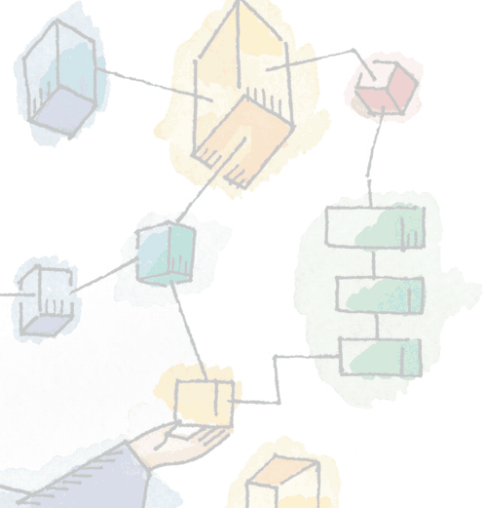
Chapter 1 Computer System Overview
Operating Systems: Internals and Design Principles, 6/E William Stallings

Slide 6
Operating System
Exploits the hardware resources of one or more processors
Provides a set of services to system users
Manages secondary memory and I/O devices
Notes:
سیستم عامل از منابع سخت افزاری شامل یک یا چند پردازنده برای ارائه خدمات استفاده می کند
یک مجموعه ای خدمات را به کاربران سیستم ارائه می کند
همچنین حافطه ثانوی و دستگاه های ورودی و خروجی را مدیریت می کند

Slide 7
Basic Elements
Processor
Two internal registers
Memory address resister (MAR)
Specifies the address for the next read or write
Memory buffer register (MBR)
Contains data written into memory or receives data read from memory
I/O address register
I/O buffer register
Notes:
عناصر اصلی

Slide 8
Basic Elements
Main Memory
Volatile
Referred to as real memory or primary memory

Slide 9
Basic Elements
I/O Modules
Secondary Memory Devices
Communications equipment
Terminals
System bus
Communication among processors, main memory, and I/O modules
Notes:
مولفه ورودی و خروجی: داده ها را بین کامپیوتر . محیز خارج آن منتقل می کندمحیط خارج شامل حافطه ثانوی، تجهیزات ارتباطی و انواع ترمینالها است
گذرگاه سیستم : ارتباط بین پردازنده حافظه اصلی و ورودی و خروجی را مشخص می کند

Slide 10
Computer Components: Top-Level View

Slide 11
Processor Registers
User-visible registers
Enable programmer to minimize main memory references by optimizing register use
Control and status registers
Used by processor to control operating of the processor
Used by privileged OS routines to control the execution of programs

Slide 12
User-Visible Registers
May be referenced by machine language
Available to all programs – application programs and system programs

Slide 13
User-Visible Registers
Data
Address
Index register: Adding an index to a base value to get the effective address
Segment pointer: When memory is divided into segments, memory is referenced by a segment and an offset
Stack pointer: Points to top of stack

Slide 14
Control and Status Registers
Program counter (PC)
Contains the address of an instruction to be fetched
Instruction register (IR)
Contains the instruction most recently fetched
Program status word (PSW)
Contains status information
Notes:
حاوی اطلاعات وضعیت شامل بیت فعال و غیر فعال بیت حالت کاربر و یا سرپرست می باشد

Slide 15
Control and Status Registers
Condition codes or flags
Bits set by processor hardware as a result of operations
Example
Positive, negative, zero, or overflow result

Slide 16
Instruction Execution
Two steps
Processor reads (fetches) instructions from memory
Processor executes each instruction

Slide 17
Basic Instruction Cycle

Slide 18
Instruction Fetch and Execute
The processor fetches the instruction from memory
Program counter (PC) holds address of the instruction to be fetched next
PC is incremented after each fetch

Slide 19
Instruction Register
Fetched instruction loaded into instruction register
Categories
Processor-memory, processor-I/O, data processing, control

Slide 20
Characteristics of a Hypothetical Machine

Slide 21
Example of Program Execution

Slide 22
Interrupts
Interrupt the normal sequencing of the processor
Most I/O devices are slower than the processor
Processor must pause to wait for device

Slide 23
Classes of Interrupts

Slide 24
Program Flow of Control

Slide 25
Program Flow of Control

Slide 26
Program Flow of Control

Slide 27
Interrupt Stage
Processor checks for interrupts
If interrupt
Suspend execution of program
Execute interrupt-handler routine

Slide 28
Transfer of Control via Interrupts

Slide 29
Instruction Cycle with Interrupts

Slide 30
Program Timing: Short I/O Wait

Slide 31
Program Timing: Long I/O Wait

Slide 32
Simple Interrupt Processing

Slide 33
Changes in Memory and Registers for an Interrupt

Slide 34
Changes in Memory and Registers for an Interrupt

Slide 35
Sequential Interrupt Processing

Slide 36
Nested Interrupt Processing

Slide 37
Multiprogramming
Processor has more than one program to execute
The sequence in which programs are executed depend on their relative priority and whether they are waiting for I/O
After an interrupt handler completes, control may not return to the program that was executing at the time of the interrupt

Slide 38
Memory Hierarchy
Faster access time, greater cost per bit
Greater capacity, smaller cost per bit
Greater capacity, slower access speed

Slide 39
The Memory Hierarchy

Slide 40
Going Down the Hierarchy
Decreasing cost per bit
Increasing capacity
Increasing access time
Decreasing frequency of access to the memory by the processor

Slide 41
Secondary Memory
Auxiliary memory
External
Nonvolatile
Used to store program and data files

Slide 42
Cache Memory
Processor speed faster than memory access speed
Exploit the principle of locality with a small fast memory

Slide 43
Cache and Main Memory

Slide 44
Cache Principles
Contains copy of a portion of main memory
Processor first checks cache
If desired data item not found, relevant block of memory read into cache
Because of locality of reference, it is likely that future memory references are in that block

Slide 45
Cache/Main-Memory Structure

Slide 46
Cache Read Operation

Slide 47
Cache Principles
Cache size
Even small caches have significant impact on performance
Block size
The unit of data exchanged between cache and main memory
Larger block size yields more hits until probability of using newly fetched data becomes less than the probability of reusing data that have to be moved out of cache

Slide 48
Cache Principles
Mapping function
Determines which cache location the block will occupy
Replacement algorithm
Chooses which block to replace
Least-recently-used (LRU) algorithm

Slide 49
Cache Principles
Write policy
Dictates when the memory write operation takes place
Can occur every time the block is updated
Can occur when the block is replaced
Minimize write operations
Leave main memory in an obsolete state

Slide 50
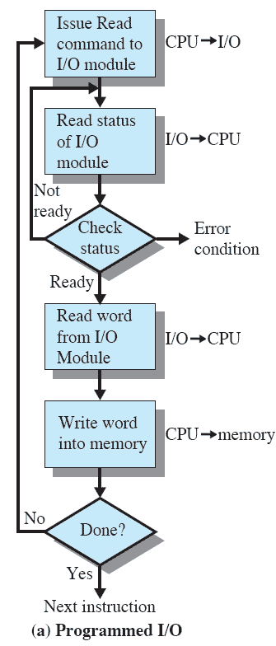
Programmed I/O
I/O module performs the action, not the processor
Sets the appropriate bits in the I/O status register
No interrupts occur
Processor checks status until operation is complete

Slide 51
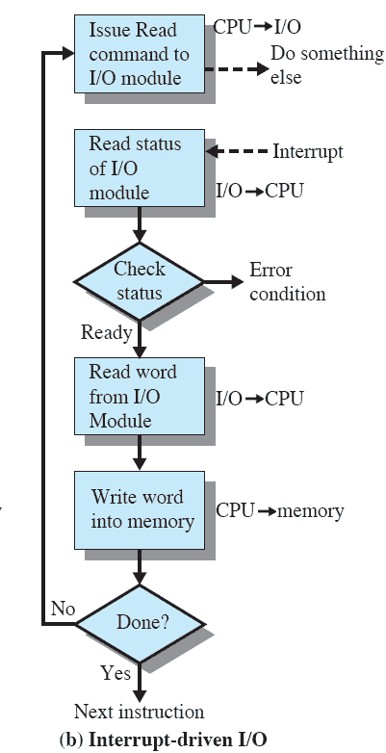
Interrupt-Driven I/O
Processor is interrupted when I/O module ready to exchange data
Processor saves context of program executing and begins executing interrupt-handler

Slide 52
Interrupt-Driven I/O
No needless waiting
Consumes a lot of processor time because every word read or written passes through the processor

Slide 53
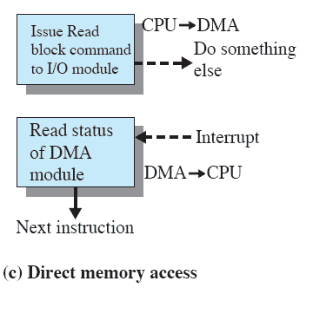
Direct Memory Access
Transfers a block of data directly to or from memory
An interrupt is sent when the transfer is complete
More efficient

