Slide 1
Part IV: Software

Slide 2
Why Software?
Why is software as important to security as crypto, access control, protocols?
Virtually all of information security is implemented in software
If your software is subject to attack, your security can be broken
  Regardless of strength of crypto, access control or protocols
Software is a poor foundation for security

Slide 3
Chapter 11:
Software Flaws and Malware

Slide 4
Software Issues
Alice and Bob
Find bugs and flaws by accident
Hate bad software…
…but must learn to live with it
Must make bad software work
Trudy
Actively looks for bugs and flaws
Likes bad software…
…and tries to make it misbehave
Attacks systems via bad software

Slide 5
Complexity
“Complexity is the enemy of security”, Paul Kocher, Cryptography Research, Inc.
System | Lines of Code (LOC)
Netscape | 17 million
Space Shuttle | 10 million
Linux kernel 2.6.0 | 5 million
Windows XP | 40 million
Mac OS X 10.4 | 86 million
Boeing 777 | 7 million
A new car contains more LOC than was required to land the Apollo astronauts on the moon

Slide 6
Software Security Topics
Program flaws (unintentional)
  Buffer overflow
  Incomplete mediation
  Race conditions
Malicious software (intentional)
  Viruses
  Worms
  Other breeds of malware

Slide 7
Program Flaws
An error is a programming mistake
  To err is human
An error may lead to incorrect state: fault
  A fault is internal to the program
A fault may lead to a failure, where a system departs from its expected behavior
  A failure is externally observable
error
fault
failure

Slide 8
Example
char array[10];
for(i = 0; i < 10; ++i)
array[i] = `A`;
array[10] = `B`;
This program has an error
This error might cause a fault
  Incorrect internal state
If a fault occurs, it might lead to a failure
  Program behaves incorrectly (external)
We use the term flaw for all of the above

Slide 9
Secure Software
Secure software engineering requires that software does what is intended…
…and nothing more
Absolutely secure software is impossible
  But, absolute security anywhere is impossible
How can we manage software risks?

Slide 10
Program Flaws
Program flaws are unintentional
  But can still create security risks
We’ll consider 3 types of flaws
  Buffer overflow (smashing the stack)
  Incomplete mediation
  Race conditions
These are the most common problems

Slide 11

Buffer Overflow

Slide 12
Possible Attack Scenario
Users enter data into a Web form
Web form is sent to server
Server writes data to array called buffer, without checking length of input data
Data “overflows” buffer
  Such overflow might enable an attack
  If so, attack could be carried out by anyone with Internet access

Slide 13
Buffer Overflow
int main(){
int buffer[10];
buffer[20] = 37;}
Q: What happens when code is executed?
A: Depending on what resides in memory at location “buffer[20]”
  Might overwrite user data or code
  Might overwrite system data or code
  Or program could work just fine

Slide 14

Simple Buffer Overflow
Consider boolean flag for authentication
Buffer overflow could overwrite flag allowing anyone to authenticate
Boolean flag
buffer
F
O
U
R
S
C
…
T
F

Slide 15
Memory Organization
Text == code
Data == static variables
Heap == dynamic data
Stack == “scratch paper”
  Dynamic local variables
  Parameters to functions
  Return address
low
address
text
data
heap
↓
↑
stack
pointer (SP)
stack
high
address

Slide 16
Simplified Stack Example
low →
void func(int a, int b){
char buffer[10];
}
void main(){
func(1, 2);
}
:
:
SP
buffer
SP
ret
return
address
a
SP
high →
b
SP

Slide 17
Smashing the Stack
low →
What happens if buffer overflows?
???
:
:
Program “returns” to wrong location
buffer
SP
overflow
SP
A crash is likely
ret
ret…
NOT!
overflow
a
SP
high →
b
SP

Slide 18
Smashing the Stack
low →
Trudy has a better idea…
:
:
Code injection
Trudy can run code of her choosing…
  …on your machine
SP
evil code
ret
ret
SP
a
SP
high →
b
SP

Slide 19
Smashing the Stack
:
:
Trudy may not know…
  Address of evil code
  Location of ret on stack
Solutions
  Precede evil code with NOP “landing pad”
  Insert ret many times
NOP
:
NOP
evil code
ret
ret
ret
:
ret
:
:

Slide 20
Stack Smashing Summary
A buffer overflow must exist in the code
Not all buffer overflows are exploitable
  Things must align properly
If exploitable, attacker can inject code
Trial and error is likely required
  Fear not, lots of help is available online

Slide 21
Stack Smashing Defenses
Employ non-executable stack
  “No execute” NX bit (if available)
  Seems like the logical thing to do, but some real code executes on the stack (Java, for example)
Use a canary
Use safe languages (Java, C#)
Use safer C functions
  For unsafe functions, safer versions exist
  For example, strncpy instead of strcpy

Slide 22

Stack Smashing Defenses
low →
Canary
  Run-time stack check
  Push canary onto stack
:
:
buffer
overflow
canary
overflow
ret
a
high →
b

Slide 23
SQL Injection
SQL stands for Structured Query Language
Allows us to access a database
ANSI and ISO standard computer language
SQL can:
  execute queries against a database
  retrieve data from a database
  insert new records in a database
  delete records from a database
  update records in a database
Notes:
SQL stands for Structured Query Language. It is the and ANSI (American National Standards Institute) standard language for accessing and manipulating relational database systems. ANSI is a standards committee composed of database experts from industry, academia and software vendors. It has also been accepted as a standard by ISO (International Organization for Standardization).
SQL is a standard open language without corporate ownership. The commercial acceptance of SQL was precipitated by the formation of SQL Standards committees by the ANSI and the ISO in 1986 and 1987. Two years later they published a specification known as SQL89. An improvement and expansion to the standard gave the world SQL92. We now have the third generation standard, SQL99 also known as SQL3.
SQL is used to communicate with a database. The communicating parties are typically a "front end" which sends a SQL Statement across a connection to a "back end" that holds the data. SQL statements are used to perform tasks such as retrieve, create, update or delete data from a database.
Some common relational database management systems that use SQL are: Oracle, MS SQL Server, MS Access, Ingres, DB2, Sybase, Informix, etc.

Slide 24
SQL Injection
There are many different versions of the SQL language
They support the same major keywords in a similar manner (such as SELECT, UPDATE, DELETE, INSERT, WHERE, and others).
Most of the SQL database programs also have their own proprietary extensions in addition to the SQL standard!
Notes:
Although most database systems use SQL, most of them also have their own additional proprietary extensions that are usually only used on their system.
Most DBMS are designed to meet the SQL92 standard partially and have not implemented the advanced features.
However, the standard SQL commands such as "Select", "Insert", "Update", "Delete", "Create", and "Drop" can be used throughout all database with little changes. All of the core functions, such as adding, reading and modifying data, are the same.

Slide 25
SQL Database Tables
A relational database contains one or more tables identified each by a name
Tables contain records (rows) with data
For example, the following table is called "users" and contains data distributed in rows and columns:
userID | Name | LastName | Login | Password
1 | John | Smith | jsmith | hello
2 | Adam | Taylor | adamt | qwerty
3 | Daniel | Thompson | dthompson | dthompson
Notes:
A relational database system contains one or more objects called tables. The data or information for the database are stored in these tables.
Tables are uniquely identified by their names and are comprised of columns and rows. Columns contain the column name, data type, and any other attributes for the column. Rows contain the records or data for the columns.
Here is a sample table called "users". This is a user defined table that could be used for validating and managing application users.
In this table, the first row called userID is specified as an integer. By being defined as an integer column the only type of data that can be stored in that column are numeric integers.
UserID is also the Primary Key for the Table. A table usually has a column or combination of columns whose values uniquely identify each row in the table. This column (or columns) is called the Primary Key of the table and enforces the entity integrity of the table. There can be no duplicate values.
The other four columns are varchar (variable character data). Any kind of strings can be stored in these columns. Character data consists of any combination of letters, symbols, and numeric characters.
To note, the password field is not encrypted. This should be implemented at an application level. These passwords are not directly linked or related to the SQL database passwords or the Operating System passwords.

Slide 26
SQL Queries
With SQL, we can query a database and have a result set returned
Using the previous table, a query like this:
  SELECT LastName
  FROM users
  WHERE UserID = 1;
Gives a result set like this:
  LastName
  --------------
  Smith
Notes:
The SELECT statement is used to query the database and retrieve selected data that match the criteria that you specify.
The column LastName that follows the SELECT keyword determines which column will be returned in the results. You can select as many column names that you'd like, or you can use a "*" to select all columns.
The table name users that follows the keyword FROM specifies the table that will be queried to retrieve the desired results.
The WHERE clause (optional) specifies which data values or rows will be returned or displayed. Based on the criteria described after the keyword WHERE the select statement will only bring the LastName value for all rows where UserID = 1. And also because UserID is the Primary Key (and therefore cannot have duplicate values), the only result for this query is "Smith".

Slide 27
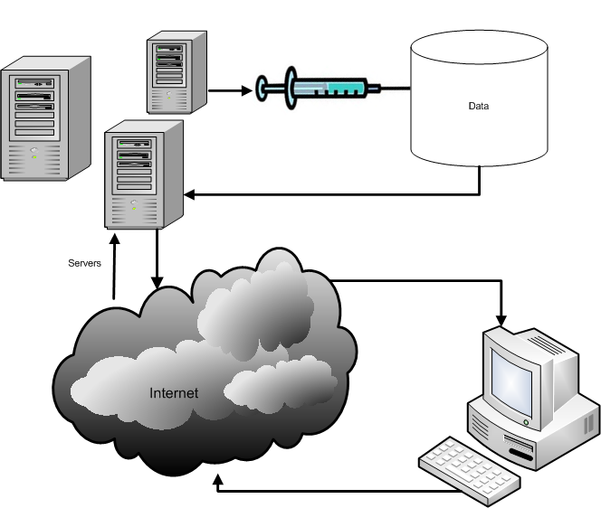

What is SQL Injection?
The ability to inject SQL commands into the database engine
through an existing application
Notes:
SQL injection is a type of security exploit in which the attacker adds SQL statements through a web application's input fields or hidden parameters to gain access to resources or make changes to data.
It's a serious vulnerability, which can lead to a high level of compromise - usually the ability to run any database query.
It is an attack on web-based applications that connect to database back-ends in which the attacker executes unauthorized (and unexpected) SQL commands by taking advantage of insecure code and bad input validation. It is very often done on systems connected to the Internet because it allows to completely bypass the firewall. SQL injection attacks can be used to steal information from a database from which the data would normally not be available and to gain access to host computers through the database engine.

Slide 28
How common is it?
It is probably the most common Website vulnerability today!
It is a flaw in "web application" development,
it is not a DB or web server problem
  Most programmers are still not aware of this problem
  A lot of the tutorials & demo “templates” are vulnerable
  Even worse, a lot of solutions posted on the Internet are not good enough
Notes:
Web-based applications constitute the worst threat of SQL injection. In our Pen Tests, over 60% of our clients continue to be vulnerable to SQL Injection.
The main problem with SQL Injection is that the vulnerability is originated when the web application is coded. Most programmers are still not aware of the problem. Tutorials and demo "templates" on the Internet and even some that have been shipped with commercial databases promote building queries by concatenating strings, which is the main source for SQL Injection vulnerabilities.
Additionally, a lot of the proposed solutions on the web continue to be flawed.

Slide 29
How does SQL Injection work?
Common vulnerable login query
  SELECT * FROM users
  WHERE login = 'ali'
  AND password = '123'
(If it returns something then login!)
ASP/MS SQL Server login syntax
  var sql = "SELECT * FROM users WHERE login = '" + formusr + "' AND password = '" + formpwd + "'";
Notes:
A common way of validating users in an application is to by checking if the user and password combination exists in the users table. The following query will bring back one record if there is one row where the login = 'kEnBy' and the password = '123':
SELECT * FROM users WHERE login = 'kEnBy' AND password = '123'
To code this, a common practice among developers is to concatenate a string with the SQL command and then execute it to see if it returns something different to null. An Active Server Page code where the SQL statement gets concatenated might look like:
var sql = "SELECT * FROM users WHERE login = '" + formusr + "' AND password = '" + formpwd + "'";

Slide 30
Injecting through Strings
formusr = ' or 1=1 – –
formpwd = anything
Final query would look like this:
  SELECT * FROM users
  WHERE username = ' ' or 1=1
  – – AND password = 'anything'
Notes:
SQL Injection occurs when an attacker is able to insert a series of SQL statements into a 'query' by manipulating data input.
If an attacker inserts: ' or 1=1 -- into the formusr field he will change the normal execution of the query.
By inserting a single quote the username string is closed and the final concatenated string would end up interpreting or 1=1 as part of the command. The -- (double dash) is used to comment everything after the or 1=1 and avoid a wrong syntax error. This could also have been achieved by inserting the following command:
' or '1'='1
By injecting any of the two commands discussed, an attacker would get logged in as the first user in the table. This happens because the WHERE clause ends up validating that the username = ' ' (nothing) OR 1=1 (OR '1'='1' in the second statement) The first conditional is False but the second one is True. By using OR the whole condition is True and therefore all rows from table users are returned. All rows is not null therefore the log in condition is met.

Slide 31
If it were numeric?
SELECT * FROM clients
WHERE user= 12345678
AND pas= 1111
PHP/MySQL login syntax
$sql = "SELECT * FROM clients WHERE " .
“user= $formusr AND " .
“pas= $formpas";
Notes:
With a similar syntax a numeric login would not use single quotes because in SQL you only need quotes for strings.
This PHP / MySQL code example concatenates a query that uses no single quotes as part of the syntaxis.

Slide 32
Injecting Numeric Fields
$formusr = 1 or 1=1 ;--
$formpas = 1111
Final query would look like this:
  SELECT * FROM clients
  WHERE user= 1 or 1=1;
  --AND pas = 1111
Notes:
Injecting into a numeric field is very similar. The main difference with string injection is that in numeric injection the first number is taken as the complete parameter (no need to close it with a single quote) and all the text after that number will be considered as part of the command.
In this case the # (number sign) is used instead of the -- (double dash) because we are injecting into a MySQL database.

Slide 33
Examples of what can SQL Injection do
Delete:
Select productinfo from table where productname = ‘whatever’; DROP TABLE productinfo; -- ’
Bypass Authentication
  Select * from users where username=’user ’ and password=’passwd ’;
  select * from users where username=’admin’--’ and password=’whocares’;

Slide 34
SQL Injection Characters
' or " character String Indicators
-- or # single-line comment
/*…*/ multiple-line comment
+ addition, concatenate (or space in url)
|| (double pipe) concatenate
% wildcard attribute indicator
?Param1=foo&Param2=bar URL Parameters
PRINT useful as non transactional command
@variable local variable
@@variable global variable
waitfor delay '0:0:10' time delay
Notes:
Symbol Usage in SQL99 complaint DBs
+ Addition operator; also concatenation operator; when used in an URL it becomes a white space)
|| Concatenation operator in Oracle and Postgres
- Subtraction operator; also a range indicator in CHECK constraints
= Equality operator
<> != Inequality operators
>< Greater-than and Less-than operators
( ) Expression or hierarchy delimiter
% Wildcard attribute indicator
, List item separator
@, @@ Local and Global variable indicators
. Identifier qualifier separator
‘’ “” Character string indicators
“” Quoted identifier indicators
-- Single-line comment delimiter
# Single-line comment delimiter in MySQL or date delimiter in MS Access
/*…*/ Begin and End multiline comment delimiter

Slide 35
SQL Injection Tools
SQL Map* is a tool that aids in the fingerprinting of a backend database
SQL Ninja* http://sqlninja.sourceforge.net/
  Aids in the exploitation of SQL injection vulnerabilities can provide root level command access to system
Automagic SQL Injector*
  Designed to work with generic installation of MS SQL
    http://scoobygang.org/magicsql/
  Videos on SQL injection can be found on the internet one great source
    http://securitytube.net/
*Source: EC Council Certified Ethical Hacker Volume 3 Chapter 19

Slide 36
SQL Injection Defense
It is quite simple: input validation
  Enforce "strong design" in new applications
  You should audit your existing websites and source code
Notes:
Input validation is the most important part of defending against SQL injection. You should enforce input validation in all new applications through strong design. Any you should audit all your existing code and websites. You should additionally always harden your servers as well.

Slide 37

Incomplete Mediation
Notes:
Richter, Gerhard
Mediation
1986
Oil on canvas
320 x 400 cm (126 x 157 1/2 in.)
Musee des beaux-arts de Montrea

Slide 38
Input Validation
Consider: strcpy(buffer, argv[1])
A buffer overflow occurs if
len(buffer) < len(argv[1])
Software must validate the input by checking the length of argv[1]
Failure to do so is an example of a more general problem: incomplete mediation

Slide 39
Input Validation
Consider web form data
Suppose input is validated on client
For example, the following is valid
  http://www.things.com/orders/final&custID=112&num=55A&qty=20&price=10&shipping=5&total=205
Suppose input is not checked on server
  Why bother since input checked on client?
  Then attacker could send http message
  http://www.things.com/orders/final&custID=112&num=55A&qty=20&price=10&shipping=5&total=25

Slide 40
Incomplete Mediation
Linux kernel
  Research has revealed many buffer overflows
  Many of these are due to incomplete mediation
Linux kernel is “good” software since
  Open-source
  Kernel ⎯ written by coding gurus
Tools exist to help find such problems
  But incomplete mediation errors can be subtle
  And tools useful to attackers too!

Slide 41
Malware

Slide 42
Malicious Software
Malware is not new…
  Fred Cohen’s initial virus work in 1980’s, used viruses to break MLS systems
Types of malware (lots of overlap)
  Virus ⎯ passive propagation
  Worm ⎯ active propagation
  Trojan horse ⎯ unexpected functionality
  Trapdoor/backdoor ⎯ unauthorized access
  Rabbit ⎯ exhaust system resources

Slide 43
Where do Viruses Live?
They live just about anywhere, such as…
Boot sector
  Take control before anything else
Memory resident
  Stays in memory
Applications, macros, data, etc.
Library routines
Compilers, debuggers, virus checker, etc.
  These would be particularly nasty!

Slide 44
Malware Examples
Brain virus (1986)
Morris worm (1988)
Code Red (2001)
SQL Slammer (2004)
Botnets (currently fashionable)
Future of malware?

Slide 45
Brain
First appeared in 1986
More annoying than harmful
A prototype for later viruses
Not much reaction by users
What it did
  Placed itself in boot sector (and other places)
  Screened disk calls to avoid detection
  Each disk read, checked boot sector to see if boot sector infected; if not, goto 1
Brain did nothing really malicious

Slide 46
Morris Worm
First appeared in 1988
What it tried to do
  Determine where it could spread, then…
  …spread its infection and…
  …remain undiscovered
Morris claimed his worm had a bug!
  It tried to re-infect infected systems
  Led to resource exhaustion
  Effect was like a so-called rabbit

Slide 47
How Morris Worm Spread
Obtained access to machines by…
  User account password guessing
  Exploit buffer overflow in fingerd
  Exploit trapdoor in sendmail
Flaws in fingerd and sendmail were well-known, but not widely patched

Slide 48
Bootstrap Loader
Once Morris worm got access…
“Bootstrap loader” sent to victim
  99 lines of C code
Victim compiled and executed code
Bootstrap loader fetched the worm
Victim authenticated sender!
  Don’t want user to get a bad worm…

Slide 49
How to Remain Undetected?
If transmission interrupted, code deleted
Code encrypted when downloaded
Code deleted after decrypt/compile
When running, worm regularly changed name and process identifier (PID)

Slide 50
Morris Worm: Bottom Line
Shock to Internet community of 1988
  Internet of 1988 much different than today
Internet designed to withstand nuclear war
  Yet, brought down by one graduate student!
  At the time, Morris’ father worked at NSA…
Could have been much worse
Result? CERT, more security awareness
But should have been a wakeup call

Slide 51
Code Red Worm
Appeared in July 2001
Infected more than 250,000 systems in about 15 hours
Eventually infected 750,000 out of about 6,000,000 vulnerable systems
Exploited buffer overflow in Microsoft IIS server software
  Then monitor traffic on port 80, looking for other susceptible servers

Slide 52
Code Red: What it Did
Day 1 to 19 of month: spread its infection
Day 20 to 27: distributed denial of service attack (DDoS) on www.whitehouse.gov
Later version (several variants)
  Included trapdoor for remote access
  Rebooted to flush worm, leaving only trapdoor
Some say it was “beta test for info warfare”
  But no evidence to support this

Slide 53
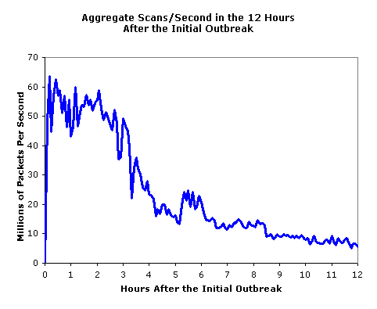
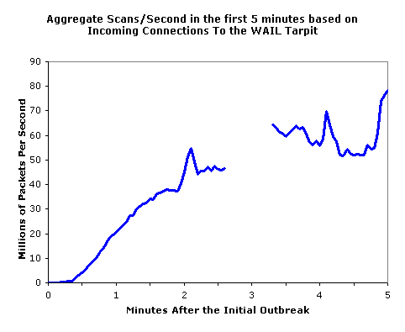
SQL Slammer
Infected 75,000 systems in 10 minutes!
At its peak, infections doubled every 8.5 seconds
Spread “too fast”…
…so it “burned out” available bandwidth

Slide 54
Why was Slammer Successful?
Worm size: one 376-byte UDP packet
Firewalls often let one packet thru
  Then monitor ongoing “connections”
Expectation was that much more data required for an attack
  So no need to worry about 1 small packet
Slammer defied “experts”

Slide 55

Trojan Horse Example
Trojan: unexpected functionality
Prototype trojan for the Mac
File icon for freeMusic.mp3:
For a real mp3, double click on icon
  iTunes opens
  Music in mp3 file plays
But for freeMusic.mp3, unexpected results…

Slide 56
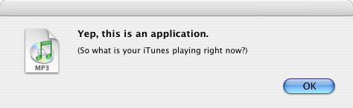
Mac Trojan
Double click on freeMusic.mp3
  iTunes opens (expected)
  “Wild Laugh” (not expected)
  Message box (not expected)

Slide 57
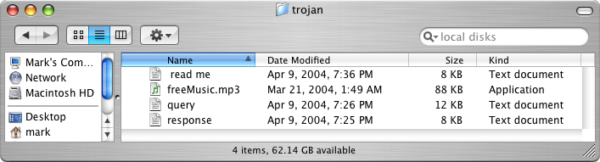
Trojan Example
How does freeMusic.mp3 trojan work?
This “mp3” is an application, not data
This trojan is harmless, but…
…could have done anything user could do
  Delete files, download files, launch apps, etc.

Slide 58
Malware Detection
Three common detection methods
  Signature detection
  Change detection
  Anomaly detection
We briefly discuss each of these
  And consider advantages…
  …and disadvantages

Slide 59
Signature Detection
A signature may be a string of bits in exe
  Might also use wildcards, hash values, etc.
For example, W32/Beast virus has signature
83EB 0274 EB0E 740A 81EB 0301 0000
  That is, this string of bits appears in virus
We can search for this signature in all files
If string found, have we found W32/Beast?
  Not necessarily ⎯ string could appear elsewhere
  At random, chance is only 1/2¹¹²
  But software is not random

Slide 60
Signature Detection
Advantages
  Effective on “ordinary” malware
  Minimal burden for users/administrators
Disadvantages
  Signature file can be large (10s of thousands)…
  …making scanning slow
  Signature files must be kept up to date
  Cannot detect unknown viruses
  Cannot detect some advanced types of malware
The most popular detection method

Slide 61
Change Detection
Viruses must live somewhere
If you detect a file has changed, it might have been infected
How to detect changes?
  Hash files and (securely) store hash values
  Periodically re-compute hashes and compare
  If hash changes, file might be infected

Slide 62
Change Detection
Advantages
  Virtually no false negatives
  Can even detect previously unknown malware
Disadvantages
  Many files change ⎯ and often
  Many false alarms (false positives)
  Heavy burden on users/administrators
  If suspicious change detected, then what?
  Might fall back on signature-based system

Slide 63
Anomaly Detection
Monitor system for anything “unusual” or “virus-like” or potentially malicious or …
Examples of “unusual”
  Files change in some unexpected way
  System misbehaves in some way
  Unexpected network activity
  Unexpected file access, etc., etc., etc., etc.
But, we must first define “normal”
  Normal can (and must) change over time

Slide 64
Anomaly Detection
Advantages
  Chance of detecting unknown malware
Disadvantages
  No proven track record
  Trudy can make abnormal look normal (go slow)
  Must be combined with another method (e.g., signature detection)
Also popular in intrusion detection (IDS)
Difficult unsolved (unsolvable?) problem
  Reminds me of AI…

Slide 65
Future of Malware
Recent trends
  Encrypted, polymorphic, metamorphic malware
  Fast replication/Warhol worms
  Flash worms, slow worms
  Botnets
The future is bright for malware
  Good news for the bad guys…
  …bad news for the good guys
Future of malware detection?

Slide 66
Encrypted Viruses
Virus writers know signature detection used
So, how to evade signature detection?
Encrypting the virus is a good approach
  Ciphertext looks like random bits
  Different key, then different “random” bits
  So, different copies have no common signature
Encryption often used in viruses today

Slide 67
Encrypted Viruses
How to detect encrypted viruses?
Scan for the decryptor code
  More-or-less standard signature detection
  But may be more false alarms
Why not encrypt the decryptor code?
  Then encrypt the decryptor of the decryptor (and so on…)
Encryption of limited value to virus writers

Slide 68
Polymorphic Malware
Polymorphic worm
  Body of worm is encrypted
  Decryptor code is “mutated” (or “morphed”)
  Trying to hide decryptor signature
  Like an encrypted worm on steroids…
Q: How to detect?
A: Emulation ⎯ let the code decrypt itself
  Slow, and anti-emulation is possible

Slide 69
Botnet
Botnet: a “network” of infected machines
Infected machines are “bots”
  Victim is unaware of infection (stealthy)
Botmaster controls botnet
  Generally, using IRC
  P2P botnet architectures exist
Botnets used for…
  Spam, DoS attacks, keylogging, ID theft, etc.

Slide 70
Botnet Examples
XtremBot
  Similar bots: Agobot, Forbot, Phatbot
  Highly modular, easily modified
  Source code readily available (GPL license)
UrXbot
  Similar bots: SDBot, UrBot, Rbot
  Less sophisticated than XtremBot type
GT-Bots and mIRC-based bots
  mIRC is common IRC client for Windows

Slide 71
More Botnet Examples
Mariposa
  Used to steal credit card info
  Creator arrested in July 2010
Conficker
  Estimated 10M infected hosts (2009)
Kraken
  Largest as of 2008 (400,000 infections)
Srizbi
  For spam, one of largest as of 2008

Slide 72
Computer Infections
Analogies are made between computer viruses/worms and biological diseases
There are differences
  Computer infections are much quicker
  Ability to intervene in computer outbreak is more limited (vaccination?)
  Bio disease models often not applicable
  “Distance” almost meaningless on Internet
But there are some similarities…

Slide 73
Computer Infections
Cyber “diseases” vs biological diseases
One similarity
  In nature, too few susceptible individuals and disease will die out
  In the Internet, too few susceptible systems and worm might fail to take hold
One difference
  In nature, diseases attack more-or-less at random
  Cyber attackers select most “desirable” targets
  Cyber attacks are more focused and damaging

Slide 74
Future Malware Detection?
Malware today outnumbers “goodware”
  Metamorphic copies of existing malware
  Many virus toolkits available
  Trudy: recycle old viruses, different signature
So, may be better to “detect” good code
  If code not on “good” list, assume it’s bad
  That is, use whitelist instead of blacklist

