Slide 1
Part II: Access Control

Slide 2
Access Control
Two parts to access control
Authentication: Are you who you say you are?
Determine whether access is allowed
Authenticate human to machine
Or authenticate machine to machine
Authorization: Are you allowed to do that?
Once you have access, what can you do?
Enforces limits on actions
Note: “access control” often used as synonym for authorization

Slide 3
Chapter 7: Authentication Are You Who You Say You Are?
How to authenticate human a machine?
Can be based on…
Something you know
For example, a password
Something you have
For example, a smartcard
Something you are
For example, your fingerprint

Slide 4
Something You Know
Passwords
Lots of things act as passwords!
PIN
Social security number
Mother’s maiden name
Date of birth, etc.

Slide 5
Trouble with Passwords
“Passwords are one of the biggest practical problems facing security engineers today.”
“Humans are incapable of securely storing high-quality cryptographic keys, and they have unacceptable speed and accuracy when performing cryptographic operations.”

Slide 6
Why Passwords?
Why is “something you know” more popular than “something you have” and “something you are”?
Cost: passwords are free
Convenience: easier for admin to reset pwd than to issue a new thumb

Slide 7
Keys vs Passwords
Crypto keys
Spse key is 64 bits
Then 2⁶⁴ keys
Choose key at random…
…then attacker must try about 2⁶³ keys
Passwords
Spse passwords are 8 characters, and 256 different characters
Then 256⁸ = 2⁶⁴ pwds
Users do not select passwords at random
Attacker has far less than 2⁶³ pwds to try (dictionary attack)

Slide 8
Good and Bad Passwords
Bad passwords
frank
Fido
password
4444
Pikachu
102560
AustinStamp
Good Passwords?
jfIej,43j-EmmL+y
09864376537263
P0kem0N
FSa7Yago
0nceuP0nAt1m8
PokeGCTall150

Slide 9
Password Experiment
Three groups of users ⎯ each group advised to select passwords as follows
Group A: At least 6 chars, 1 non-letter
Group B: Password based on passphrase
Group C: 8 random characters
Results
Group A: About 30% of pwds easy to crack
Group B: About 10% cracked
Passwords easy to remember
Group C: About 10% cracked
Passwords hard to remember
winner →

Slide 10
Password Experiment
User compliance hard to achieve
In each case, 1/3rd did not comply
And about 1/3rd of those easy to crack!
Assigned passwords sometimes best
If passwords not assigned, best advice is…
Choose passwords based on passphrase
Use pwd cracking tool to test for weak pwds
Require periodic password changes?

Slide 11
Attacks on Passwords
Attacker could…
Target one particular account
Target any account on system
Target any account on any system
Attempt denial of service (DoS) attack
Common attack path
Outsider → normal user → administrator
May only require one weak password!

Slide 12
Password Retry
Suppose system locks after 3 bad passwords. How long should it lock?
5 seconds
5 minutes
Until SA restores service
What are +’s and -’s of each?

Slide 13
Password File?
Bad idea to store passwords in a file
But we need to verify passwords
Cryptographic solution: hash the pwd
Store y = h(password)
Can verify entered password by hashing
If Trudy obtains “password file,” she does not obtain passwords
But Trudy can try a forward search
Guess x and check whether y = h(x)

Slide 14
Dictionary Attack
Trudy pre-computes h(x) for all x in a dictionary of common passwords
Suppose Trudy gets access to password file containing hashed passwords
She only needs to compare hashes to her pre-computed dictionary
After one-time work, actual attack is trivial
Can we prevent this attack? Or at least make attacker’s job more difficult?

Slide 15
Salt
Hash password with salt
Choose random salt s and compute
y = h(password, s)
and store (s,y) in the password file
Note: The salt s is not secret
Easy to verify salted password
But Trudy must re-compute dictionary hashes for each user
Lots more work for Trudy!

Slide 16
Password Cracking: Do the Math
Assumptions:
Pwds are 8 chars, 128 choices per character
Then 128⁸ = 2⁵⁶ possible passwords
There is a password file with 2¹⁰ pwds
Attacker has dictionary of 2²⁰ common pwds
Probability of 1/4 that a pwd is in dictionary
Work is measured by number of hashes

Slide 17
Password Cracking: Case I
Attack 1 password without dictionary
Must try 2⁵⁶/2 = 2⁵⁵ on average
Like exhaustive key search
Does salt help in this case?

Slide 18
Password Cracking: Case II
Attack 1 password with dictionary
With salt
Expected work: 1/4 (2¹⁹) + 3/4 (2⁵⁵) = 2^{54.6}
In practice, try all pwds in dictionary…
…then work is at most 2²⁰ and probability of success is 1/4
What if no salt is used?
One-time work to compute dictionary: 2²⁰
Expected work still same order as above
But with precomputed dictionary hashes, the “in practice” attack is free…

Slide 19
Password Cracking: Case III
Any of 1024 pwds in file, without dictionary
Assume all 2¹⁰ passwords are distinct
Need 2⁵⁵ comparisons before expect to find pwd
If no salt is used
Each computed hash yields 2¹⁰ comparisons
So expected work (hashes) is 2⁵⁵/2¹⁰ = 2⁴⁵
If salt is used
Expected work is 2⁵⁵
Each comparison requires a hash computation
Notes:
Picture would be useful here

Slide 20
Password Cracking: Case IV
Any of 1024 pwds in file, with dictionary
Prob. one or more pwd in dict.: 1 – (3/4)¹⁰²⁴ = 1
So, we ignore case where no pwd is in dictionary
If salt is used, expected work less than 2²²
See book, or slide notes for details
Approximate work: size of dict. / probability
What if no salt is used?
????
Notes:
Calculation for salted case:
Number the passwords in file, pwd1, pwd2, …,pwd1024
Consider checking each pwd in turn. The probability pwd1 is in the dictionary is 1/4 and, if so, expected work (no. of hashes) is 2^19. If pwd1 is not in dictionary but pwd2 is, we do 2^20 hashes (for pwd1) plus an expected 2^19 hashes for pwd2 and so on. We find the expected work factor is
(1/4)*(2^19) + (3/4)*((1/4)*(2^20+2^19) + (3/4)*((1/4)*(2*2^20+2^19)+…+(3/4)((1/4)(1023*2^20+2^19)))…) < 2^22

Slide 21
Other Password Issues
Too many passwords to remember
Results in password reuse
Why is this a problem?
Who suffers from bad password?
Login password vs ATM PIN
Keystroke logging software and similar Spyware
Social engineering
Error logs may contain “almost” passwords

Slide 22
Passwords
The bottom line…
Password cracking is too easy
One weak password may break security
Users choose bad passwords
Social engineering attacks, etc.
Trudy has (almost) all of the advantages
All of the math favors bad guys
Passwords are a BIG security problem
And will continue to be a big problem

Slide 23
Password Cracking Tools
Popular password cracking tools
Password Crackers
Password Portal
L0phtCrack and LC4 (Windows)
John the Ripper (Unix)
Admins should use these tools to test for weak passwords since attackers will
Good articles on password cracking
Passwords - Conerstone of Computer Security
Passwords revealed by sweet deal

Slide 24
Something You Have
Something in your possession
Examples include following…
Car key
Laptop computer (or MAC address)
Password generator (next)
ATM card, smartcard, etc.

Slide 25
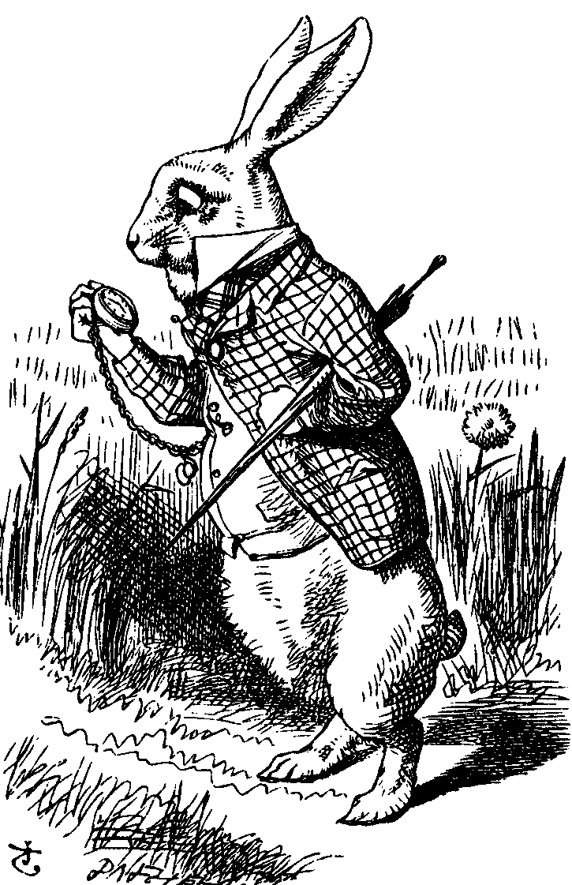
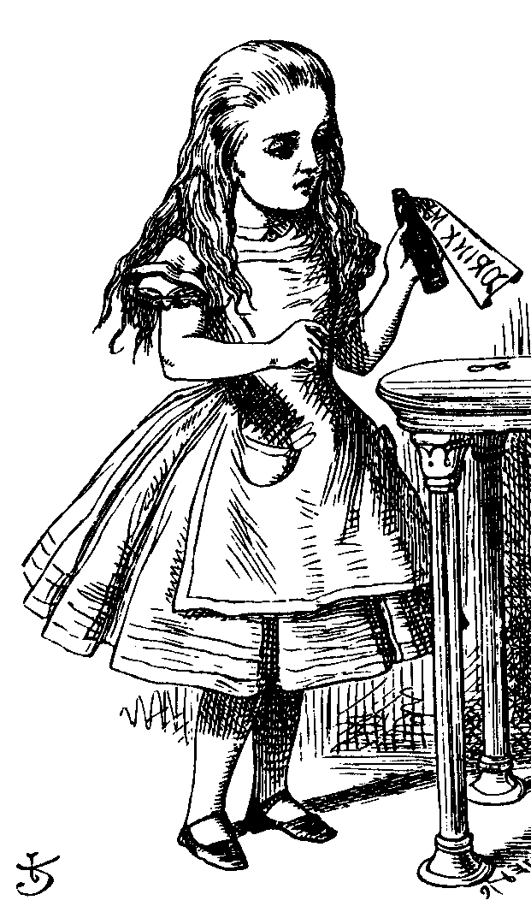
Password Generator
1. “I’m Alice”
3. PIN, R
2. R
4. h(K,R)
password
generator
K
5. h(K,R)
Alice
Bob, K
Alice receives random “challenge” R from Bob
Alice enters PIN and R in password generator
Password generator hashes symmetric key K with R
Alice sends “response” h(K,R) back to Bob
Bob verifies response
Note: Alice has pwd generator and knows PIN

Slide 26
2-factor Authentication
Requires any 2 out of 3 of
Something you know
Something you have
Something you are
Examples
ATM: Card and PIN
Credit card: Card and signature
Password generator: Device and PIN
Smartcard with password/PIN

Slide 27
Single Sign-on
A hassle to enter password(s) repeatedly
Alice wants to authenticate only once
“Credentials” stay with Alice wherever she goes
Subsequent authentications transparent to Alice
Kerberos --- example single sign-on protocol
Notes:
argument

Slide 28
Web Cookies
Cookie is provided by a Website and stored on user’s machine
Cookie indexes a database at Website
Cookies maintain state across sessions
Web uses a stateless protocol: HTTP
Cookies also maintain state within a session
Cookies also create privacy concerns

Slide 29
Authorization

Slide 30
Chapter 8: Authorization

Slide 31
Authentication vs Authorization
Authentication ⎯ Are you who you say you are?
Restrictions on who (or what) can access system
Authorization ⎯ Are you allowed to do that?
Restrictions on actions of authenticated users
Authorization is a form of access control
Classic authorization enforced by
Access Control Lists (ACLs)
Capabilities (C-lists)

Slide 32
Lampson’s Access Control Matrix
Subjects (users) index the rows
Objects (resources) index the columns
Accounting
program
Accounting
data
Insurance
data
Payroll
data
OS
rx | rx | r | --- | ---
rx | rx | r | rw | rw
rwx | rwx | r | rw | rw
rx | rx | rw | rw | rw
Bob
Alice
Sam
Accounting
program

Slide 33
Are You Allowed to Do That?
Access control matrix has all relevant info
Could be 1000’s of users, 1000’s of resources
Then matrix with 1,000,000’s of entries
How to manage such a large matrix?
Need to check this matrix before access to any resource is allowed
How to make this efficient?

Slide 34
Access Control Lists (ACLs)
ACL: store access control matrix by column
Example: ACL for insurance data is in blue
Accounting
program
Accounting
data
Insurance
data
Payroll
data
OS
rx | rx | r | --- | ---
rx | rx | r | rw | rw
rwx | rwx | r | rw | rw
rx | rx | rw | rw | rw
Bob
Alice
Sam
Accounting
program

Slide 35
Capabilities (or C-Lists)
Store access control matrix by row
Example: Capability for Alice is in red
Accounting
program
Accounting
data
Insurance
data
Payroll
data
OS
rx | rx | r | --- | ---
rx | rx | r | rw | rw
rwx | rwx | r | rw | rw
rx | rx | rw | rw | rw
Bob
Alice
Sam
Accounting
program

Slide 36
ACLs vs Capabilities
r
---
r
r
w
rw
Alice
file1
Alice
file1
w
r
---
---
r
r
Bob
file2
Bob
file2
rw
r
r
r
---
r
Fred
file3
Fred
file3
Access Control List
Capability
Note that arrows point in opposite directions…
With ACLs, still need to associate users to files
Notes:
with capabilities, the association
between users and files is built into the system, while for an ACL-based
system, a separate method for associating users to files is required. This
illustrates one of the inherent advantages of capabilities. In fact, capabilities
have several security advantages over ACLs and, for this reason, C-lists are
much beloved within the academic research community [206]. In the next
section, we discuss one potential security advantage of capabilities over ACLs.
Then we move on to the topic of multilevel security

Slide 37
Confused Deputy
Two resources
Compiler and BILL file (billing info)
Compiler can write file BILL
Alice can invoke compiler with a debug filename
Alice not allowed to write to BILL
Access control matrix
Compiler
BILL
x | ---
rx | rw
Alice
Compiler

Slide 38
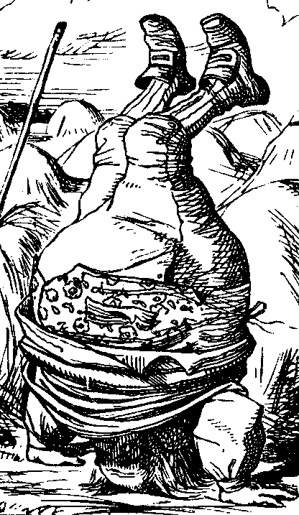
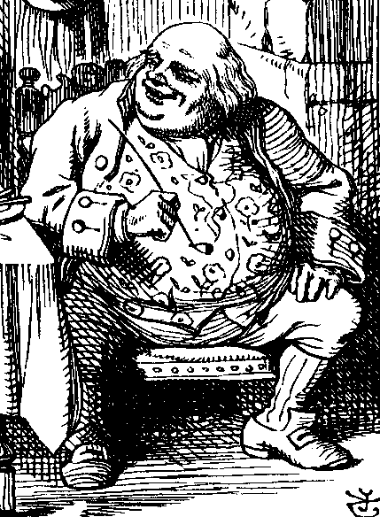
ACL’s and Confused Deputy
debug
BILL
filename BILL
Compiler
Alice
BILL
Compiler is deputy acting on behalf of Alice
Compiler is confused
Alice is not allowed to write BILL
Compiler has confused its rights with Alice’s

Slide 39
Confused Deputy
Compiler acting for Alice is confused
There has been a separation of authority from the purpose for which it is used
With ACLs, difficult to avoid this problem
With Capabilities, easier to prevent problem
Must maintain association between authority and intended purpose
Capabilities make it easy to delegate authority
Notes:
With ACLs, it's more difficult (but not impossible) to avoid the confused
deputy. In contrast, with capabilities it's relatively easy to prevent this
problem, since capabilities are easily delegated, while ACLs are not. In a
capabilities-based system, when Alice invokes the compiler, she can simply
give her C-list to the compiler. The compiler then consults Alice's C-list when
checking privileges before attempting to create the debug file. Since Alice does
not have the privilege to overwrite BILL, the situation in Figure 8.2 can be
avoided.

Slide 40
ACLs vs Capabilities
ACLs
Good when users manage their own files
Protection is data-oriented
Easy to change rights to a resource
Capabilities
Easy to delegate---avoid the confused deputy
Easy to add/delete users
More difficult to implement
The “Zen of information security”
Capabilities loved by academics
Capability Myths Demolished
Notes:
A comparison of the relative advantages of ACLs and capabilities is instructive.
ACLs are preferable when users manage their own files and when
protection is data oriented. With ACLs, it's also easy to change rights to a
particular resource. On the other hand, with capabilities it's easy to delegate
(and sub-delegate and sub-sub-delegate, and so on), and it's easier to add or
delete users. Due to the ability to delegate, it's easy to avoid the confused
deputy when using capabilities. However, capabilities are more complex to
implement and they have somewhat higher overhead—although it may not
be obvious, many of the difficult issues inherent in distributed systems arise
in the context of capabilities. For these reasons, ACLs are used in practice
far more often than capabilities.

Slide 41
Covert Channel

Slide 42
Covert Channel
Covert channel: a communication path not intended as such by system’s designers
For example, resources shared at different levels could be used to “signal” information

Slide 43
Covert Channel Example
Alice has TOP SECRET clearance, Bob has CONFIDENTIAL clearance
Suppose the file space shared by all users
Alice creates file FileXYzW to signal “1” to Bob, and removes file to signal “0”
Once per minute Bob lists the files
If file FileXYzW does not exist, Alice sent 0
If file FileXYzW exists, Alice sent 1
Alice can leak TOP SECRET info to Bob!

Slide 44
Covert Channel Example
Alice:
Create file
Delete file
Create file
Delete file
Bob:
Check file
Check file
Check file
Check file
Check file
Data:
1
0
1
1
0
Time:

Slide 45
Covert Channel
Other possible covert channels?
Print queue
ACK messages
Network traffic, etc.
When does covert channel exist?
Sender and receiver have a shared resource
Sender able to vary some property of resource that receiver can observe
“Communication” between sender and receiver can be synchronized

Slide 46
Covert Channel
So, covert channels are everywhere
“Easy” to eliminate covert channels:
Eliminate all shared resources…
…and all communication
Virtually impossible to eliminate covert channels in any useful system
DoD guidelines: reduce covert channel capacity to no more than 1 bit/second
Implication? DoD has given up on eliminating covert channels!
Notes:
The U.S. Department of Defense, or DoD,

Slide 47
Covert Channel
Consider 100MB TOP SECRET file
Plaintext stored in TOP SECRET location
Ciphertext (encrypted with AES using 256-bit key) stored in UNCLASSIFIED location
Suppose we reduce covert channel capacity to 1 bit per second
It would take more than 25 years to leak entire document thru a covert channel
But it would take less than 5 minutes to leak 256-bit AES key thru covert channel!

Slide 48
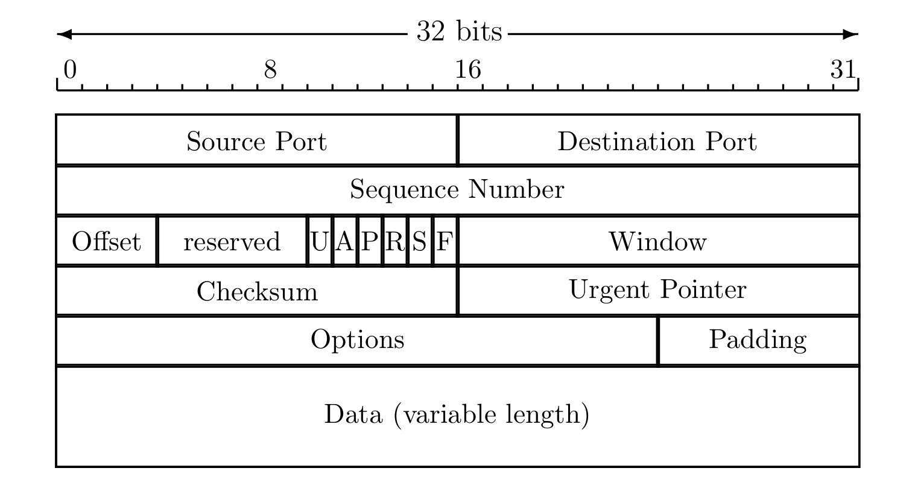
Real-World Covert Channel
Hide data in TCP header “reserved” field
Or use covert_TCP, tool to hide data in
Sequence number
ACK number

Slide 49
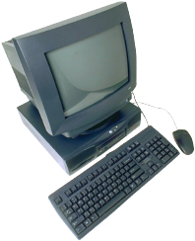
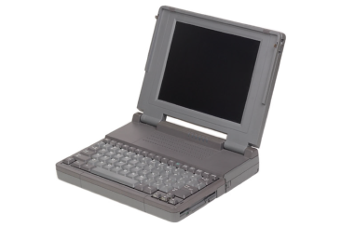
Real-World Covert Channel
Hide data in TCP sequence numbers
Tool: covert_TCP
Sequence number X contains covert info
ACK (or RST)
Source: B
Destination: C
ACK: X
SYN
Spoofed source: C
Destination: B
SEQ: X
B. Innocent
server
A. Covert_TCP
sender
C. Covert_TCP
receiver

Slide 50
Firewalls

Slide 51
Firewalls
Internal
network
Internet
Firewall
Firewall decides what to let in to internal network and/or what to let out
Access control for the network

Slide 52
Firewall as Secretary
A firewall is like a secretary
To meet with an executive
First contact the secretary
Secretary decides if meeting is important
So, secretary filters out many requests
You want to meet chair of CS department?
Secretary does some filtering
You want to meet the POTUS?
Secretary does lots of filtering

Slide 53
Firewall Terminology
No standard firewall terminology
Types of firewalls
Packet filter ⎯ works at network layer
Stateful packet filter ⎯ transport layer
Application proxy ⎯ application layer
Other terms often used
E.g., “deep packet inspection”

Slide 54
Packet Filter
Operates at network layer
Can filters based on…
Source IP address
Destination IP address
Source Port
Destination Port
Flag bits (SYN, ACK, etc.)
Egress or ingress
application
transport
network
link
physical

Slide 55
Packet Filter
Advantages?
Speed
Disadvantages?
No concept of state
Cannot see TCP connections
Blind to application data
application
transport
network
link
physical

Slide 56
Packet Filter
Configured via Access Control Lists (ACLs)
Different meaning than at start of Chapter 8
Source
IP
Dest
IP
Source
Port
Dest
Port
Flag
Bits
Action
Protocol
Allow | Inside | Outside | Any | 80 | HTTP
Allow | Outside | Inside | 80 | > 1023 | HTTP
Deny | All | All | All | All | All
Any
ACK
All
Q: Intention?
A: Restrict traffic to Web browsing

Slide 57
TCP ACK Scan
Attacker scans for open ports thru firewall
Port scanning is first step in many attacks
Attacker sends packet with ACK bit set, without prior 3-way handshake
Violates TCP/IP protocol
ACK packet pass thru packet filter firewall
Appears to be part of an ongoing connection
RST sent by recipient of such packet

Slide 58
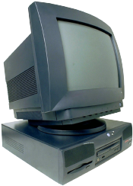
TCP ACK Scan
ACK dest port 1207
ACK dest port 1208
ACK dest port 1209
Trudy
RST
Internal
Network
Packet
Filter
Attacker knows port 1209 open thru firewall
A stateful packet filter can prevent this
Since scans not part of established connections

Slide 59
Tiny Fragment Attack
uses small fragments to force some of the TCP header information into the next fragment.
TCP flags field is forced into the second fragment and filters will be unable to test these flags in the first octet thereby ignoring them in subsequent fragments.
can be prevented at the router by enforcing rules, which govern the minimum size of the first fragment, large enough to ensure it contains all the necessary header information

Slide 60
Overlapping Fragment Attack
can be used to overwrite part of the TCP header information of the first fragment, which contained data that was allowed to pass through the firewall, with malicious data in subsequent fragments.
overwriting destination port number to change from port 80 (HTTP) to port 23 (Telnet) which would not be allowed to pass the router in normal circumstances

Slide 61
Stateful Packet Filter
Adds state to packet filter
Operates at transport layer
Remembers TCP connections, flag bits, etc.
Can even remember UDP packets (e.g., DNS requests)
application
transport
network
link
physical

Slide 62
Stateful Packet Filter
Advantages?
Can do everything a packet filter can do plus...
Keep track of ongoing connections (so prevents TCP ACK scan)
Disadvantages?
Cannot see application data
Slower than packet filtering
application
transport
network
link
physical

Slide 63
Application Proxy
A proxy is something that acts on your behalf
Application proxy looks at incoming application data
Verifies that data is safe before letting it in
application
transport
network
link
physical

Slide 64
Application Proxy
Advantages?
Complete view of connections and applications data
Filter bad data at application layer (viruses, Word macros)
Disadvantages?
Speed
application
transport
network
link
physical

Slide 65
Application Proxy
Creates a new packet before sending it thru to internal network
Attacker must talk to proxy and convince it to forward message
Proxy has complete view of connection
Prevents some scans stateful packet filter cannot ⎯ next slides

Slide 66
Firewalk
Tool to scan for open ports thru firewall
Attacker knows IP address of firewall and IP address of one system inside firewall
Set TTL to 1 more than number of hops to firewall, and set destination port to N
If firewall allows data on port N thru firewall, get time exceeded error message
Otherwise, no response

Slide 67
Firewalk and Proxy Firewall
Packet
filter
Trudy
Router
Router
Router
Dest port 12343, TTL=4
Dest port 12344, TTL=4
Dest port 12345, TTL=4
Time exceeded
This will not work thru an application proxy (why?)
The proxy creates a new packet, destroys old TTL

Slide 68
Deep Packet Inspection
Many buzzwords used for firewalls
One example: deep packet inspection
What could this mean?
Look into packets, but don’t really “process” the packets
Like an application proxy, but faster

Slide 69
Firewalls and Defense in Depth
Typical network security architecture
DMZ
FTP server
Web server
DNS server
Intranet with
additional
defense
Packet
Filter
Application
Proxy
Internet

Slide 70
Intrusion Detection Systems

Slide 71
Intrusion Prevention
Want to keep bad guys out
Intrusion prevention is a traditional focus of computer security
Authentication is to prevent intrusions
Firewalls a form of intrusion prevention
Virus defenses aimed at intrusion prevention
Like locking the door on your car

Slide 72
Intrusion Detection
In spite of intrusion prevention, bad guys will sometime get in
Intrusion detection systems (IDS)
Detect attacks in progress (or soon after)
Look for unusual or suspicious activity
IDS evolved from log file analysis
IDS is currently a hot research topic
How to respond when intrusion detected?
We don’t deal with this topic here…

Slide 73
Intrusion Detection Systems
Who is likely intruder?
May be outsider who got thru firewall
May be evil insider
What do intruders do?
Launch well-known attacks
Launch new/little-known attacks
Use compromised system to attack others. etc.

Slide 74
IDS
Intrusion detection approaches
Signature-based IDS
Anomaly-based IDS
Intrusion detection architectures
Host-based IDS
Network-based IDS
Any IDS can be classified as above

Slide 75
Host-Based IDS
Monitor activities on hosts for
Known attacks
Suspicious behavior
Designed to detect attacks such as
Buffer overflow
Escalation of privilege, …
Little or no view of network activities

Slide 76
Network-Based IDS
Monitor activity on the network for…
Known attacks
Suspicious network activity
Designed to detect attacks such as
Denial of service
Network probes
Malformed packets, etc.
Some overlap with firewall
Little or no view of host-base attacks

Slide 77
Signature Detection Example
Failed login attempts may indicate password cracking attack
IDS could use the rule “N failed login attempts in M seconds” as signature
If N or more failed login attempts in M seconds, IDS warns of attack
Note that such a warning is specific
Admin knows what attack is suspected
Easy to verify attack (or false alarm)

Slide 78
Signature Detection
Suppose IDS warns whenever N or more failed logins in M seconds
Set N and M so false alarms not common
Can do this based on “normal” behavior
But, if Trudy knows the signature, she can try N − 1 logins every M seconds…
Then signature detection slows down Trudy, but might not stop her

Slide 79
Signature Detection
Many techniques used to make signature detection more robust
For example, if “about” N login attempts in “about” M seconds
Warn of possible password cracking attempt
What are reasonable values for “about”?
Can use statistical analysis, heuristics, etc.
Must not increase false alarm rate too much

Slide 80
Signature Detection
Advantages of signature detection
Simple
Detect known attacks
Know which attack at time of detection
Efficient (if reasonable number of signatures)
Disadvantages of signature detection
Signature files must be kept up to date
Number of signatures may become large
Can only detect known attacks
Variation on known attack may not be detected

Slide 81
Anomaly Detection
Anomaly detection systems look for unusual or abnormal behavior
There are (at least) two challenges
What is normal for this system?
How “far” from normal is abnormal?
No avoiding statistics here!
mean defines normal
variance gives distance from normal to abnormal

Slide 82
How to Measure Normal?
How to measure normal?
Must measure during typical behavior
Must not measure during an attack…
…or else attack will seem normal!
Normal is statistical mean
Must also compute variance to have any reasonable idea of abnormal

Slide 83
How to Measure Abnormal?
Abnormal indicates possible attack
Statistical discrimination techniques include
Linear discriminant analysis (LDA)
Neural nets, hidden Markov models (HMMs), etc.
Fancy modeling techniques also used
Artificial intelligence

Slide 84
Anomaly Detection (1)
Spse we monitor use of three commands:
open, read, close
Under normal use we observe Alice:
open, read, close, open, open, read, close, …
Of the six possible ordered pairs, we see four pairs are normal for Alice,
(open,read), (read,close), (close,open), (open,open)
Can we use this to identify unusual activity?

Slide 85
Anomaly Detection (1)
We monitor use of the three commands
open, read, close
If the ratio of abnormal to normal pairs is “too high”, warn of possible attack
Could improve this approach by
Also use expected frequency of each pair
Use more than two consecutive commands
Include more commands/behavior in the model

Slide 86
Anomaly Detection (2)
Over time, Alice has accessed file F_{n} at rate H_{n}
Recently, “Alice” has accessed F_{n} at rate A_{n}
H₀ | H₁ | H₂ | H₃
.10 | .40 | .40 | .10
A₀ | A₁ | A₂ | A₃
.10 | .40 | .30 | .20
Is this normal use for Alice?
We compute S = (H₀−A₀)²+(H₁−A₁)²+…+(H₃−A₃)² = .02
We consider S < 0.1 to be normal, so this is normal
How to account for use that varies over time?

Slide 87
Anomaly Detection (2)
To allow “normal” to adapt to new use, we update averages: H_{n} = 0.2A_{n} + 0.8H_{n}
In this example, H_{n} are updated… H₂=.2∗.3+.8∗.4=.38 and H₃=.2∗.2+.8∗.1=.12
And we now have
H₀ | H₁ | H₂ | H₃
.10 | .40 | .38 | .12

Slide 88
Anomaly Detection (2)
The updated long term average is
Suppose new observed rates…
H₀ | H₁ | H₂ | H₃
.10 | .40 | .38 | .12
A₀ | A₁ | A₂ | A₃
.10 | .30 | .30 | .30
Is this normal use?
Compute S = (H₀−A₀)²+…+(H₃−A₃)² = .0488
Since S = .0488 < 0.1 we consider this normal
And we again update the long term averages:
H_{n} = 0.2A_{n} + 0.8H_{n}

Slide 89
Anomaly Detection (2)
The starting averages were:
After 2 iterations, averages are:
H₀ | H₁ | H₂ | H₃
.10 | .40 | .40 | .10
H₀ | H₁ | H₂ | H₃
.10 | .38 | .364 | .156
Statistics slowly evolve to match behavior
This reduces false alarms
But also opens an avenue for attack…
Suppose Trudy always wants to access F₃
Can she convince IDS this is normal for Alice?

Slide 90
Anomaly Detection (2)
To make this approach more robust, must incorporate the variance
Can also combine N stats S_{i} as, say,
T = (S₁ + S₂ + S₃ + … + S_{N}) / N
to obtain a more complete view of “normal”
Similar (but more sophisticated) approach is used in an IDS known as NIDES
NIDES combines anomaly & signature IDS

Slide 91
Anomaly Detection
Advantages?
Chance of detecting unknown attacks
Disadvantages?
Cannot use anomaly detection alone…
…must be used with signature detection
Reliability is unclear
Anomaly detection indicates “something unusual”, but lacks specific info on possible attack

Slide 92
Anomaly Detection: The Bottom Line
Anomaly-based IDS is active research topic
Many security experts have high hopes for its ultimate success
Often cited as key future security technology
Anomaly detection is difficult and tricky

Slide 93
Access Control Summary
Authentication and authorization
Authentication ⎯ who goes there?
Passwords ⎯ something you know
Biometrics ⎯ something you are (you are your key)
Something you have

Slide 94
Access Control Summary
Authorization ⎯ are you allowed to do that?
Access control matrix/ACLs/Capabilities
MLS/Multilateral security
BLP/Biba
Covert channel
Inference control
CAPTCHA
Firewalls
IDS

